Slide 1
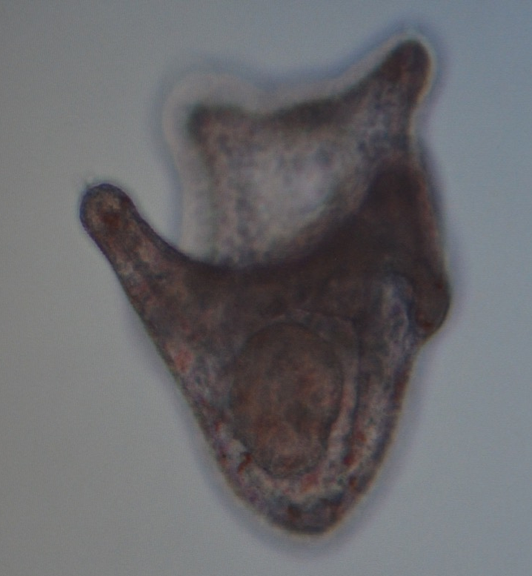
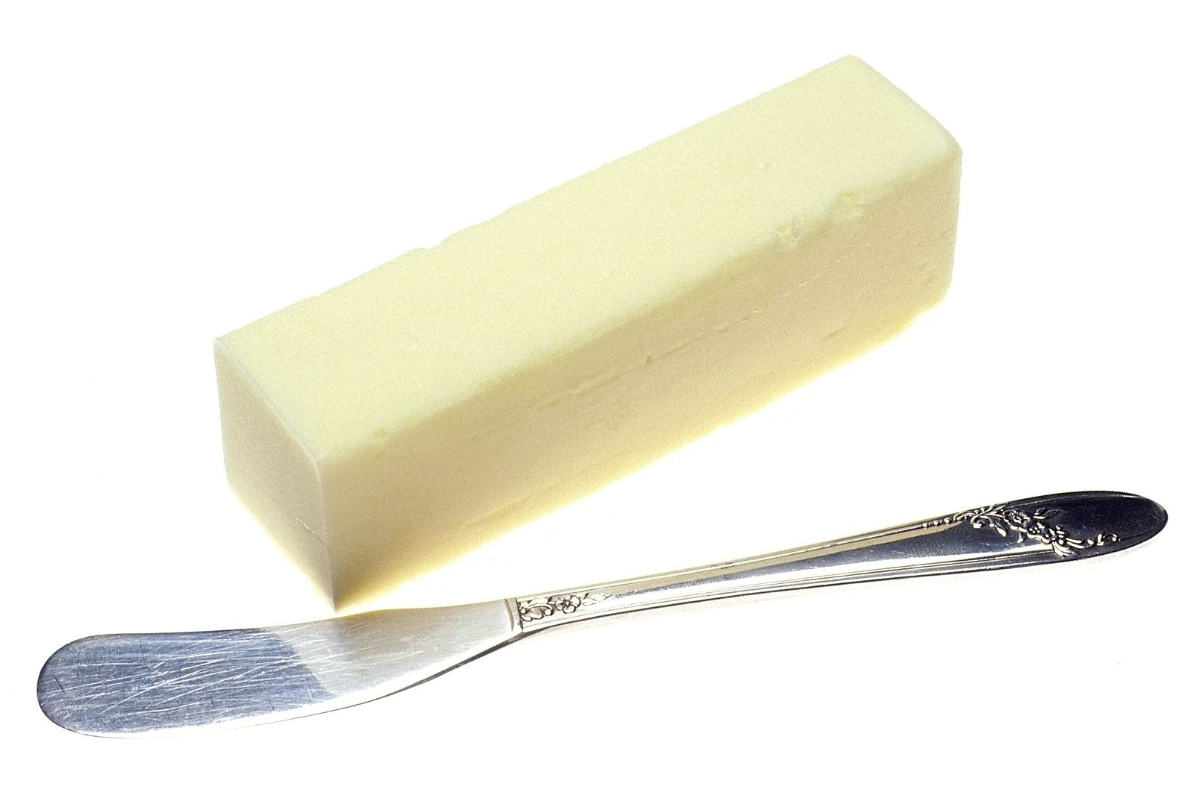
ICE POD: Sea Urchin Larvae and Butter
What do sea urchins and butter have in common? They both act differently in warmer temperatures! Sea urchins grow a lot slower in colder waters, like those in Antarctica.
Ask questions about sea urchins in the “Ask the Team” section of today’s journal.
Notes:
Sea urchins that live in the cold waters surrounding Antarctica develop a lot slower than those in warmer waters. For example, the legs you see in the sea urchin larvae above took 14 days to develop in Antarctica, but would only take about 3 days to develop in a warmer environment. This is because cold temperatures slow things down! If butter is refrigerated or left in the cold, it is hard and requires more energy to cut, however butter that is warm will melt more and is much easier to cut through. The same is true with mechanisms inside an organism. Physical gates in an organism’s cells have to open and close to allow chemicals to pass through. In colder temperatures, these gates are harder and slower to open and close, leading to slower development.
Learn more about sea urchins in Antarctica and ask the team questions by going to this journal:
https://www.polartrec.com/expeditions/human-impacts-in-antarctica-2015/journals/2015-11-13

