Slide 1
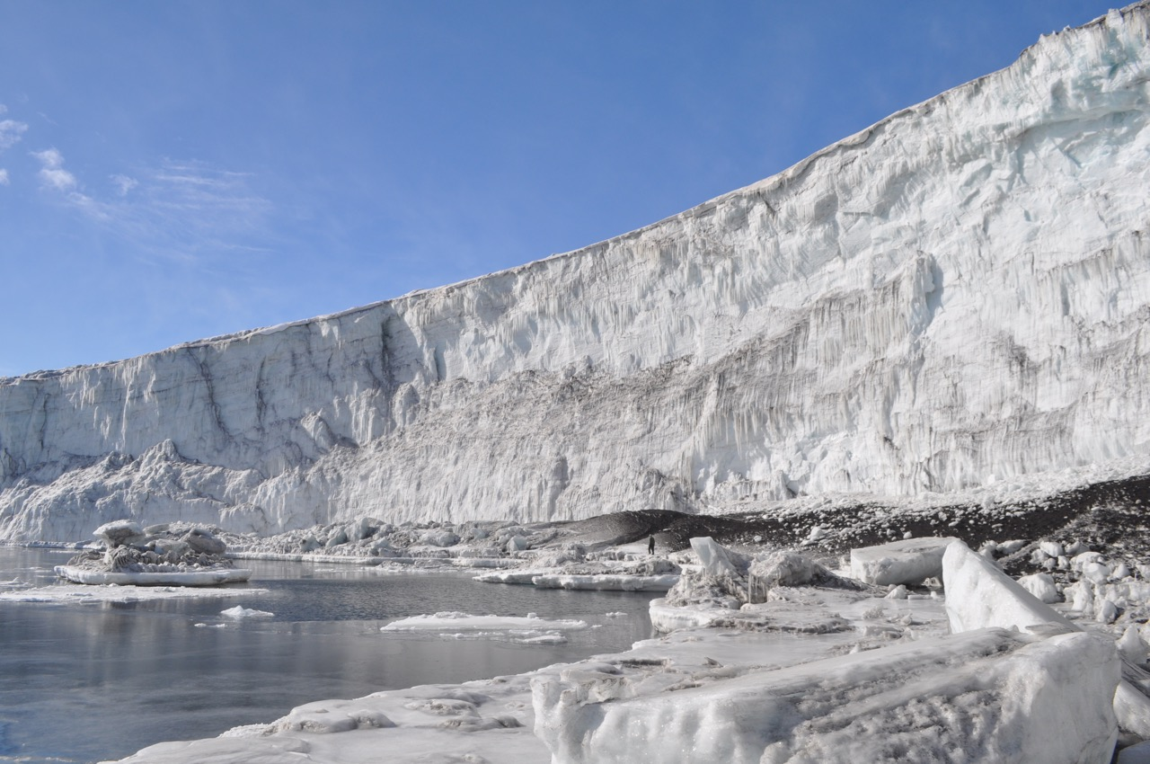
ICE POD: Glaciers at Cape Bird
Glaciers are rivers of ice that move slowly and change the landscape. Over years, the ice compresses and becomes dense. When ice is very dense, air is forced out and it is tinted blue, otherwise it is white.
Where is the ice in this picture very dense? How do you know?
Ask questions about glaciers in the “Ask the Team” section of today’s journal.
Notes:
Glaciers are very important aspects of our world. They currently cover 10% of the land on Earth (5.8 million square miles). They store 75% of the world’s fresh water. If all land ice melted, sea level would rise 70 meters. Scientists in Antarctica are studying glaciers to better understand how they respond to climate change.
Interesting to point out to students: For scale, point out the small figure standing on a darkened hill in front of the glacier (If you go down in a straight line from the letters “ve” in very, you will see a dark figure standing near the water. That is Terry Palmer, the benthic ecologist in our expedition.
There are areas of blue ice throughout the glacier, noticeably in the top right. These areas have been pressurized and have less air in them. The areas in the bottom also probably have been compressed, but some are covered in silt.
Learn more about sea urchins in Antarctica and ask the team questions by going to this journal:
https://www.polartrec.com/expeditions/human-impacts-in-antarctica-2015/journals/2015-11-16

