Slide 1
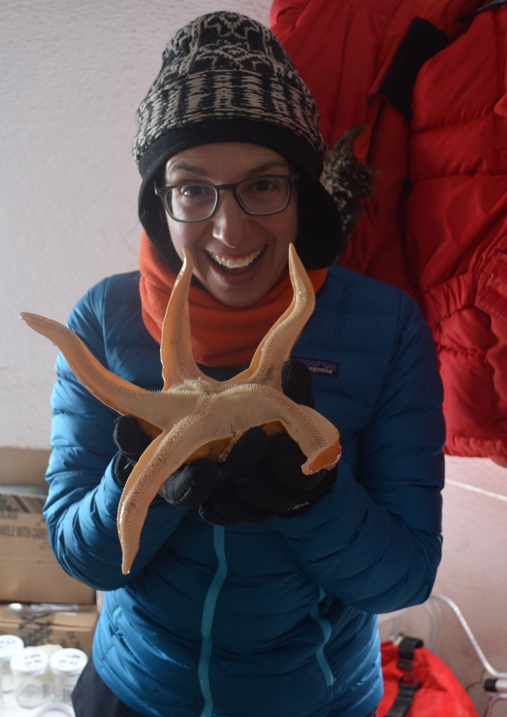
ICE POD: Large Sea Stars
Sea stars in Antarctica are predators in the area and impact the diversity of the community. For example, they eat sea sponges that are overtaking the area.
Ask questions about sea stars and other organisms in the “Ask the Team” section of today’s journal.
Notes:
Sea Stars are common on the sea floor of Antarctica, but what is startling is how large they can get! It is common for organisms in the cold waters of Antarctica to be larger than their counterparts in warmer waters. Sea spiders, for example, are also larger. What is also interesting about these Antarctic sea stars is that they help control populations along the seafloor. Paul Dayton, a marine ecologist who has worked in Antarctica, has studied this and found the sea stars eat large sponges that are trying to overtake the area. Another cool fact about sea stars: instead of putting food into their mouth, they can slide their stomach outside of their mouth and lay it on their food (or prey)!
Learn more about sea stars and other organisms in Antarctica and ask the team questions by going to this journal:
https://www.polartrec.com/expeditions/human-impacts-in-antarctica-2015/journals/2015-11-17

