Slide 1
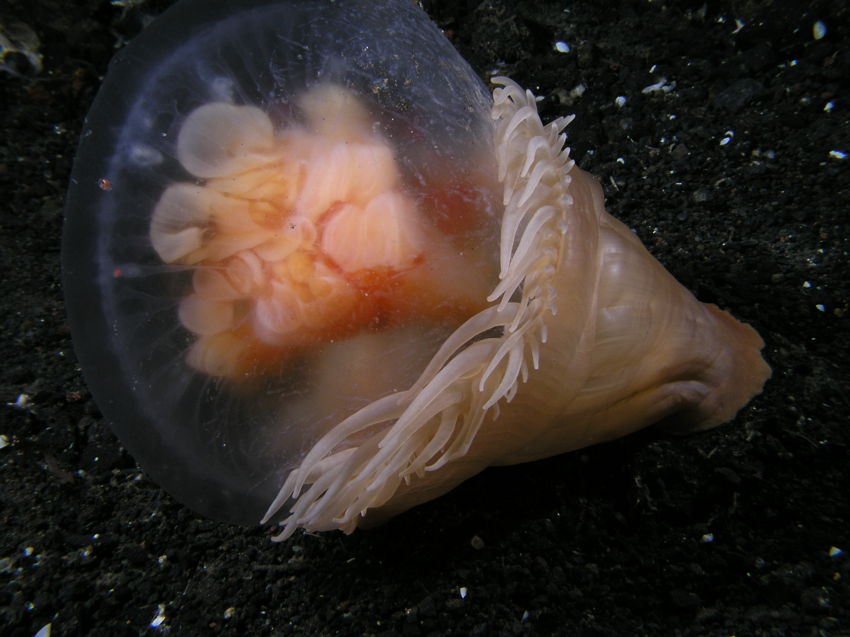
ICE POD: Sea Anemones
This picture (courteys of R. Robbins) shows a sea anemone (right) feeding on its cousin, the jellyfish—a common occurrence in Antarctica. How do you think jellyfish get captured by anemone?
Ask questions about sea anemones in the “Ask the Team” section of today’s journal.
Notes:
When jelly fish are in shallow water, they can get close enough to the sea anemone, which are stuck to rocks on the seafloor. They get captured by the anemone’s tentacles. The anemone slowly pulls the jellyfish into its mouth. The struggle can continue for a long time!
Learn more about sea stars and other organisms in Antarctica and ask the team questions by going to this journal:
https://www.polartrec.com/expeditions/human-impacts-in-antarctica-2015/journals/2015-11-17

