Slide 1
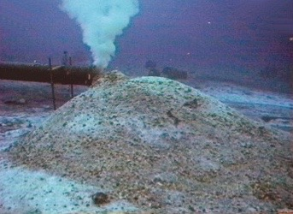
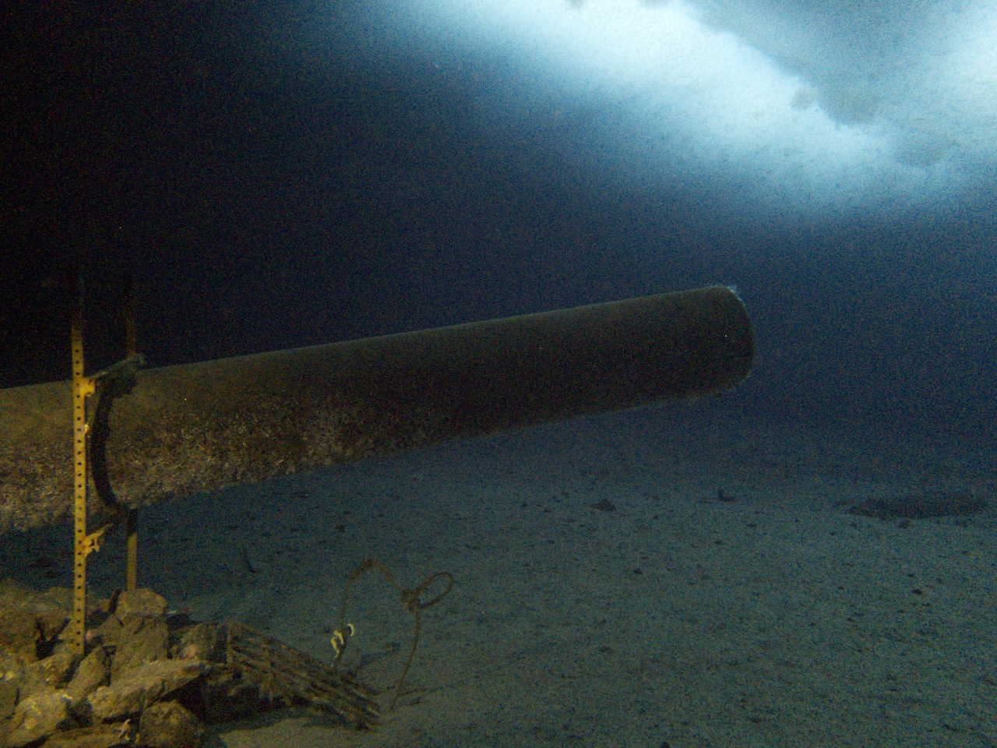
Ice POD: Before and After
Photos courtesy of Rob Robbins
The picture on the left shows the sewage outflow in years past, and on the right shows the sewage outflow more recently. What has changed since the sewage outflow has stopped depositing waste? What might we see in the future?
Ask questions in the “Ask the Team” section of today’s journal.
Notes:
Before 2003, sewage at McMurdo Station flowed into the sea floor. After the Waste Water Treatment Plant was built, sewage is now processed, compressed and shipped back to the U.S.
Learn more about the past and present of the sewage outflow area and ask the team questions by going to this journal: https://www.polartrec.com/expeditions/human-impacts-in-antarctica-2015/journals/2015-11-19

