Slide 1
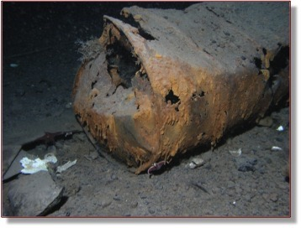
Ice POD: Pollution’s Past and Future
Photo courtesy of Rob Robbins
60 years ago, it was common practice to dump waste and forget about it. Although now McMurdo Station’s waste is shipped back to the U.S., the pollution from the past still remain on the seafloor at Winter Quarters Bay. Why aren’t we cleaning up the waste? What are the risks associated with cleaning it up?
Ask questions in the “Ask the Team” section of today’s journal.
Notes:
In the 1950s and later, waste, oil drums, and equipment was left to sink into Winter Quarters Bay. It is now a highly contaminated site (though luckily, it is also highly concentrated, since the bay keeps pollutants in the area). Although the USAP has stopped depositing waste in McMurdo Station, it is reluctant to clean up lots of the debris on the seafloor. Cleaning up the debris has the risk of damaging the ecosystem. The seafloor is still. The water is fairly clear, and most of the contamination is settled into the soil. Cleaning up the waste will disturb the soil and further damage the ecosystem.
Learn more about the pollution in Winter Quarters Bay and ask the team questions by going to this journal: https://www.polartrec.com/expeditions/human-impacts-in-antarctica-2015/journals/2015-11-20

