Slide 1
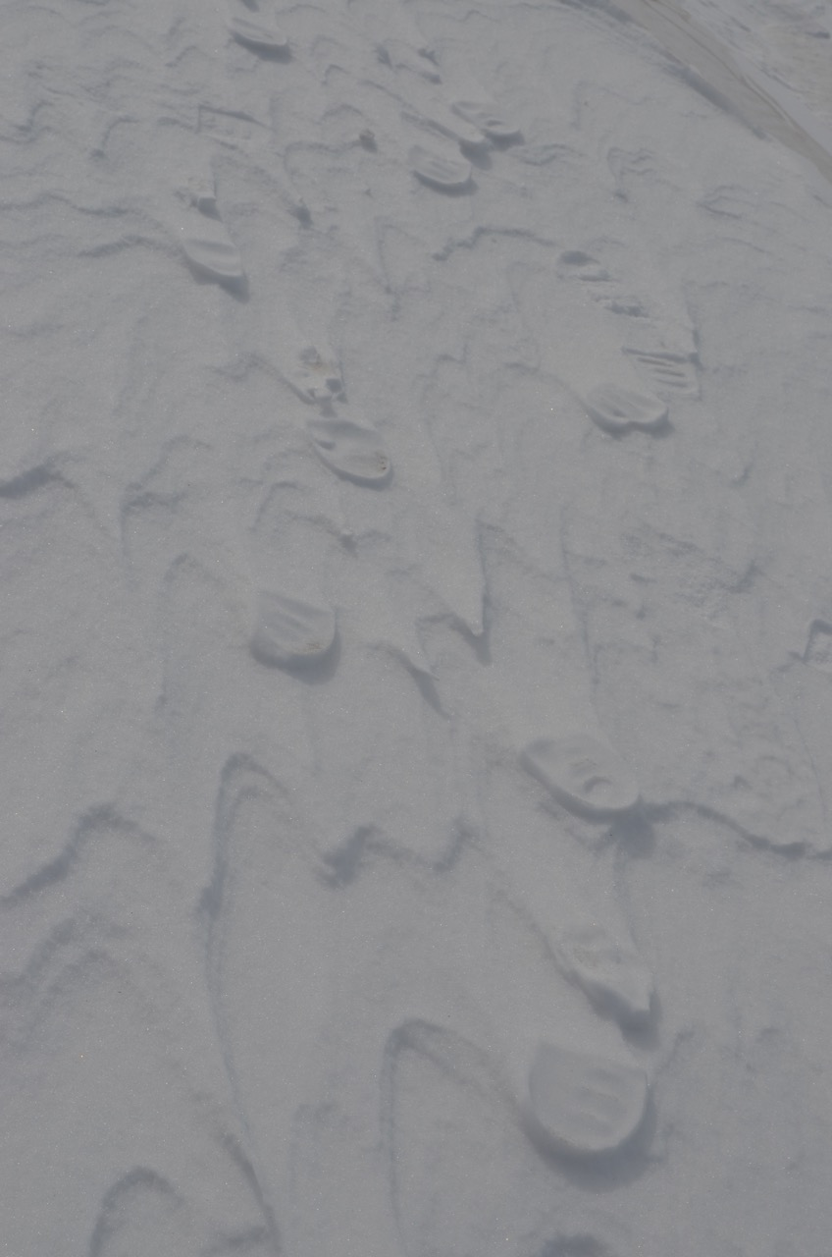
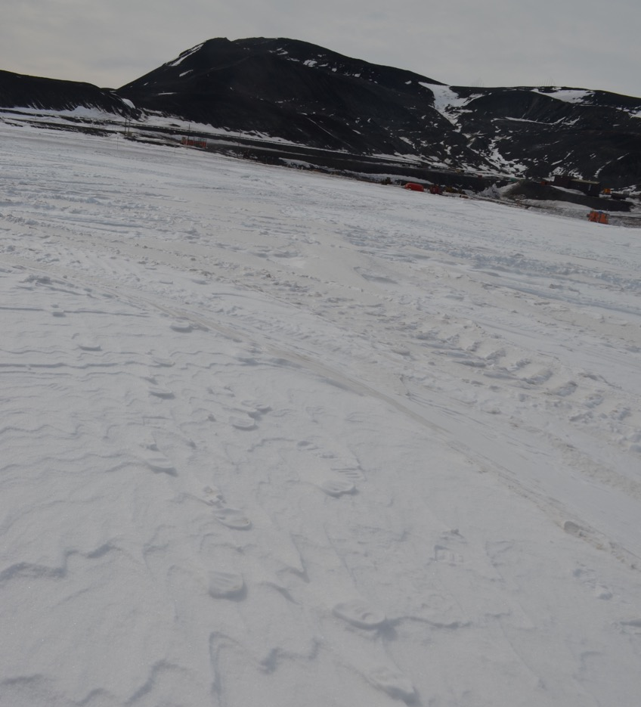
Ice POD: Tracks in the Snow
These footprints were elevated above the surrounding snow. Why did this occur?
Ask questions in the “Ask the Team” section of today’s journal.
Notes:
I noticed these footprints on my walk to the dive hut the other day. The footprint was elevated and the remaining snow was below it. This occurred because the footprints were compacted. The compaction made the snow denser and more stuck together. Loose snow surrounding the footprint blew away in the wind, leaving the footprint (once originally lower than the snow) behind.
Learn more about life in Antarctica and ask the team questions by going to this journal: https://www.polartrec.com/expeditions/human-impacts-in-antarctica-2015/journals/2015-11-22

