Slide 1
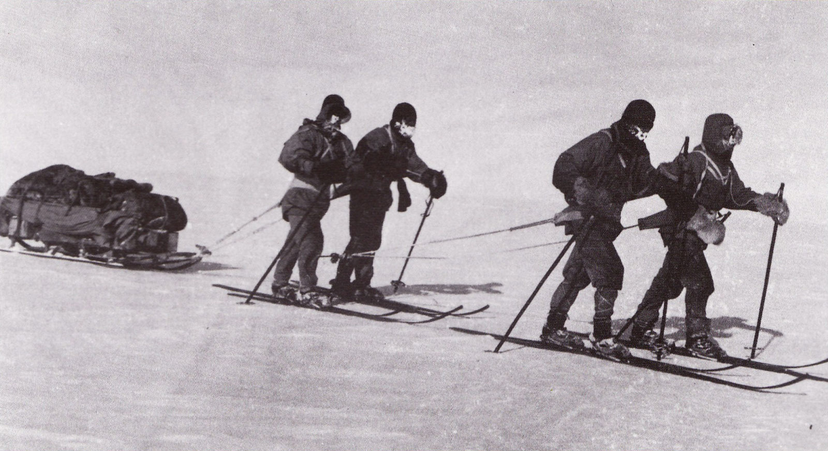
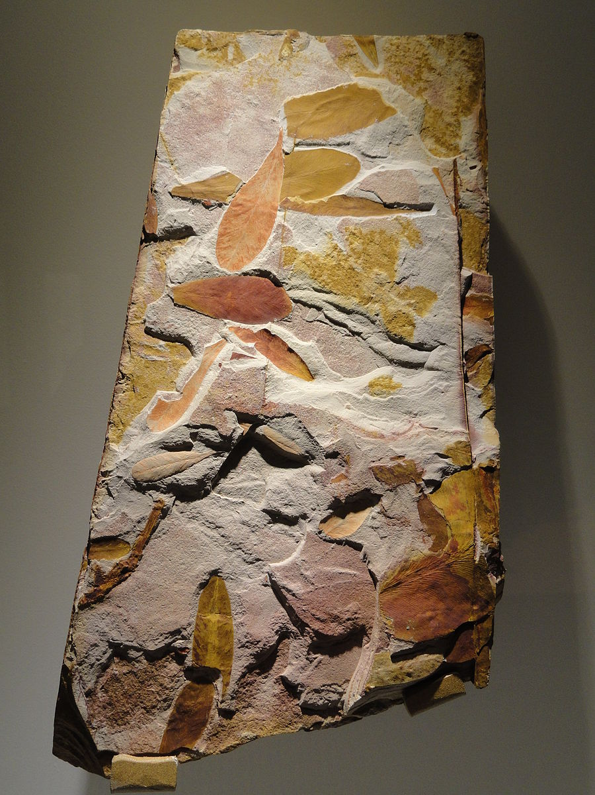
Ice POD: Glossopteris Fossils
Scott’s team drags supplies back from their South Pole trek, including 30 pounds of Glossopteris Fossils (seen at right). What theory did these fossils help support?
Ask questions in the “Ask the Team” section of today’s journal.
Notes:
Glossopteris fossils, seen at right (though this is not a sample taken from Antarctica, it represents the same plant) were found by Scott Wilson in Robert Falcon Scott’s Terra Nova expedition in 1912. Although Wilson and his team did not survive the journey back, his fossils did. They helped support the theory of plate tectonics and provided an important link, since the fossils matched plant fossils found in South America and Australia. This also helps prove that climates were once much warmer in Antarctica (due to a different latitude, among other conditions). Interestingly, biologists suspect there were perhaps herbivores in Antarctica too!
Learn more about life in Antarctica and ask the team questions by going to this journal: https://www.polartrec.com/expeditions/human-impacts-in-antarctica-2015/journals/2015-11-24

