Slide 1
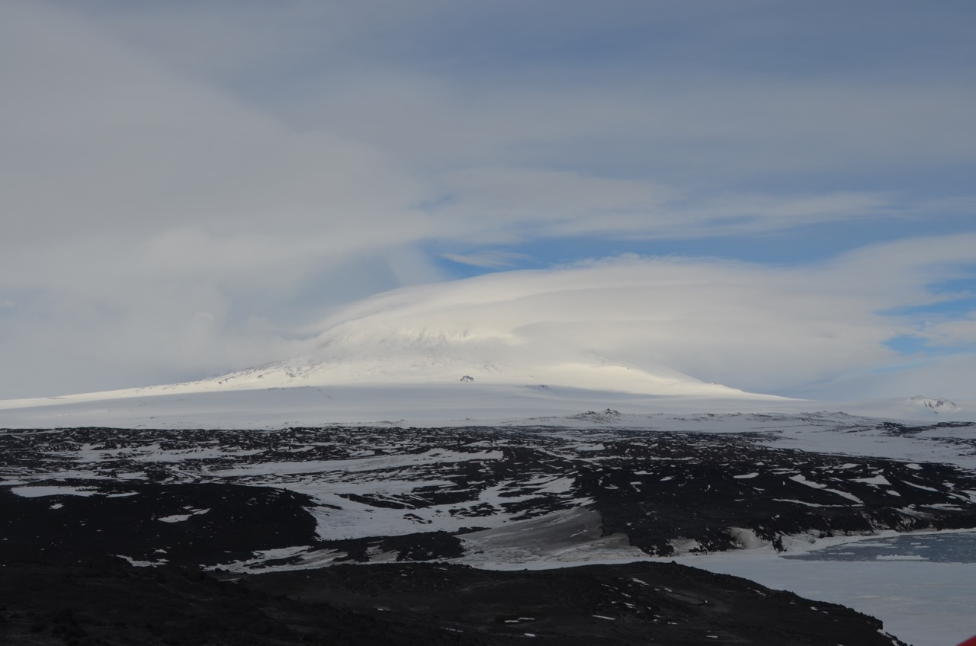
Ice POD: Lenticular Clouds
Lenticular Clouds are lens-shaped clouds that can often be seen by Mt. Erebus. They are starting to form in this picture.
Why do you think the clouds form over Mt. Erebus?
Ask questions in the “Ask the Team” section of today’s journal.
Notes:
Lenticular clouds (Altocumulus lenticularis) are lens-shaped clouds that form in the troposphere. They are perpindicular to the wind direction. They form when something obstructs the movement of air and the temperature drops to dewpoint to form clouds.
Learn more about Antarctica and ask the team questions by going to this journal: https://www.polartrec.com/expeditions/human-impacts-in-antarctica-2015/journals/2015-11-25

