Slide 1
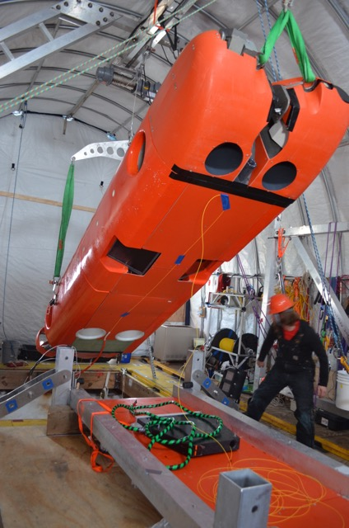
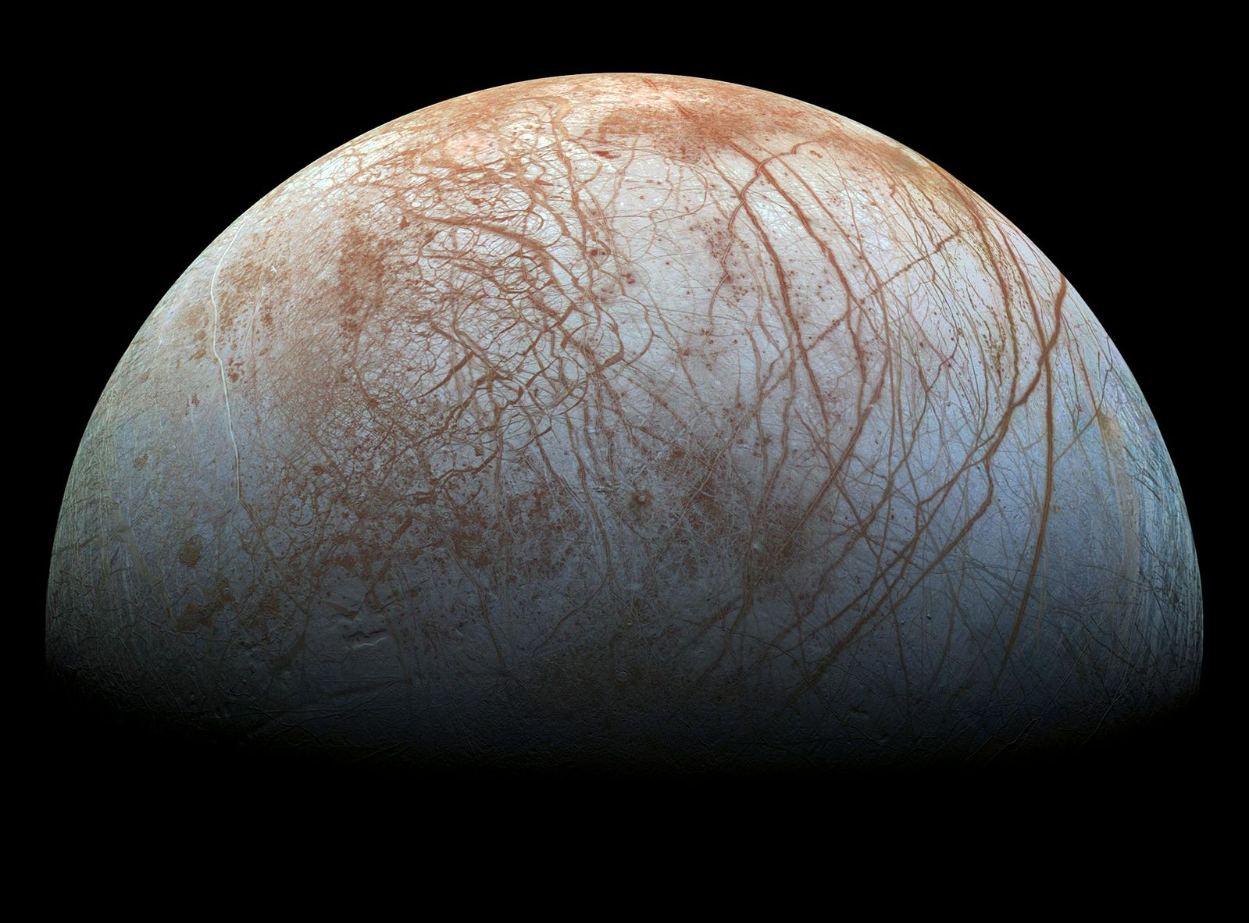
Ice POD: Europa and Antarctica
Photo courtesy of wikimedia.org
The SIMPLE project is sending a robot under the sea ice to better understand conditions that are similar to Jupiter’s moon, Europa. What data do you think they might collect?
Ask questions in the “Ask the Team” section of today’s journal.
Notes:
There are lots of instruments Artemis uses. For example, it has a Protein Fluorescent Spectrometer which can detect specific protein signals, it has a light sensor which can understand the amount of light under the ice, it also can collect water to be analyzed and measures data about water including salinity, water depth, current, temperature, turbidity, pH, the amount of dissolved oxygen, currents, and more.
Learn more about Antarctica and ask the team questions by going to this journal: https://www.polartrec.com/expeditions/human-impacts-in-antarctica-2015/journals/2015-11-30

