Slide 1
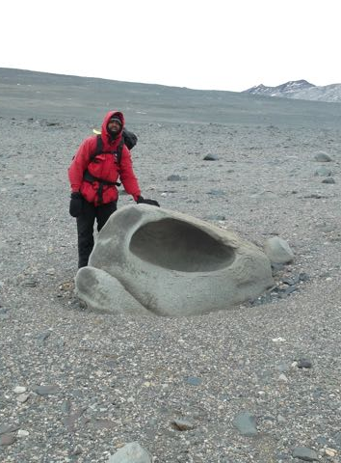
Ice POD: Ventifact
Ventifacts are found all along the Dry Valleys. Although glaciers had been there in the past, the area is now a polar desert. If there is no ice or water acting on the ventifacts, how do you think they form such interesting shapes?
Ask questions in the “Ask the Team” section of today’s journal.
Notes:
Researcher, Carl Green, stands by a large ventifact. The smooth surfaces and holes are shaped by wind. The wind picks up small grains of sediment and pushes them forward. When those sediments hit rocks, such as the one by Carl, or even smaller, they hit them, over time slowly abrading or wearing down the surface to form smooth shapes. Ventifacts can also be identified because their angled in the direction of the predimonant wind (along with nearby ventrifacts).
Learn more about Antarctica and ask the team questions by going to this journal: https://www.polartrec.com/expeditions/human-impacts-in-antarctica-2015/journals/2015-12-01

