Slide 1
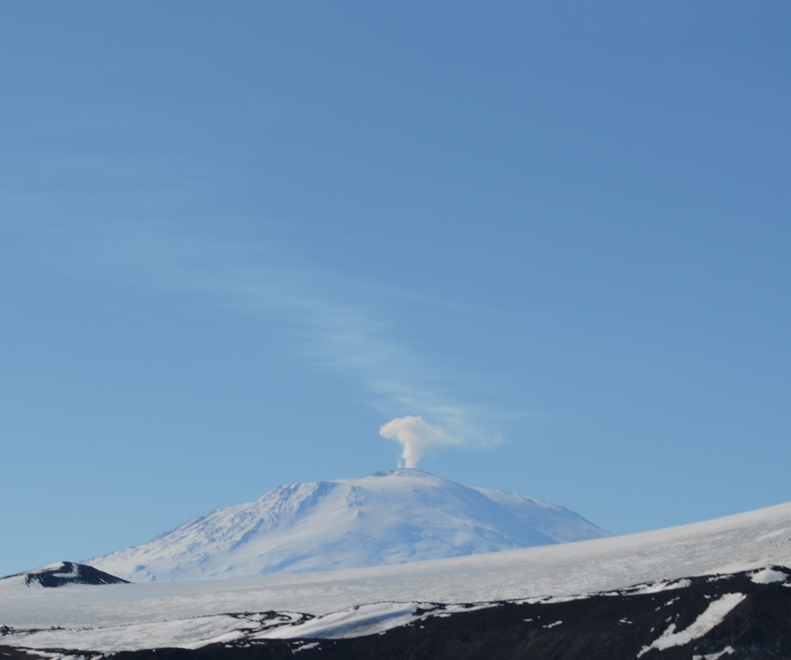
Ice POD: Mt. Erebus
Mt. Erebus, located on Ross Island, is an active stratovolcano known for its active boiling lava lake.
If you could slice the volcano in half and see deep down into the crust, what do you think it would it look like?
You can see a live webcam of the volcano here.
Ask questions in the “Ask the Team” section of today’s journal.
Notes:
This volcano is connected to a “long-lived, open and stable magma plumbing system.” Lava lakes are rare and require a balance of heat supply, which comes from a liquid-filled conduit in the magma chamber that provides rising magmatic gases, and heat loss, which is due to the heat lost in the cold at the surface of the lake. To find out more, go here: http://www.volcanodiscovery.com/erebus.html
Learn more about life and work in Antarctica, and ask the team questions by going to this journal: https://www.polartrec.com/expeditions/human-impacts-in-antarctica-2015/journals/2015-12-03

