Slide 1
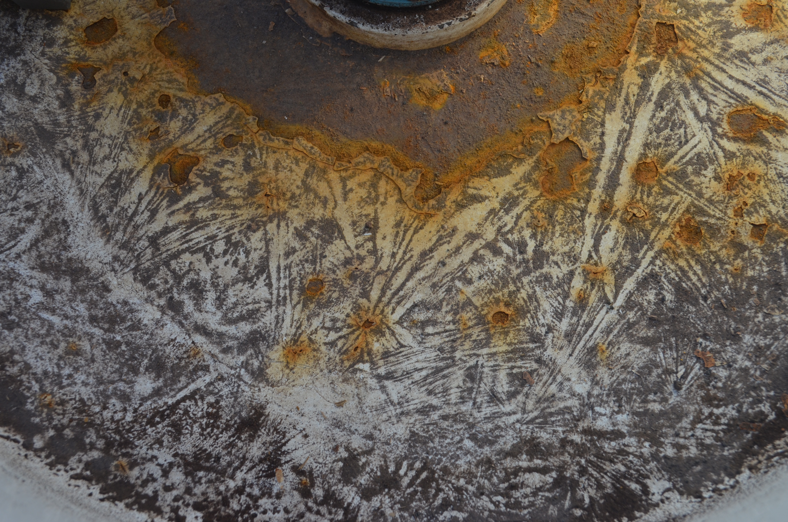
Ice POD: Patterns in the Fuel Can
Look at the pattern found on top of a fuel canister. The dark lines are actually made up of small sediments.
What do you think created this pattern?
Ask questions in the “Ask the Team” section of today’s journal.
Notes:
This pattern was caused by ice that had frozen on top of the can. The cool patterns resemble ice crystals. As the ice froze and then melted and evaporated, sediment moved and was deposited between the ice/water. It left behind an image of where the ice once was!
Learn more about life and work in Antarctica, and ask the team questions by going to this journal: https://www.polartrec.com/expeditions/human-impacts-in-antarctica-2015/journals/2015-12-04

