Slide 1
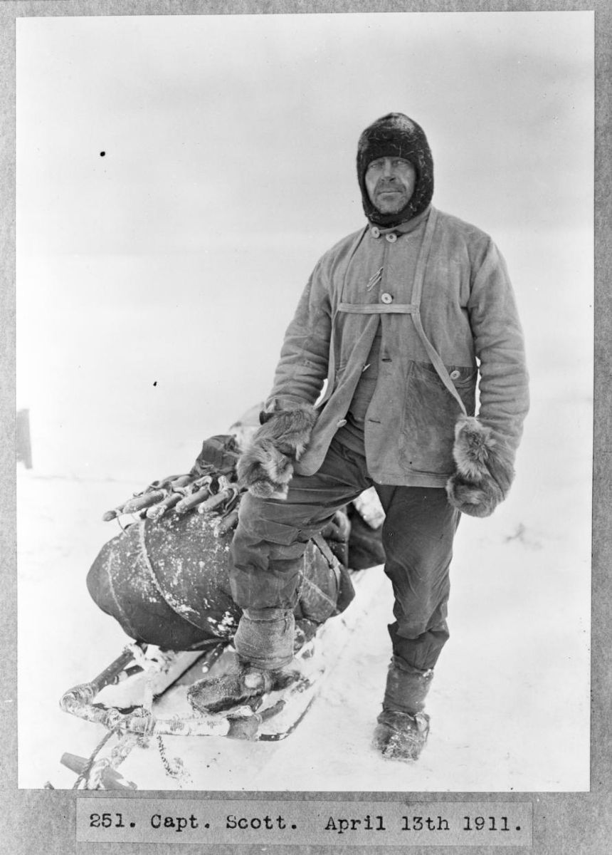
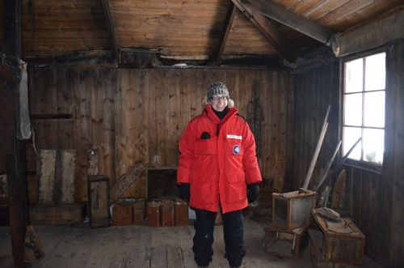
ICE Picture of the Day: Robert Scott
People have been coming to Antarctica for over 100 years. Robert Falcoln Scott led expeditions in 1901 and 1910, making significant geographic and scientific discoveries. His hut from 1901 still stands today.
Notes:
This picture shows Robert Scott in polar gear on a return journey to Antarctica in 1911. In future ICE POD pictures, we will learn about some of the scientific contributions Scott and his team made. For more information about the hut Scott build at McMurdo Station, go here: https://www.polartrec.com/expeditions/human-impacts-in-antarctica-2011/journals/2011-11-20 To see a movie of Scott's hut, frozen in time, go here: https://www.youtube.com/watch?v=5h9t8v1v7yk
Photo Credit: Captain Robert Falcon Scott, leader of the Terra-Nova-Expedition (1911-1913), in polar gear, Photograph by Herbert Ponting

