Slide 1
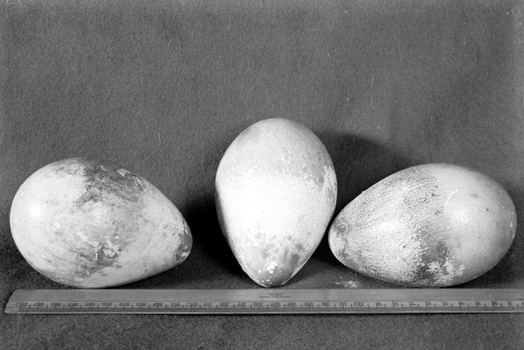
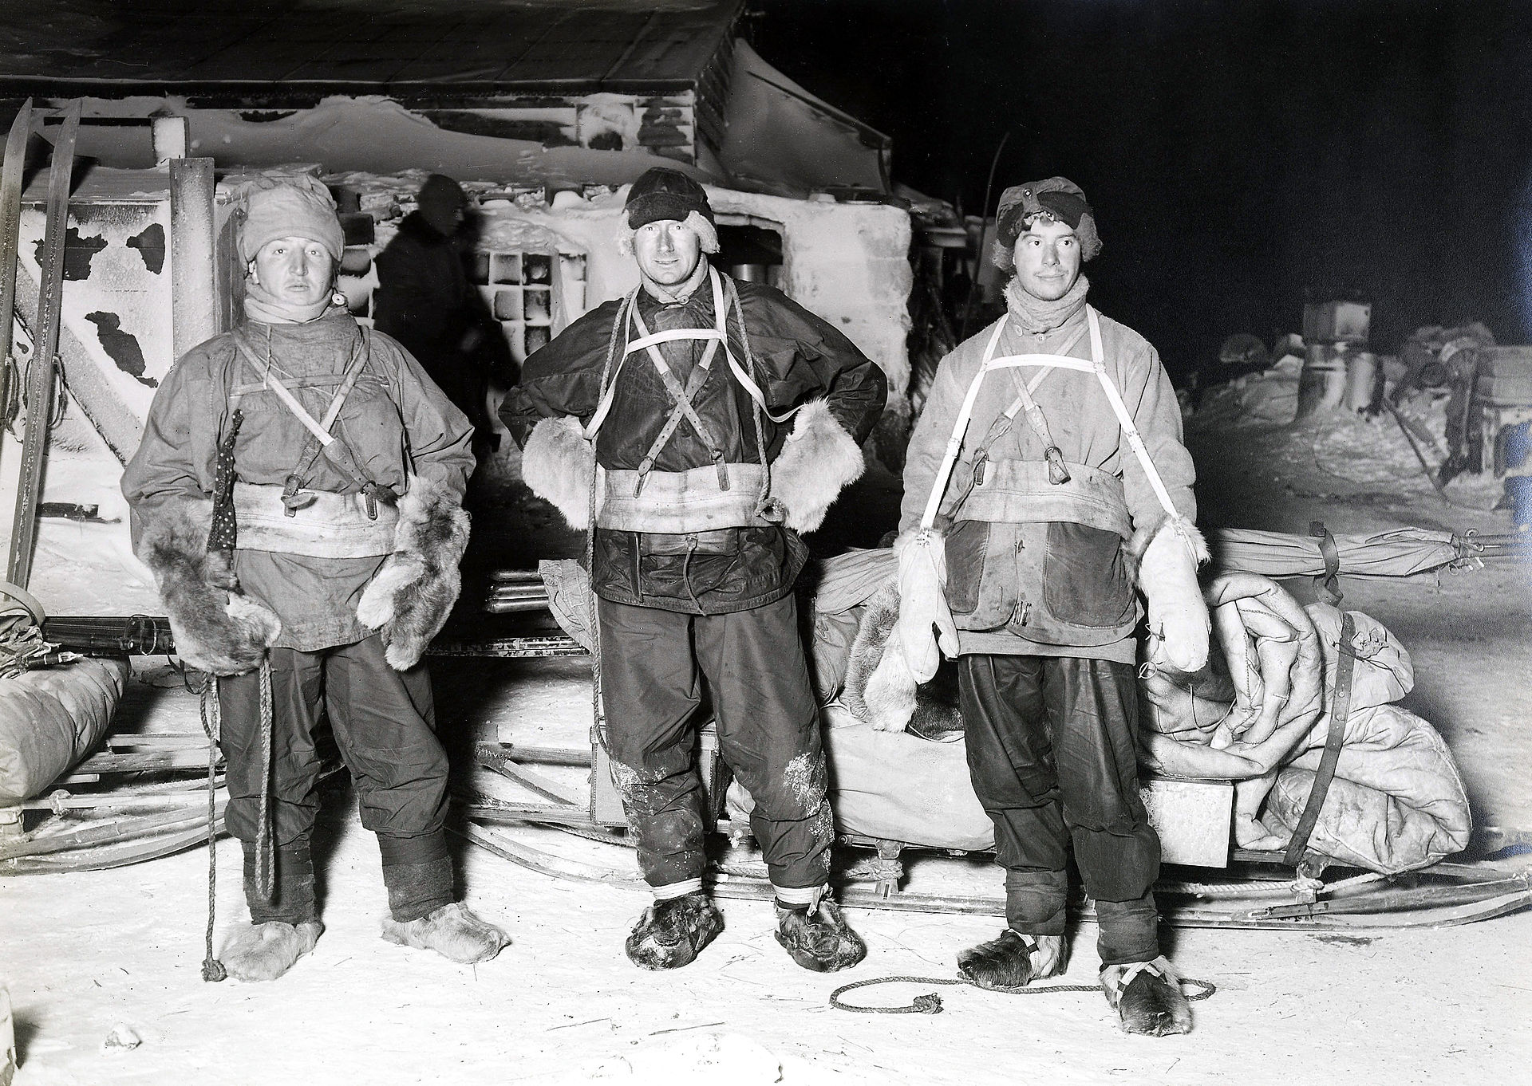
ICE POD: Scott’s Antarctic Egg Hunt
In 1910, Scott’s team members traveled for weeks in the below-freezing cold to collect Emperor Penguin Eggs.
They thought evolution could be seen through embryos. Turns out they were wrong, but we can see how dedicated scientists are to understanding the natural world!
Notes:
In Scott’s 1910 Terra Nova Expedition, aside from trying to be the first to reach the South Pole, three men in his team (Henry Bowers, Edward Wilson and Apsley Cherry-Garrard, shown in the picture above) trekked for 5 weeks to Cape Crozier (a trip that was over 200 km). Why? Because at the time, scientists thought that the evolution of animals could be seen in their embryos, known as “ontogeny recapitulates phylogeny” as theorized by Ernst Haeckl. The team traveled in complete darkness in -30 – 90 degree F weather to get the eggs. They got 5 eggs, two of which cracked on the return trip. Wilson cut squares in the eggs and removed and pickled the embryos. Unfortunately all this work was for naught. By the time the embryos were analyzed and results published, the theory was no longer accepted. Still, it shows just how far scientists are willing to go to collect evidence towards a theory!
NGSS alignment:
Scientific Knowledge is Based on Empirical Evidence - Scientists look for patterns and order when making - observations about the world. (2-LS4-1)
See: http://www.the-scientist.com/?articles.view/articleNo/38356/title/Harrowing-Egg-Hunt--1911/ and http://www.bbc.com/news/magazine-15384729 for more information.

