Slide 1
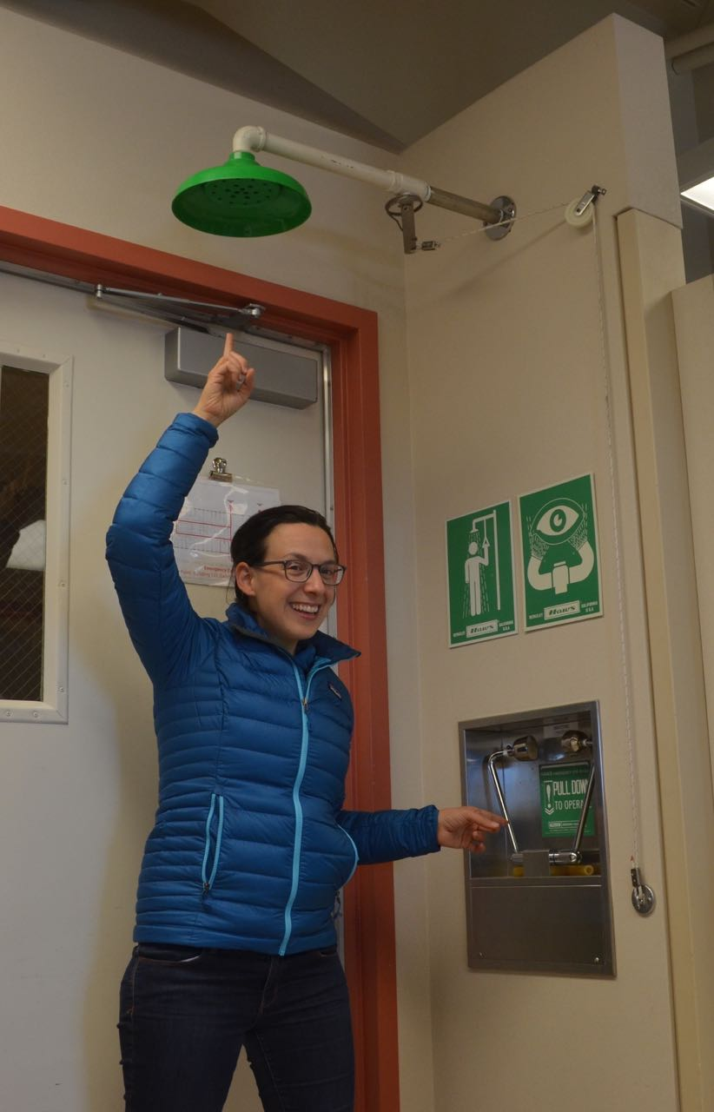
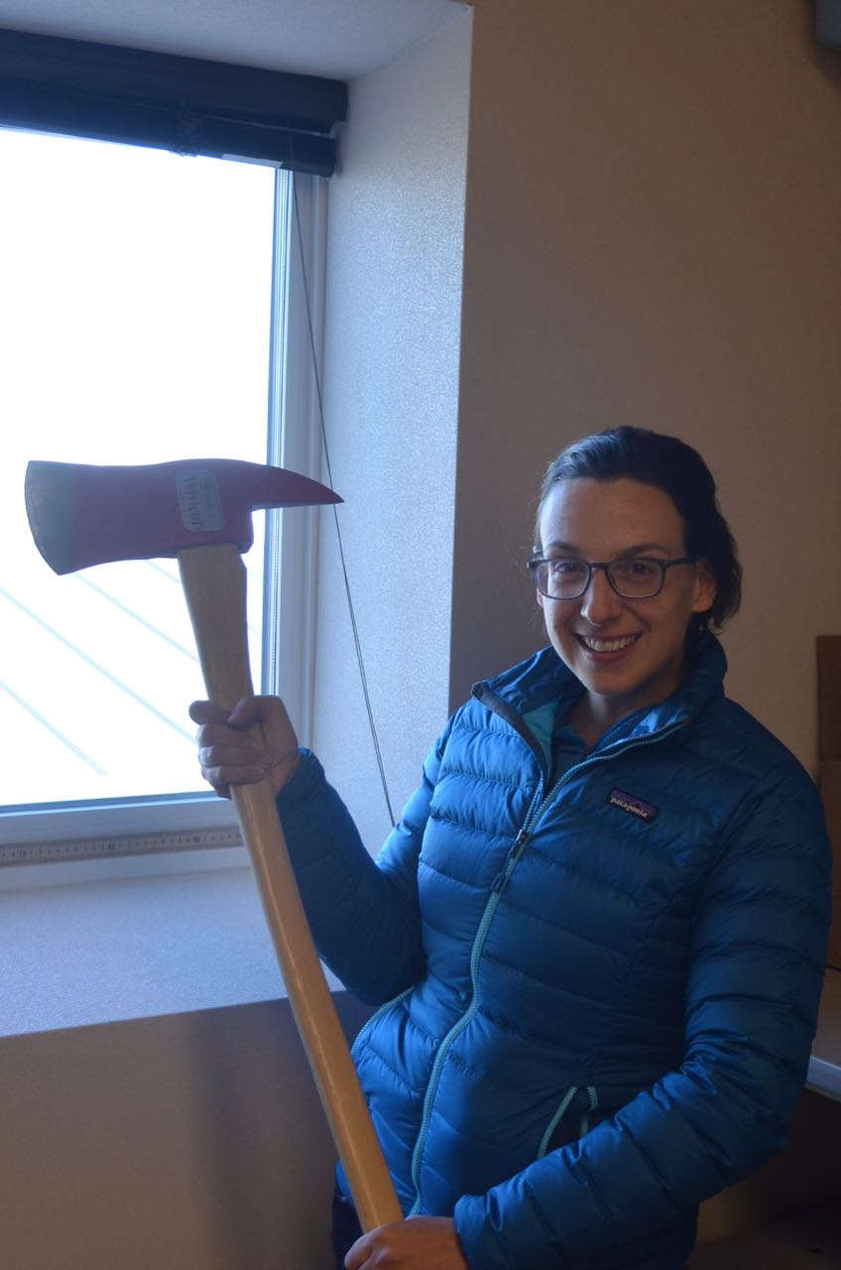
ICE POD: Safety in the Lab
Before working in the lab in McMurdo Station, scientists tour the building and learn about safety features.
How is an axe a safety feature in this lab?
What safety features are in your science classroom?
Record your answers in the “Ask the Team” section of today’s journal.
Notes:
There are many safety features in the lab offices at Crary (in McMurdo Station, Antarctica). Each lab contains an eyewash station and shower (picture on left). There are also fire extinguishers and fire blankets. Scientists must follow MSDS sheets and label and dispose of chemicals properly. Each room also has an axe by the window. The axe allows scientists to break the window, allowing for a safe escape route if there was a fire in the building and no other safe exit was possible. For more information about Crary and the safety tour, go here: https://www.polartrec.com/expeditions/human-impacts-in-antarctica-2015/journals/2015-11-09

