Slide 1
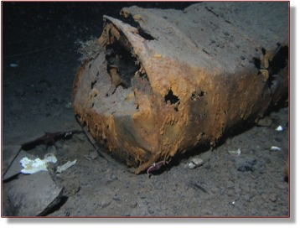
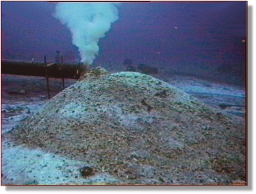
ICE POD: Pollution and the Environment
Oil drums and other waste remain on the sea floor in McMurdo Sound, Antarctica.
How do you think this affects sea life in the area?
Record your answers in the “Ask the Team” section of today’s journal.
Notes:
From the 1950s to as late as 2003, waste has been accumulating in the seafloor surrounding McMurdo Station, Antarctica. From empty oil drums (shown left) which sat on the ice and eventually fell into the bay, to sewage that was piped directly to the seafloor, like many environments outside Antarctica, McMurdo Sound has pollution on its seafloor. There are far fewer organisms in these areas, although some sea life, like polychaete worms, can tolerate the pollution.
Learn more about the history of the pollution and ask the team questions by going to this journal:
https://www.polartrec.com/expeditions/human-impacts-in-antarctica-2015/journals/2015-11-10

