Slide 1
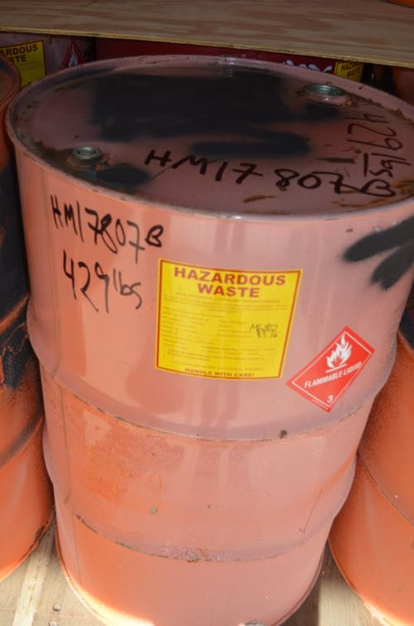
ICE POD: Hazardous Waste
All hazardous waste from U.S. research stations is collected and shipped back to the United States. Containers are carefully marked.
Why is hazardous waste shipped back to the U.S.?
Why do you think containers need to be carefully marked?
Record your answers in the “Ask the Team” section of today’s journal.
Notes:
Before the 1990s, hazardous waste was not carefully disposed of in Antarctica. However, regulations soon changed and now all hazardous waste is collected and shipped back to the United States to be carefully disposed of. Antarctica is the last pristine continent on Earth—the Antarctic Treaty ensures that we try to maintain that, this includes removing as much waste as possible. It is important to carefully mark containers so that materials are treated properly. Also, hazardous materials should not be mixed or else a chemical reaction could cause damage.
NGSS standard: Generate and compare multiple solutions to a problem based on how well they meet the criteria and constraints of the design problem. (3-5-ETS1-2)
Learn more about hazard waste in Antarctica and ask the team questions by going to this journal:
https://www.polartrec.com/expeditions/human-impacts-in-antarctica-2015/journals/2015-11-11

