Slide 1
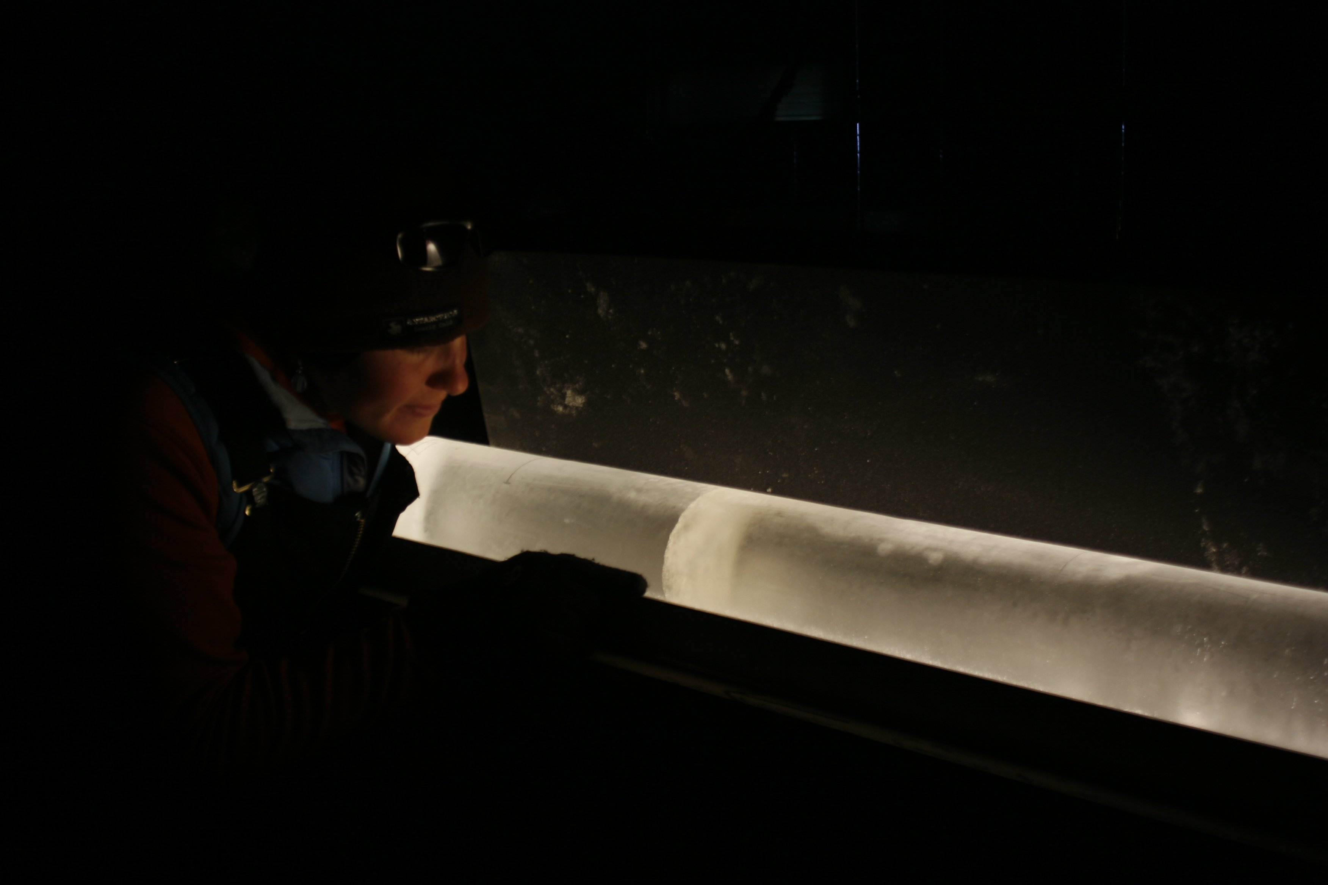
The Science of Ice:
How ice sheets form and
how scientists use ice to learn about past climate

Slide 2
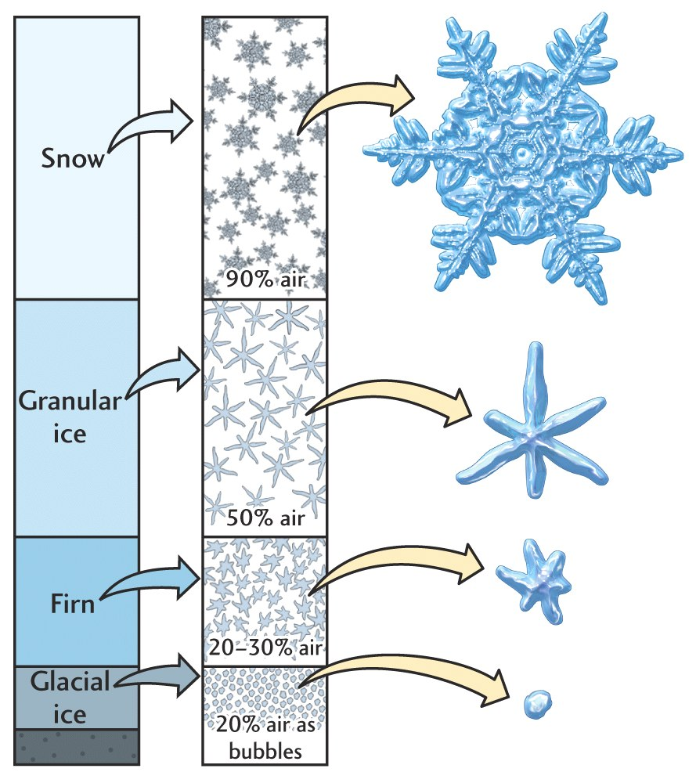
Glaciers and ice sheets form as snow accumulates. Over time, as snow accumulates, pressure increases, weighing down the underlying snow. This creates a layer of dense snow, called firn. Eventually the firn gets so compacted it turns into solid ice. Scientist study this ice to learn about past climate changes.
Source: http://hays.outcrop.org/images/glaciers/press4e/figure-16-08.jpg

Slide 3
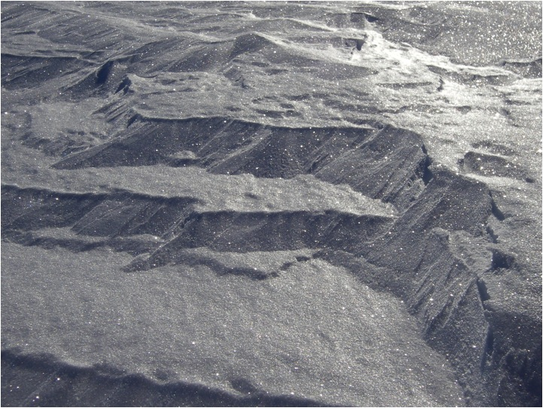
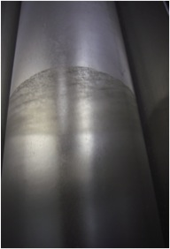
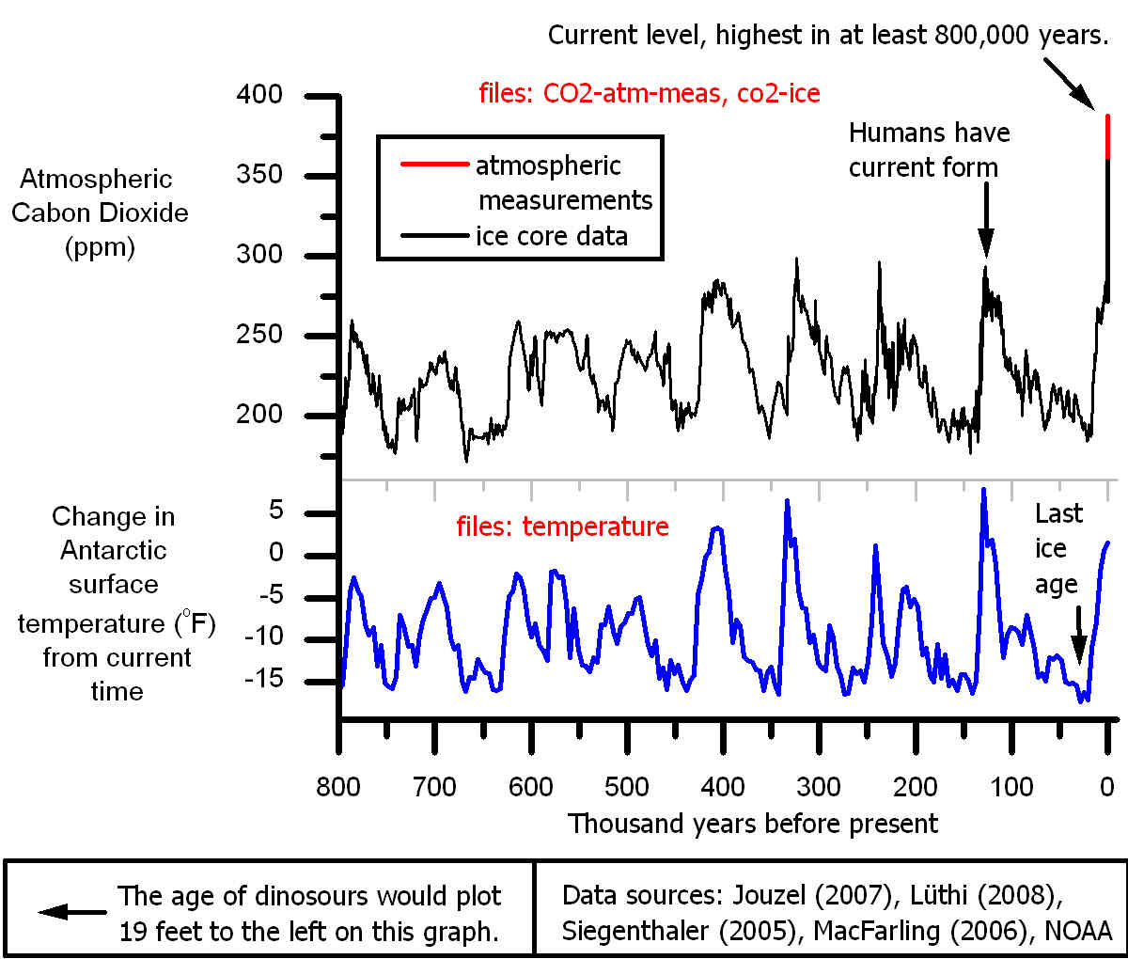
Ice Cores and Climate Change:
Greenhouse gas concentration fluctuations
Ice can preserve ancient atmospheres
The concentrations of greenhouse gas like carbon dioxide and methane can be extracted from air bubbles trapped within the ice.
Gases get trapped
Snow accumulates
Ice forms with bubbles in it
This is a composite record of the CO₂ measured in Antarctic ice cores
Data sources: Jouzel (2007), Luthi (2008), Siegenthaler (2005), MacFarling (2006), NOAA

Slide 4
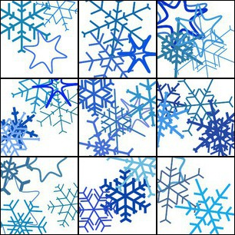
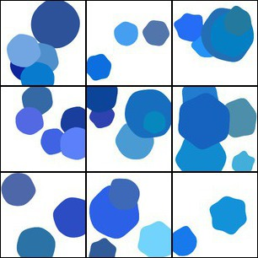
- Can you draw snowflakes, firn and ice?
Ice Core Art Activity
- What do you think each would look like?

