Slide 1
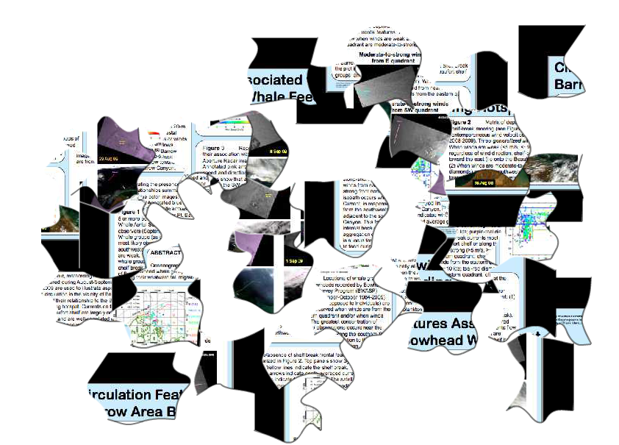
Scientific Poster “puzzle” Dissection
Bowhead Whale- Arctic
E. Eubanks- Capstone Project Fall 2013
Integrated Life and Earth Sciences in the Polar Regions

Slide 2
Objectives
1. Print the following pieces of the “puzzle” Poster (slides 3-9 ..pages 1-7)
2. Put Students into teams of at least two.
3. Give each team two pieces of the puzzle.
4. Utilizing internet resources & have students research 5 facts about their each piece (anything will do ☺ )
5. Display this presentation - and have students present what they learned for each slide.
6. On the third to last slide – click the link to the “Poster Puzzle” and have students put it together.
To familiarize students with:
The Scientific Method
Real Polar Scientific Posters
Real Polar Scientific Research
Real Polar Scientific Terminology
Real Polar Scientific Technology
Real Polar Scientific Data
Real Polar (Arctic) Scientists
***REAL SCIENCE***

Slide 3
1

Slide 4
2

Slide 5
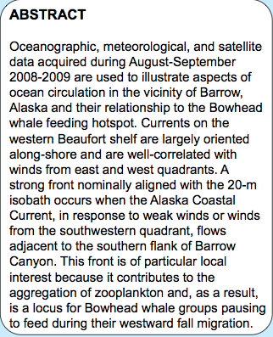
3

Slide 6
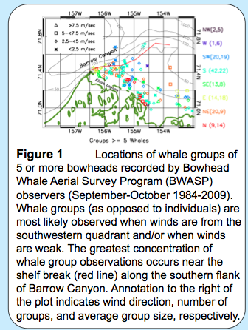
4

Slide 7
5

Slide 8
6

Slide 9
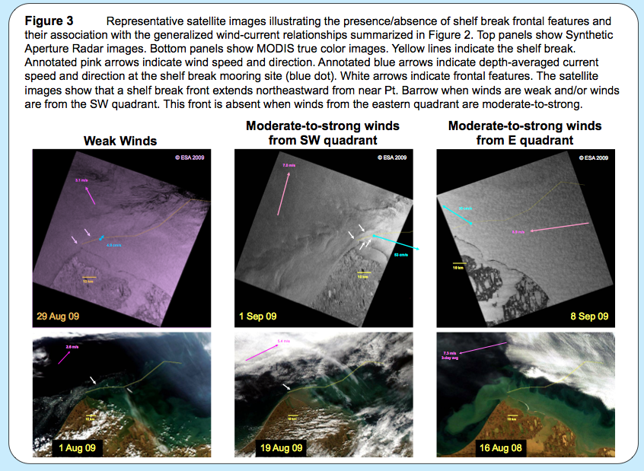
7

Slide 10
Lets Put the Pieces Together
http://four.flash-gear.com/npuz/puz.php?c=v&id=3811551&k=88550453
Follow the Link- Scroll down on the page until you see the puzzle

Slide 12
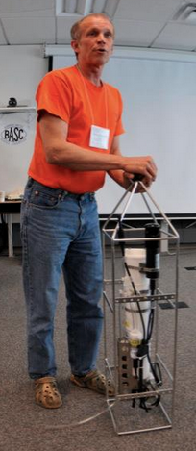
Special Thanks to Dr. Steve Okkonen for sharing the poster and time

