Slide 1
Growing Up on Ice Lesson

Slide 2
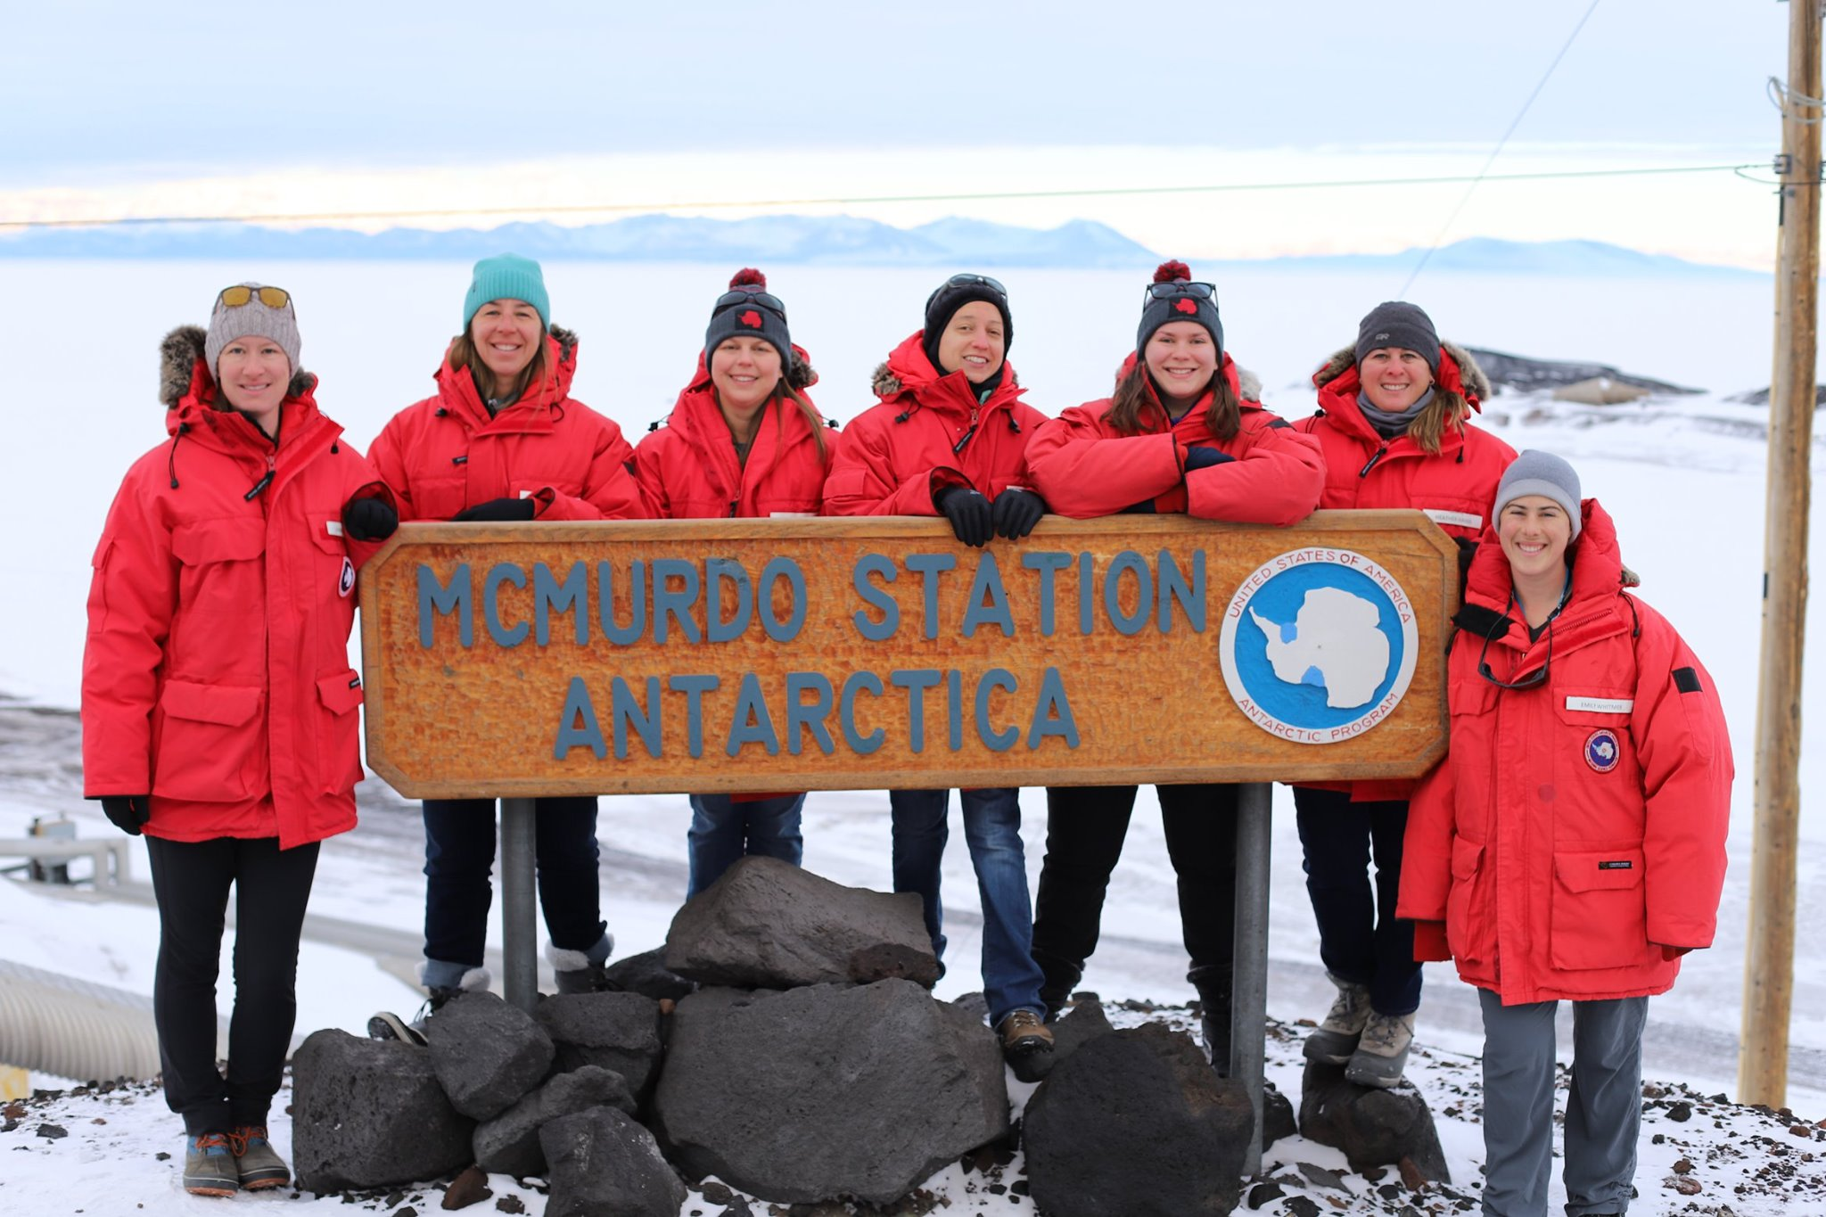
B-030 Research Team
The B-030 Research team consists of 7 women. From left to right Dr. Linnea Pearson (co-principal investigator), Erin Brodie (veterinary technician), Dr. Heather Liwanag (principal investigator), Bridget Ward (PolarTREC teacher), Emma Weitzner (graduate student researcher), Heather Harris (field veterinarian) and Emily Whitmer (field veterinarian).

Slide 3
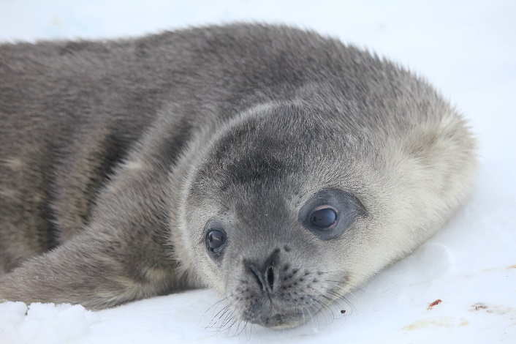
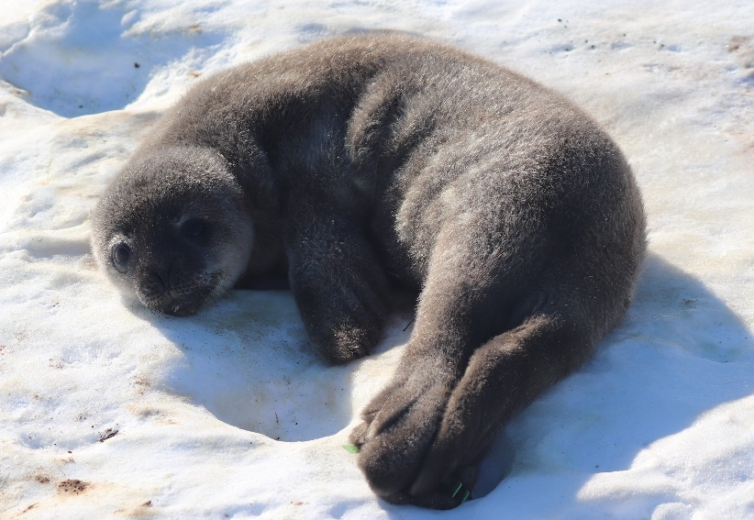
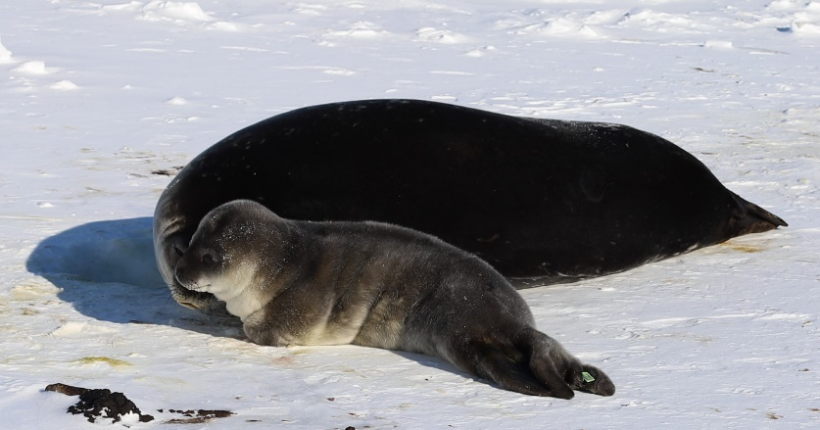
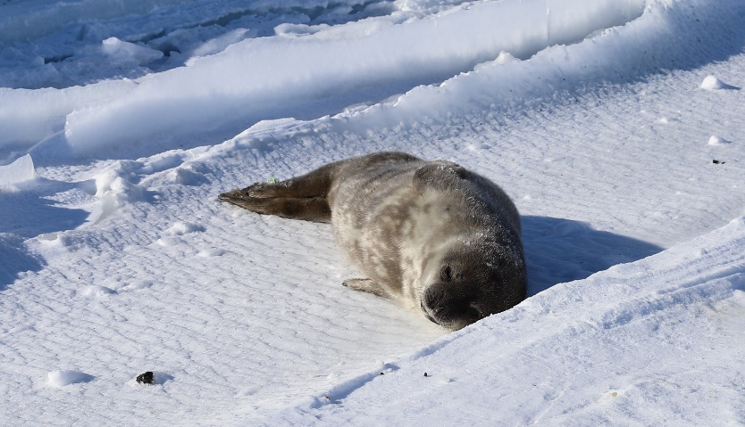
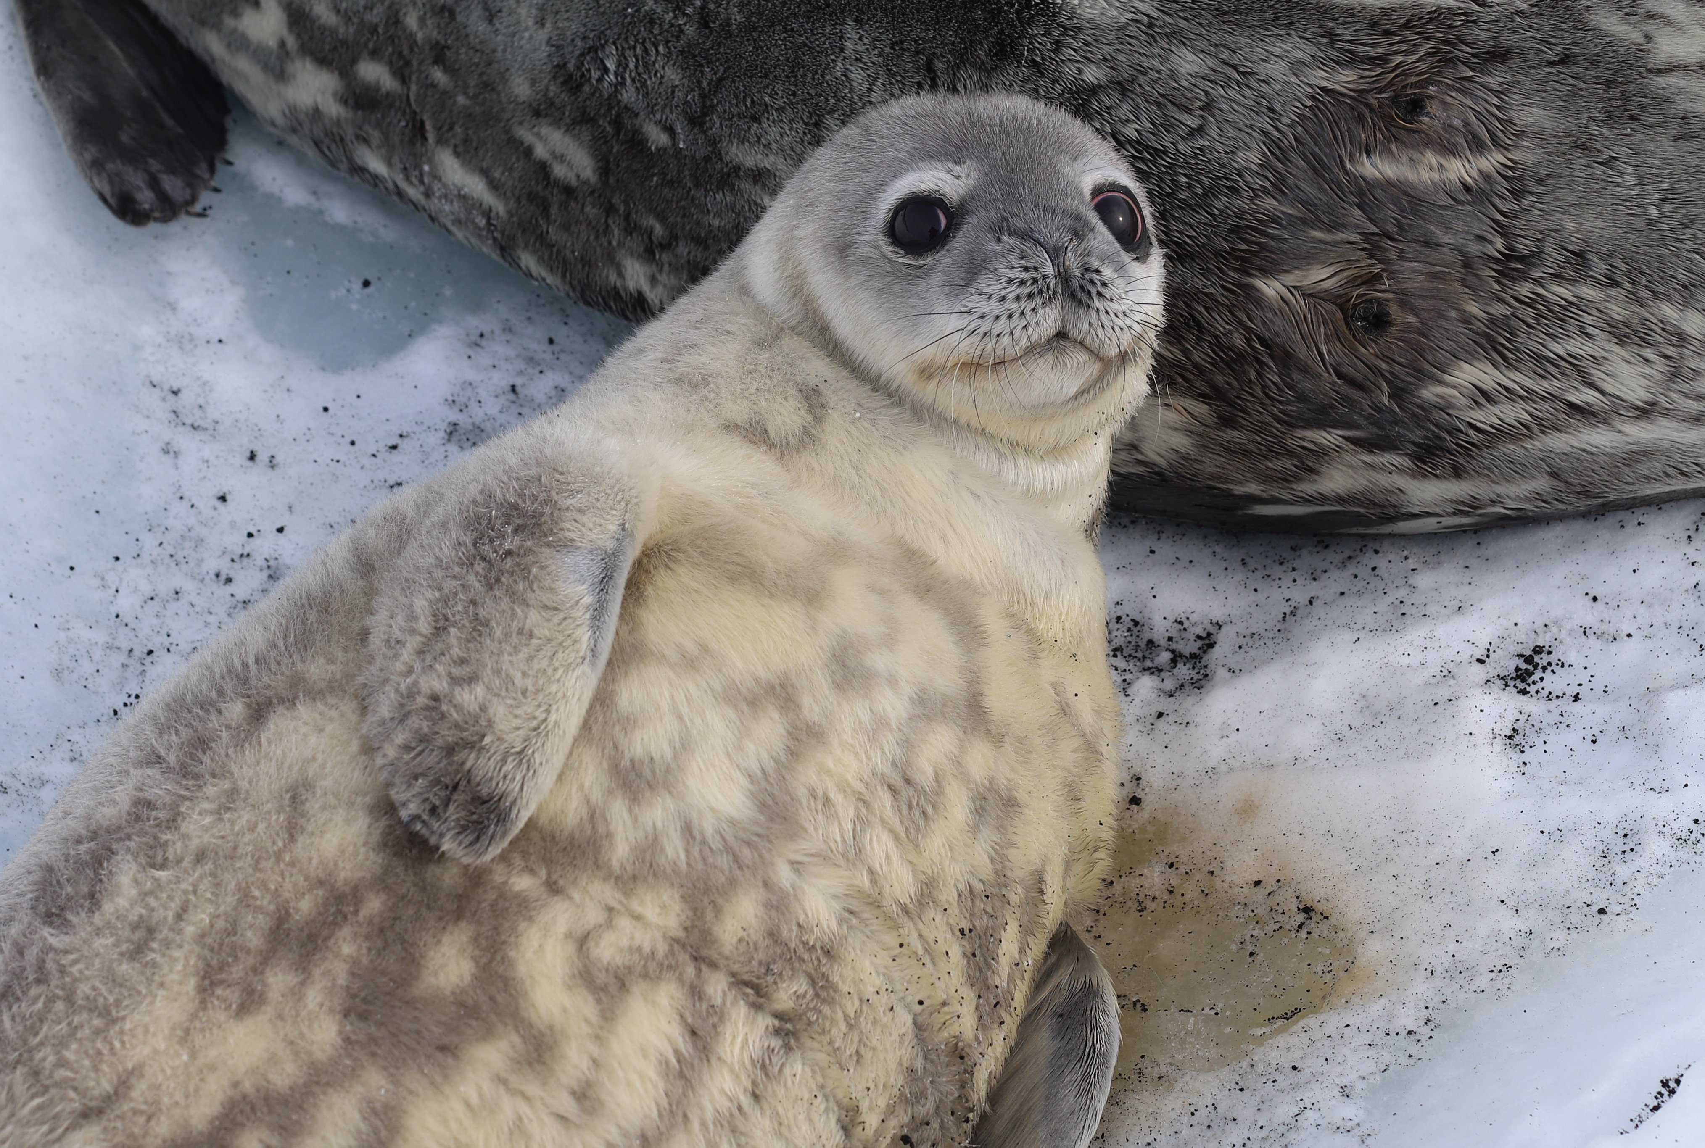
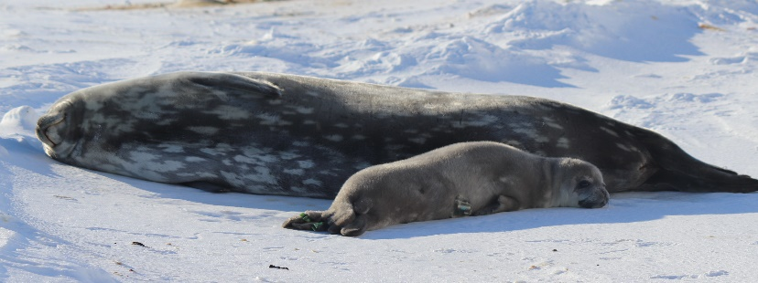
Meet the Weddell Seal Pups!
Caramello
Smartie
Mr. Goodbar
Charleston Chew
Sweetart
Twix
These pictures were taken under ACA Permit number 2018-013 M#1 and MMPA Permit Number 21006-01

Slide 4
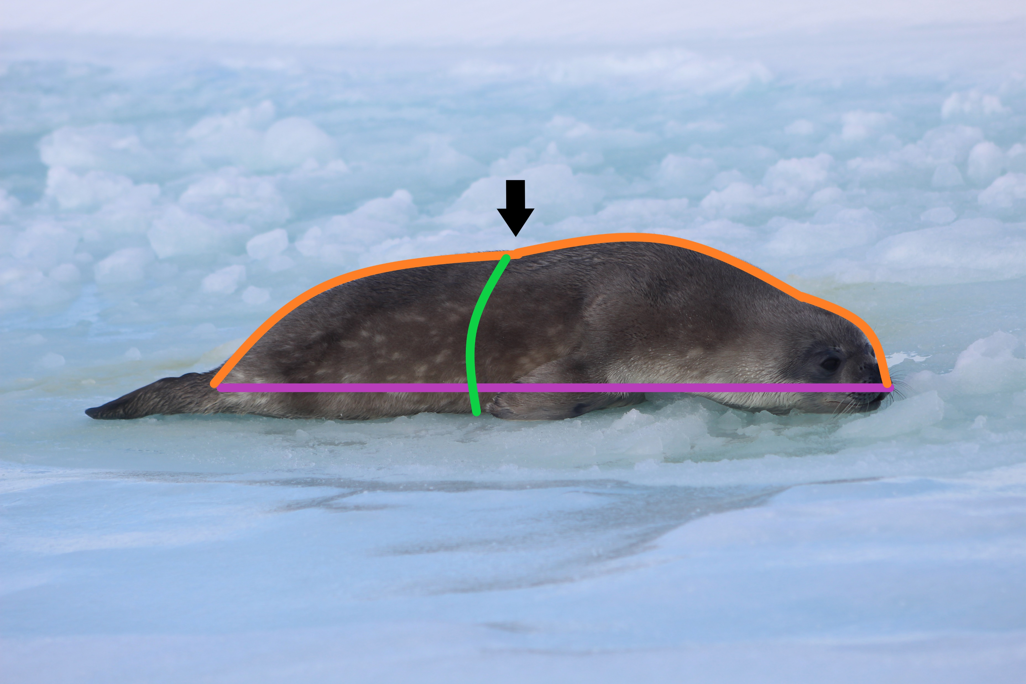
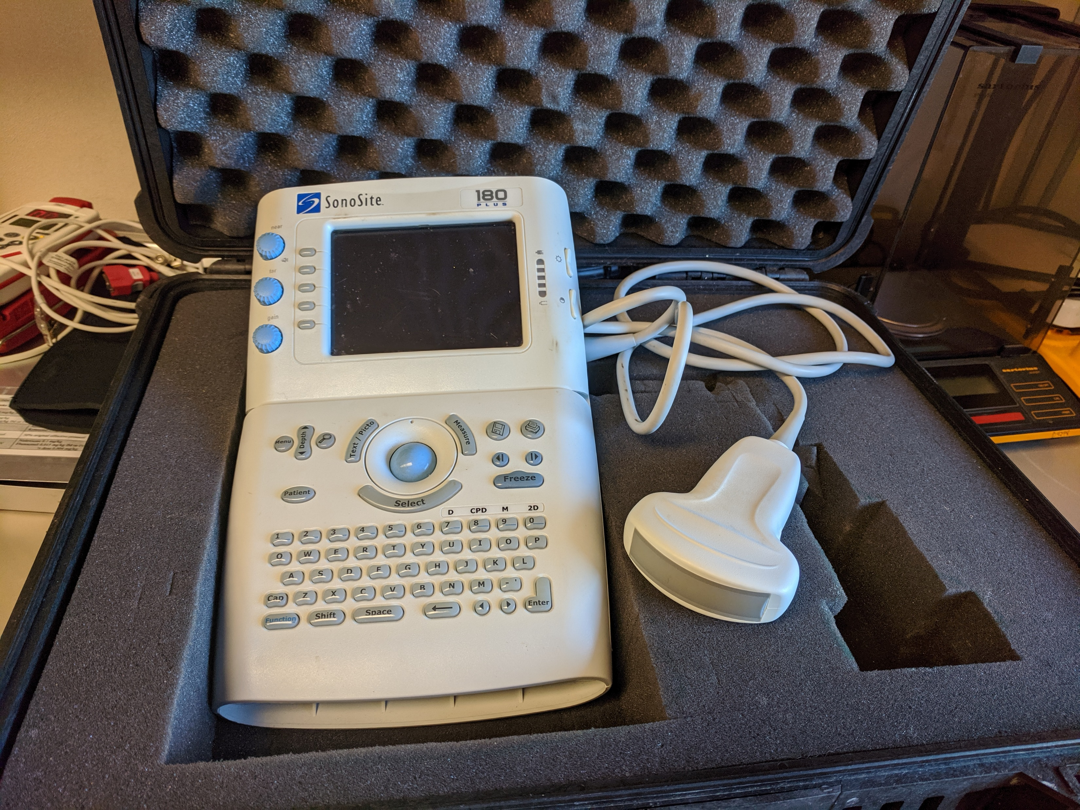
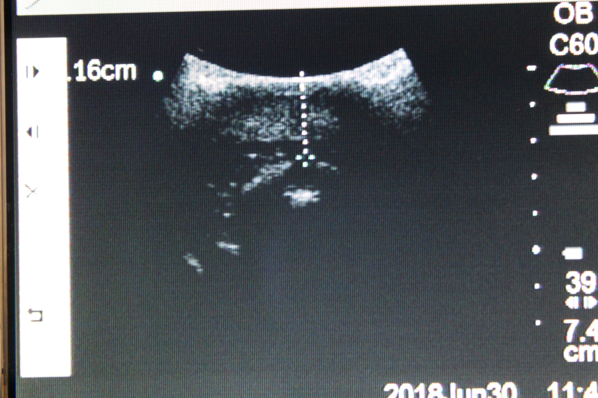
Measuring Weddell Seal Pups
Blubber depth is measured by ultrasound.
Measurements:
Straight length nose to tail
Curve length nose to tail
Blubber depth at the dorsal sternum location
Sternum girth. Girth is measured around the body.
Mass is measured with a scale.
These pictures were taken under ACA Permit number 2018-013 and M#1 MMPA Permit Number 21006-01

