Slide 1
Investigating Permafrost Depth in the Arctic Experimental Set Up
Shrubs, Snow, and Nitrogen in the Arctic 2019
PolarTREC Expedition

Slide 2
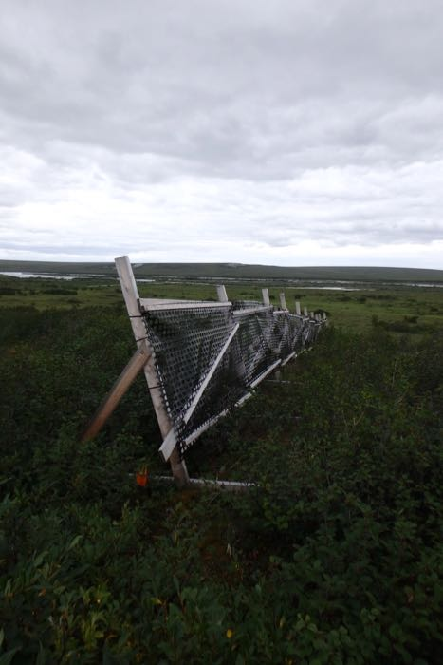
Snowdrift Fence
Purpose: to collect snow on one side (orange arrow) so that there is a higher snowpack on one side of the fence during the winter months.

Slide 3
How do scientists measure the permafrost layer?
Scientists can push a metal probe into the ground. When they reach ice the probe stops. This allows them to measure the depth of the permafrost and see how close it is to the surface.
Photo credit: https://www.polartrec.com/expeditions/shrubs-snow-and-nitrogen-in-the-arctic-2019

Slide 4
Snowdrift Fence
Red arrow: direction of measurements. Arrow tail = 0 m
Green arrow: snowdrift side
Yellow arrow: control side

Slide 5
Snowdrift Side
Position (M) | Thaw Depth (cm)
0 | 21
5 | 51
10 | 51
15 | 19
20 | 75
25 | 72
30 | 55
35 | 40
40 | 75
45 | 72
50 | 57
55 | 59
60 | 28

Slide 6
Control Side
Position (M) | Thaw Depth (cm)
0 | 46
5 | 55
10 | 55
15 | 45
20 | 40
25 | 60
30 | 36
35 | 57
40 | 49
45 | 50
50 | 32
55 | 47
60 | 38

