Slide 1
The Last Glacial Maximum (LGM)
Modified from: Royal Geographic Society: Glacial Landscapes Lesson 1

Slide 2
What is the LGM?
Latest phase in Earth’s geologic history (26,000-18,000 years ago) when the planet’s:
Average temperature reached a minimum
Area of land covered by glaciers and ice sheets reached a maximum
~3x more than currently present
Sea-level was about 120 meters lower than present

Slide 3
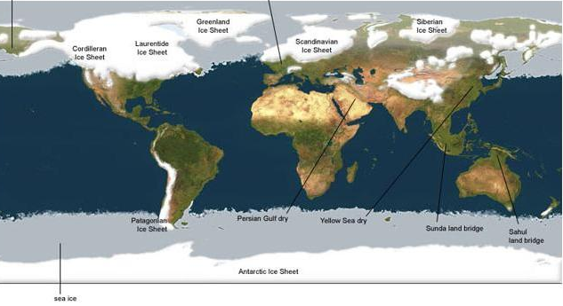
Global Glacial Coverage During the LGM
Image Source: http://www.humberriver.ca/globalice.html

Slide 4
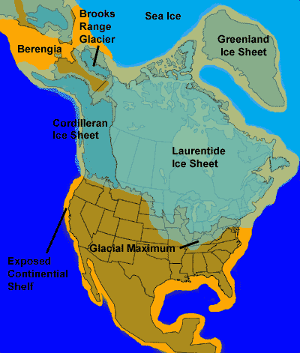
Glacial Coverage of North America During the LGM
Image Source: Idaho Museum of Natural History

Slide 5
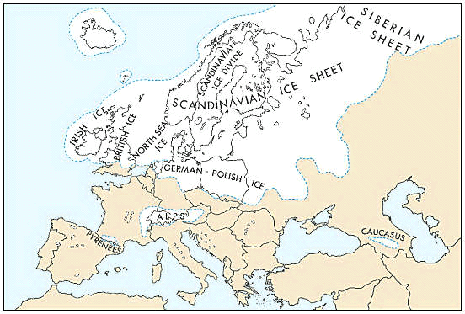
Glacial Coverage of Europe During the LGM
Image Source: www.kids.britannica.com

Slide 6
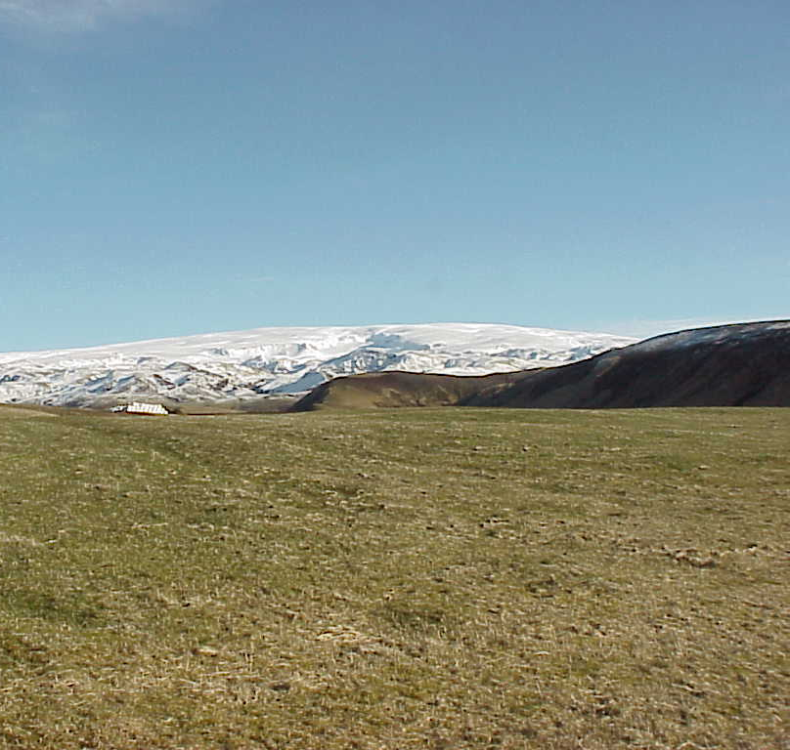
The edge of an ice cap in modern day Iceland
This may be similar to what landmasses in the Northern Hemisphere looked like during the LGM
D.E.Anderson

Slide 7
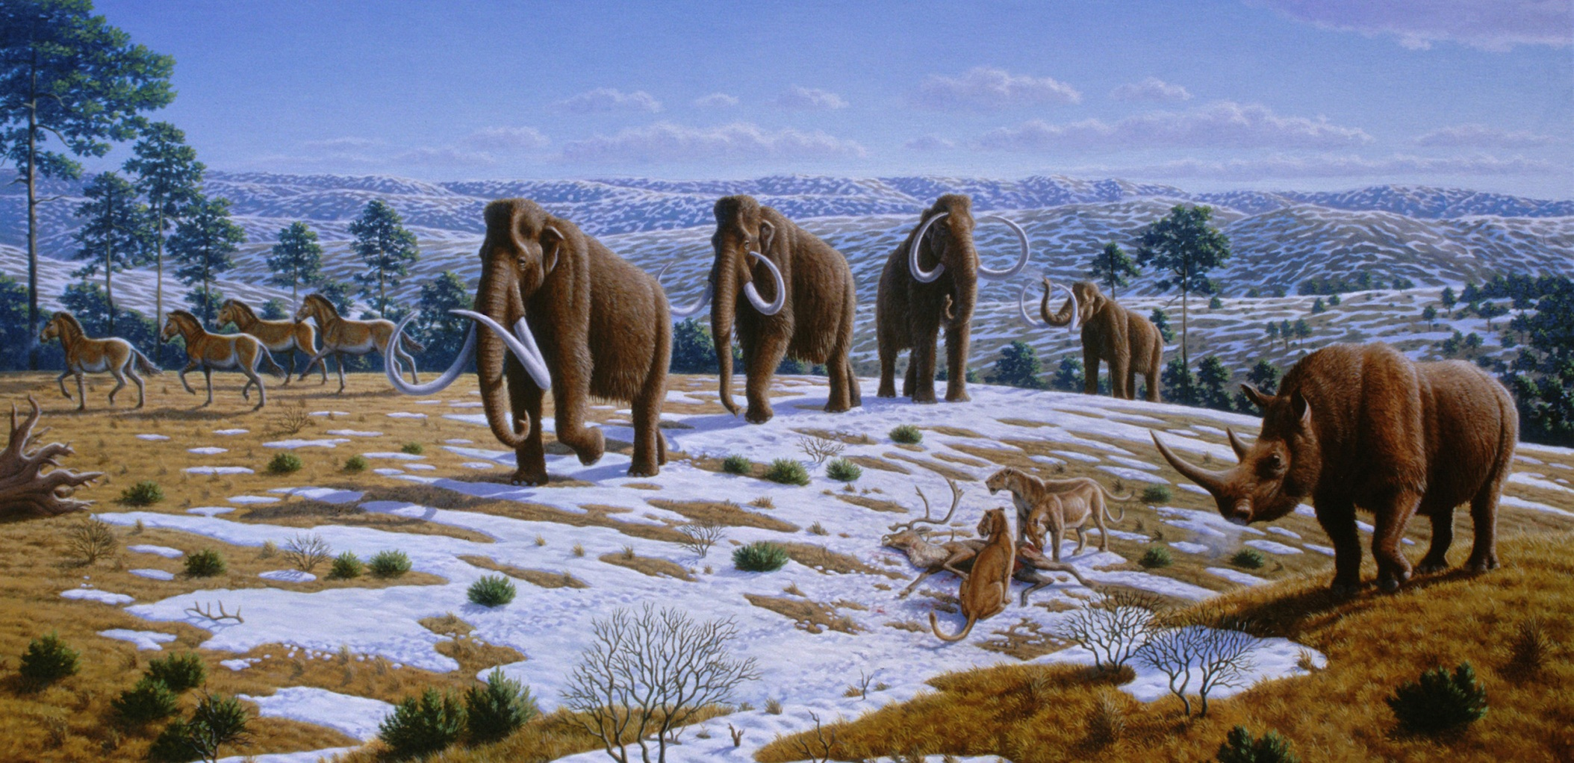
Extinct Animals & Ice Age Terrain
Image source: Wiki Commons

Slide 8
Glacial Cycles within the Quaternary
Earth’s climate has oscillated between cold glacial times and warm interglacial periods
The LGM was the coldest part of the most recent ‘glacial’ period
We are currently warming up from the LGM and entering an interglacial period

Slide 9
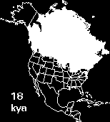
Retreat of North American Glaciers as the LGM Ended
Animation Source: http://www.museum.state.il.us/exhibits/ice_ages/

Slide 10
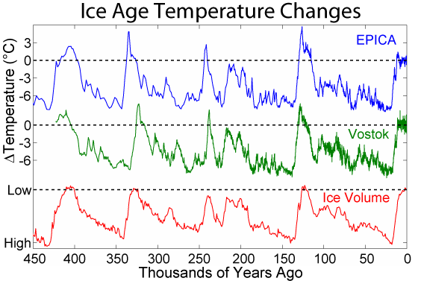
These are two
ice core based
temp. reconstructions
from Antarctica
Average global
temp. change
from today
Our present
warm time,
the Holocene
The LGM
Image Source: Robert A. Rohde / Global Warming Art

Slide 11
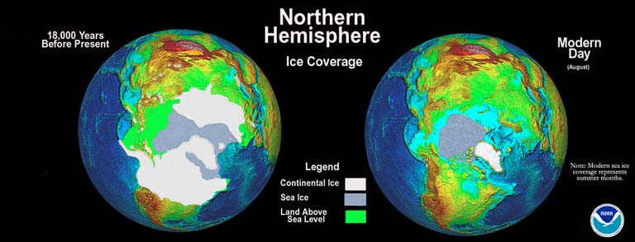
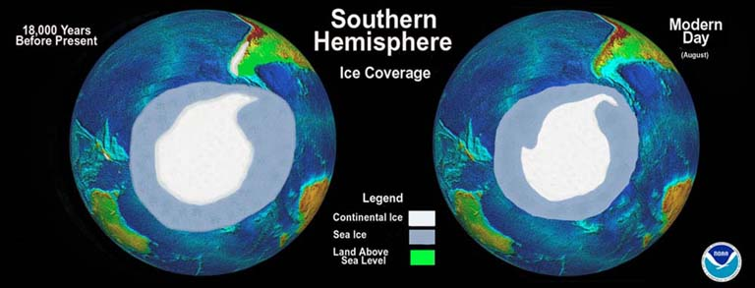
Differences in Ice Sheet/Sea Ice Extent Between LGM and Today
LGM
LGM
Mark McCaffrey , NGDC/NOAA
Source: http://www.ncdc.noaa.gov/paleo/slides/slideset/11/11_178_slide.html

Slide 12
Global Glacial Coverage
Present
LGM
About 10% of land was covered by glaciers (~15 x 10⁶ km²)
Distribution of world’s glacial ice:
Antarctica: 85%
Greenland: 11%
Remainder of globe: 4%
About 30% of land was covered by glaciers (>40 x 10⁶ km²)
Distribution of world’s glacial ice:
Antarctica: 30%
Greenland: 5%
Laurentide Ice Sheet (northeastern - North America): ~30%
Scandinavian Ice Sheet (northern Europe): ~15%
Remainder of globe: ~20%

Slide 13
Average Global Temperatures
Present
LGM
Average: 14.6°C
Still colder at high latitudes
Warmer nearer to the Equator
Temperatures have risen 0.5°C since 1960s
About 6°C colder
Much colder at high latitudes
Slightly less nearer to the Equator

Slide 14
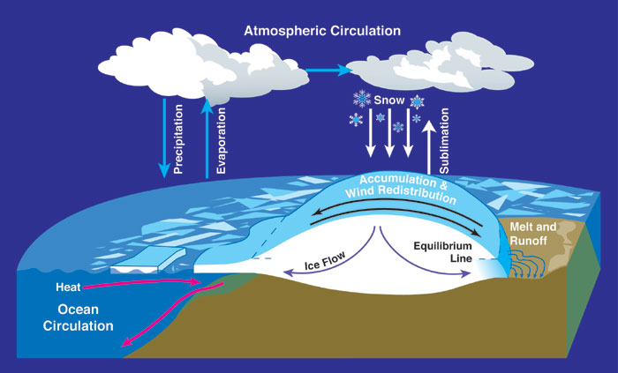
Sea Level Change During the LGM
Dropped to about 120 meters below present level
More of the world’s H₂0 was transferred from the oceans to glacier ice

Slide 15
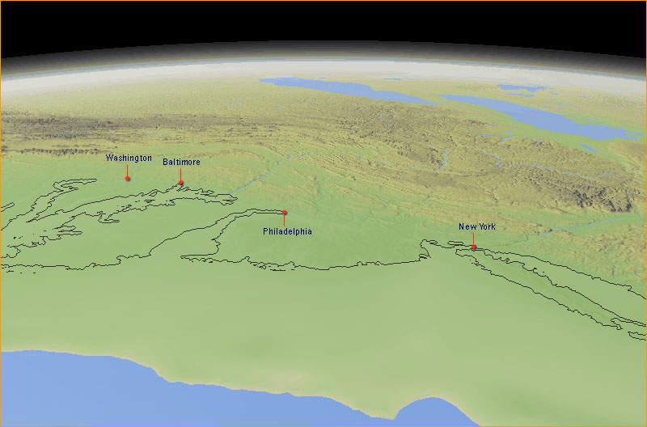
Eastern U.S. Coastline During the LGM
Image Source: PBS - NOVA: Mountain of Ice

Slide 16
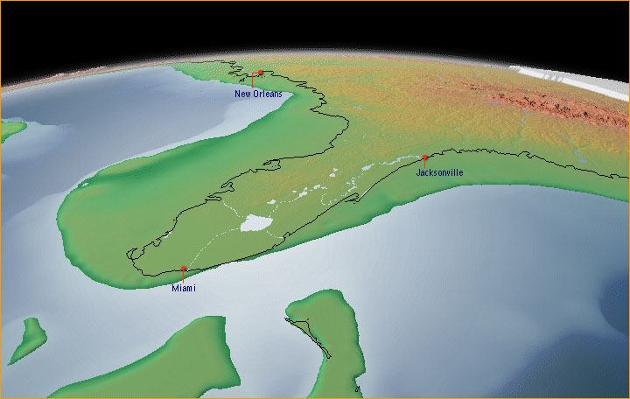
Florida & Eastern Gulf of Mexico Coastline During the LGM
Image Source: PBS - NOVA: Mountain of Ice

Slide 17
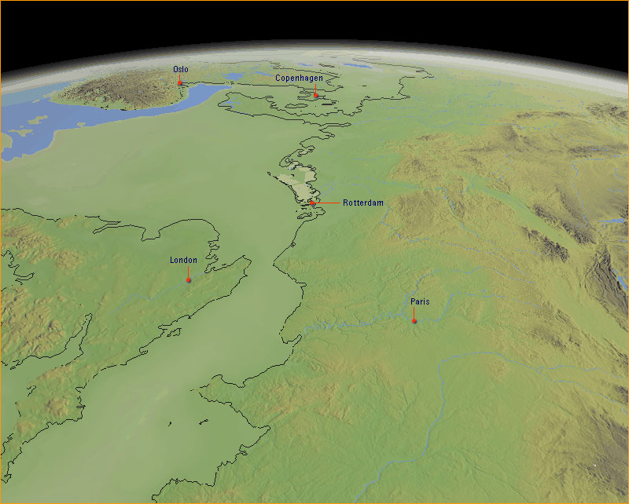
Northern European Coastline During the LGM
Image Source: PBS - NOVA: Mountain of Ice

Slide 18
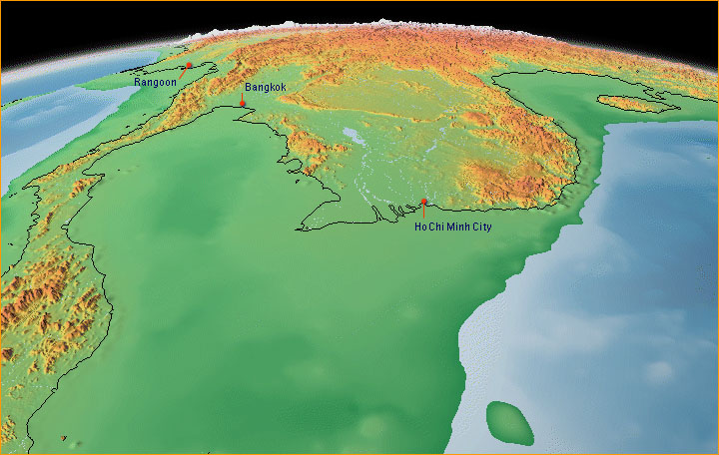
Southeast Asian Coastline During the LGM
Image Source: PBS - NOVA: Mountain of Ice

