Slide 2
Squirrely Numbers: Exploring Arctic Ground Squirrel Data
This PowerPoint is part of a lesson by 2013 PolarTREC teacher Alicia Gillean.
Lesson available at: http://www.polartrec.com/resources

Slide 3
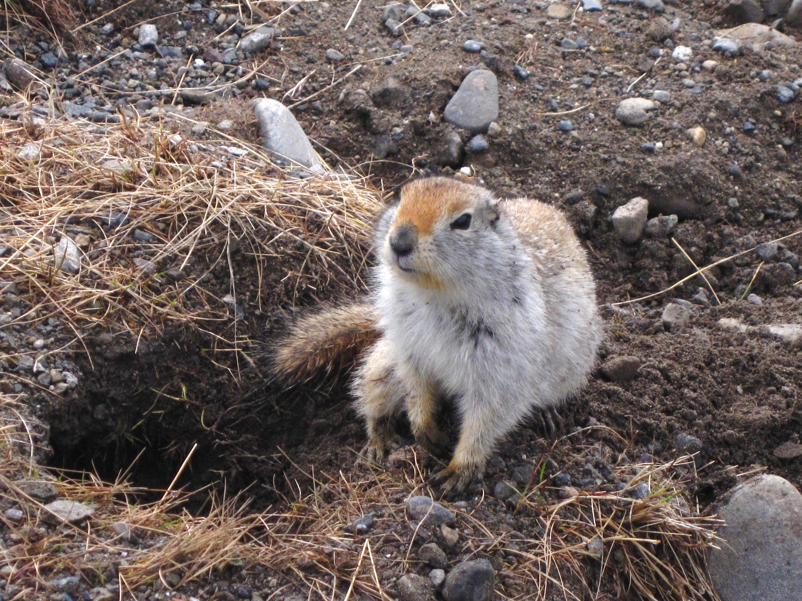

Slide 4
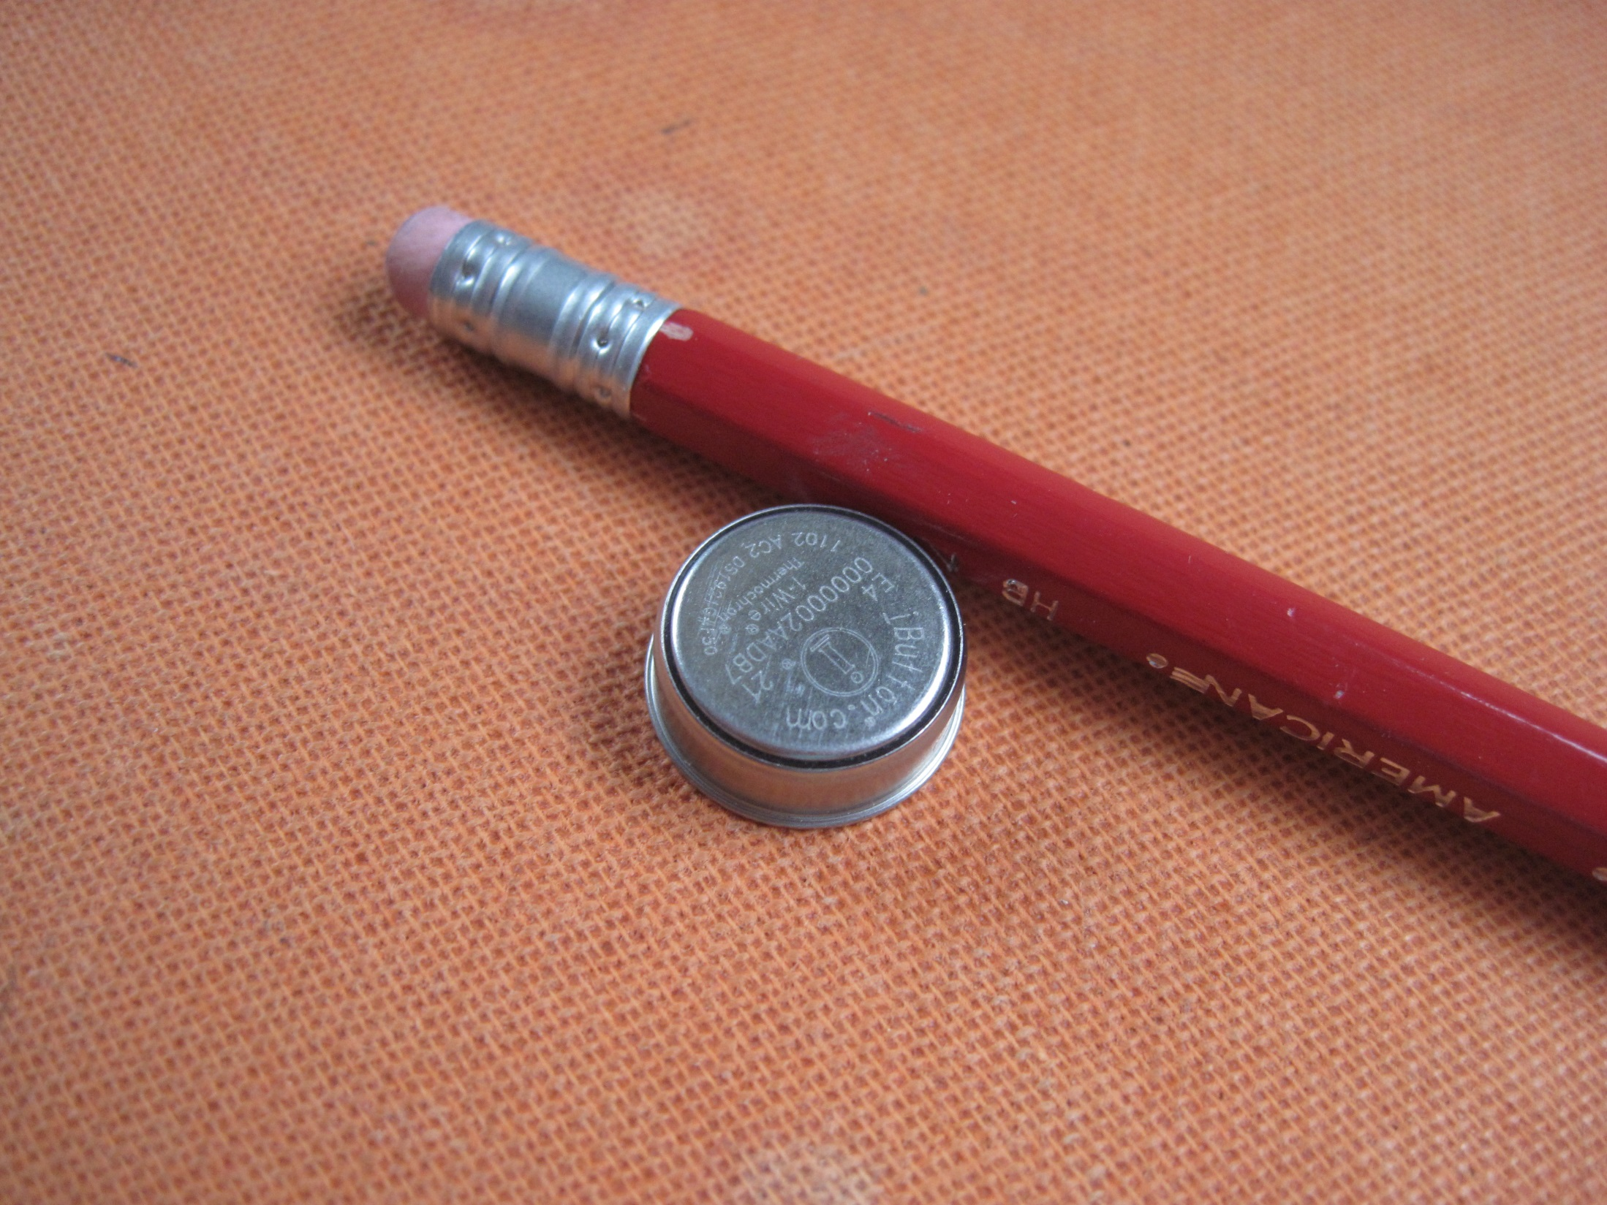

Slide 6
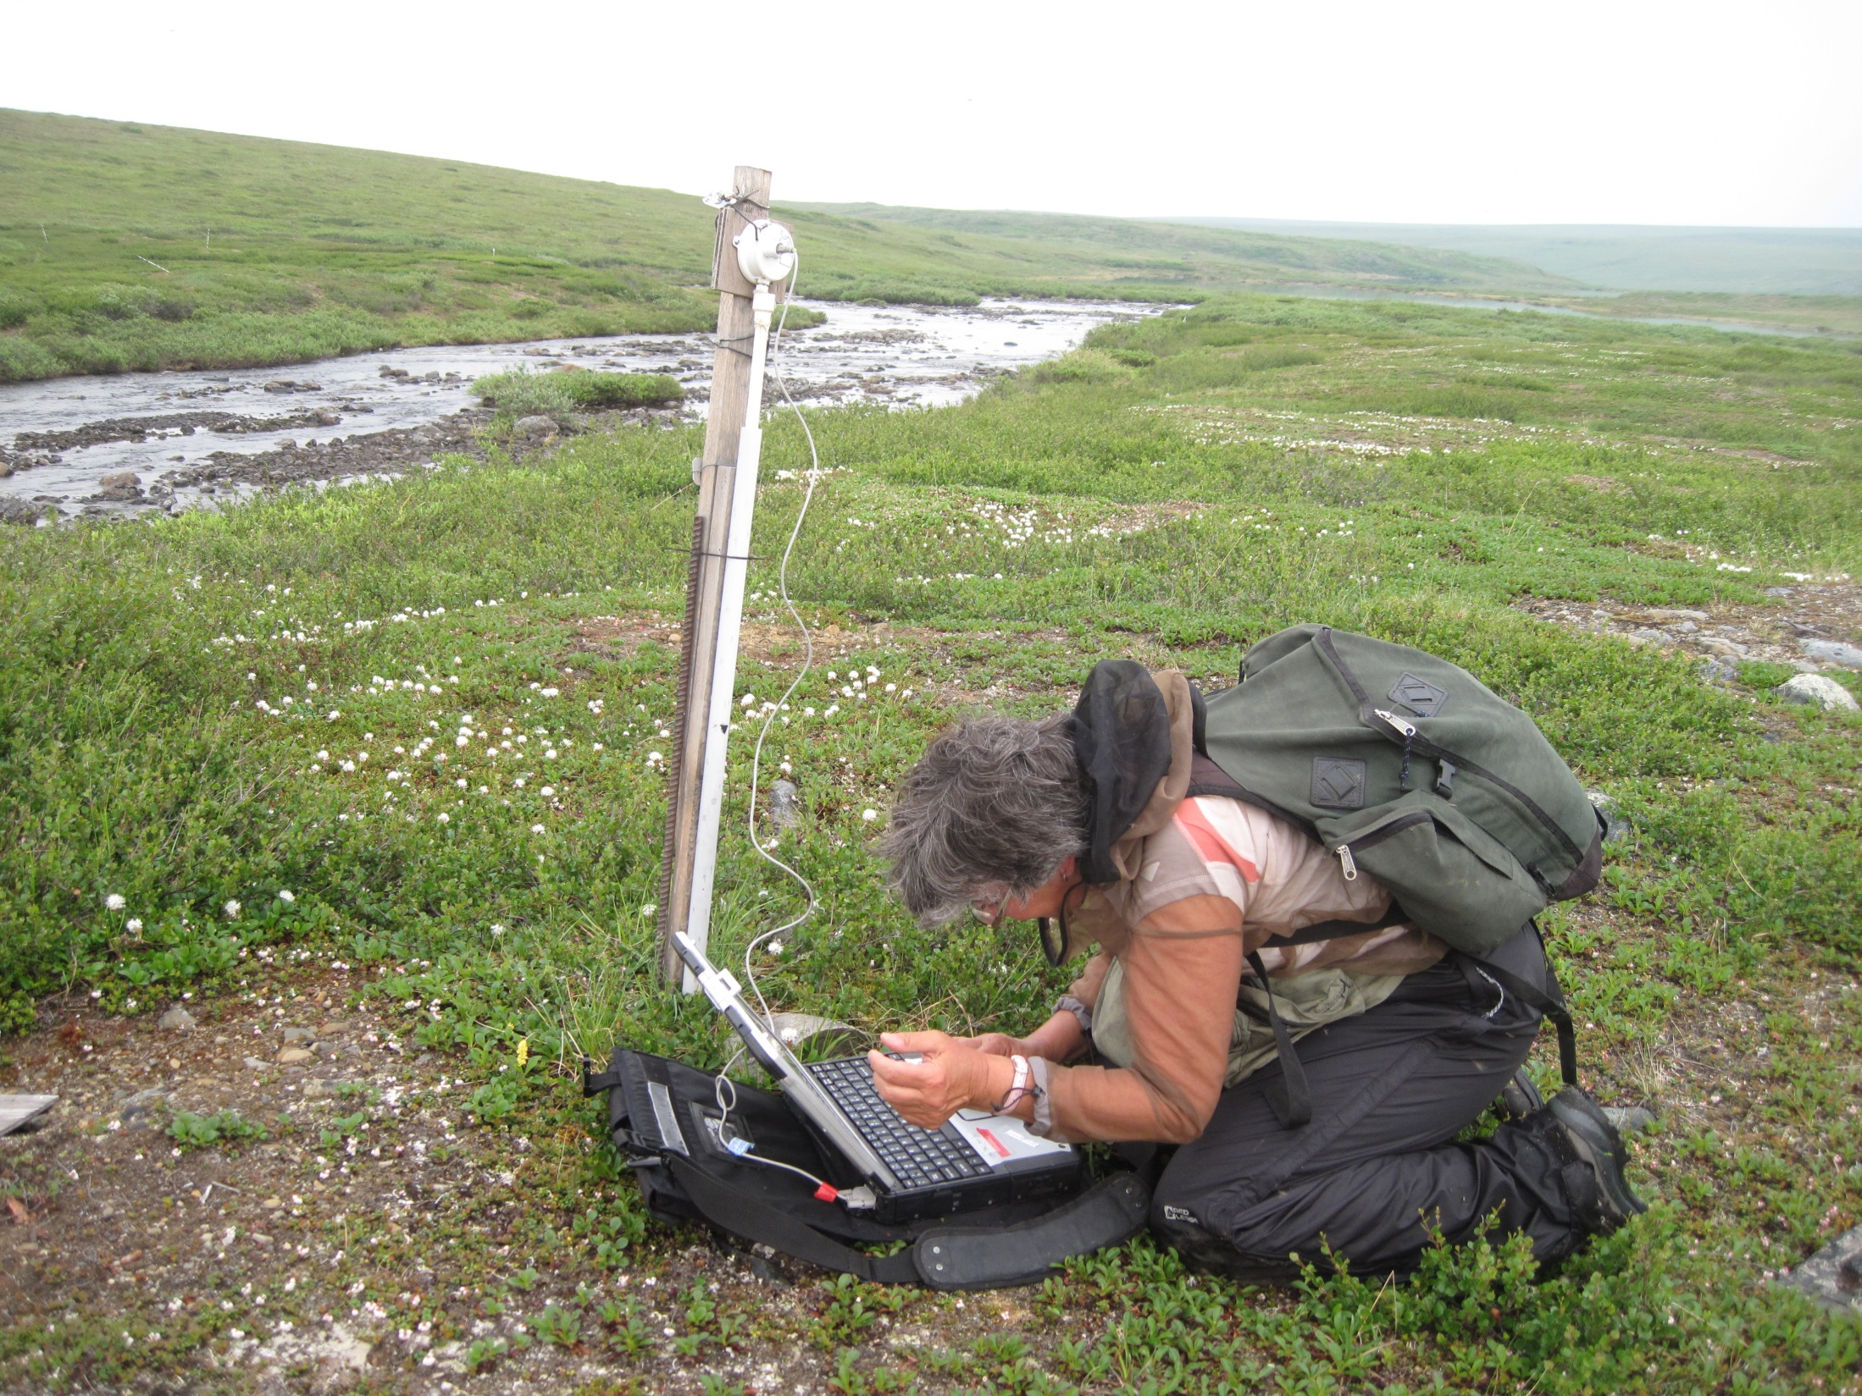

Slide 7
