Slide 1


Thawing Permafrost Lessons & Labs
By Bruce Taterka, West Morris Mendham High School
and Rose Cory, University of Michigan
Version 1. June 13, 2014.
This presentation is meant to be used in conjunction with the companion Thawing Permafrost Lessons & Lab Manual.
Feedback and questions are welcome:
Bruce Taterka: btaterka@gmail.com
Rose Cory : rmcory@umich.edu

Slide 2
Lesson 1 – What is Permafrost?
Thawing Permafrost Lessons & Labs
By Bruce Taterka, West Morris Mendham High School
and Rose Cory, University of Michigan

Slide 3
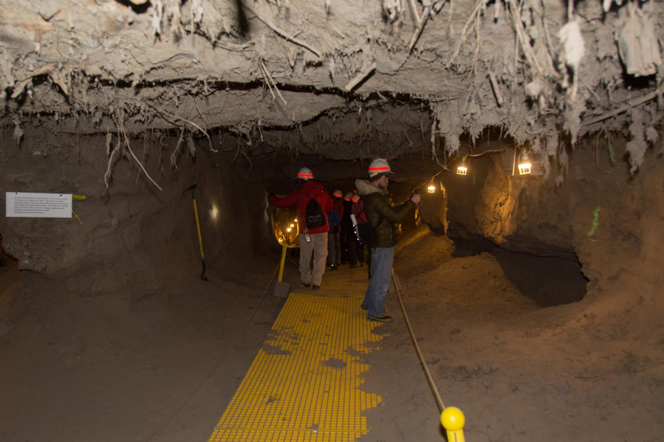

Photo by Zeb Polly
Notes:
This is the permafrost tunnel near Fairbanks, Alaska. http://permafrosttunnel.crrel.usace.army.mil/. You can see roots of ancient frozen plants poking out from the ceiling.
This key point to emphasize is that permafrost contains a huge amount of frozen plant remains, which represents a carbon sink. (1,600 billion tons of C frozen in permafrost, compared to ~800 billion tons in the atmosphere). The tunnel here is approximately 15 meters below ground, and the roots in the ceiling are approximately 10,000 years old.

Slide 4
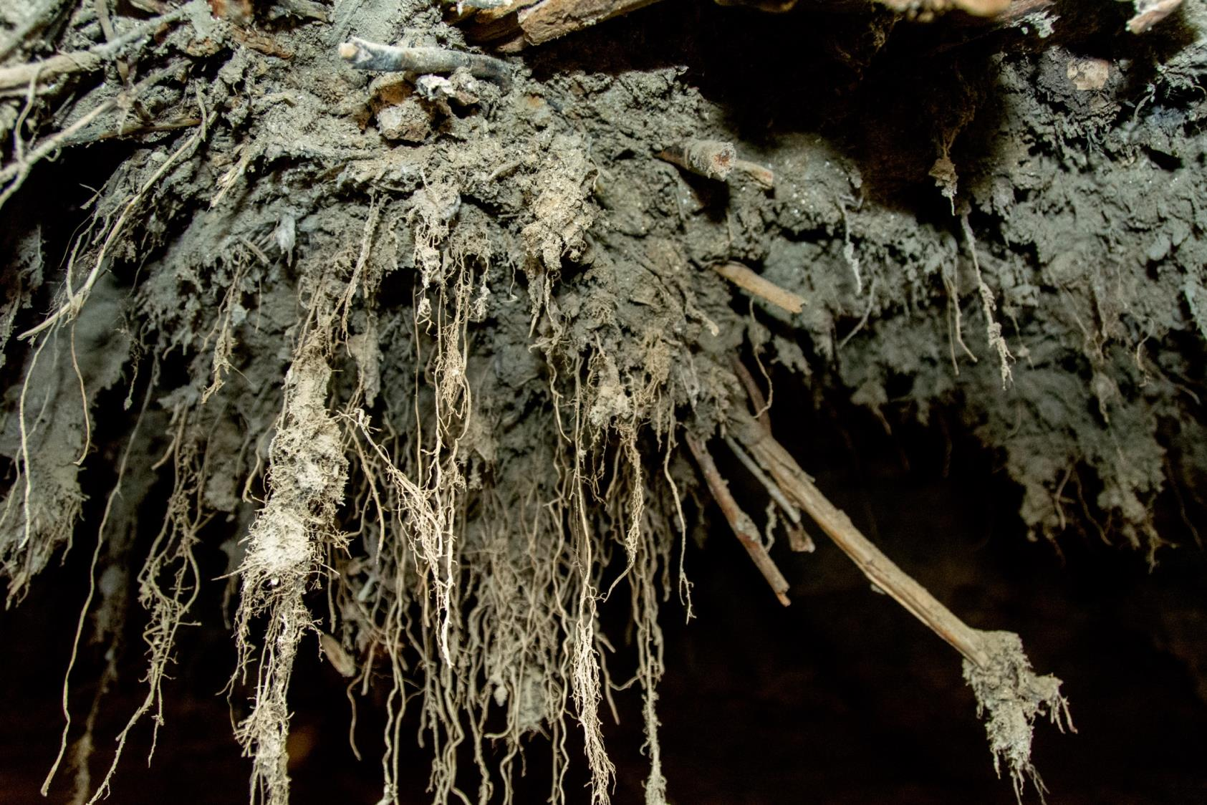
Photo by Zeb Polly
Notes:
Closeup of ancient frozen plant roots in the Permafrost Tunnel. These are approximately 10,000 years old.

Slide 5
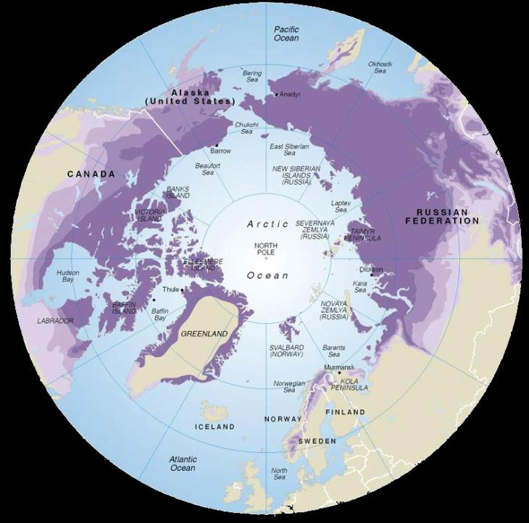
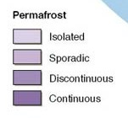
International Permafrost Association, 1998
Notes:
Polar projection map showing extent of permafrost. http://ipa.arcticportal.org/resources.html
Permafrost covers 25% of the earth’s land surface, approximately 23 million km². In some places it can be over 1km deep and 500,000 years old. There is a lot of permafrost, and it plays an important role in the earth’s carbon cycle and global climate. Permafrost is estimated to hold approximately 1,600 billion tons of carbon (1.6 Pg), which is roughly twice the amount contained in the earth’s atmosphere. Thus, permafrost represents a major pool of carbon and could play an important role in global warming as Arctic temperatures increase.
Continuous permafrost has no areas of thawing in between and is typically more than 100 meters thick. Discontinuous permafrost has areas of thawing in between.

Slide 6
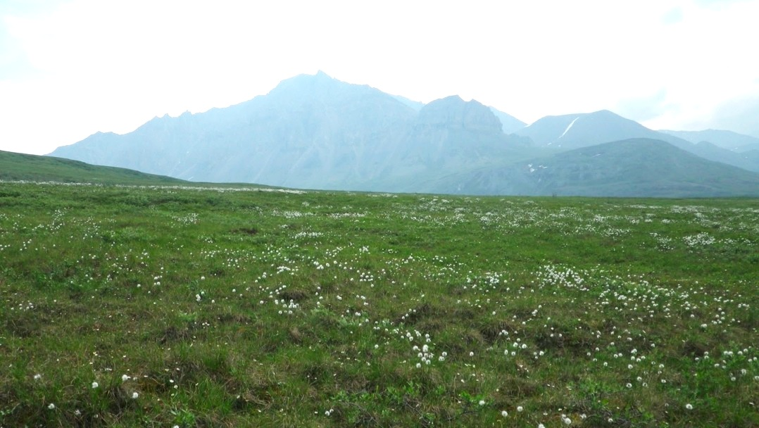






CO₂
respiration
& decomposition
photosynthesis
organic matter
Notes:
This slide shows the C cycle on the tundra. During the short summer growing season, plants convert CO2 from the atmosphere into plant biomass through photosynthesis. At the same time, respiration takes place with animals eating plants and soil bacteria decomposing plant material, putting CO2 back in the air.
In the Arctic, photosynthesis is the dominant process, with more photosynthesis taking place on annual basis compared to respiration. As a result, dead plant material has been building up over the years, frozen into permafrost. Thus, in the earth’s carbon cycle, permafrost is a major sink with ~1,600 billion tons of C stored there.

Slide 7
?
CO₂
CO₂
CO₂
CO₂
~1,600 billion tons C
Notes:
The important question for Arctic ecology and future climate change is, what is going to happen to this giant C sink as the earth’s climate warms?
If it is broken down to CO2 and CH4 (methane), that will increase the greenhouse effect and cause more warming. On the other hand, warming could increase photosynthesis which would reduce atmospheric C.
The focus of the work here is to better understand the fate of C from thawing permafrost, and to learn about the tools scientists are using to try and answer these questions.

Slide 8
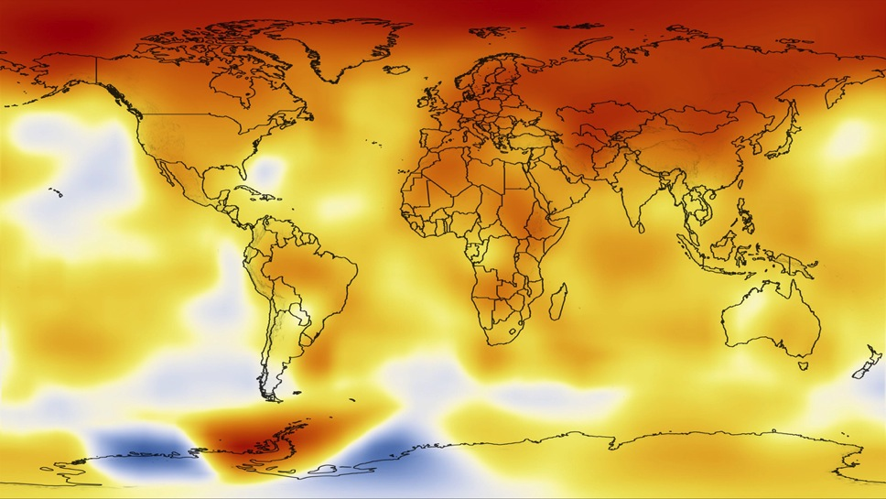

Most intense warming effects are seen in the Arctic
Courtesy of NASA
Notes:
Temperature changes 2000-2009 relative to the 1951-1980 mean. Warmer areas in red, cooler blue. The largest increases occurred in the Arctic and part of the Antarctic. Image courtesy NASA.
http://www.earth.columbia.edu/articles/view/2620
https://www.youtube.com/watch?v=gaJJtS_WDmI

Slide 9
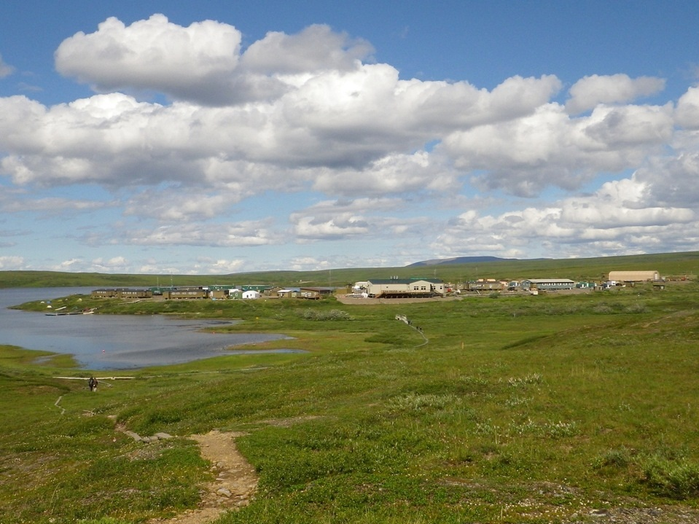
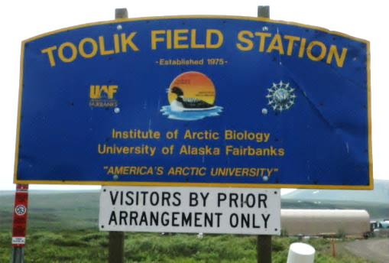
Notes:
This is the Toolik Field Station on Alaskan tundra, where much of the research that went into this presentation took place. Toolik is located on the Dalton Highway on the North Slope of Alaska, between the Brooks Range and the Arctic Ocean.

Slide 10
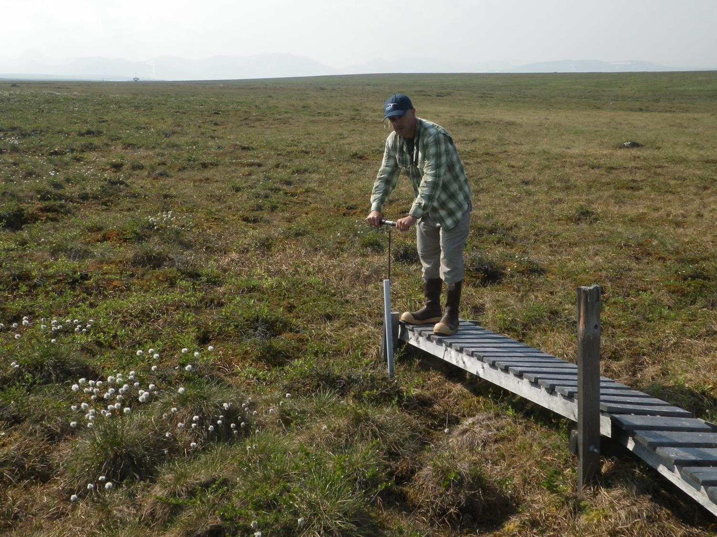
Measuring thaw depth
Notes:
This is how the depth of the active layer is measured. The metal probe is pushed into the ground until solid permafrost is hit, and the depth is read off the probe in cm.

Slide 11
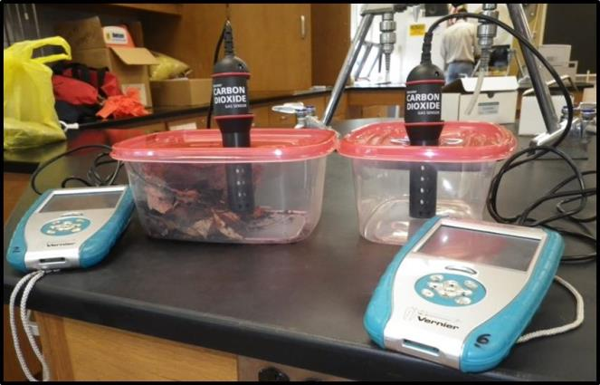
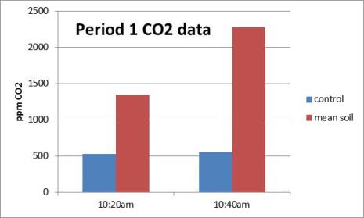
Control
Container with leaf litter
Figure 1. Soil respiration experimental setup & results.

Slide 12
Lesson 2 – Climate Feedback Loops
Thawing Permafrost Lessons & Labs
By Bruce Taterka, West Morris Mendham High School
and Rose Cory, University of Michigan

Slide 13

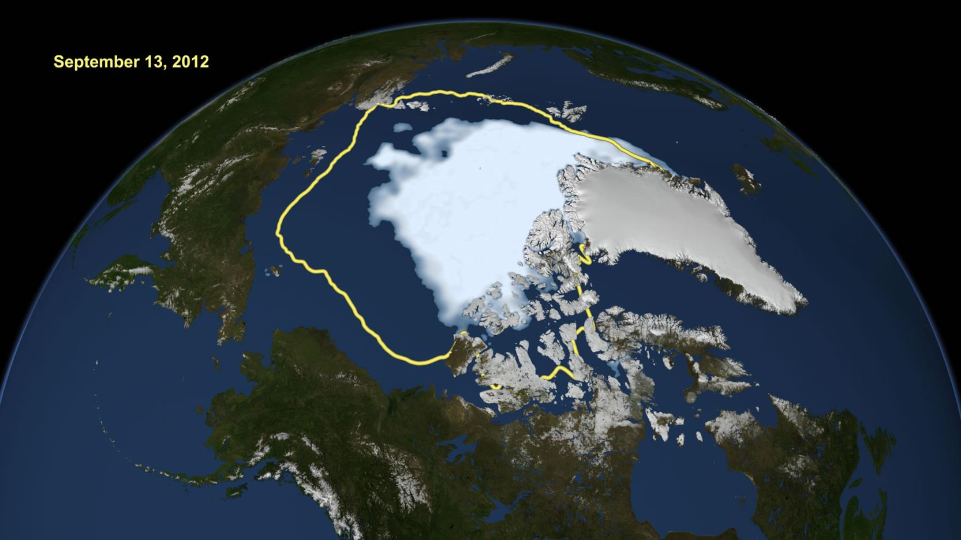
Heat reflected into space keeps earth cool
September 1979
September 2012
Open ocean absorbs heat
And so on ...
Climate warms
More ice melts
Notes:
This is an illustration of a positive feedback loop in the earth’s climate system.
How it works:
The polar ice cap is white, which naturally reflects sunlight back into space. This has a cooling effect on the earth’s climate system.
The ocean, on the other hand, is dark, which naturally absorbs sunlight. This has a warming effect on the earth’s climate system.
As climate warms more polar ice melts, which creates more open ocean. With less ice and more ocean, less sunlight is reflected and more heat is absorbed, further warming climate. As climate further warms, more ice melts, causing less reflection and more absorption of sunlight, causing more warming. And so on.

Slide 14

Thawing permafrost releases CO₂
More CO₂ causes warmer temperatures
And so on ...
Warmer temperatures increase thawing permafrost
Notes:
Another positive feedback loop in the earth’s climate system.
How it works:
As climate warms permafrost thaws, releasing frozen C to the atmosphere as CO2 (and CH4). More CO2 increases the greenhouse effect, further warming climate. As climate further warms, more permafrost thaws, increasing the greenhouse effect and causing more warming. And so on.

Slide 15
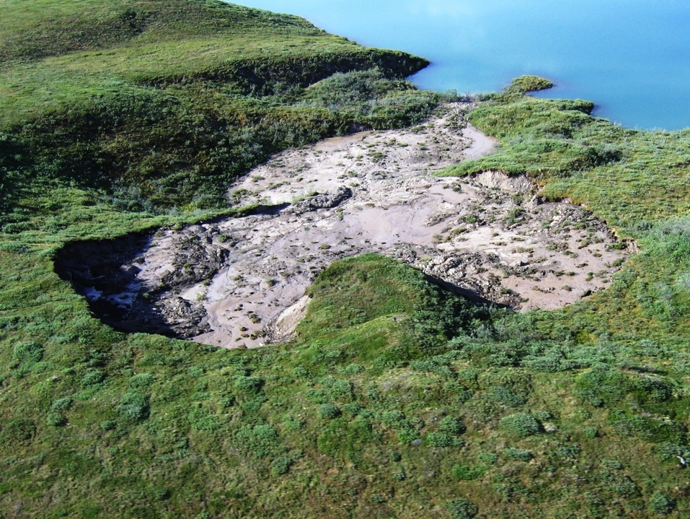
“Thermokarst”
Notes:
This is an example of permafrost thawing – a “thermokarst” feature, like a sinkhole where there permafrost has thawed and collapsed. Photo taken near the Toolik Field Station.

Slide 16
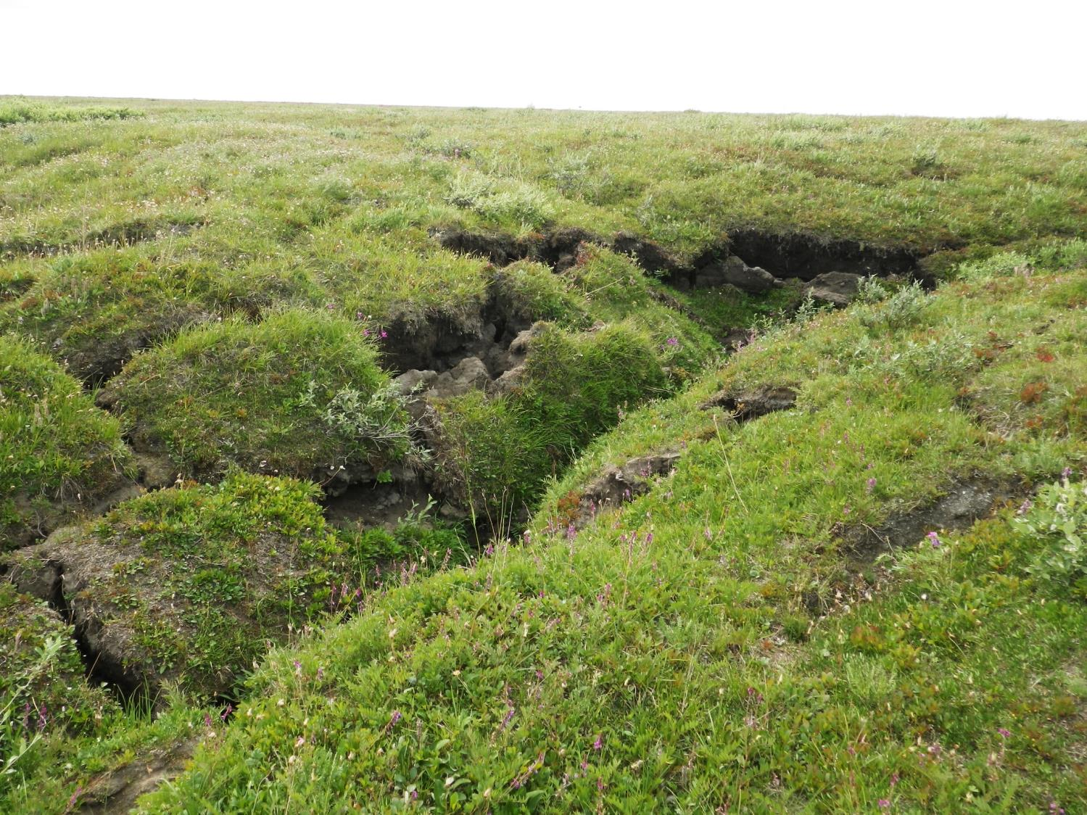
Notes:
Slumping tundra caused by thawing permafrost.

Slide 17
Lesson 3
Dissolved Organic Matter in Natural Waters
Thawing Permafrost Lessons & Labs
By Bruce Taterka, West Morris Mendham High School
and Rose Cory, University of Michigan

Slide 18
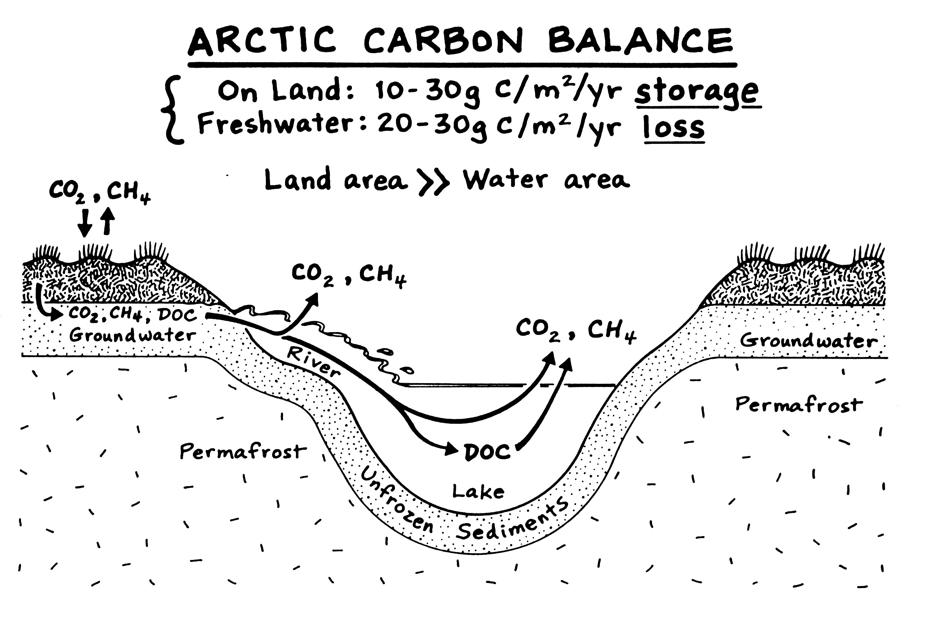
Arctic Carbon Balance
On Land: 10 – 30 g C/m²/yr storage
Freshwater: 20 – 30 g C/m²/yr loss
Notes:
MAIN POINT - When permafrost thaws, the C that has previously been frozen now becomes a participant in the C cycle. It can be converted to CO2 & CH4, or become dissolved organic matter DOM in groundwater and surface water. From there, it can be converted into CO2 & CH4, be buried in lake sediments, or flow out to the ocean. The role of surface water in the Arctic is critical to the C cycle, because research indicates that on an annual basis C is lost from the water to the air, while on land the flow is the opposite with C flowing from air to land.

Slide 19
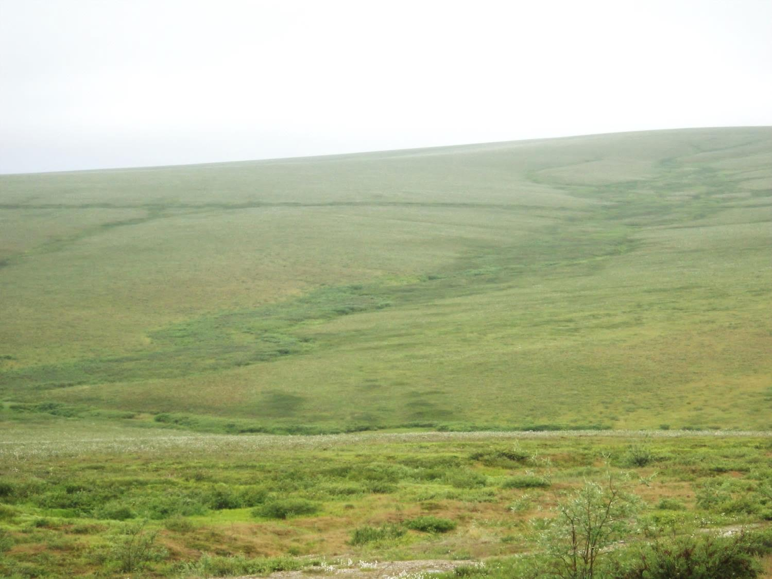
Water Tracks
Notes:
The point of this and the next 2 slides are to show the flow of DOM in water on the tundra. To understand the flow of C in the Arctic C cycle, we must follow the C from the moment the permafrost thaws. One of the first steps in the movement of C from thawing permafrost is as DOM in groundwater. Groundwater flow on the tundra is indicated by water tracks.

Slide 20
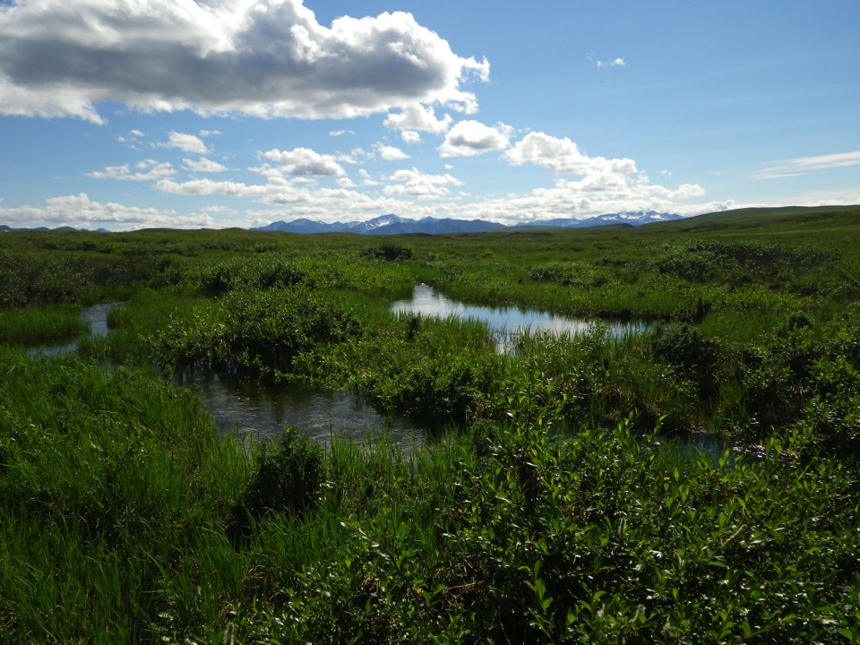
Ponds & Wetlands
Notes:
Water tracks flow into tundra ponds and wetlands.

Slide 21
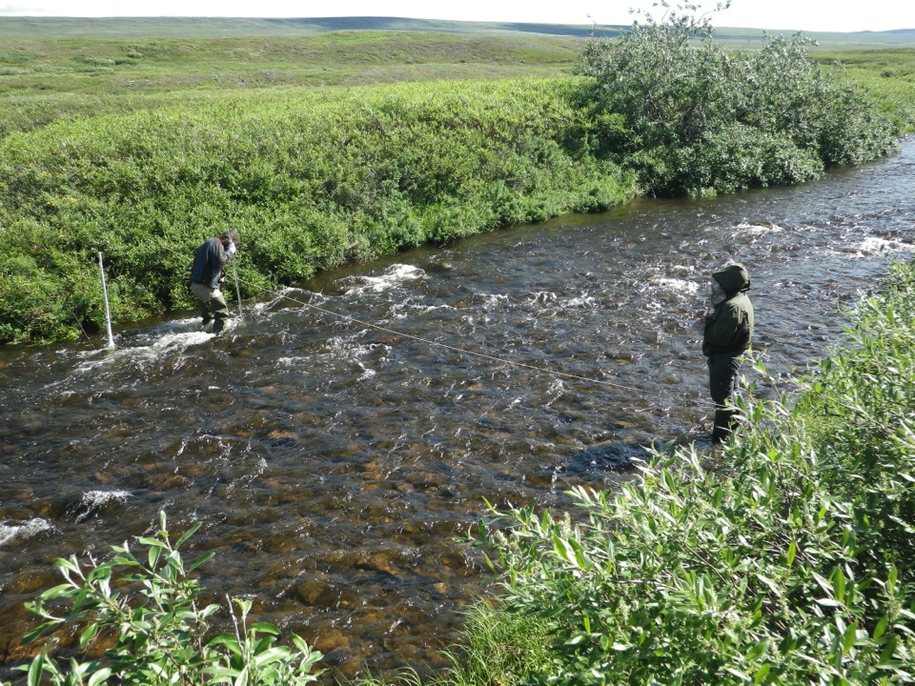
Notes:
In this picture, scientists are measuring the width of a stream to calculate flow rate. Ponds & wetlands flow into streams and lakes, and eventually to the ocean. To understand the overall C cycle, it is important to measure C concentrations in surface water and the rate at which water flows.

Slide 22
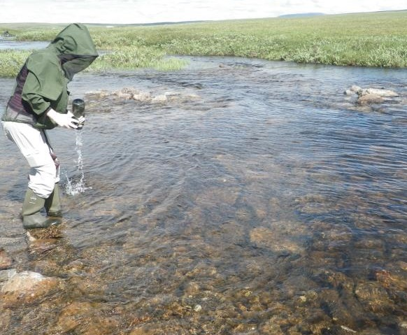
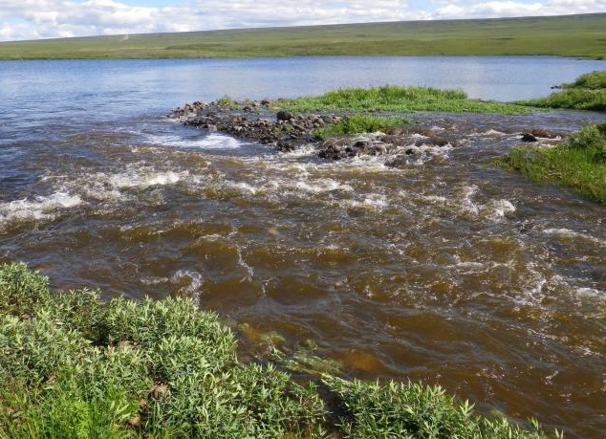
Lake I-8 outlet
Lake I-8 inlet
Notes:
The point of this slide is to show how water quality changes as it flows across the tundra. At bottom right is a turbid stream flowing into Lake I-8, near the Toolik Field Station. At top left is clear water flowing out of Lake I-8. The question is, where did the turbidity go and organic matter in the inflow? Did it settle at the bottom of Lake I-8? Was it consumed and converted to CO2? Did it change into something else? These questions need to be answered to understand the fate of C from thawing permafrost.

Slide 23
Global Carbon Cycle
Numbers are in billions of tons of C
Land (plants & soil)
2,400
Fossil Fuel + Land Use 9/yr
Atmosphere
860
Permafrost
soils
1,600
Photosynthesis minus respiration 3/yr
2.2/yr
Land to water 2.7
Evasion 1.2
Oceans
39,000
Rivers 0.7
Lakes
150
Lake and
river burial
0.6 – 1.6 / yr
Hansell 2002, Canadell et al. 2007, Battin et al. 2009, Aufdenkampe et al. 2011, Tarnocai et al. 2009, Batjes 1996
Notes:
23
MAIN POINT – The real driver of climate warming is the human input of heat trapping gases to the atm, now at a rate of ~9 Gt per year, and this perturbation has reached the point where other parts of the natural cycle are poised to change their behavior. For example, much of this tremendous store of carbon in high latitude soils has been encased in permafrost for many thousands of years, but as climate warms the permafrost melts and that C can once again participate in the C cycle and potentially cause a positive feedback that drives more rapid warming. The outstanding question then, is what is the arc of change of these feedbacks and how will they determine Earth’s climate in the next 50-100 years. Another perspective on the importance of this change is that, given the increasing pressure for international climate treaties to limit CO2 emissions, consider that to stabilize at 450 ppm CO2, about a 3C warming, the world can emit another 45 Gt of C. This amount could easily come from the C stored in permafrost, meaning that nations who share arctic territory may be severely constrained in their emissions and energy policies on the global stage.
What we learned in the Arctic through our LTER program has changed the way we view the global carbon cycle in that land to water transfers are large, and we have added an important term which is the return of C from freshwaters to the atmosphere.
Note that these land-water-atm fluxes are roughly equal to the other major net exchanges with the atm, the uptake by oceans and by land.
And within this role of surface waters there is a critical point, a “triple point”, where organic C from land is either oxidized to CO2 and returned to the atmosphere, buried in lake or river sediments, or partially altered and exported to the ocean.
AT THE LEVEL OF OUR LTER, WE ARE ORGANIZED SO THAT THE TERRESTRIAL GROUP IS INVESTIGATING THE C BALANCE ON LAND, AND THE AQUATIC GROUPS ARE LOOKING AT THE IMPACTS OF MATERIALS BROUGHT IN FROM LAND, AND THE LW GROUP IS INTEGRATING THESE TERRESTRIAL AND AQUATIC PIECES IN ORDER TO UNDERSTAND THE LANDSCAPE-LEVEL C BALANCE AND ITS CHANGES OVER TIME.
-------------------------------------
In our land-water research we started by examining the controls on the production of dissolved C on land and its export to lakes and streams.
Key control point of C cycling is at the point where inputs from land have different fates – evasion as gas, storage in sediments, transport as DOC to oceans.
-----------------
I want to set the stage for carbon cycling by reviewing this global diagram showing the modern, active C cycle.
The largest pool of C is in the ocean, but it also has the slowest turnover. The ocean also has the largest amount of dissolved organic carbon (DOC), roughly equivalent to the C pool in the atmosphere.
There is also a large pool of C stored in frozen soils in the Arctic and boreal zones, that is also about equivalent to the C in the atmosphere.
If you look at the net fluxes between the atm and oceans and atm and land, they are comparable and on the same order of magnitude as the amount of dissolved organic carbon moved from land to water, or the amount of land carbon converted to CO2 and released to the atmosphere from surface waters (point to evasion), or the amount of DOC that is moved from land to oceans worldwide.
Today I will talk about the specific controls on this degradation of DOM and its conversion to CO2 and why this process matters for the release of frozen carbon stored in arctic soils as the arctic warms.
+++++++++++++++++++++++++++++++++
The real driver of climate warming is the human input of heat trapping gases to the atm, now at a rate of ~9 Gt per year. This perturbation to the global C cycle has reached the point where other parts of the natural cycle are poised to change their behavior. For example, much of this tremendous store of carbon in high latitude soils has been encased in permafrost for many thousands of years, but as climate warms the permafrost melts and that C can once again participate in the global C cycle, potentially causing a feedback that drives more rapid warming. The outstanding question then, is what is the arc of change of these alterations in the carbon cycle, and how will they determine the climate of our world in the next 50-100 years. Another perspective on the importance of this change is that, Given the increasing pressure for international climate treaties to limit CO2 emissions, consider that to stabilize at 450 ppm CO2, about 3C increase, the world can emit another 45 Gt of C. This amount could easily come from the C stored in permafrost, meaning that nations who share arctic territory may be severely constrained in their emissions and energy policies on the global stage.
[This is one of the reasons why climate change in general, and the arctic C cycle has generated some of the most intense scientific and social debates of our time.]
This is a relatively simple portrayal of the climate system, and the actual understanding of the role of the Arctic requires tremendous intellectual investment because, it isn’t simple… (next)
This new evasion term is substantial when you consider that it is 25% of the total C moving from land to oceans each year. And the total flux to the ocean, which is about half inorganic and half organic C, coupled with the evasion is half of the ocean sink. All this C originates on land, and is processed as it moves across the landscape. Given that, we have been following this simple conceptual diagram to guide our research on C cycling.
Consider this diagram of the arctic C cycle that Dave McGuire and others put together recently. It has stocks and flows of C, but it doesn’t represent the key questions, one of which is “where in this system are the most important control points on the trajectory of future change in C and N cycling? What I want to do today is to synthesize work we’ve done near Toolik Lake not to answer this question outright, but to perhaps help us focus our research motivations, questions, and efforts more precisely.
We also found that From a mass balance perspective, DOM is an important flux in the global carbon cycle. Here is a diagram of the fluxes of C between the major pools; it shows photosynthesis and respiration on land and in the oceans, atmospheric inputs due to the burning of fossil fuel, and this yellow arrow then shows the total transfer of dissolved C from land to water, so both organic and inorganic forms: about half of which is DOC. Compared to absolute fluxes of photosynthesis and respiration, it is relatively small, but when compared to net fluxes,
===============================================================================================
Here is representation of the global C cycle.
1)source of E and building block of all living organisms and is intimately linkeed with the O2 cycle- important for reduction oxidation reactions.
2)Understanding regional cycles can give insights into ecological processes- primary production, nutrient and water cycling
this diagram represents the major pools of C in the bioshpere
ocean is the largest pool, slight sink, taking in ~ 2 Pg C per year
terrestrial C. 200 of this is in thearctic
Atmosphere is a relatively small pool- increasing about 3 per year .
(arrows)Fluxes: ps balanced by respiration of above ground biomass and soils.
Burning of fossil fuels and deforestation adding to atmoshperic pool
Not balanced. So clearly there is more we need to learn about c cycling.
Flux from land to water is what I will be focusing on. Lots of measurements made
~90% is in the dissolved rather than the particulate (based on size)
- what controls this flux?
If you look at the dominant fluxes into and out of the terrestrial biosphere, the Arctic component is not very noteworthy (0.8 Pg NPP, probably 2 GPP – 2% of total flux). However, if you instead consider the potential for contributing to the net fluxes (current net flux into the atm is the one of most concern), then the northern latitudes stand out due to the great stores of C that are currently locked up in permafrost soils. In other words, these pools are not currently engaged in C cycling on very short time scales, similar to the deep ocean stores of C. But the potential for melting permafrost due to global warming, and injecting an amount of C into the atmosphere that could greatly increase the current atm stock, is a very real concern and provides some justification for understanding how C cycling currently operates in the Arctic.
From a mass balance perspective, DOM is an important flux in the global carbon cycle. Here is a diagram of the fluxes of C between the major pools; it shows photosynthesis and respiration on land and in the oceans, atmospheric inputs due to the burning of fossil fuel, and this yellow arrow then shows the total transfer of dissolved C from land to water, so both organic and inorganic forms: about half of which is DOC. Compared to absolute fluxes of photosynthesis and respiration, it is relatively small, but when compared to net fluxes it is pretty large, up to 40% of the net balance globally with the atmosphere (0.8/2 Pg sink) ignoring human additions.
DOC export to ocean is estimated using total C value of rivers and groundwater of 0.9 Pg/yr, and a IC/OC ratio of ~0.5 (Cole et al. 2007), and then taking a ratio of DOC/TOC of 0.5 (Seitzinger et al. 2005). That gives 0.9 * 0.5 * 0.5 = 0.225 Pg/yr
=======================================================
OLD MATERIAL -- I want to set the stage with this figure representing the global C cycle. If you look at the dominant fluxes into and out of the terrestrial biosphere, the Arctic component is not very noteworthy (0.8 Pg NPP, probably 2 GPP – 2% of total flux). However, if you instead consider the potential for contributing to the net fluxes (current net flux into the atm is the one of most concern), then the northern latitudes stand out due to the great stores of C that are currently locked up in permafrost soils. In other words, these pools are not currently engaged in C cycling on very short time scales, similar to the deep ocean stores of C. But the potential for melting permafrost due to global warming, and injecting an amount of C into the atmosphere that could greatly increase the current atm stock, is a very real concern and provides some justification for understanding how C cycling currently operates in the Arctic.
From a mass balance perspective, DOM is an important flux in the global carbon cycle. Here is a diagram of the fluxes of C between the major pools; it shows photosynthesis and respiration on land and in the oceans, atmospheric inputs due to the burning of fossil fuel, and this yellow arrow then shows the total transfer of dissolved C from land to water, so both organic and inorganic forms: about half of which is DOC. Compared to absolute fluxes of photosynthesis and respiration, it is relatively small, but when compared to net fluxes it is pretty large, up to 40% of the net balance globally with the atmosphere (0.8/2 Pg sink) ignoring human additions.
DOC export to ocean is estimated using total C value of rivers and groundwater of 0.9 Pg/yr, and a IC/OC ratio of ~0.5 (Cole et al. 2007), and then taking a ratio of DOC/TOC of 0.5 (Seitzinger et al. 2005). That gives 0.9 * 0.5 * 0.5 = 0.225 Pg/yr

Slide 24
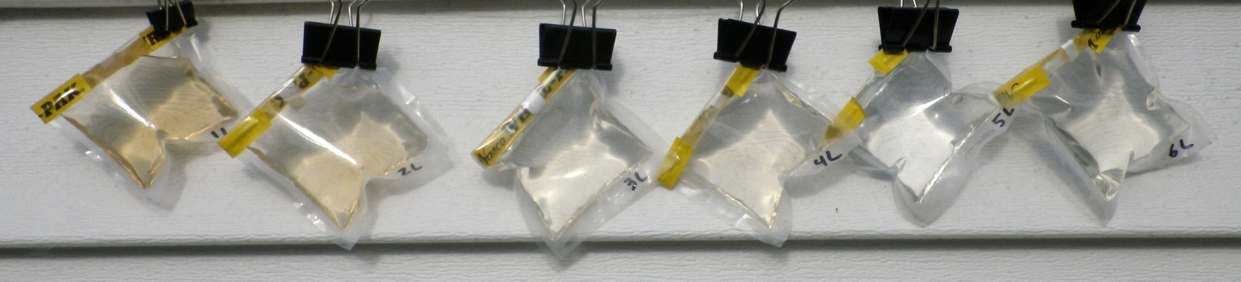
An example of natural waters containing a range of DOM from Chester, NJ

Slide 25
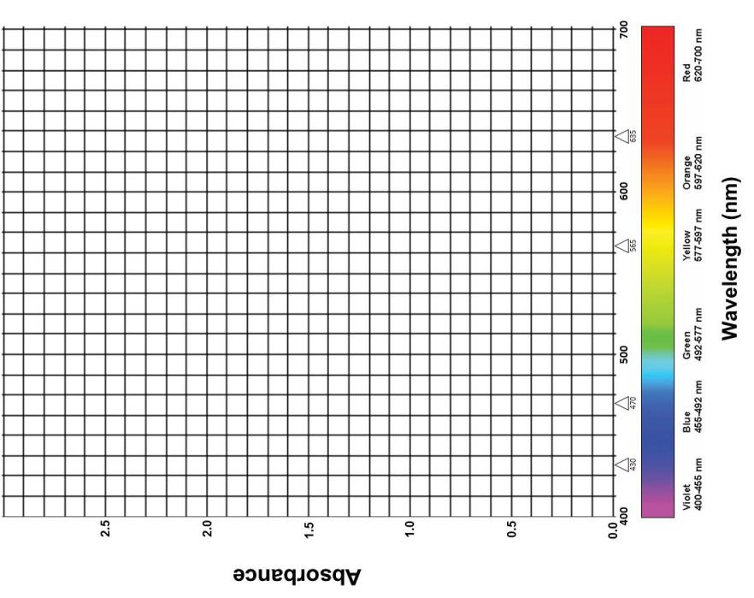

Slide 26
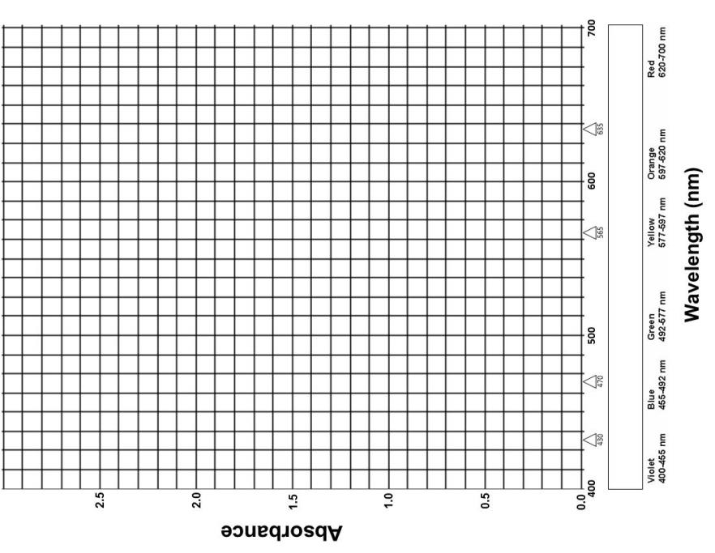

Slide 27
Lesson 4
Effect of Sunlight on Organic Molecules
Thawing Permafrost Lessons & Labs
By Bruce Taterka, West Morris Mendham High School
and Rose Cory, University of Michigan

Slide 28
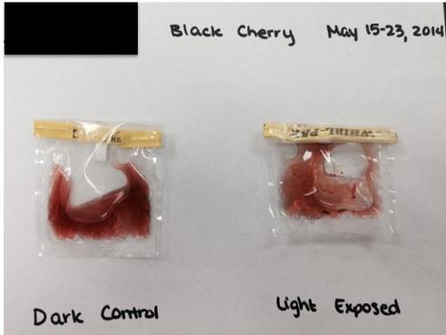
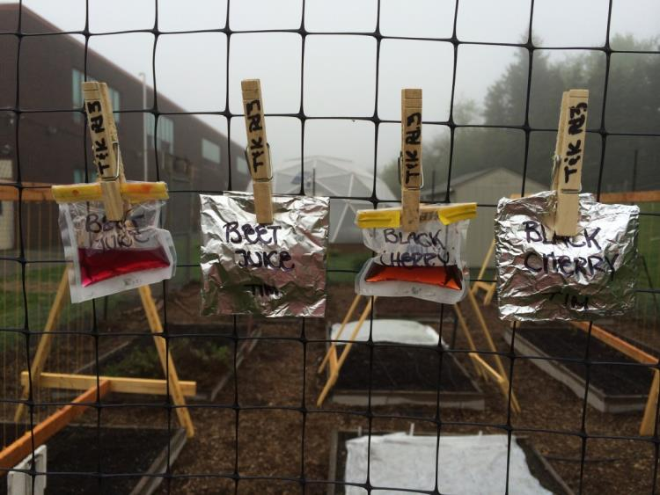
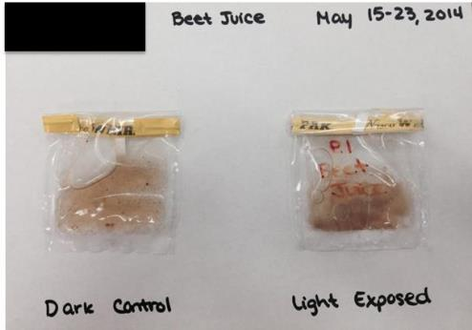
Light and dark samples of black cherry soda after being left outside from May 15-23.
Experimental setup. Light and dark samples of natural beet juice on left; light and dark samples of black cherry soda on right. Samples were exposed to sunlight from May 15-23.
Light and dark samples of beet juice after being left outside from May 15-23.
Notes:
Experimental setup to measure the effect of sunlight on organic molecules.

Slide 29
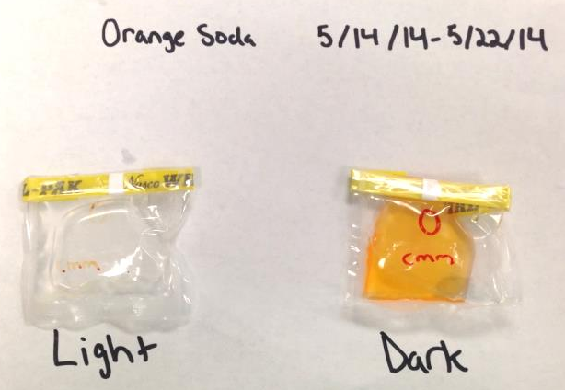
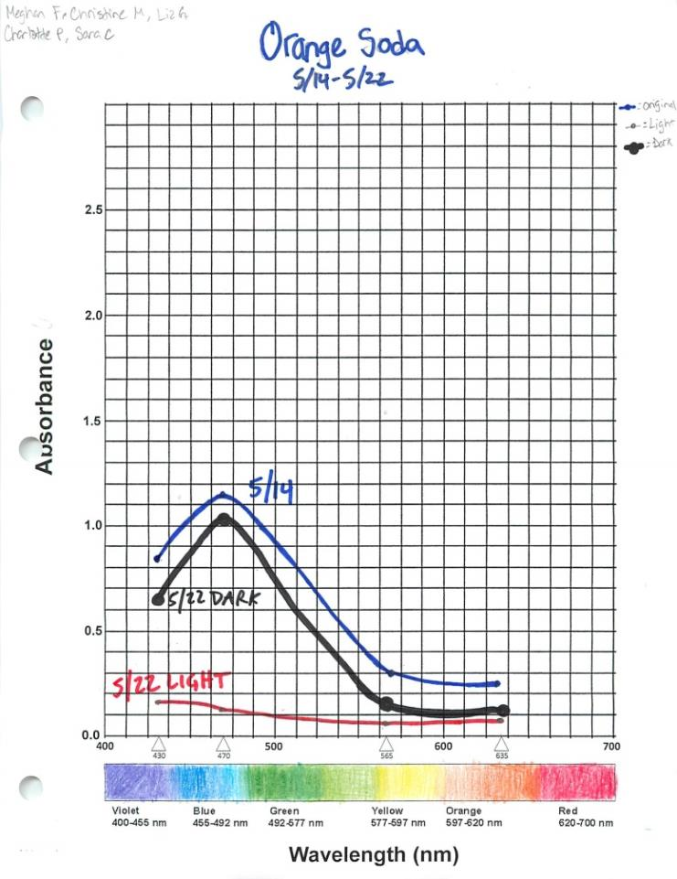
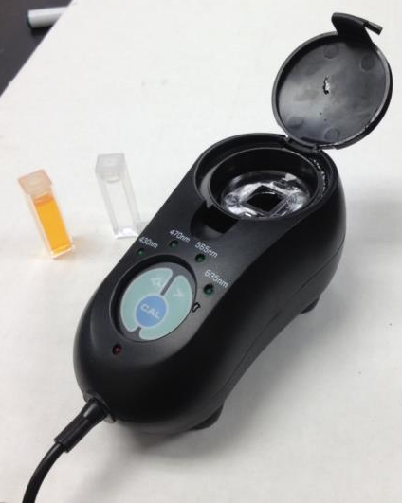
Student graph showing absorption curves for orange soda on May 15 (blue), and dark and light-exposed samples on May 22 (black and red).
Light and dark samples of orange soda after being left outside from May 15-23.
Cuvettes holding samples of light-exposed and dark orange soda to be analyzed for light absorption at 430, 470, 565, and 635 nm.
Notes:
Note that orange soda looses its color after being photo-exposed for a week, while dark sample retains almost all color. Colorimeter allows quantification of visual observations.

Slide 30
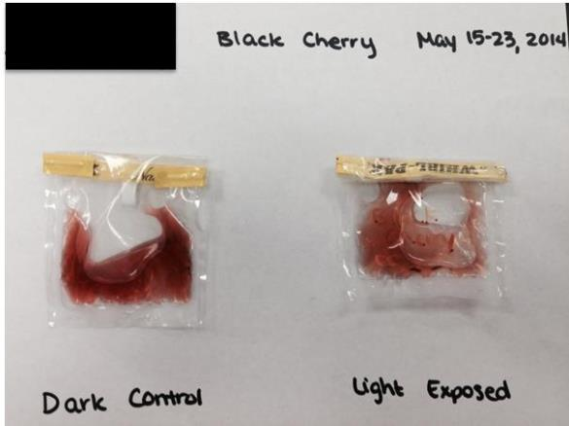
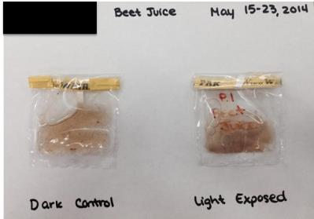
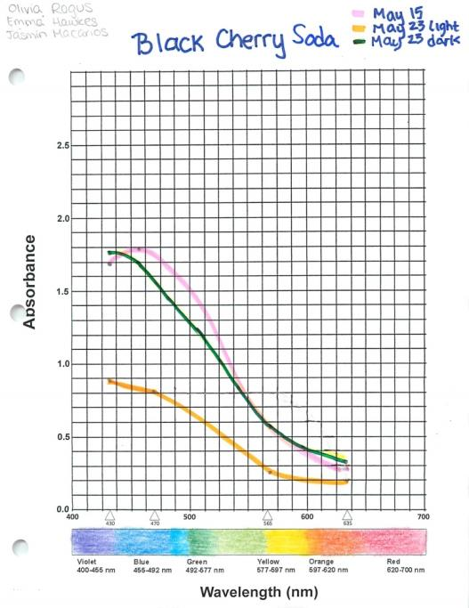
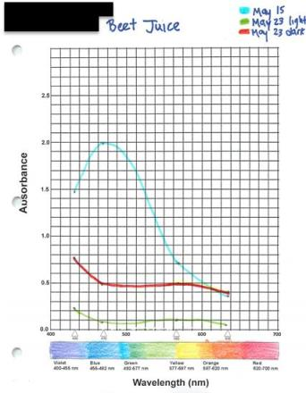
Photos of light-exposed and dark control samples of black cherry soda and beet juice, along with absorption graphs.

Slide 31
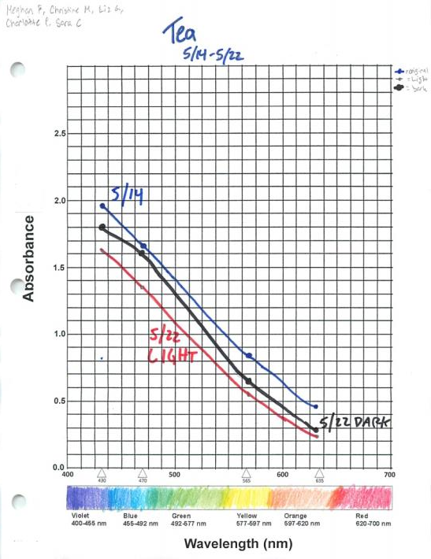
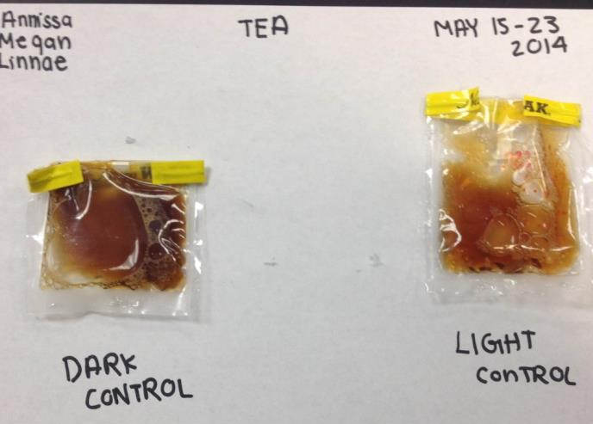

Slide 32
Lesson 5
Respiration from Natural Waters
Thawing Permafrost Lessons & Labs
By Bruce Taterka, West Morris Mendham High School
and Rose Cory, University of Michigan

Slide 33
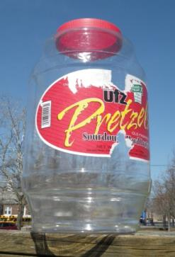
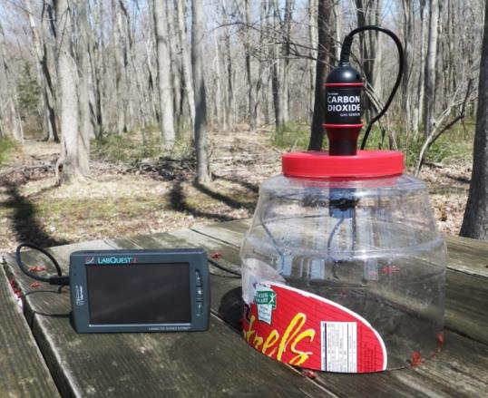
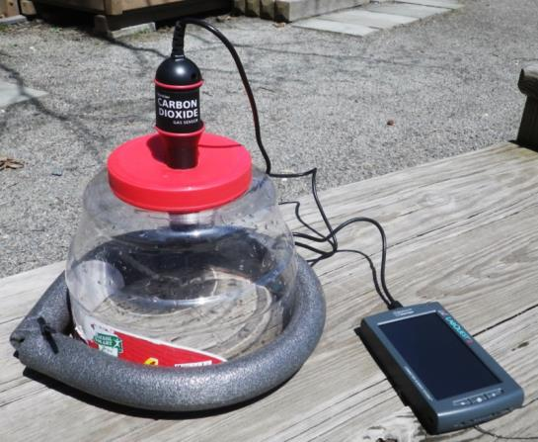
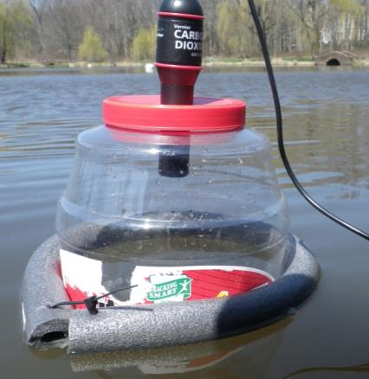
Instructions for Floating CO₂ Chamber
Step 1. Get a large plastic pretzel barrel and cut it in half, or use a plastic storage container or file box.
Step 2. Cut a hole in it to fit your CO₂ sensor
Step 3. Wrap a piece of foam pipe insulation around container for stability. Tape or attach with cable tie.
Step 4. Float it! You can tell if it’s tight if there’s suction when you pull it from the water.

Slide 34
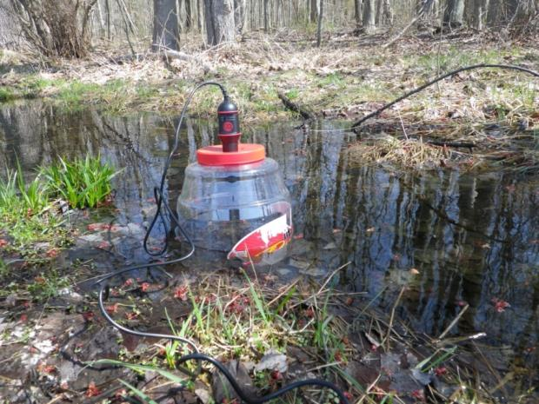
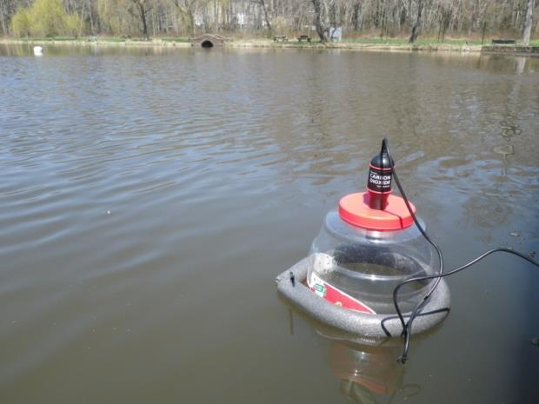
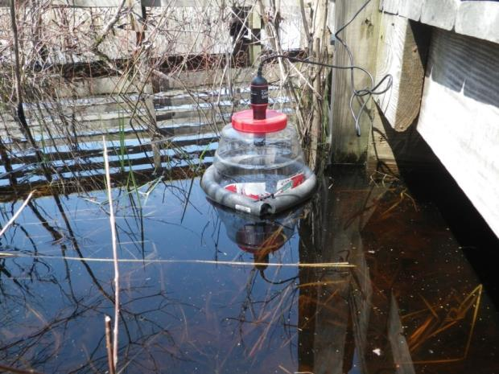
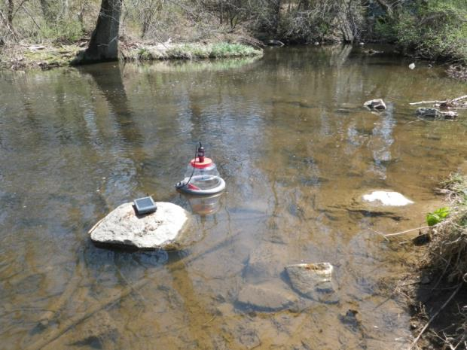
Vernal pool
Pond
Swamp
Brook

Slide 35
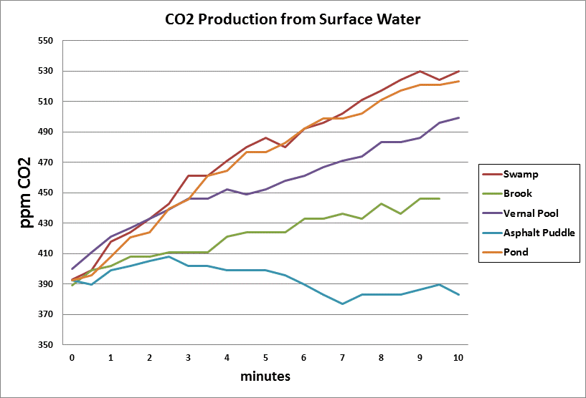

Slide 36


