Slide 1
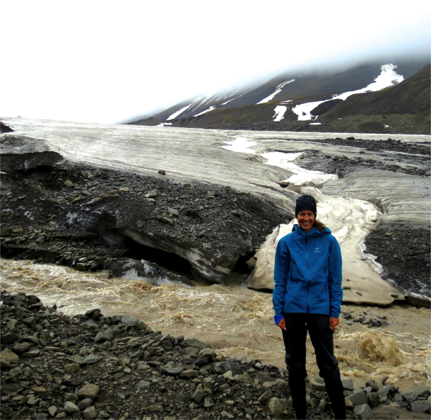
“I think it's much more interesting to live not knowing than to have answers which might be wrong.”
-Richard P. Feynman
Notes:
It is fun to not know things because then you have much to try to figure out! This quote by Richard Feynam captures that enthusiasm for science- an enthusiasm that we hope to impart to our students through an inquiry approach to learning. After reviewing inquiry approach methods, we will learn a little about glaciers to prepare you for a lab using an inquiry approach.

Slide 2
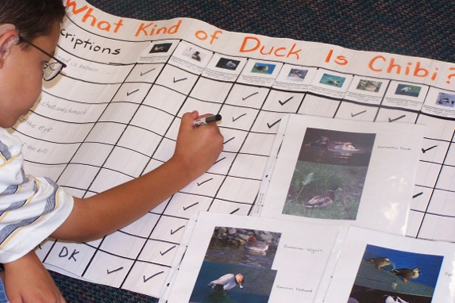
Image credit: ANOVA Science Education
Inquiry-Based Learning
Reflects practices of scientists
Students construct new knowledge through discovery
(Cobern et al., 2010, p.82)
Notes:
The inquiry approach emphasizes the PROCESS of learning

Slide 3
Inquiry involves learners:
tackling real-world questions, issues and controversies
developing questioning, research and communication skills
solving problems or creating solutions
collaborating within and beyond the classroom
developing deep understanding of content knowledge
participating in the public creation and improvement of ideas and knowledge
From Introduction to Inquiry Based Learning by Neil Stephenson, 2014

Slide 4
Example (from math)
Image Credit: Margo Lynn Mankus
Notes:
Prior to providing the algorithm on the left, students manipulate base ten blocks to discover how they can take 9 ones away from 6.

Slide 5
Inquiry-based learning
Pros
Cons
Models aspects of scientific inquiry
Can be too open ended
Increases curiosity and interest
Potential for misconceptions
Potential for better understanding and retention
Not always properly understood by teachers
(Cobern et al., 2010, p.92)

Slide 6
Inquiry- Based Learning is not just…..
Doing projects
Conducting experiments
Simply “hands on”
Working in groups
Researching literature
Inquiry- based learning includes a component in which the learner is constructing new self-knowledge on his/her own.
Notes:
The components of inquiry based learning are structured to encourage construction of new knowledge and meta-cognition (student self reflection on the process). This facilitates acquisition and retention of new knowledge.

Slide 7
IBL is very effective and creates those “ah ha” moments that every teacher wants to see
It can be time consuming and can therefore be very challenging in the “real world”.
“Some things just have to be taught”
“However, as far as science conceptual development is concerned, our conclusion is that expertly designed instructional units, sound active-engagement lessons, and good teaching are as important as whether lessons are cast as inquiry or direct.” (Cobern et al., 2010, p.93)
Notes:
There are pros and cons to inquiry based learning. It is highly appropriate in many learning environments, but teachers have many demand on them including standardized testing, behavior management, special needs, professional requirements and parent demands. Strive for a balance, especially as a new teacher. Incorporate inquiry based learning a little at a time and continue to build on your existing lessons.

Slide 8
References
Cobern, W., Schuster, D., Adams, B., Applegate, B., Skjold, B., Undreiu, A., et al. (2010). Experimental Comparison Of Inquiry And Direct Instruction In Science. Research in Science & Technological Education, 28(1), 81-96.

Slide 9
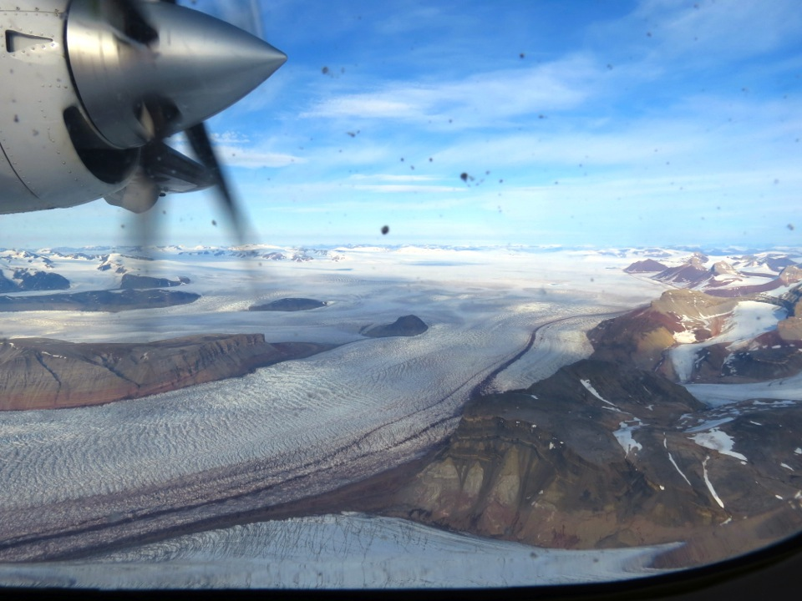
Notes:
The remaining pictures were taken in Svalbard, Norway during “High Arctic Change 2014”.
Aerial view of two merging glaciers, Kronebreen and Kongsvegan. Glaciers form over many, many years from the compaction of snow that doesn’t melt in the summer. Tidewater glaciers flow toward the ocean, bay or fjord. The type of flow is called plastic flow and it results from slight deformation because of the glaciers own weight. As glaciers flow they are highly erosive and gouge out rock like a bulldozer. It grinds the rock sometimes so fine it is known as rock flour and pushes the sediment to the side of the glacier and ahead of it.

Slide 10
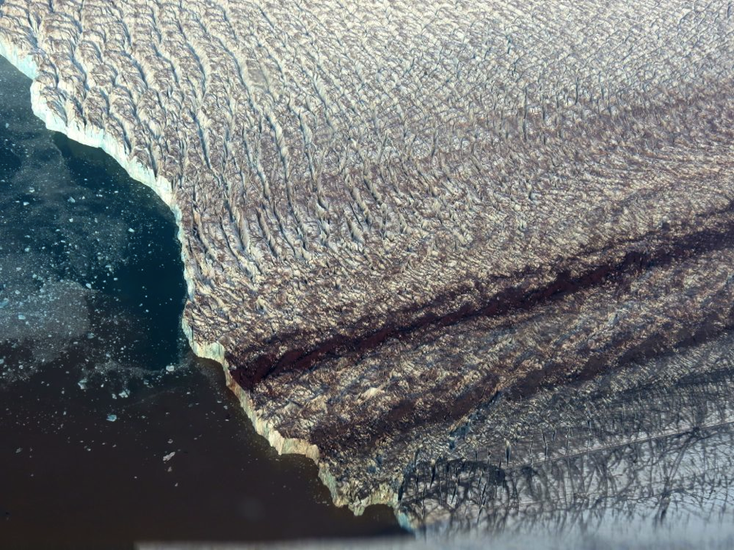
Notes:
This is another aerial view. Notice the medial moraines where the two glaciers merged. This is from eroded sediment. Notice also the muddy area in front of the glacier. This is from sediment that is being pushed into the fjord.

Slide 11
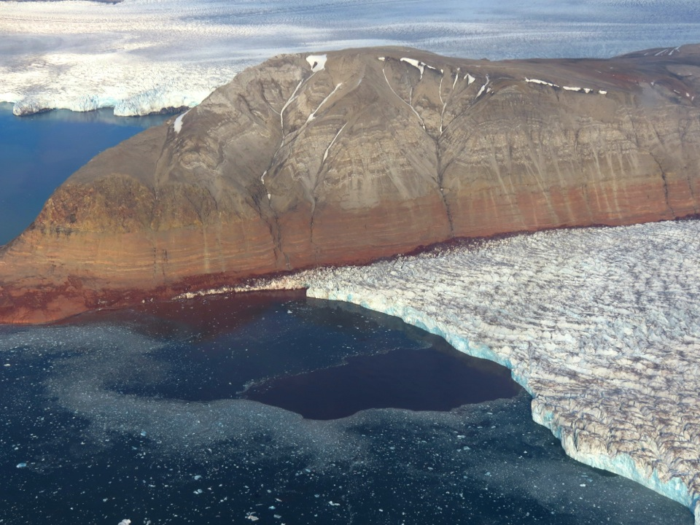
Notes:
For a sense of scale, the terminus (end) of this glacier is about 2 miles across.

Slide 12
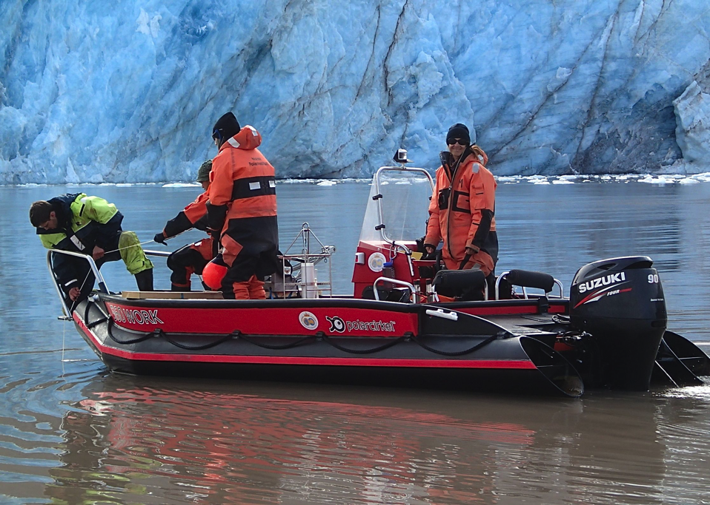
Notes:
During “High Arctic Change 2014” a team of scientists, undergraduate students and a teacher used boats to approach the glacier and collect data to better understand how the glacier and deposition in the fjord reflects climate. In this picture, Steve, a student from Grand Valley Sate University in Michigan is pulling up a sediment trap that he will later analyze to determine deposition rates.

Slide 13
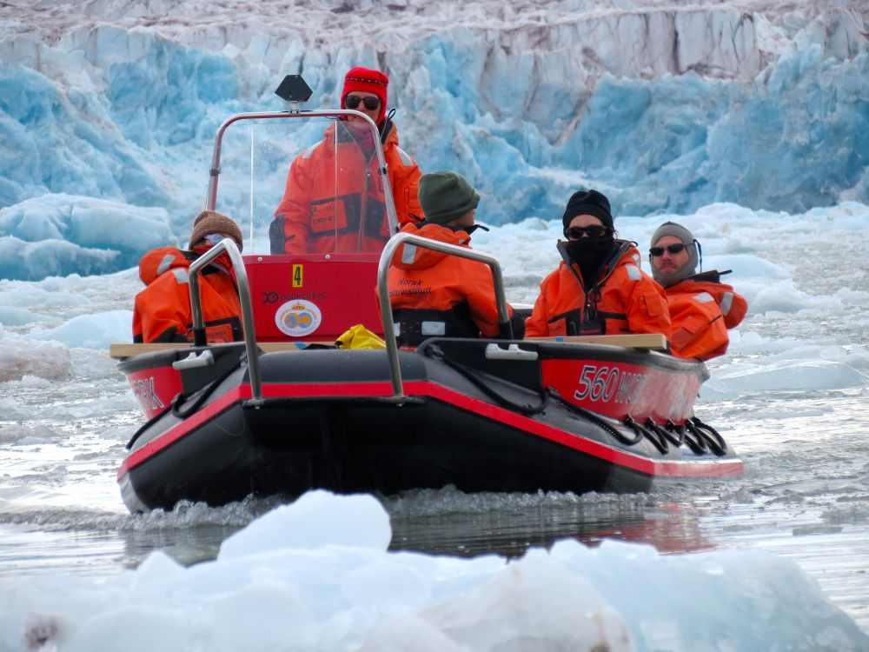
Notes:
Conditions were sometimes difficult to work in. It was cold and the boats had to navigate between many chunks of ice.

Slide 14
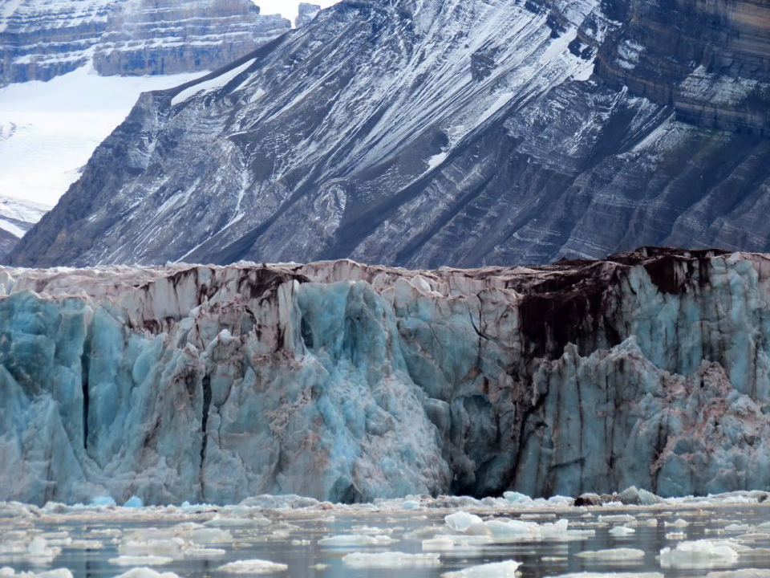
Notes:
Notice how dirty the terminus (end) of the glacier is. This is from all of the sediment resulting from erosion.

Slide 15
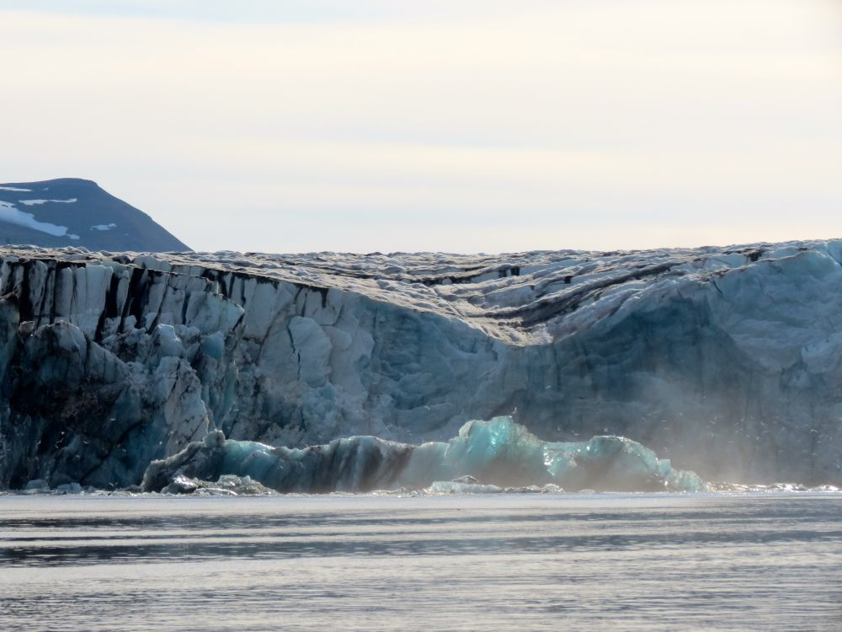
Notes:
At the terminus of the glacier, huge chunks of ice break off in a process known as calving and produce large icebergs.. This iceberg calved off just before this picture was taken.

Slide 16
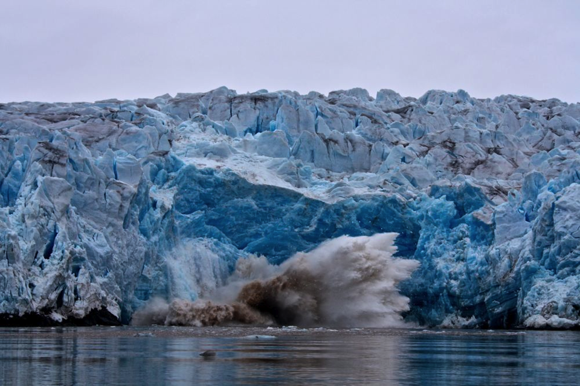
Notes:
Here is a picture of the glacier caught in the process of calving.

Slide 17
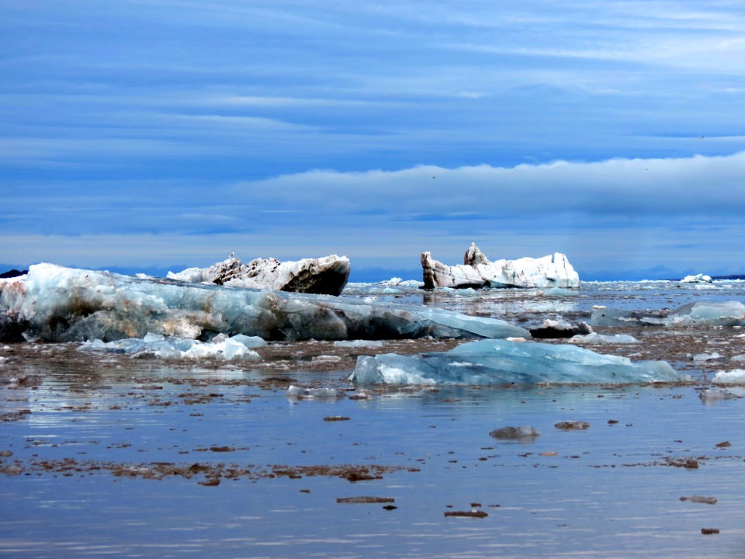
Notes:
Huge icebergs floated past us and all around us. Do you think there is more of the iceberg above the water or below the water? How much?

Slide 18
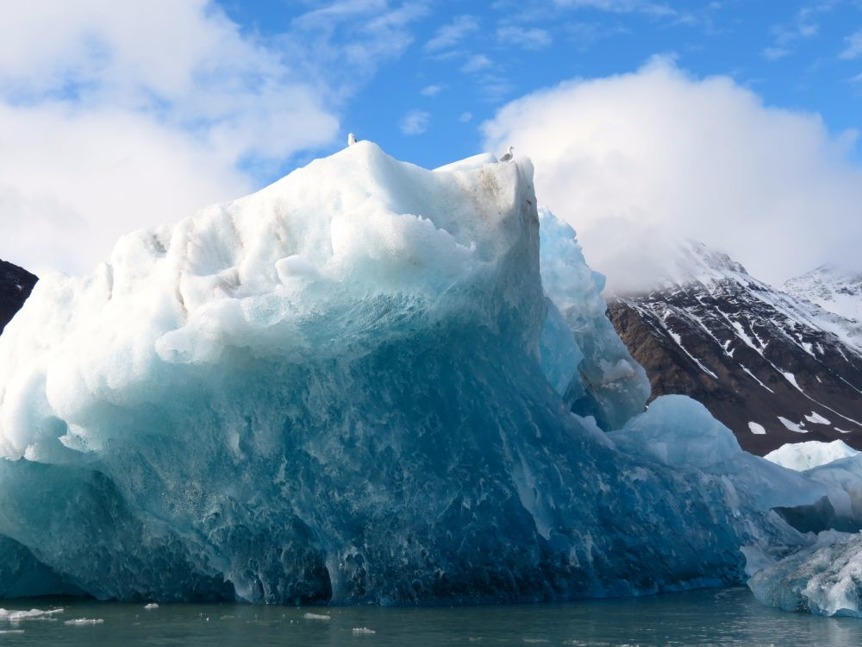
Notes:
Seagulls liked to perch on the top of the icebergs.

Slide 19
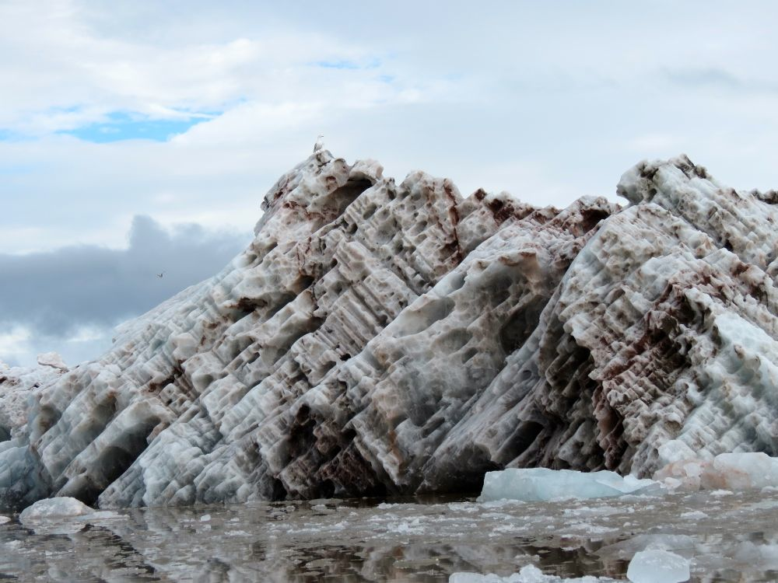
Notes:
This is a very dirty iceberg. We studied this glacier and fjord to learn more about all glaciers. By better understanding how glaciers behave, we can better understand the changes that we are seeing.

Slide 20
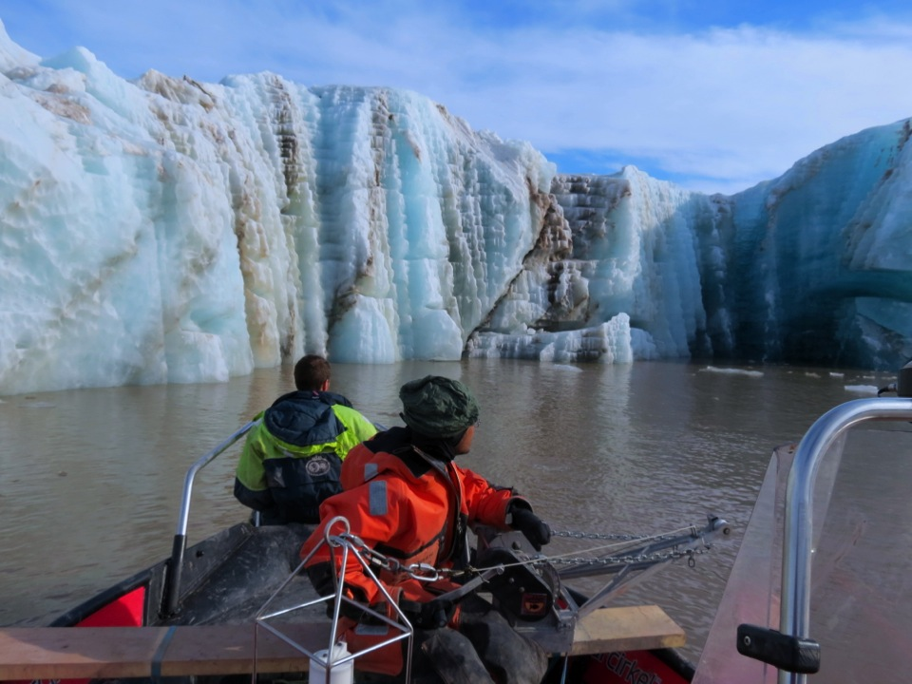
Notes:
This glacier was so big that we could pull the boat right up into it. It was like a cathedral. By inquiring about our world and asking questions about things we don’t know we can learn more about glaciers and our changing climate.

