Slide 1
Warm Up: Examine this picture and describe what you observe and what you think it would be like to be in this scene.
NASA/JPL-Caltech

Slide 2
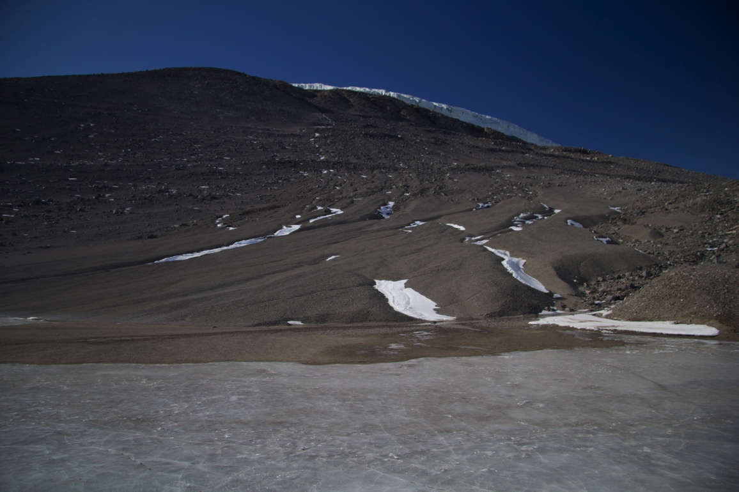
What are the similarities and differences between these and the previous slide?

