Slide 1
Arctic Challenge
Sandra L. W. Thornton
PolarTREC Fellow/NOAA TAS 2016
Hidden Ocean 2016: Chukchi Borderlands, NOAA, UAF
https://www.polartrec.com/expeditions/chukchi-sea-borderland

Slide 2
Equipment | Careers | Animals | Climate Change | Geography
100 | 100 | 100 | 100 | 100
200 | 200 | 200 | 200 | 200
300 | 300 | 300 | 300 | 300
400 | 400 | 400 | 400 | 400
500 | 500 | 500 | 500 | 500

Slide 3
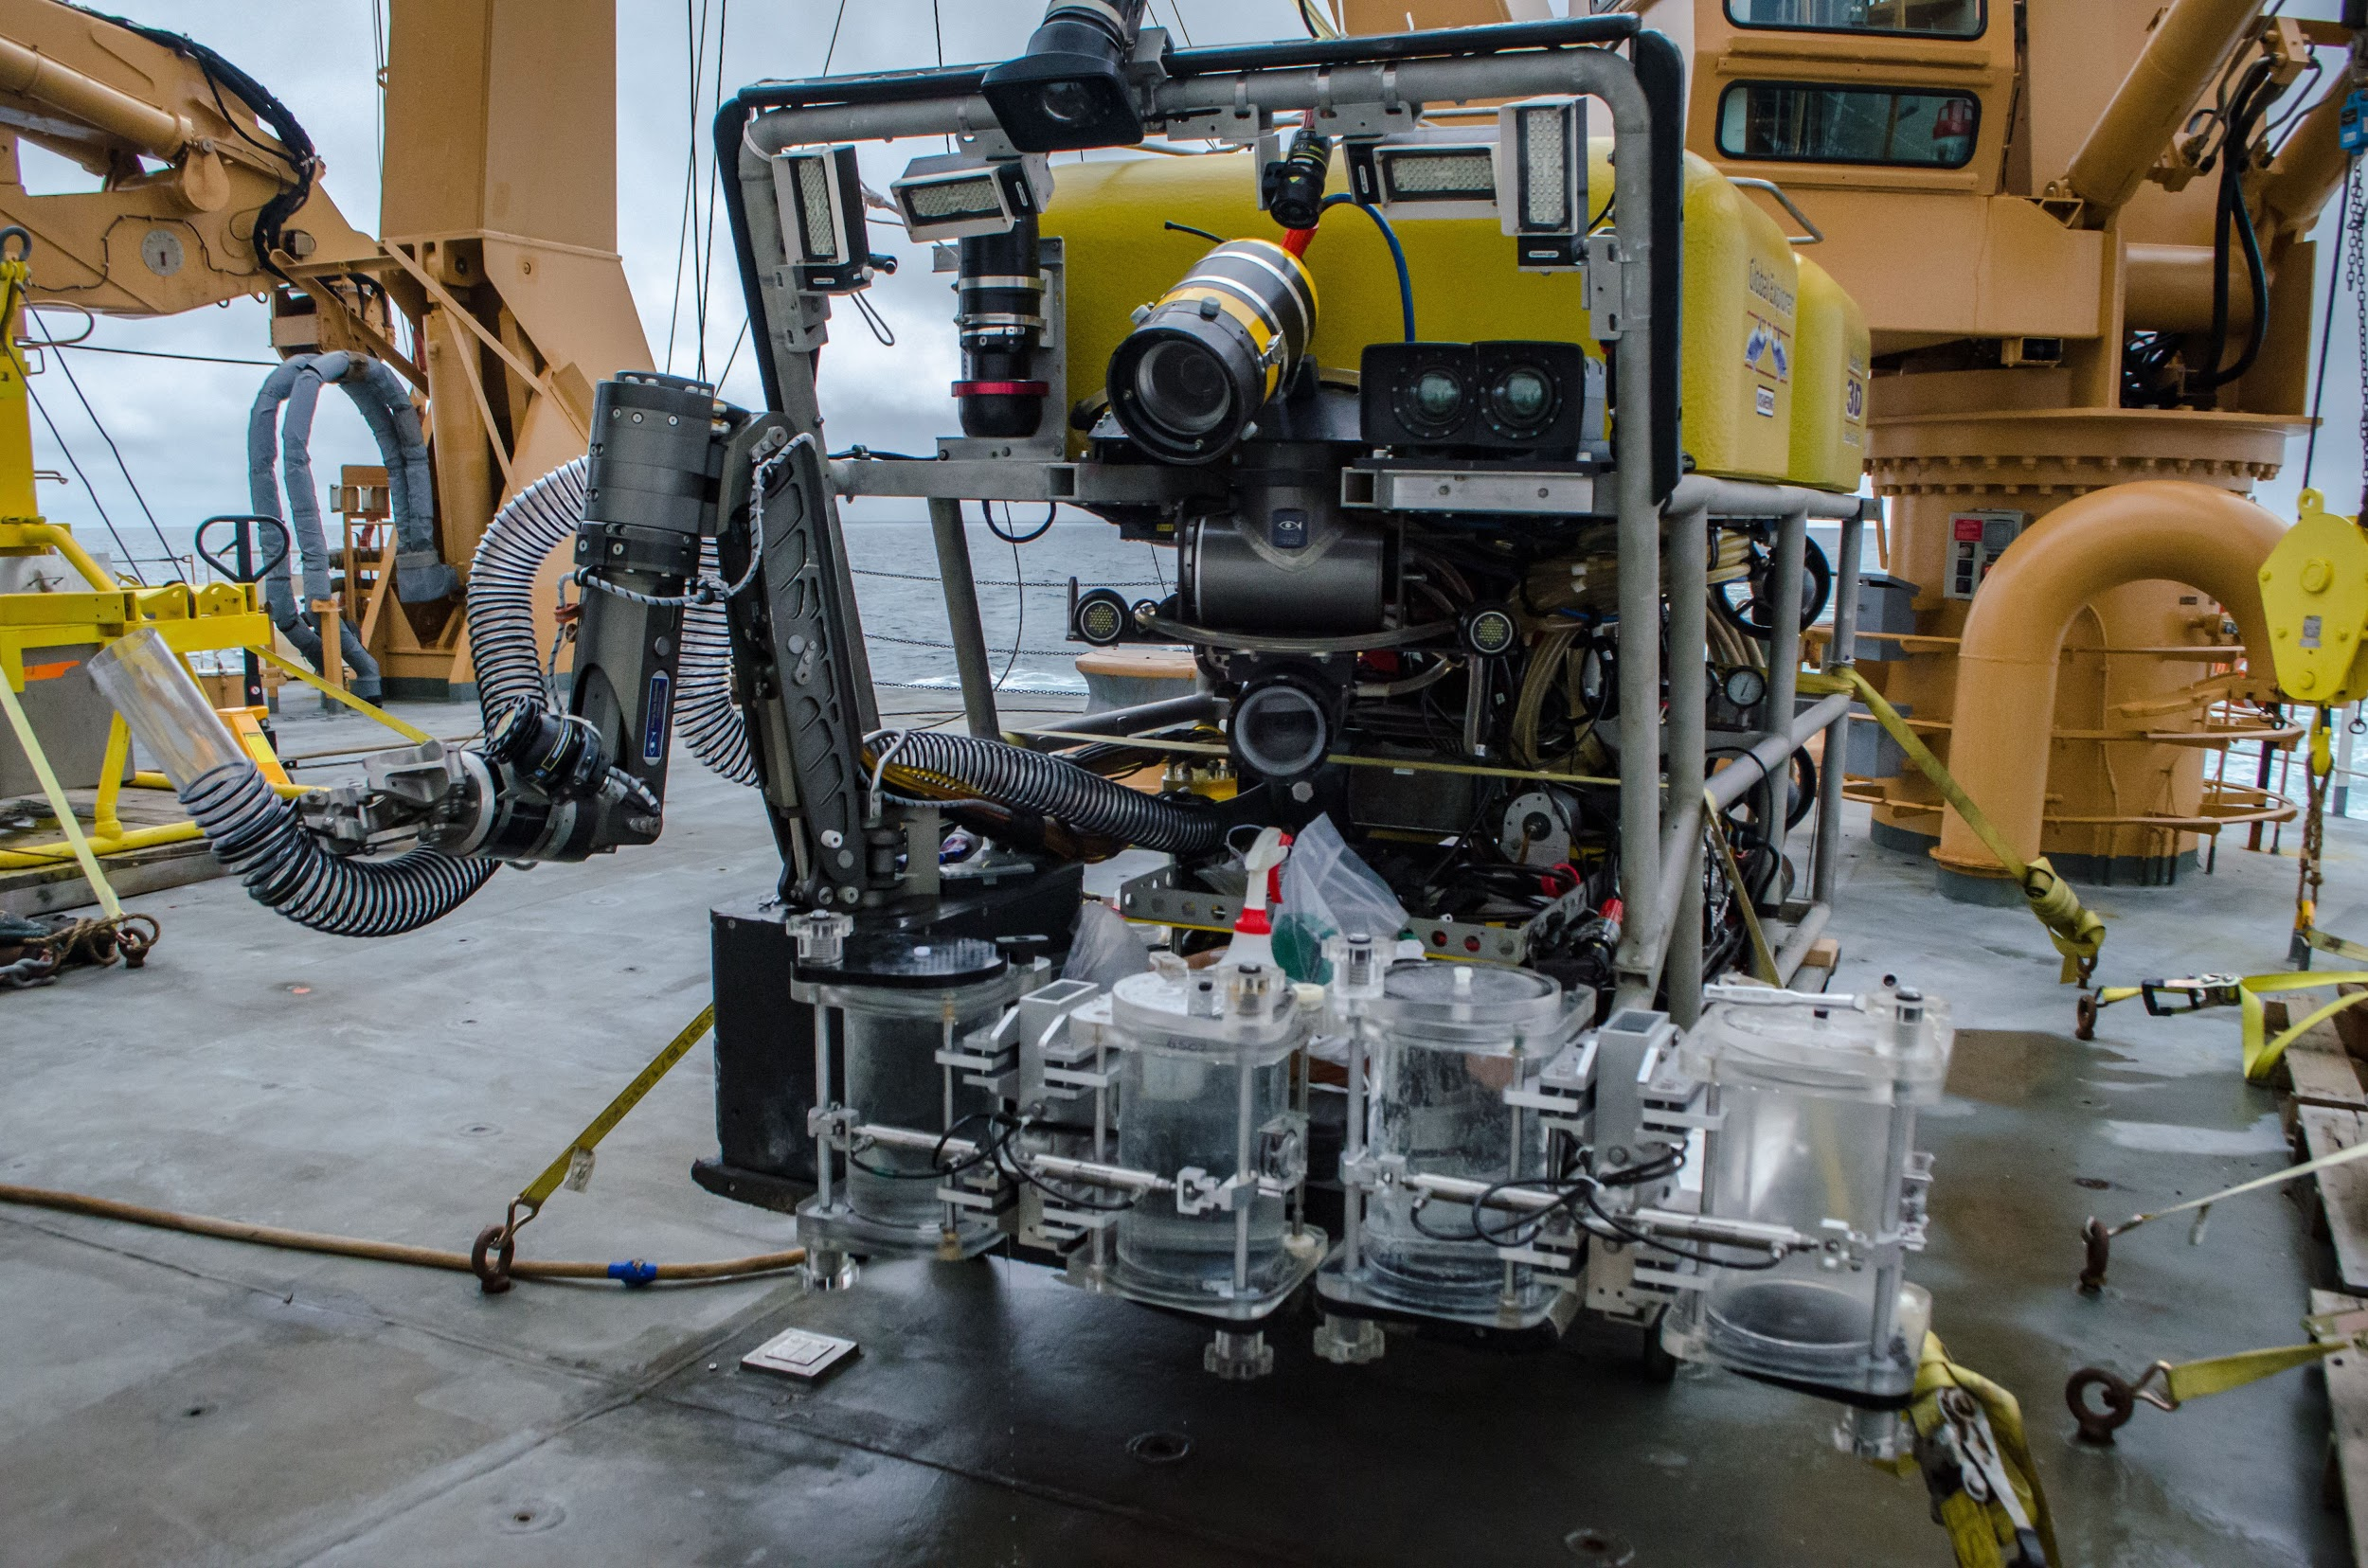
Equipment 100 points
Question: What kind of device operated from afar allows scientists to view organisms in situ?
Answer: A remotely operated vehicle (ROV) allows scientists to see organisms in their environment and collect samples of organisms. This
is particularly
beneficial with
soft-bodied
organisms such
as jellyfish and
ctenophores.
Back to Topics
Photo courtesy of Caitlin Bailey, GFOE, The Hidden Ocean 2016: Chukchi Borderlands

Slide 4
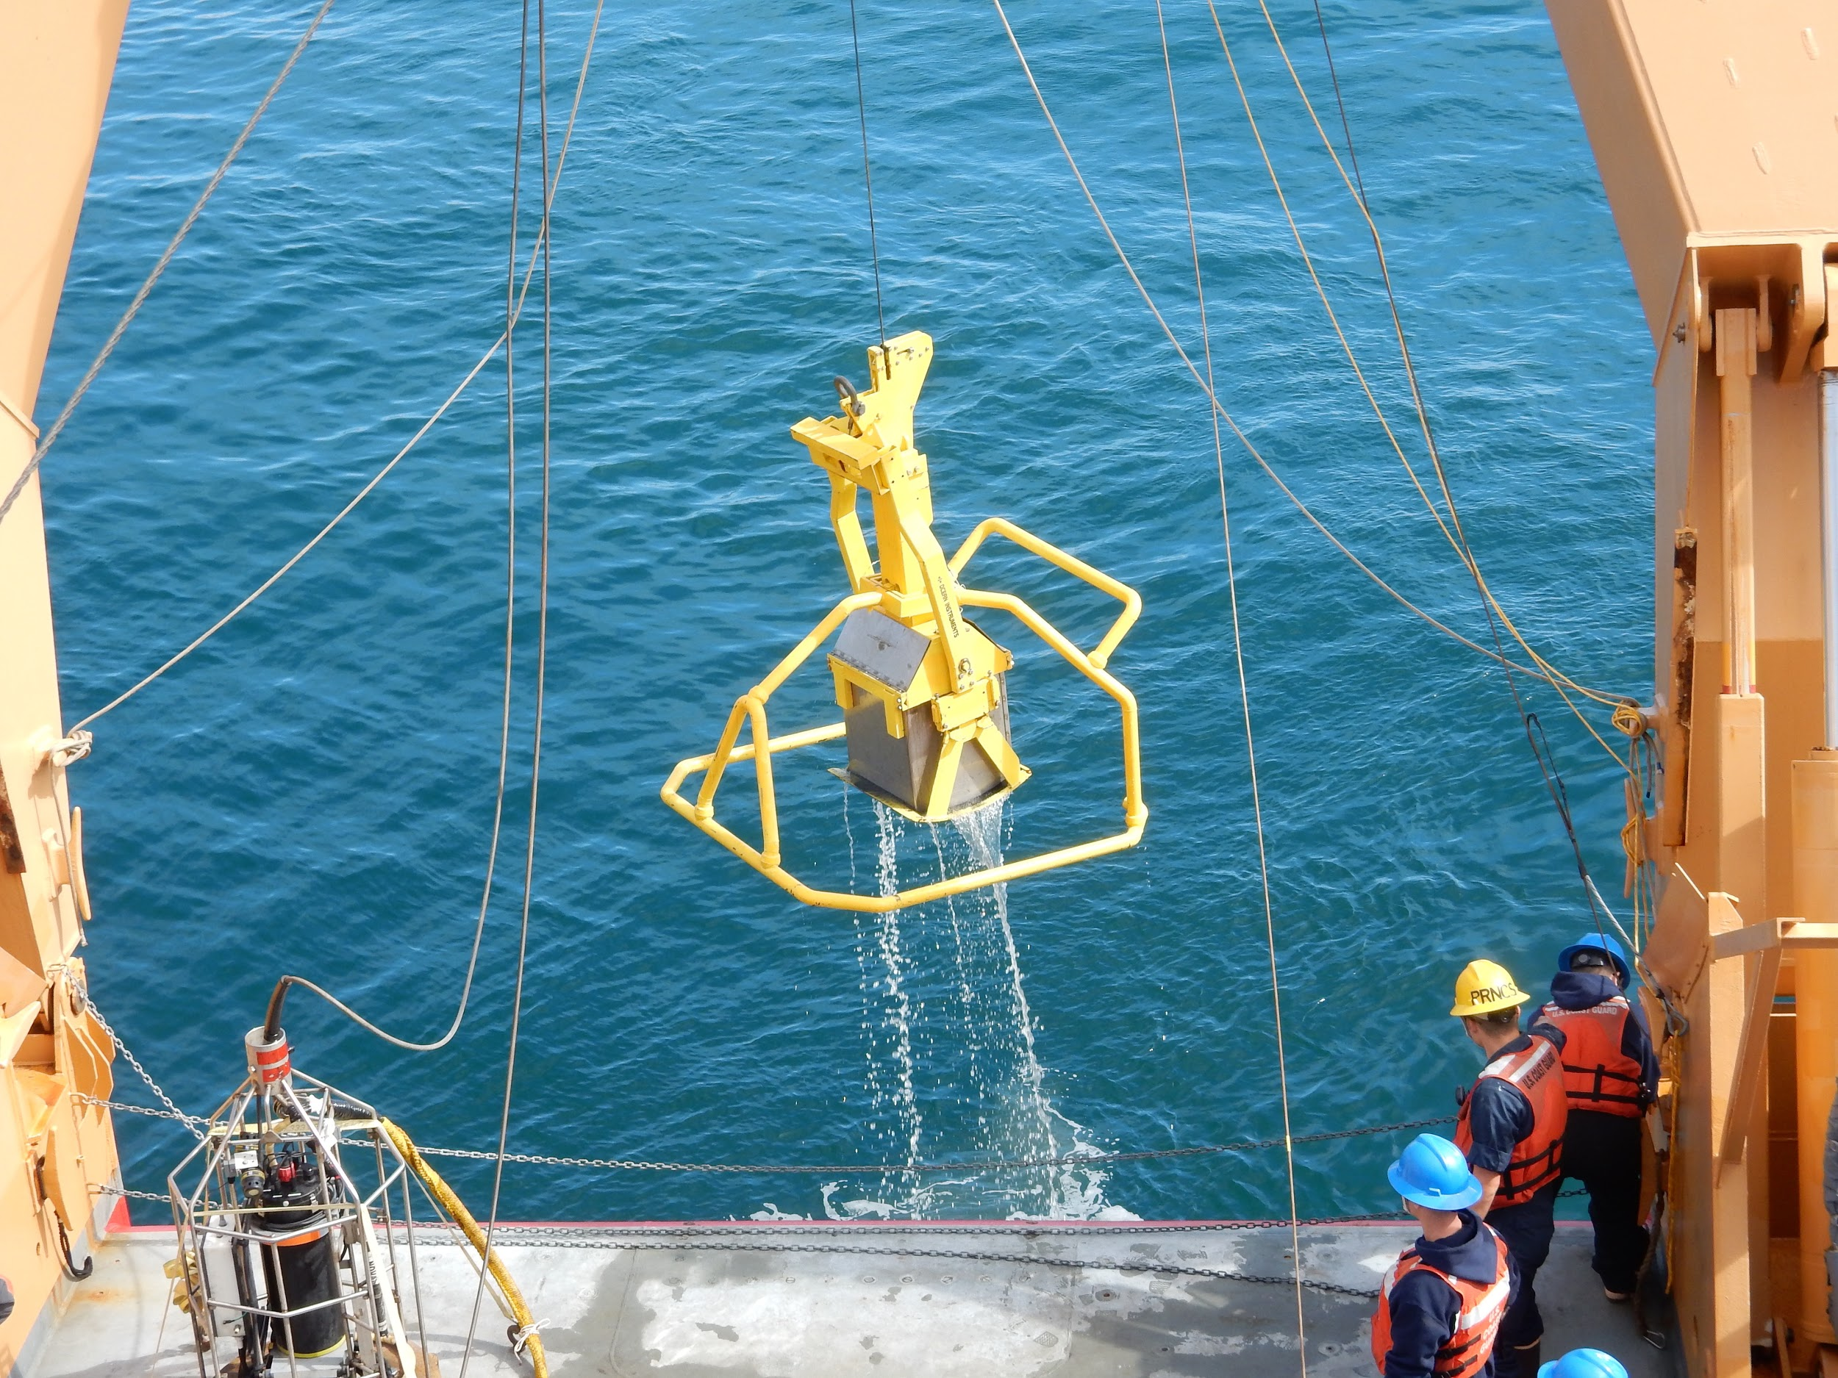
Equipment 200 points
Question: What device allows scientists to collect large samples of sediments from the seafloor?
Answer: A box corer may be
used to collect samples of
sediments from the seafloor.
Samples of organisms may be
collected from the sediments,
and other types of tests may be
used to analyze the sediments.
Back to Topics
Photo Credit: Sandra Thornton PolarTREC Fellow/NOAA TAS

Slide 5
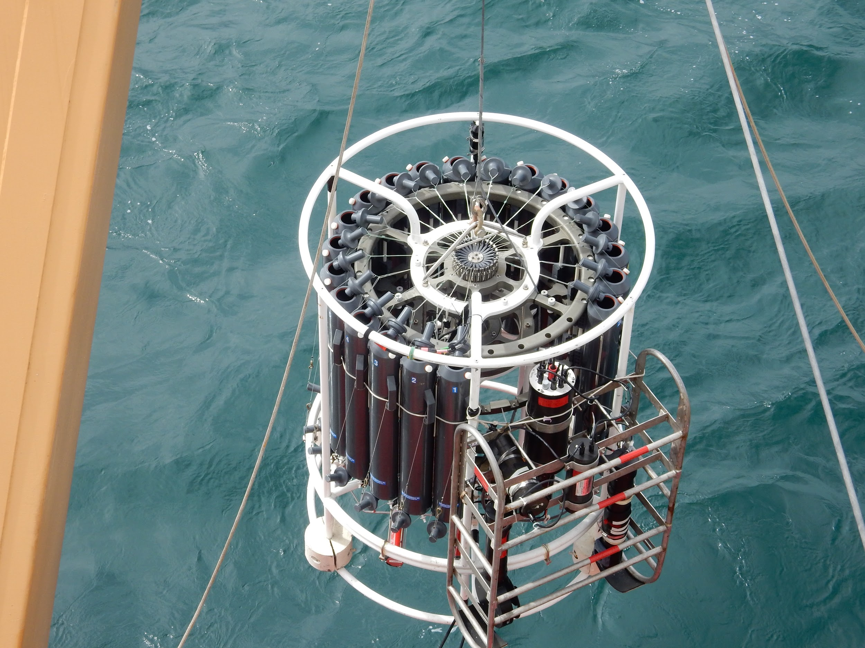
Equipment 300 points
Question: What device is equipped with sensors that allow scientists to measure a range of water conditions, including salinity, temperature, dissolved oxygen content, and presence of chlorophyll?
Answer: A CTD (Conductivity,
Temperature, Depth) allows scientists
to collect data about water and may
even be used to collect samples of
water at different depths.
Back to Topics
Photo Credit: Sandra Thornton PolarTREC Fellow/NOAA TAS

Slide 6
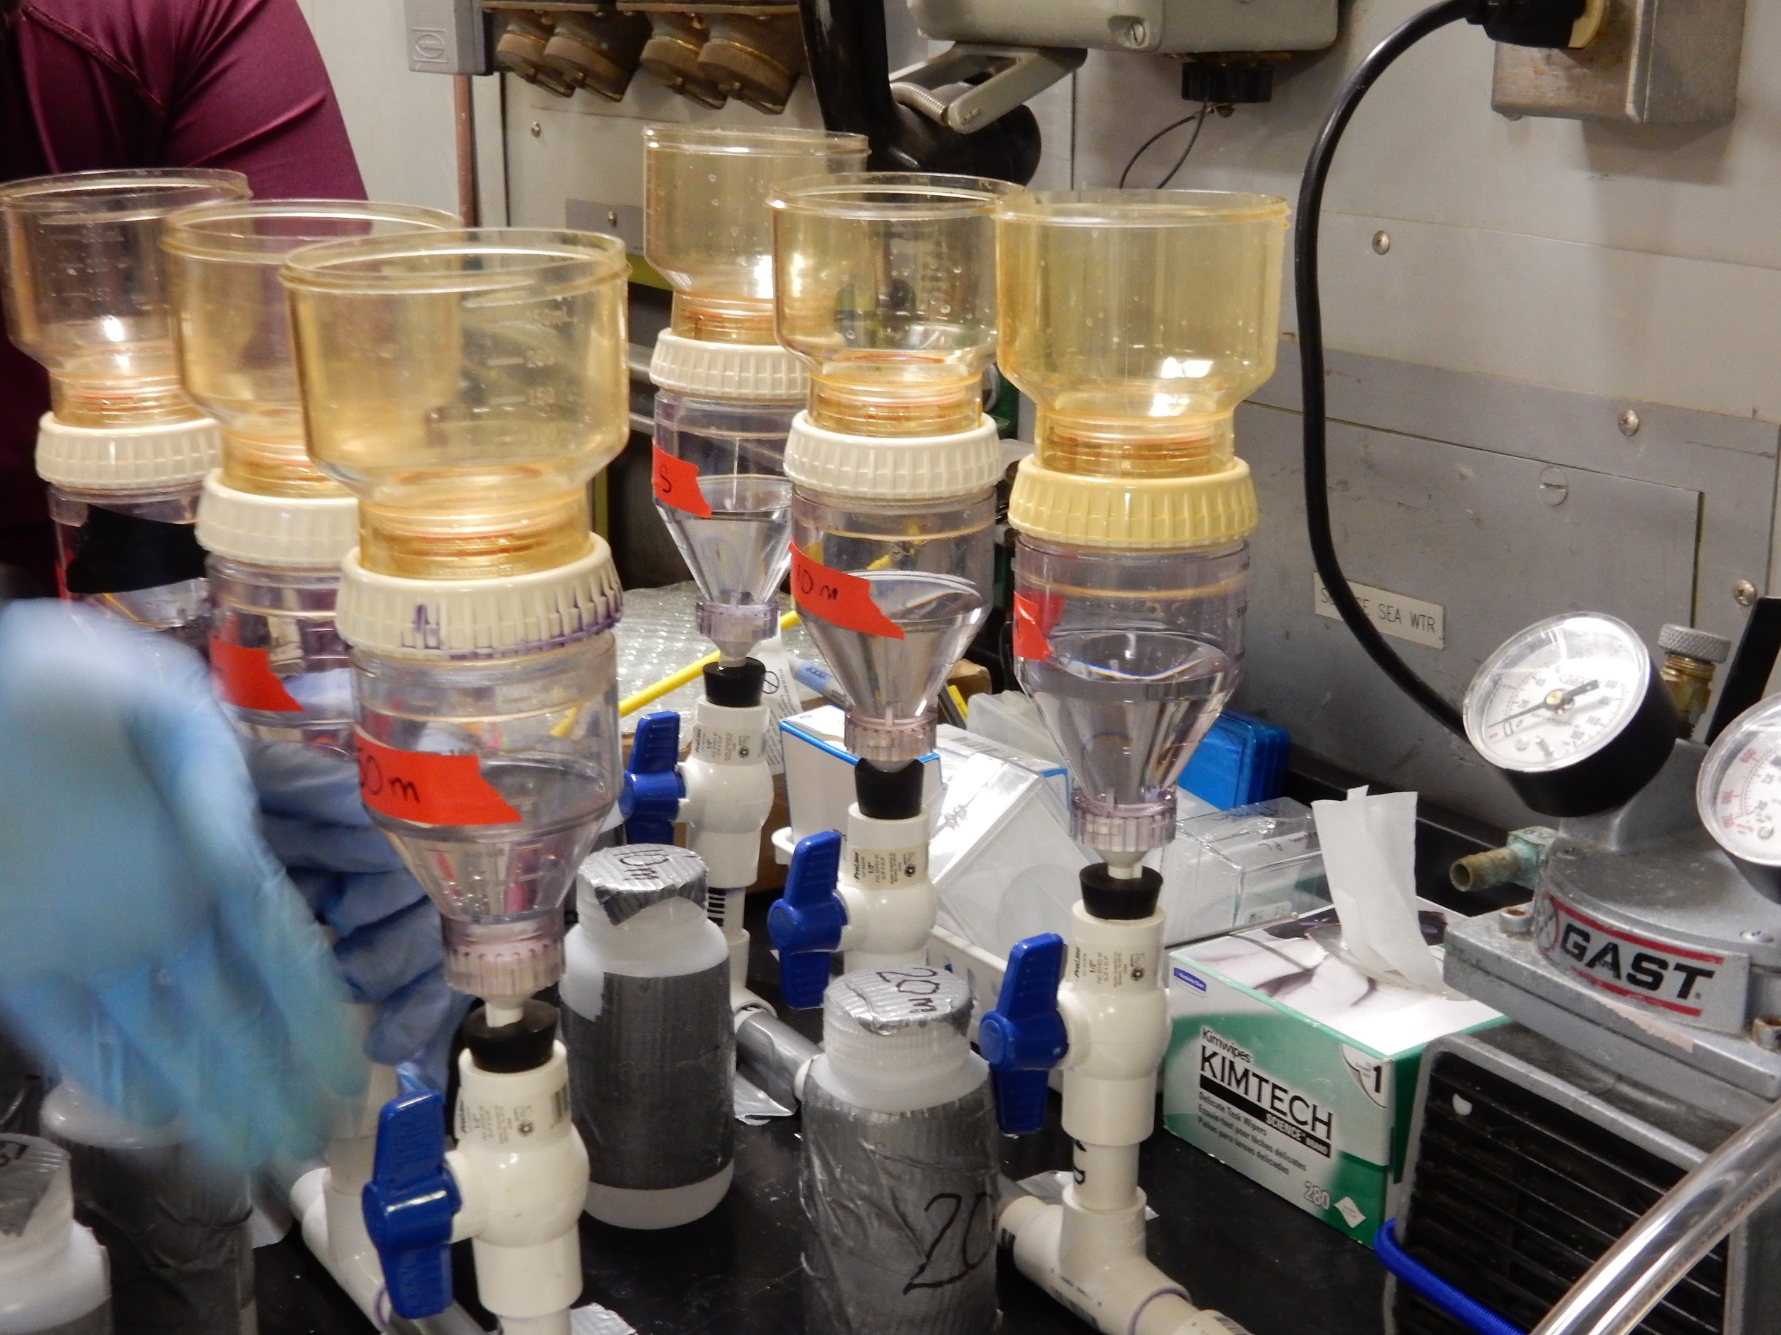
Equipment 400 points
Question: What device allows scientists to remove microscopic organisms and particles from a seawater sample?
Answer: A vacuum filtration unit is
used to filter out microscopic
organisms and tiny particles from
a sample of seawater. Filters are
available in a range of pore sizes
to collect even tiny bacteria.
Back to Topics
Photo Credit: Sandra Thornton PolarTREC Fellow/NOAA TAS

Slide 7
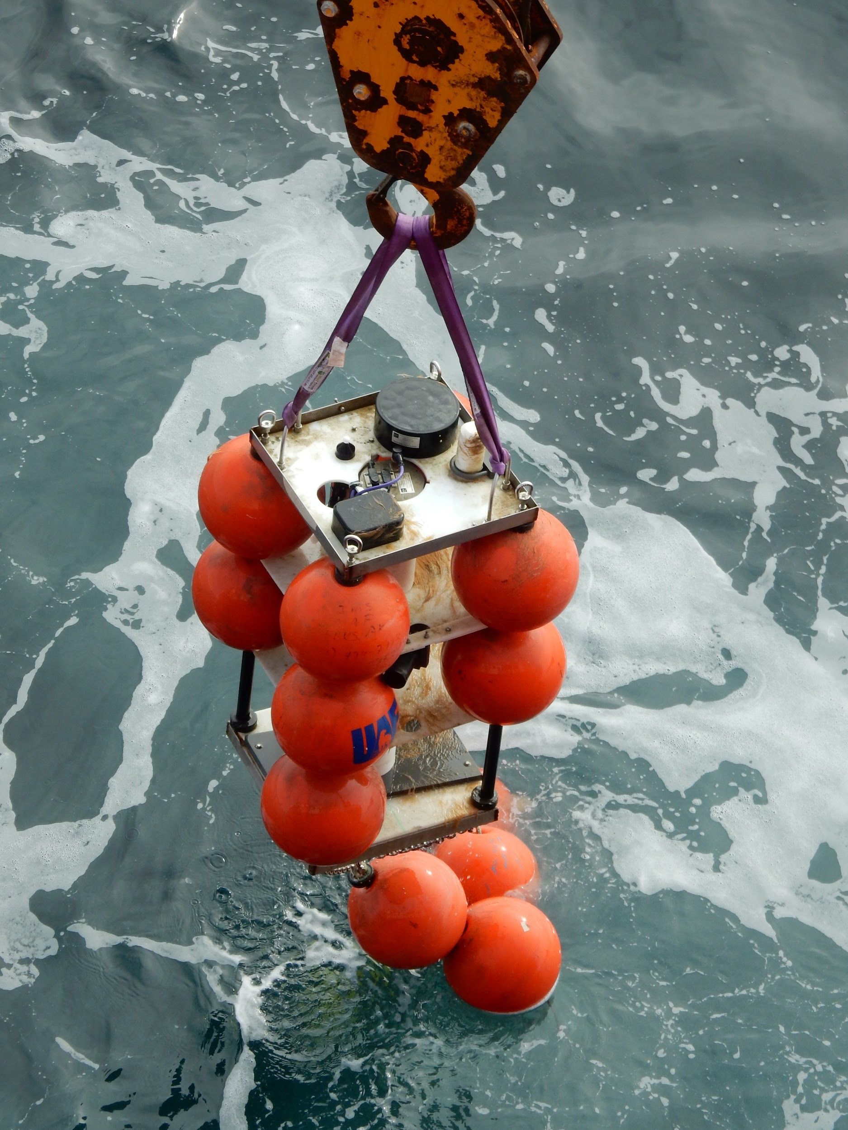
Equipment 500 points
Question: What equipment may be left in the water for extended periods of time to collect data on environmental conditions and organisms?
Answer: Moorings may be left in the
water column for extended periods
of time to collect water data such
as current patterns, temperature,
and salinity. A hydrophone attached
to a mooring may be used to collect
sounds of marine mammals, and
these sounds help to provide
information about presence of marine
mammals and travel patterns.
Back to Topics
Photo Credit: Sandra Thornton PolarTREC Fellow/NOAA TAS

Slide 8
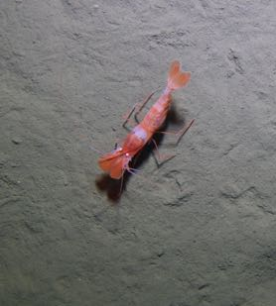
Careers 100 points
Question: What type of scientist specializes in the study of organisms and how they relate to each other and to their environment?
Answer: An ecologist studies organisms
and how they relate to their environment
and to each other. A benthic ecologist
focuses on organisms that live on or
near the seafloor.
Back to Topics
Bythocaris (Benthic Shrimp)
From: “The Hidden Ocean 2016: Chukchi Borderlands, NOAA, UAF, Oceaneering-DSSI”

Slide 9
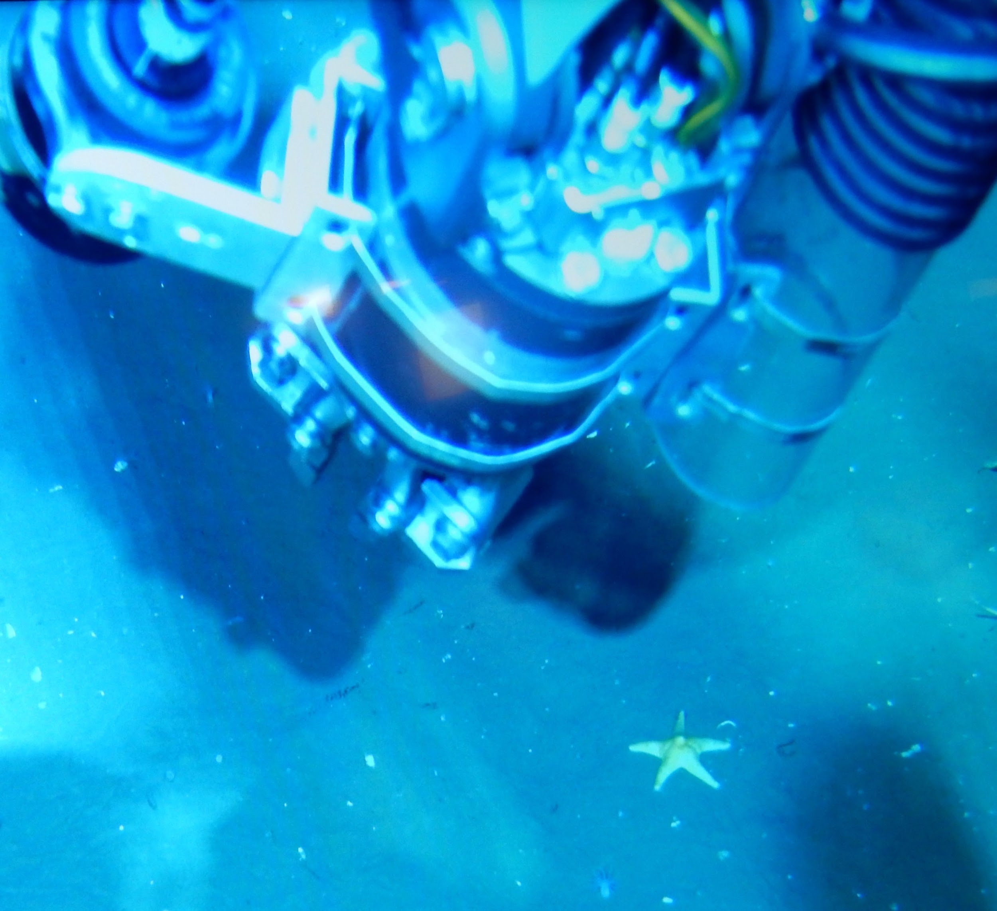
Careers 200 points
Answer: What type of pilot “flies” underwater rather than through the air?
Question: An ROV (remotely
operated vehicle) pilot maneuvers
an ROV under the ocean’s surface.
The ROV may travel throughout the
water column or along the seafloor
to collect observations, specimen
samples, and water samples.
Back to Topics
“The Hidden Ocean 2016: Chukchi Borderlands, NOAA, UAF, Oceaneering-DSSI”

Slide 10
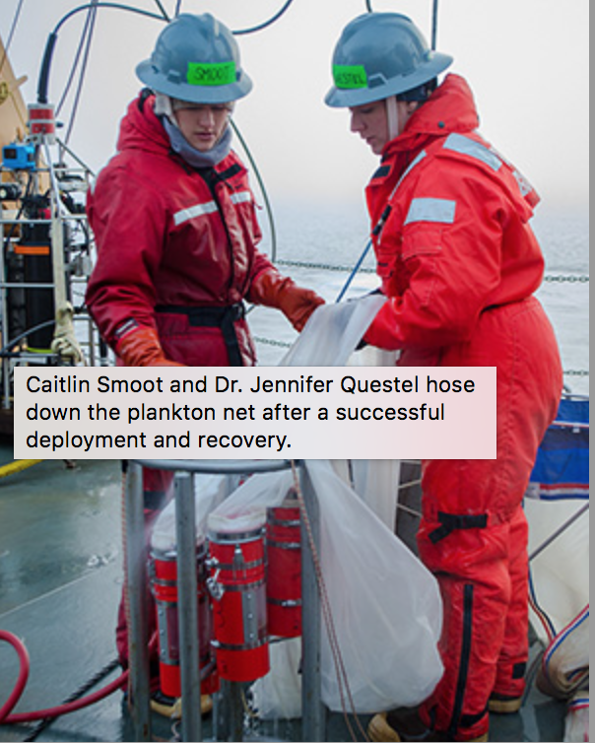
Careers 300 points
Question: Which scientists often hold roles that include collecting and processing samples, coordinating and packing equipment for research expeditions, and maintaining lab space?
Answer: Lab technicians and research staff
play important roles in the field and in
the laboratory by collecting data and helping
to coordinate and maintain equipment and
facilities.
Back to Topics
Photo courtesy of Caitlin Bailey, GFOE, The Hidden Ocean 2016: Chukchi Borderlands

Slide 11
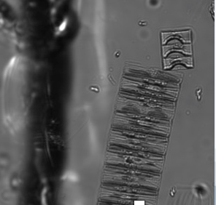
Careers 400 points
Question: What type of scientist studies microscopic organisms such as bacteria, algae, and fungi?
Answer: A microbiologist studies
microscopic organisms, including
bacteria, algae, and fungi. In the
Arctic, a microbiologist might study
ice algae to learn more
about algae’s role in the Arctic
ecosystem.
Unidentified chain forming diatom
Photo Credit: Kyle Dilliplaine, University of Alaska, Fairbanks
Back to Topics

Slide 12
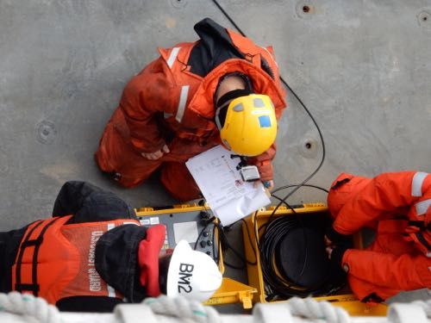
Careers 500 points
Question: What branch of oceanography uses sounds of marine mammals to learn more about behavior and migration patterns of these animals?
Answer: The field of bioacoustics
uses analysis of marine mammal
sounds to learn more about behavior
and migration patterns of marine
mammals.
Back to Topics
Communicating with a mooring.
Photo Credit: Sandra Thornton PolarTREC Fellow/NOAA TAS

Slide 13
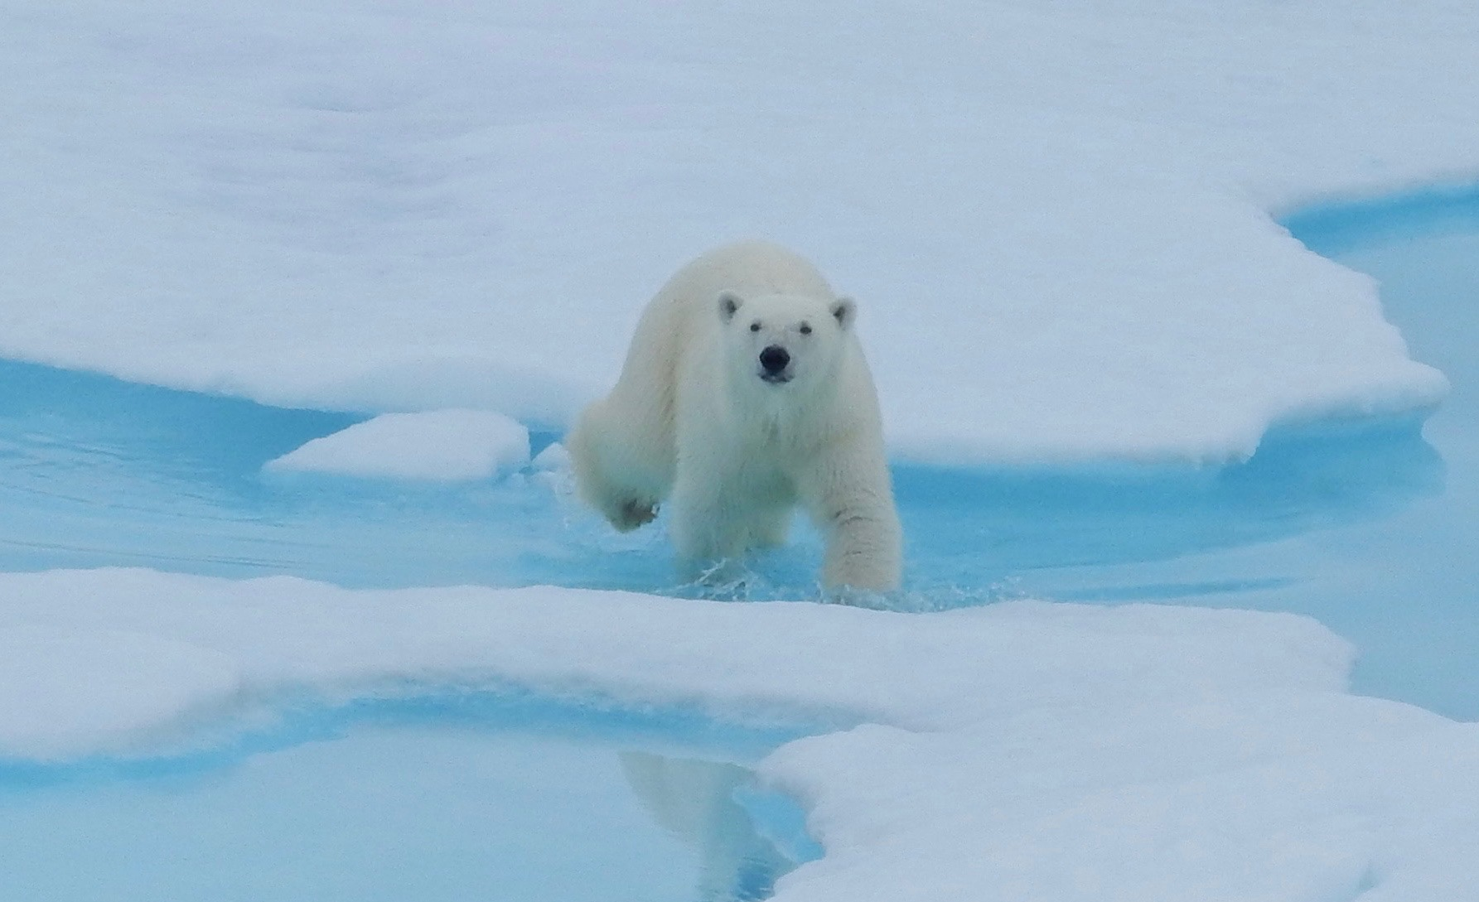
Animals 100 points
Question: Classified as a marine mammal, what is Earth’s largest land-based carnivore?
Answer: Polar Bear
(Ursus maritimus)
Adult female polar bears
may weigh over 500
pounds and adult males
may weigh over 900
pounds.
Back to Topics
Photo Credit: Sandra Thornton PolarTREC Fellow/NOAA TAS

Slide 14
Animals 200 points
Question: To what class do these diverse, mostly marine worms, named for
bundles of bristles on each segment, belong?
Polynoid polychaete worm. From: “The Hidden Ocean 2016: Chukchi Borderlands, NOAA, UAF, Oceaneering - DSSI.
Answer: Polychaete (or Polychaeta). These worms are segmented and have bristles (chaetae) on each segment.
Back to Topics

Slide 15
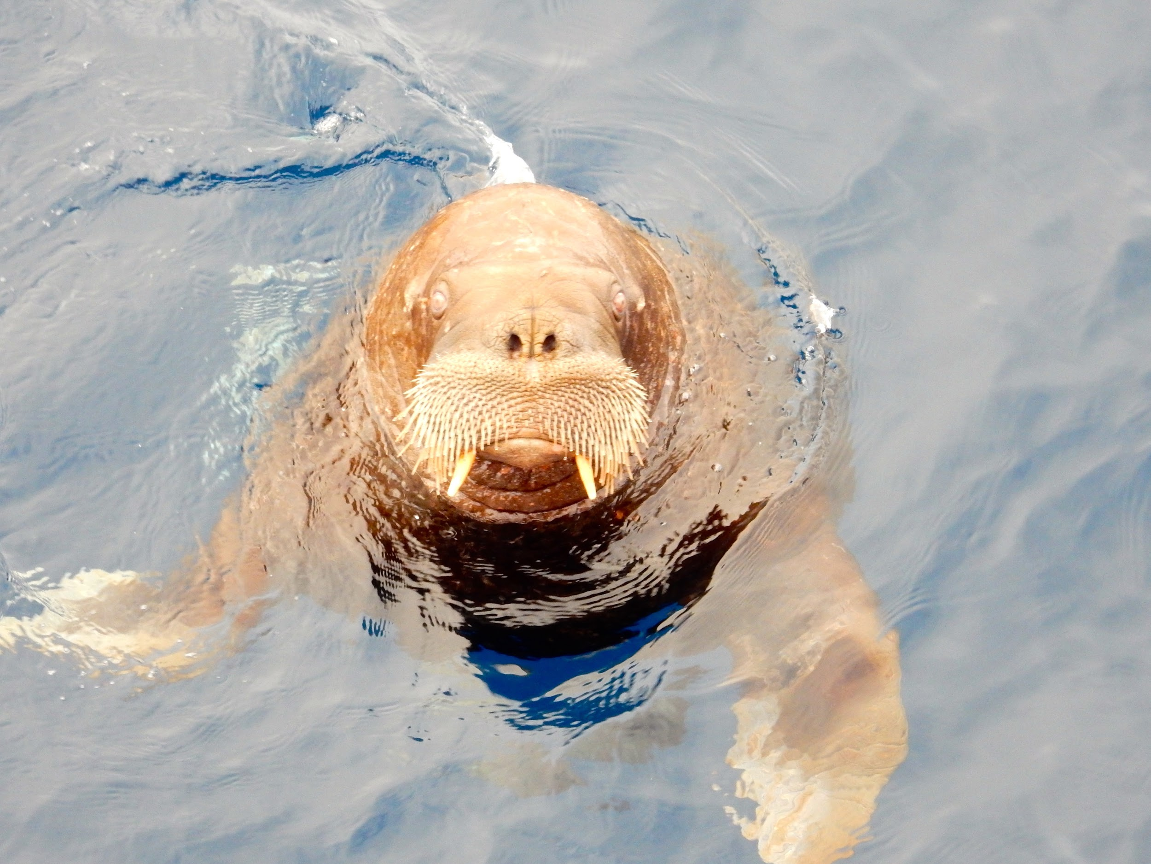
Animals 300 points
Question: This walrus is more than just another pretty face. For what purpose does a walrus use its whiskers?
Answer: Walruses use their
vibrissae (whiskers) to help
locate tasty shellfish on the seafloor.
Walruses have poor vision and
vibrissae provide another way for
walruses to gather sensory information.
Back to Topics
Photo Credit: Sandra Thornton PolarTREC Fellow/NOAA TAS

Slide 16
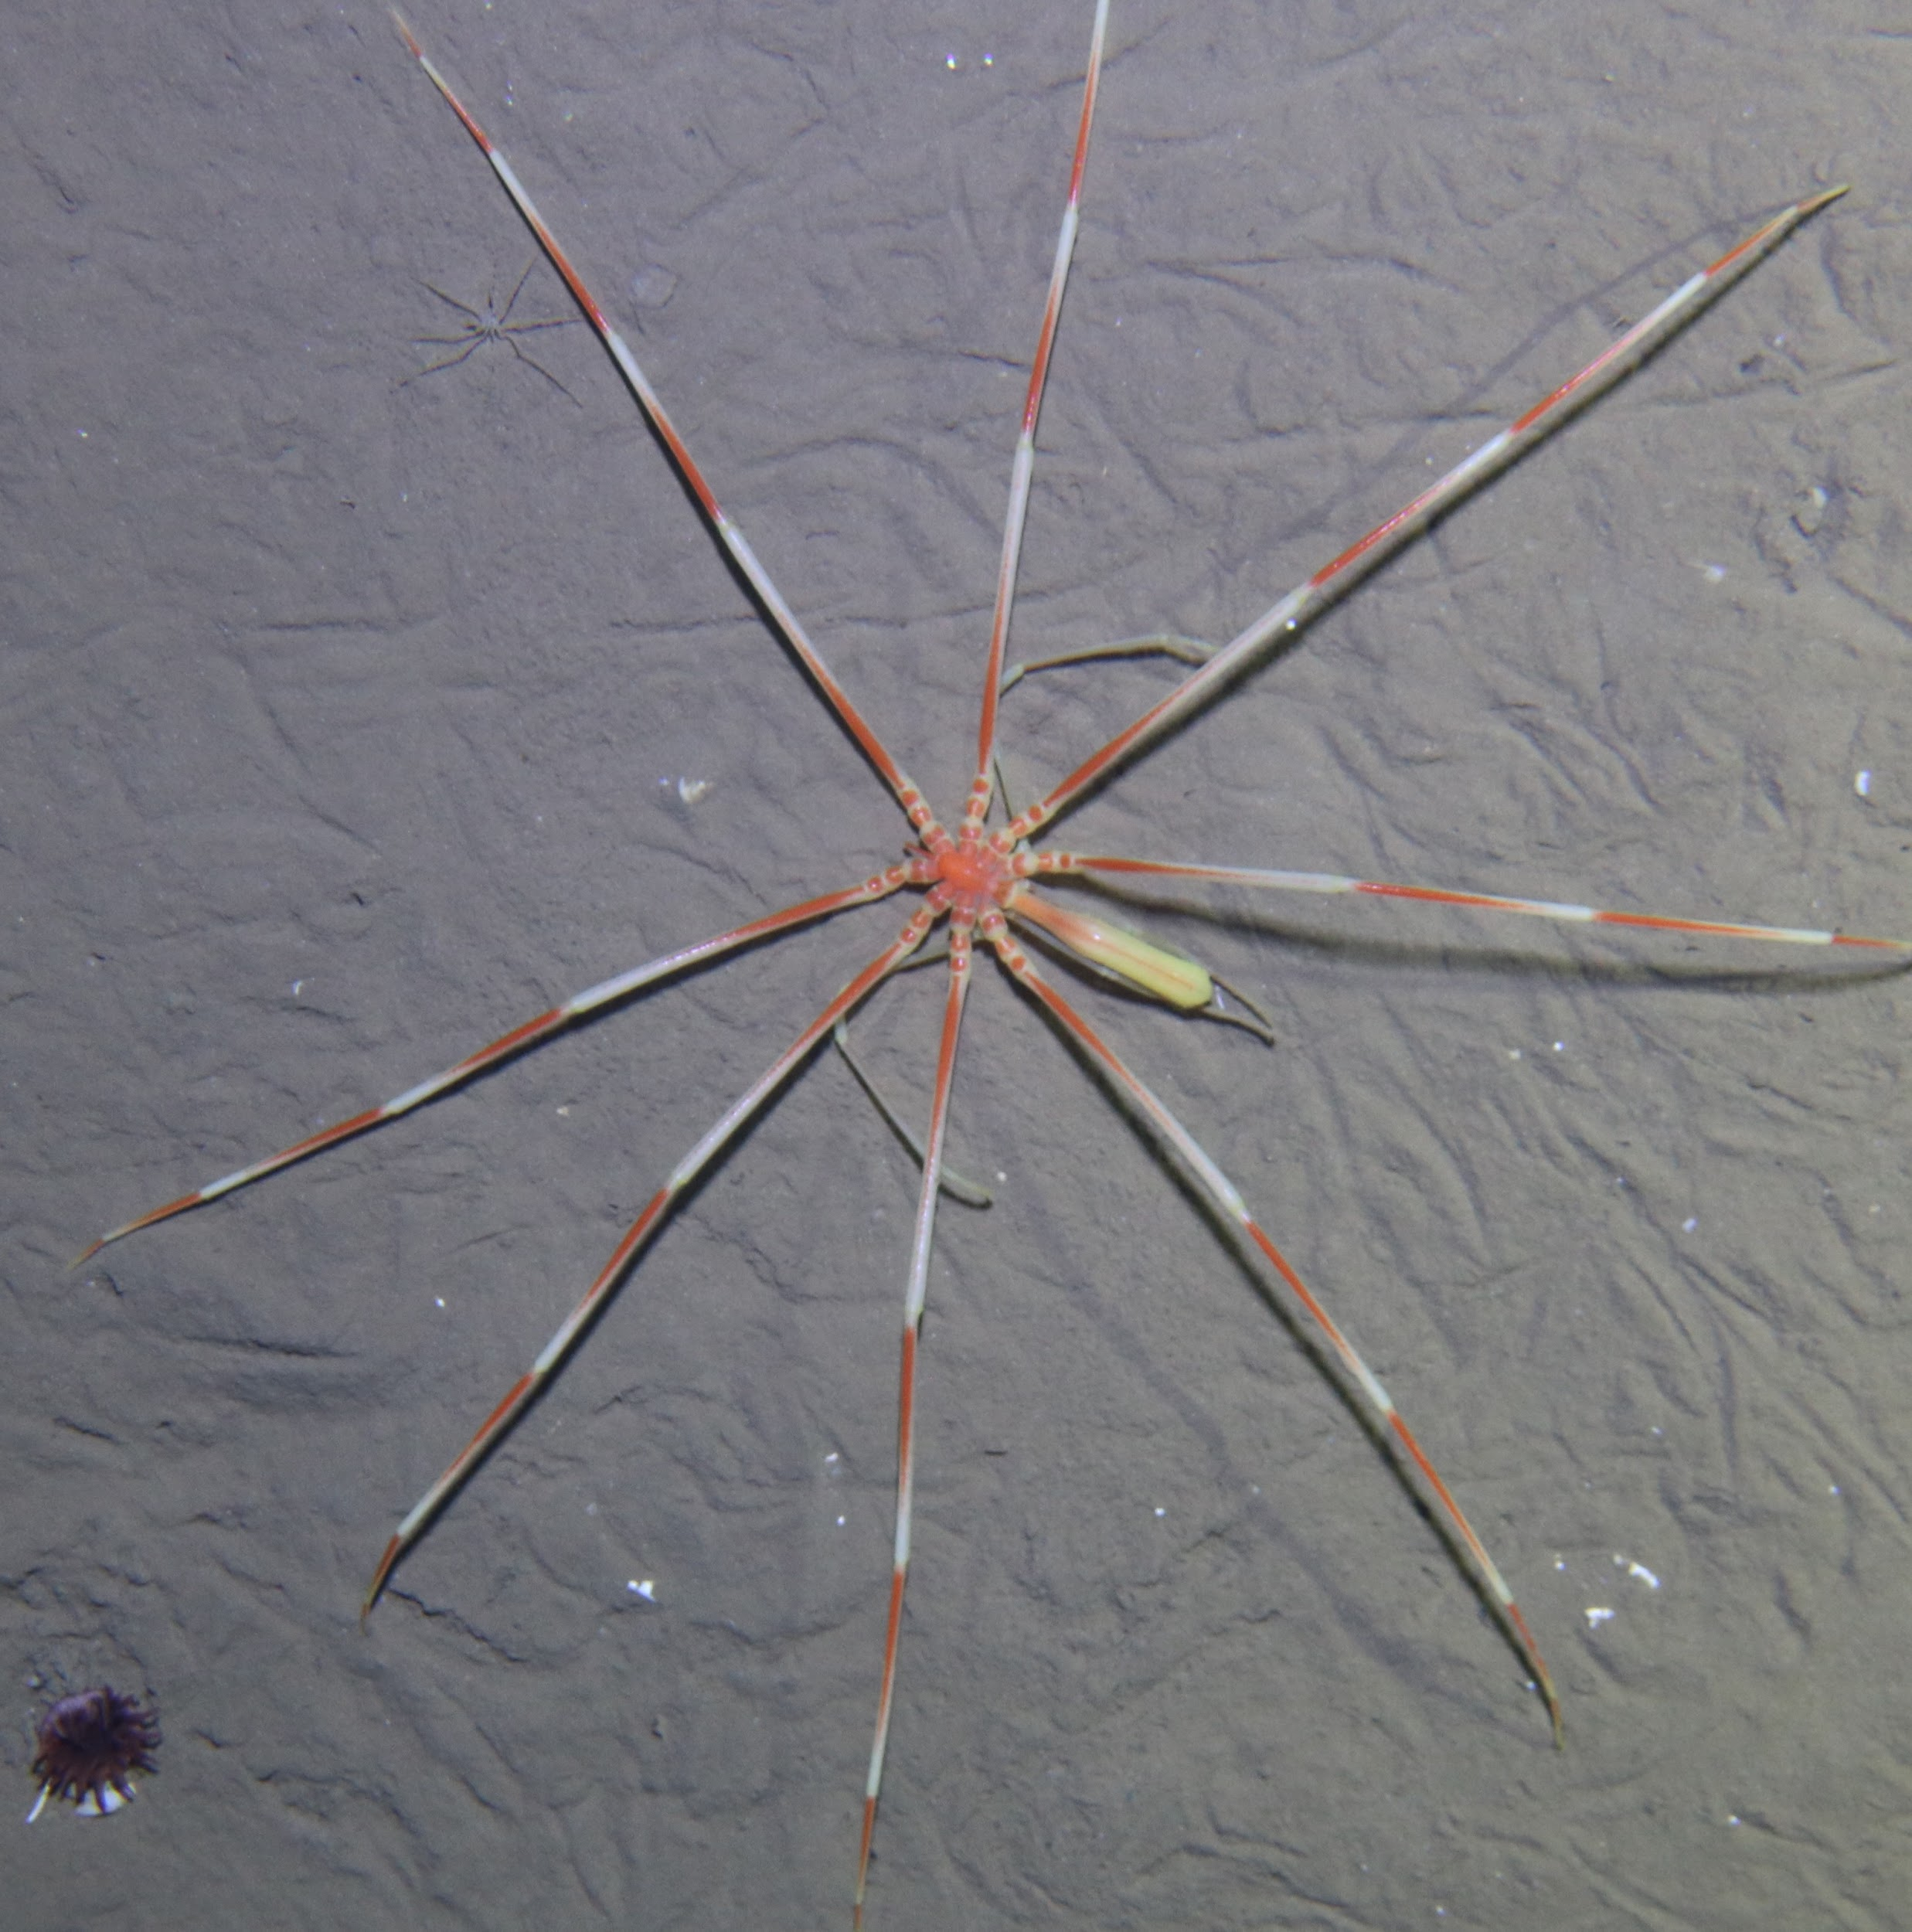
Animals 400 points
Question: When found in temperate waters, these arthropods are much smaller than specimens found in the Arctic or Antarctic. By what common name are Pycnogonids referred?
Answer: Although they are not spiders,
pycnogonids are commonly referred to
as “sea spiders” because of their similar
appearance to spiders (arachnids).
Pycnogonid (Sea Spider - Arctic Ocean)
From: “The Hidden Ocean 2016 - Chukchi Borderlands, NOAA, UAF, Oceaneering-DSSI”
Back to Topics

Slide 17
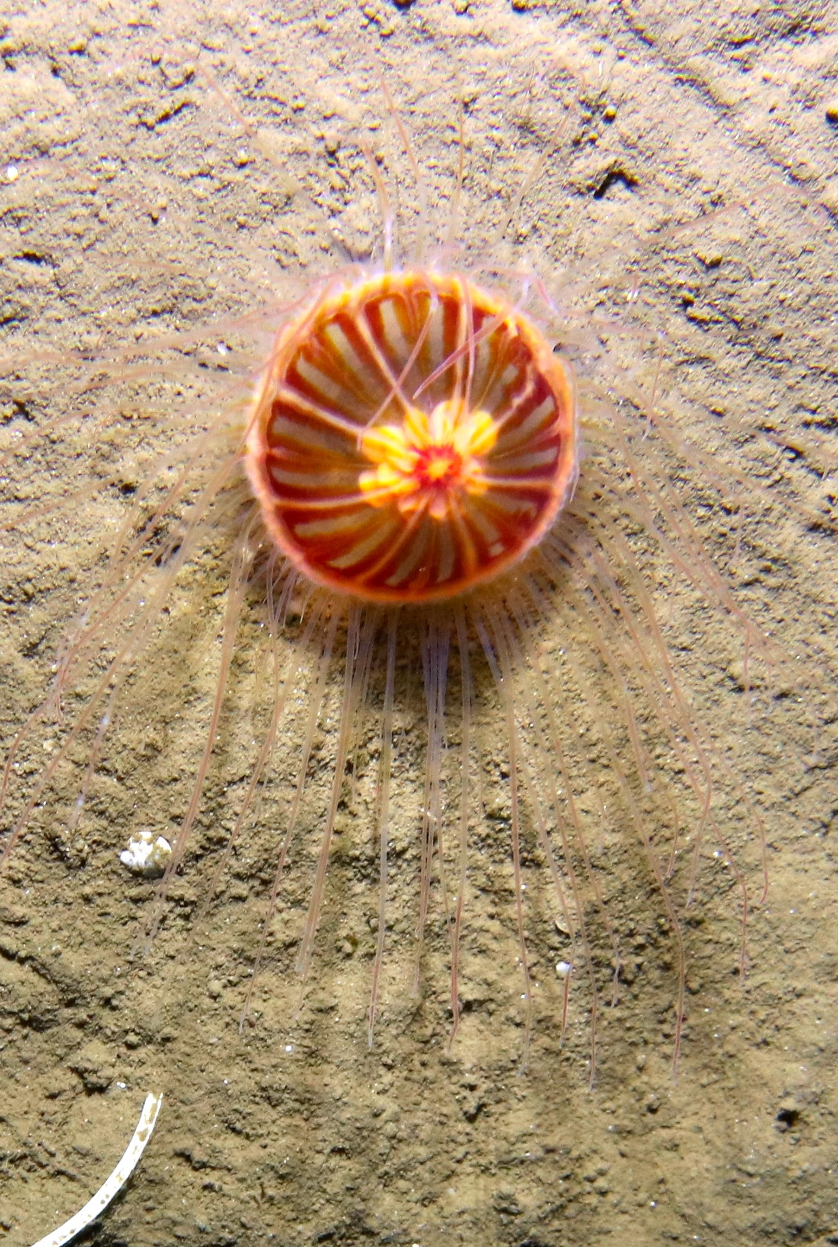
Animals 500 points
Question: What role do these soft-bodied organisms
found in Arctic waters play in the Arctic food web?
Benthic Jellyfish
From: “The Hidden Ocean 2016: Chukchi Borderlands, NOAA, UAF, Oceaneering-DSSI”
Answer: Jellyfish play an important role as
predators in the Arctic food web. This example is a benthic jellyfish that hangs out near the seafloor. Other jellyfish may be found higher in the water column.
Back to Topics

Slide 18
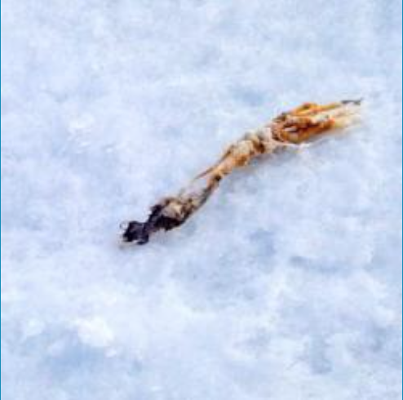
Climate Change 100 points
Question: Why is ice important to polar bears?
Answer: Polar bears are good
swimmers, but they rely on ice
to help hunt their preferred food of
seals. When a seal surfaces to
breathe, a polar bear can grab the
seal and haul it onto the ice to be
eaten.
Back to Topics
The tasty remains of a polar bear meal?
Photo Credit: Sandra Thornton PolarTREC Fellow/NOAA TAS

Slide 19
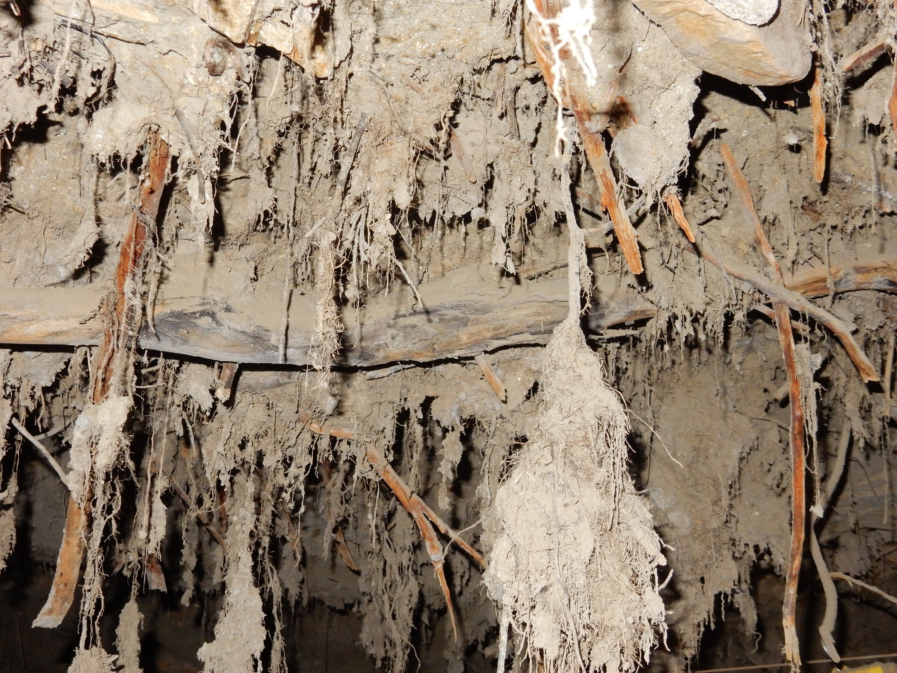
Climate Change 200 points
Question: Approximately how much carbon is sequestered in Arctic permafrost?
a. Half of the carbon currently in Earth’s atmosphere
b. Equal to the amount of carbon currently in Earth’s atmosphere
c. Twice as much carbon as is currently in Earth’s atmosphere
Answer: C. It is estimated that twice
as much carbon is stored in Arctic
permafrost compared to Earth’s
atmosphere. (UAF)
Back to Topics
Pleistocene Vegetation - Permafrost Tunnel, Fairbanks, AK
Photo Credit: Sandra Thornton PolarTREC Fellow/NOAA TAS

Slide 20
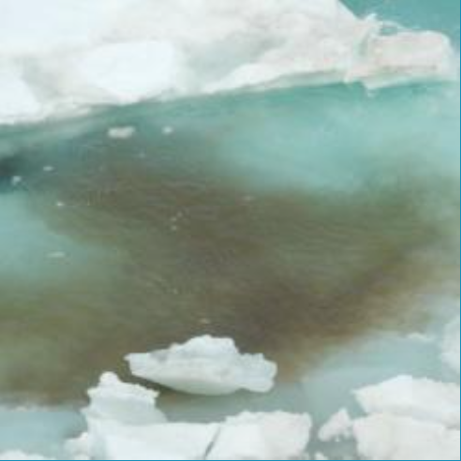
Climate Change 300 points
Question: Why are ice algae important in the Arctic food web?
Answer: As primary producers, ice
algae use the sun’s energy to convert
inorganic carbon into organic
carbon, feeding small organisms
which, in turn, feed larger
organisms. These producers play a
very important role in the Arctic food
web.
Back to Topics
Ice Algae
Photo Credit: Sandra Thornton PolarTREC Fellow/NOAA TAS

Slide 21
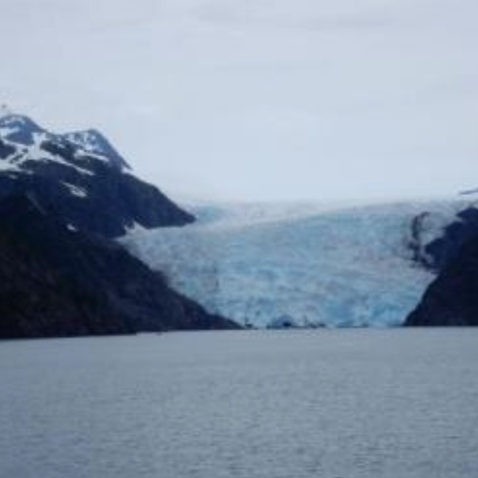
Climate Change 400 points
Question: Why does melting Arctic ice contribute to rising temperatures on Earth?
Answer: Less ice causes Earth’s
temperature to increase.
Ice reflects sunlight, so
more ice reflects more sunlight.
This causes temperatures on Earth
to be cooler. Albedo is a measure
of reflectivity of a material. Ice has
a greater albedo than water and
reflects heat energy back into Earth’s
atmosphere.
Back to Topics
Holgate Glacier
Photo Credit: Sandra Thornton PolarTREC Fellow/NOAA TAS

Slide 22
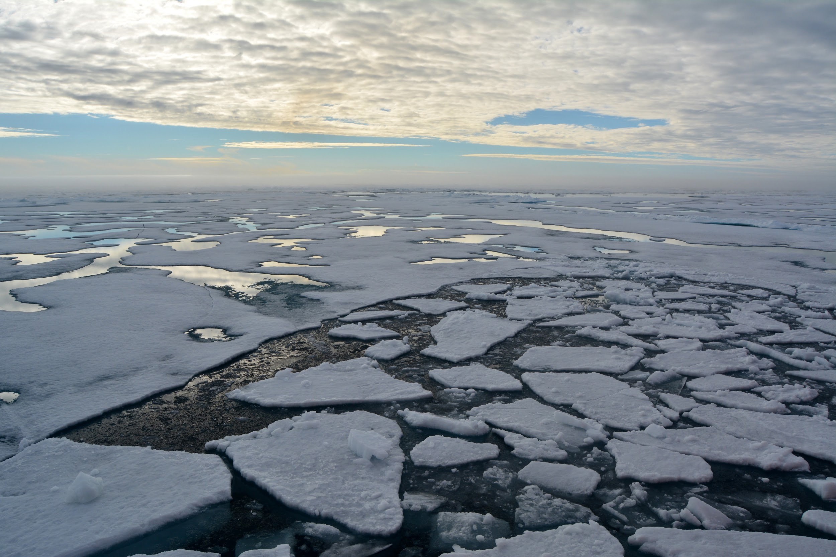
Climate Change 500 points
Question: What makes the Chukchi Borderlands an important Arctic area to study?
Answer: The Chukchi Borderlands
represents one of the biggest
annual ice melts in the Arctic. Because
this area has not been studied very
much, scientists are not sure how
these large changes in climate are
affecting organisms that live in the
Chukchi Borderlands.
Photo Credit: Sandra L. W. Thornton
PolarTREC Fellow/NOAA TAS
Back to Topics

Slide 23
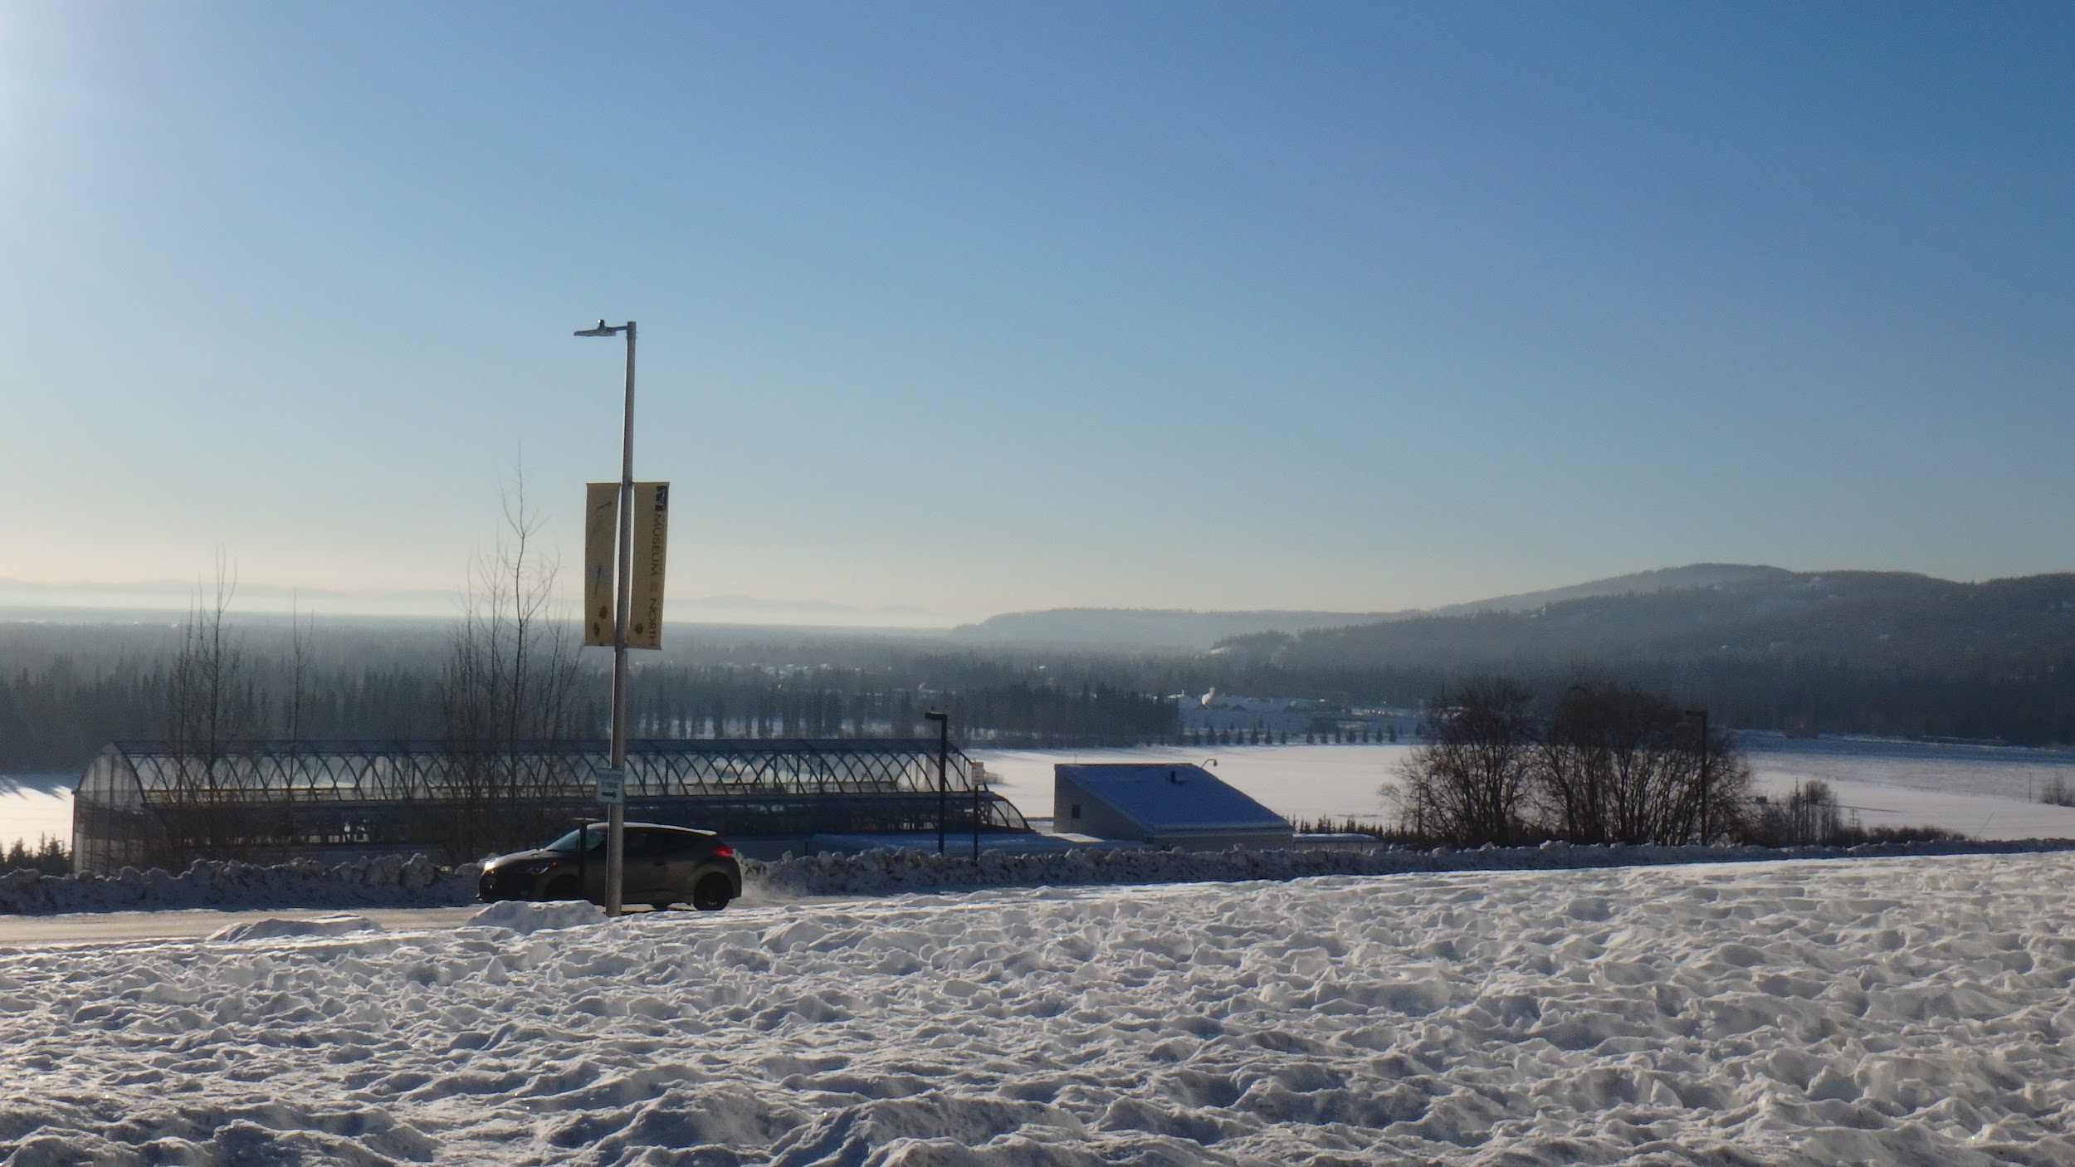
Geography 100 points
Question: True or False? The Arctic is all snow and ice.
Answer: False. A large
portion of the Arctic is
made up of forested
and tundra regions
with a variety of plants.
Back to Topics
Fairbanks, AK
Photo Credit: Sandra Thornton PolarTREC Fellow/NOAA TAS

Slide 24
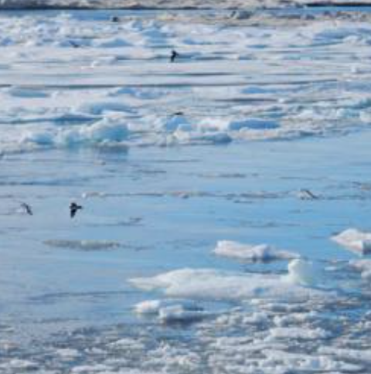
Geography 200 points
Question: The size of the Arctic is approximately:
a. Half the size of North America
b. Equal to the size of North America
c. Double the size of North America.
Answer: B. The Arctic
covers an area nearly
equal to the size of
North America
Birds feeding behind USCGC Healy
Photo Credit: Sandra Thornton PolarTREC Fellow/NOAA TAS
Back to Topics

Slide 25
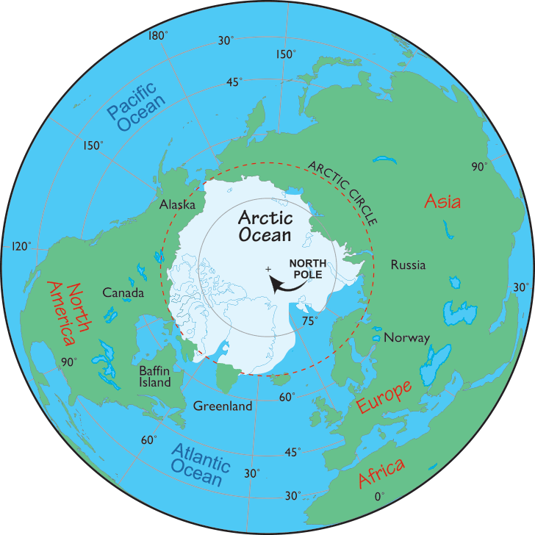
Geography 300 points
Question: What is the name of the region found above an imaginary line drawn approximately 66°33’46.5” north of the Equator?
Answer: The Arctic Circle.
http://www.worldatlas.com/img/areamap/continent/arctic_map.gif
Back to Topics

Slide 26
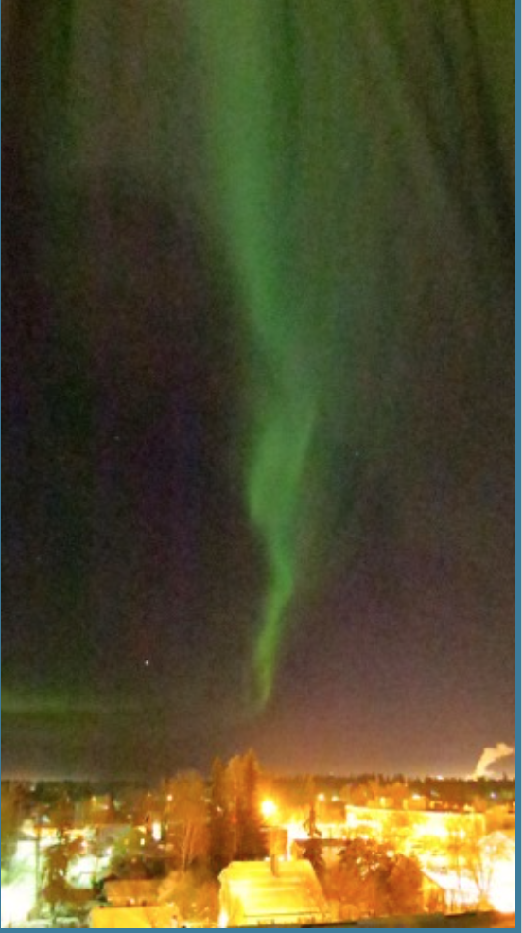
Geography 400 points
Question: What causes the
phenomenon shown in this photo?
Aurora borealis from Westmark Hotel, Fairbanks.
Photo Credit: DJ Kast.
Answer: The Aurora Borealis (Northern Lights) is produced when electrons emitted from the sun collide with atoms and molecules in Earth’s upper atmosphere. Although this can happen at any time of the year, it is only seen when the sky is dark.
Back to Topics

Slide 27
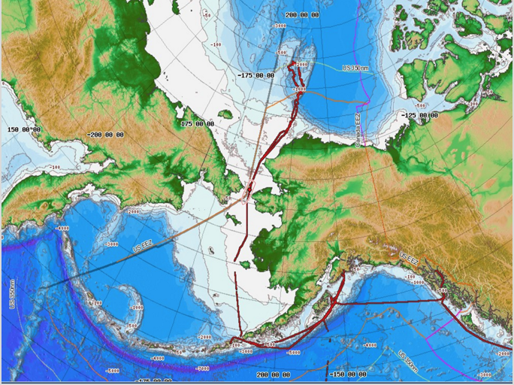
Geography 500 points
Question: What body of water connects the Arctic Ocean to the Pacific Ocean?
Answer: The Arctic Ocean is
connected to the Pacific
Ocean via the Bering Strait.
Back to Topics

