Slide 1
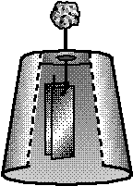
Lab:
Making and Using an Electroscope

Slide 2
List your materials:
ruler
scissors
10 cm x 30 cm piece of foil
1 paperclip
1 plastic cup with a hole
3 g of clay

Slide 3
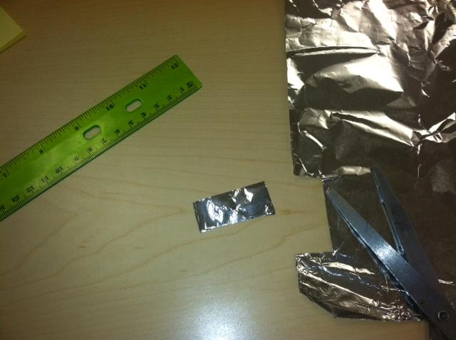
Write the procedure:
1. Cut a piece
of foil 2 cm x 4 cm

Slide 4
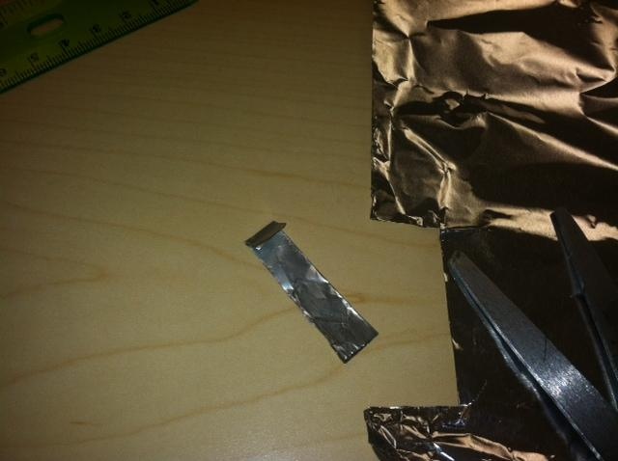
2. Fold foil in half (hot dog style) and fold one end over 0.5 cm
Cut a small triangle
along the edge to
create a diamond-
shaped hole after
unfolding it

Slide 5
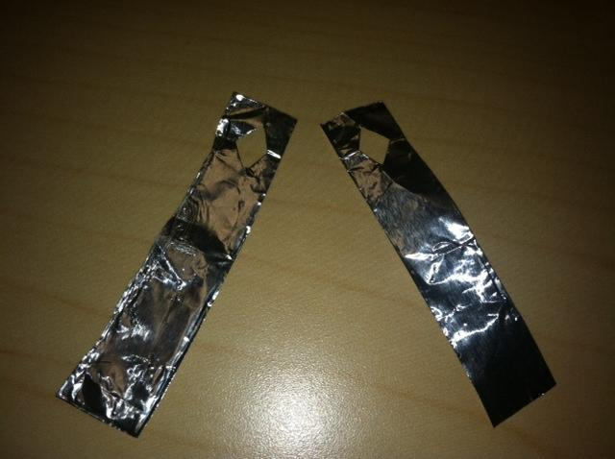
3. Carefully unfold the foil and cut into two separate leaves

Slide 6
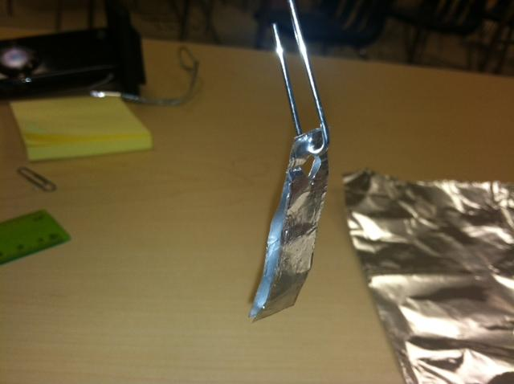
4. Unfold one end of a paper clip and hang the leaves on the loop

Slide 7
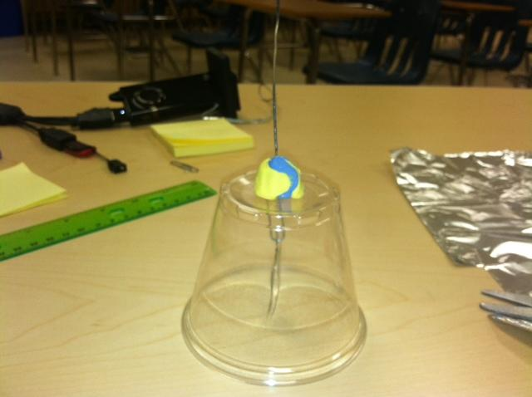
5. Insert the paperclip into the cup and secure it with the clay.

Slide 8
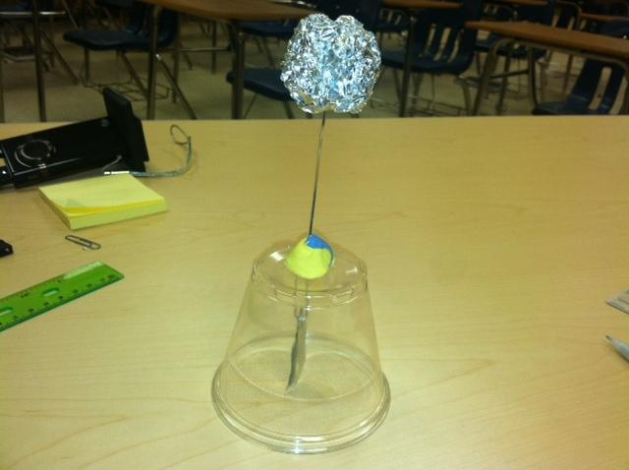
6. Ball up the remaining foil and place on the straight end of the paper clip

Slide 9
7. Write your name on a Post-it and secure it to the electroscope

