Slide 1
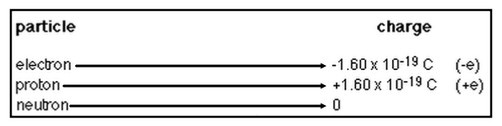
Charges:
Protons and electrons have equal but opposite charges

Slide 2
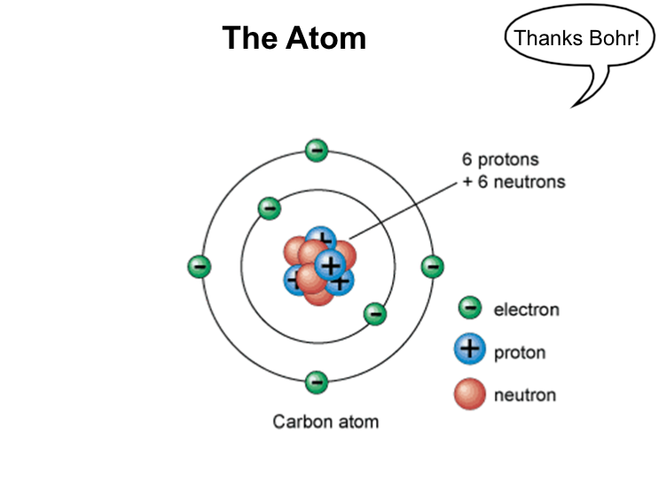

Slide 3
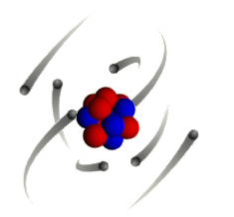
Which particles can move and why?
ELECTRONS!
    They’re light (mass = 9.10938356 × 10⁻³¹ kilograms)
    They’re small (radius = ~2.8179 x 10⁻¹⁵ meters)
    They’re on the outside of the atom

Slide 4
Net Charge:
An object that gains electrons is "charged negative"
An object that looses electrons is "charged positive"

Slide 5
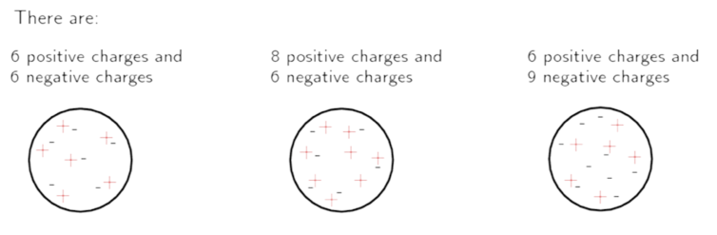
What is the NET charge on these objects?

Slide 6
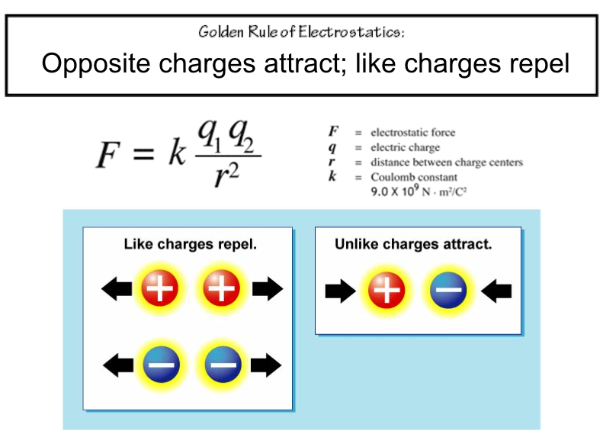

Slide 7
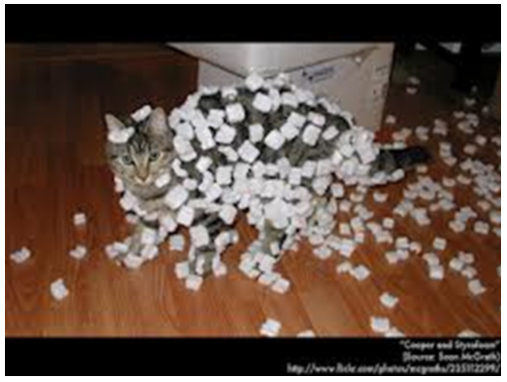
How can we charge an object?

Slide 8
How can we charge an object?
Think: How can we get electrons to move?
Friction - transferring electrons through rubbing
Conduction - transferring electrons through touch or contact
Induction - bringing a charged close to a neutral object and polarizing it

Slide 9
Friction: transferring electrons through rubbing
Think: ripping electrons off one object and transferring them to another.
Example: sock & shirt
http://phet.colorado.edu/en/simulation/balloons

Slide 10

Conduction: transferring electrons through touch
Think: electrons flowing from one object to another
Example: Van de Graaff Generator and hair

Slide 11
Induction: bringing a charged close to a neutral object and polarizing it
What’s that?

Slide 12
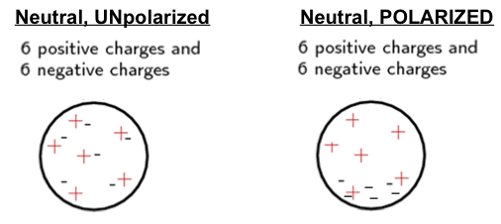
Polarization:
Even though your net charge might be neutral, the object can still be polarized!
Polarization is when each side of the object develops a charge.

Slide 13
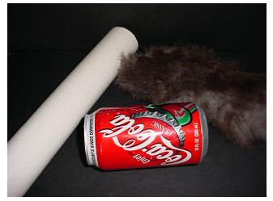
Induction: bringing a charged close to a neutral object and polarizing it
Think: Think: inducing a charge at a distance
Example: Pop can & rod

Slide 14
How can we get rid of a net charge?
Think: How can we restore a neutral charge?
Discharging: getting rid of net charge
Grounding: removing electrons through contact with the 'ground'
  A ground is something that has seemingly infinite supply of electrons; it can give or take electrons from the object
  Example: ground
  Example: person

Slide 15
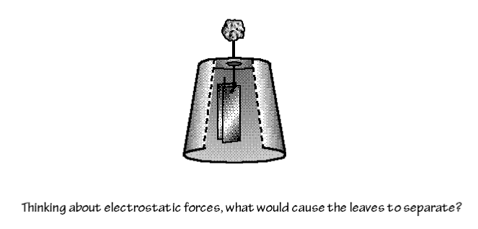
Electroscope Lab

Slide 16
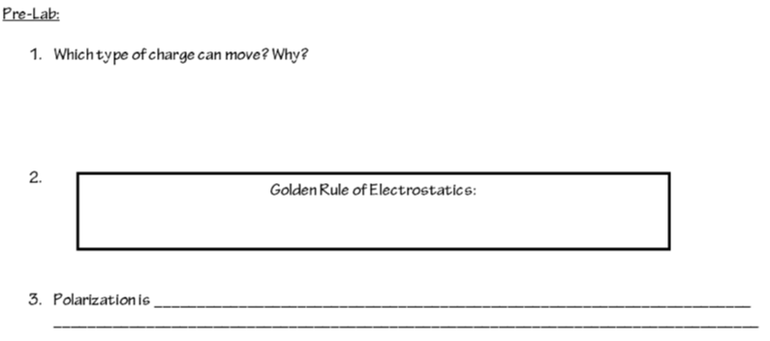

Slide 17
Post-Lab Discussion:
Describe how positive and negative charges interact with one another.
Describe how neutral charges interact with other charges.
Knowing that a neutrino is chargeless, what types of interactions would you expect?
Knowing this, why might IceCube researchers be so interested in neutrinos? (Hint: Think about the path a neutrino would take from its source to you!)
Knowing this, why might neutrinos be difficult for IceCube researchers to detect?

