Slide 1
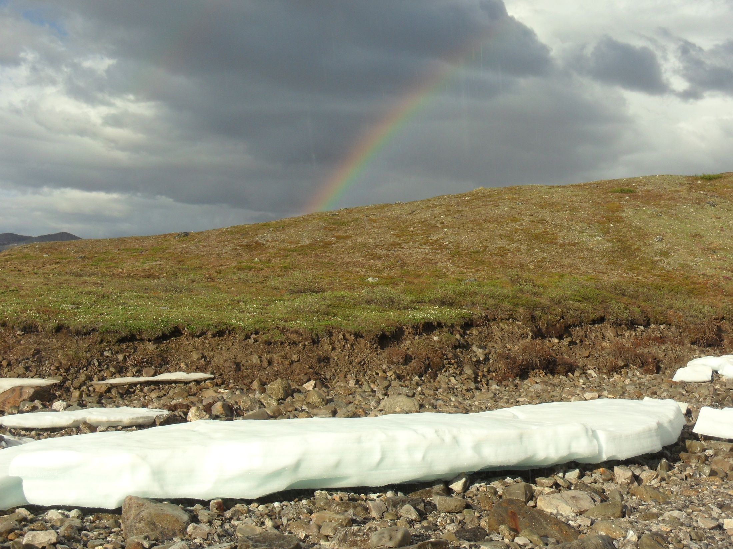
Teaching science through the lens of scientific research
An overview of a scientific expedition to the Arctic
Notes:
Title: scientific research study trips

Slide 2
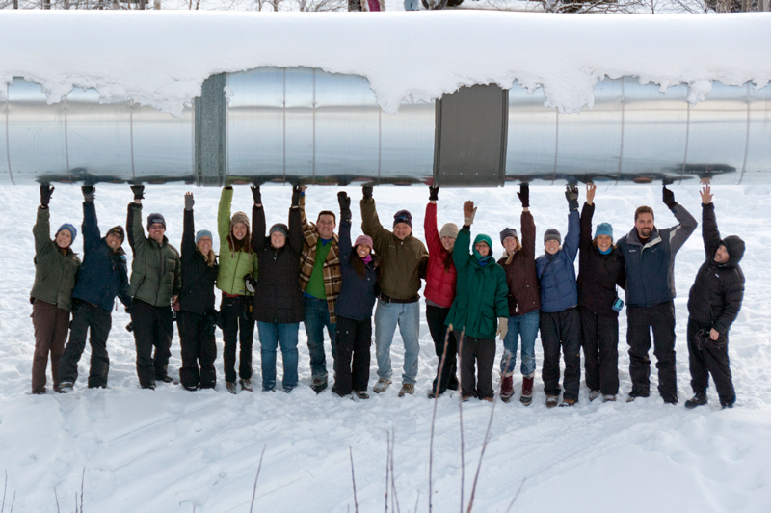
This past year, I was lucky enough to be one of a dozen teachers selected from nearly 200 applicants to be a participating teacher in the 2012-2013 PolarTREC expeditions.

Slide 3
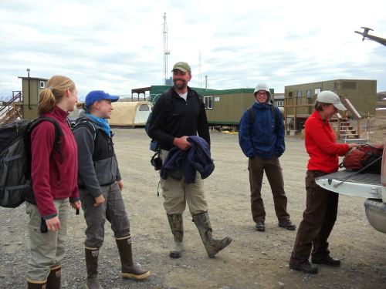
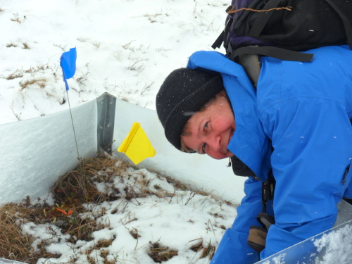
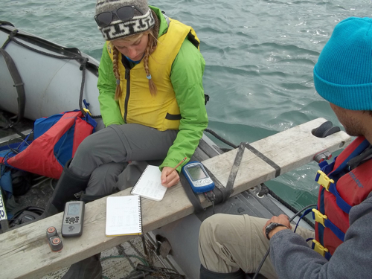
PolarTREC is a professional development program funded by the National Science Foundation and administered by the Arctic Research Consortium of the United States. The heart of the program is to pair teachers with researchers working for two to six weeks in the Arctic or Antarctic, and have the teacher become an integral part of the researcher team.

Slide 4
Of course, it’s all for more powerful teaching and learning for the students!

Slide 5
Let’s look at some ways to bring authentic science and skills into a classroom

Slide 6
Make a rough sketch map of the room that includes where you sit, or where you have placed something of yours, maybe your coffee cup…add in as much detail as necessary so that someone else can pick out the landmarks and find where your seat or item is located. When everyone is done, trade sketches with someone else in the room, and see if you can find their item or seat.

Slide 7
Field skill #1 : Map making of a phenology plot, or a litterbag placement, or to mark a site where photos are always taken.
These are science projects you can do in your schoolyard, and marking and re-finding plots can be a problem solving skill in and of itself.

Slide 8
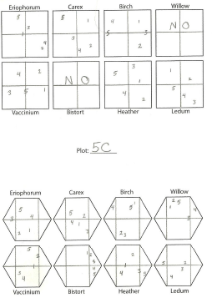
Isn’t pattern recognition and organizing data a major part of science?

Slide 9
Think about
What was the most helpful part of the sketch? What were some of the things that made your sketch useful? Were any of the sketches impossible to use and you were unable to find the item? What made the map difficult or unreliable?
On a sticky note titled “map”, write down 2 or 3 skills or concepts this activity involved you in. During round robin share of the information on stickies, jot down additional points you thought were useful

Slide 10
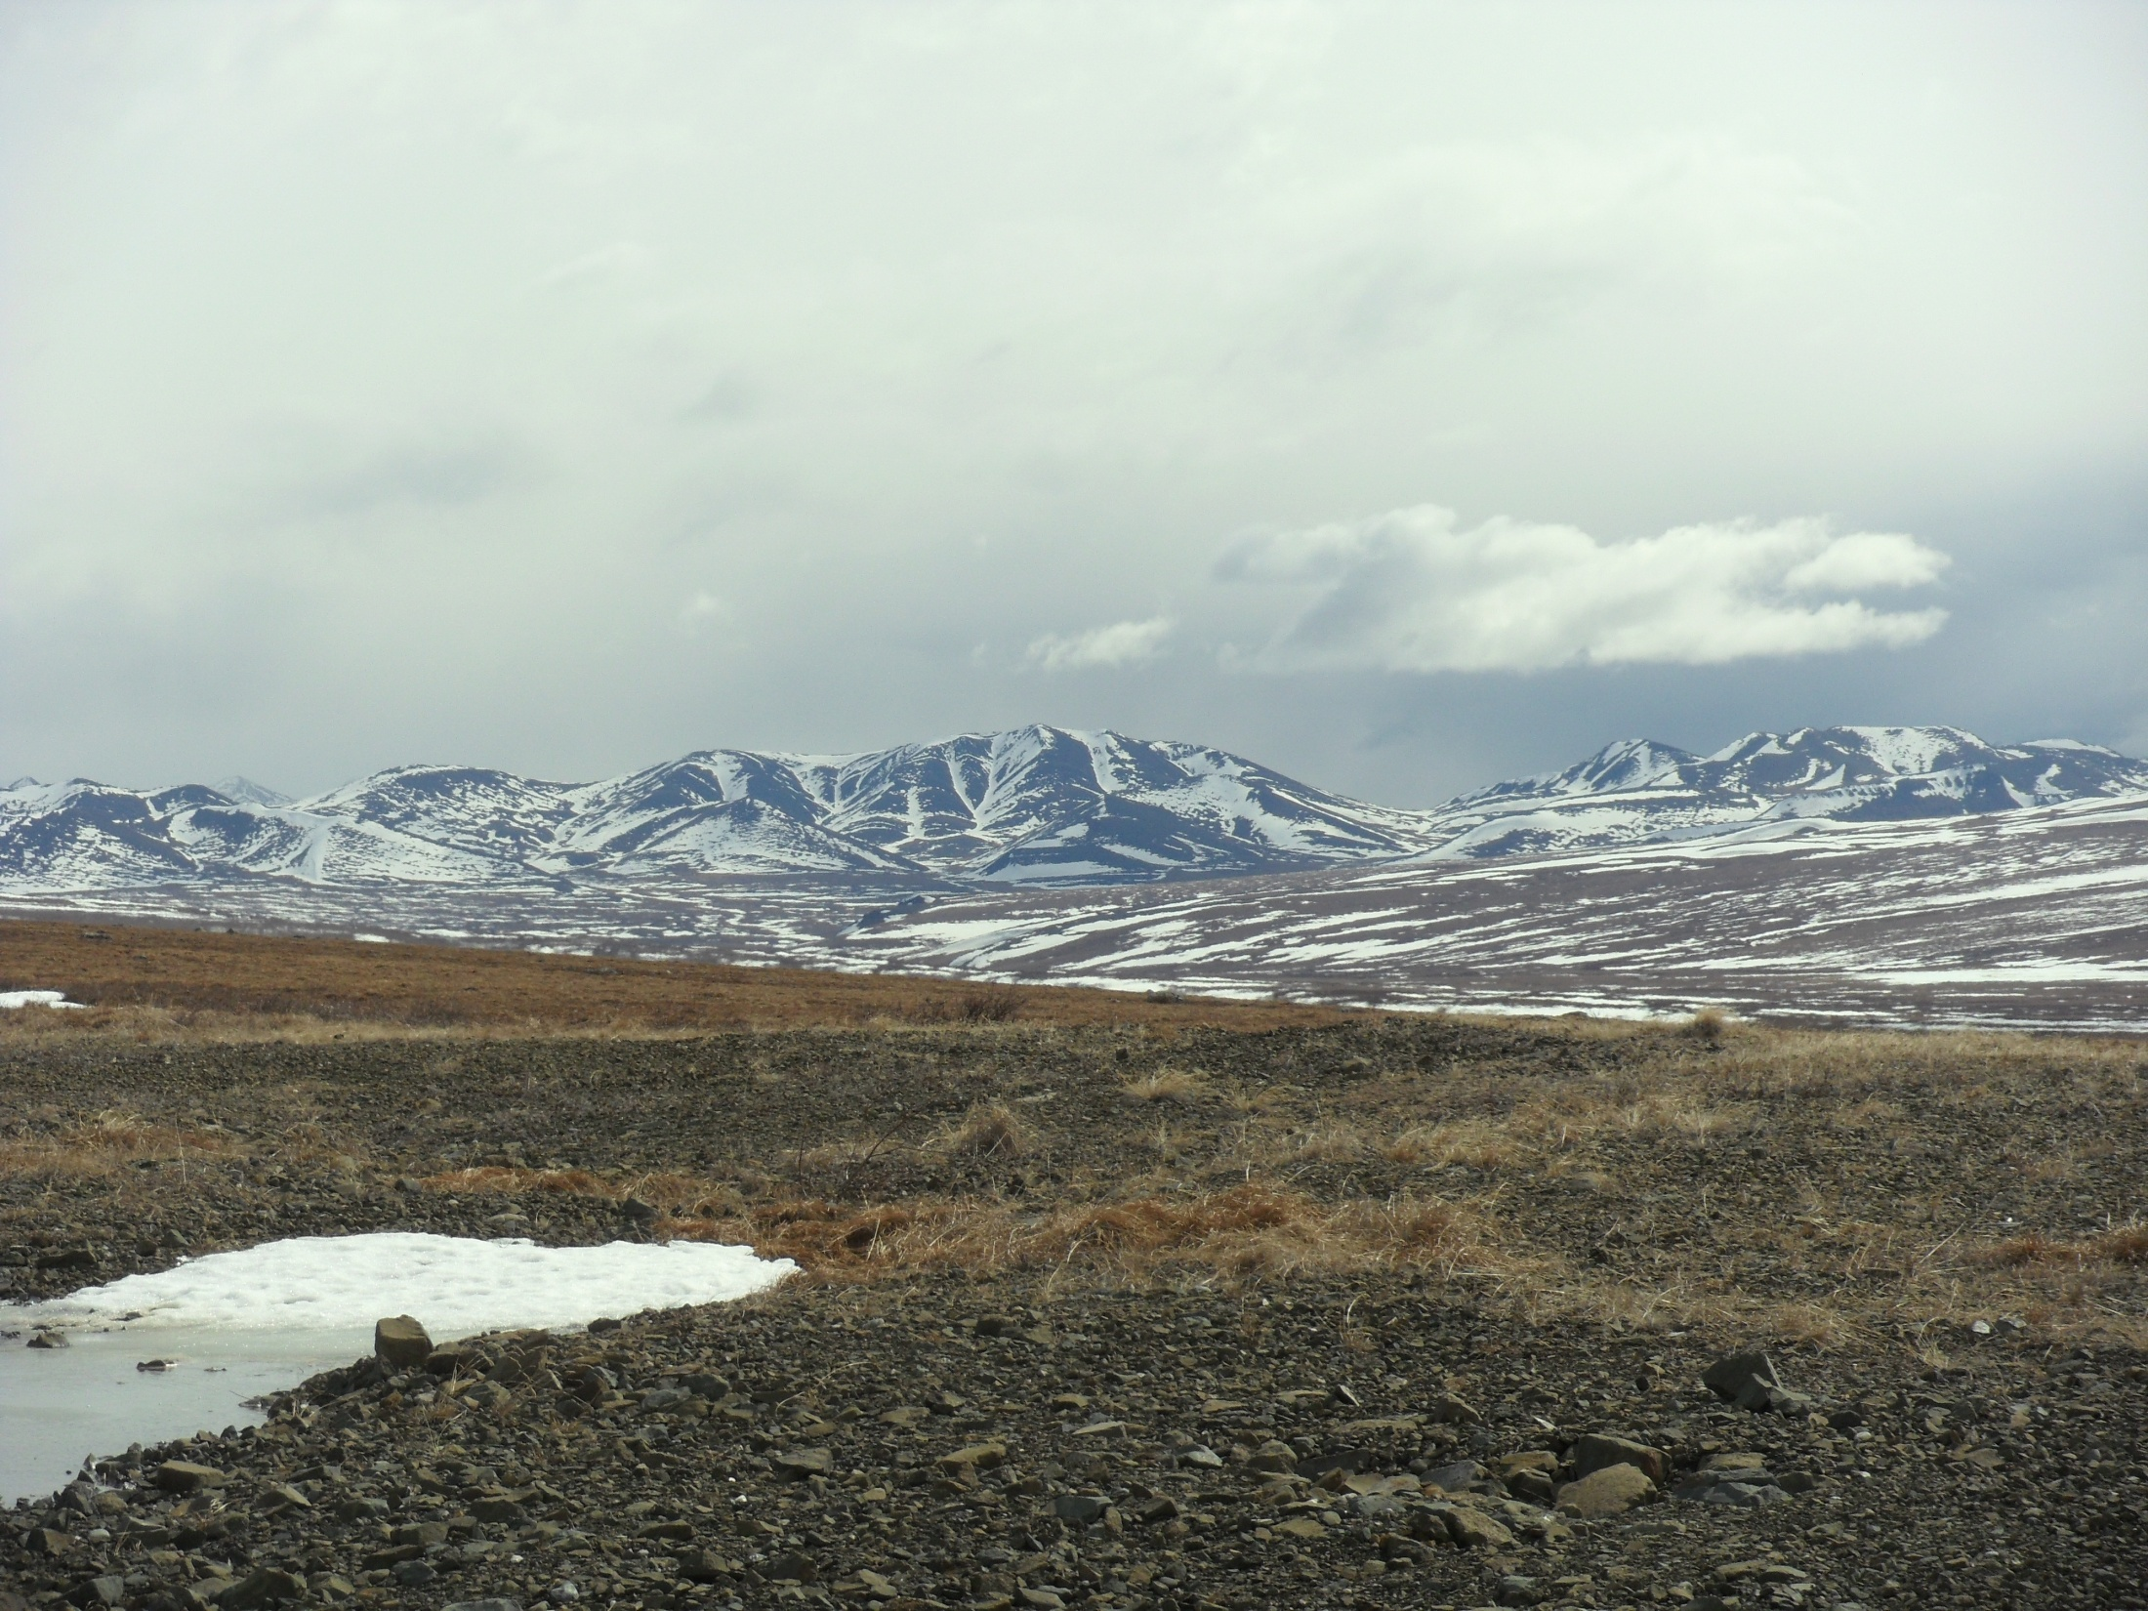

Slide 11
Writing skills
Journaling or blogging. A part of the work of scientists includes sharing their work with peers. Science writing for the popular audience is becoming increasingly more important, and as a part of PolarTREC I was required to write and post journals about our science.
Questioning skills are also an important part of authentic learning. You can interact with a PolarTREC teacher and their expedition by having your students post questions in the Ask The Team Forum on each expedition website.

Slide 12
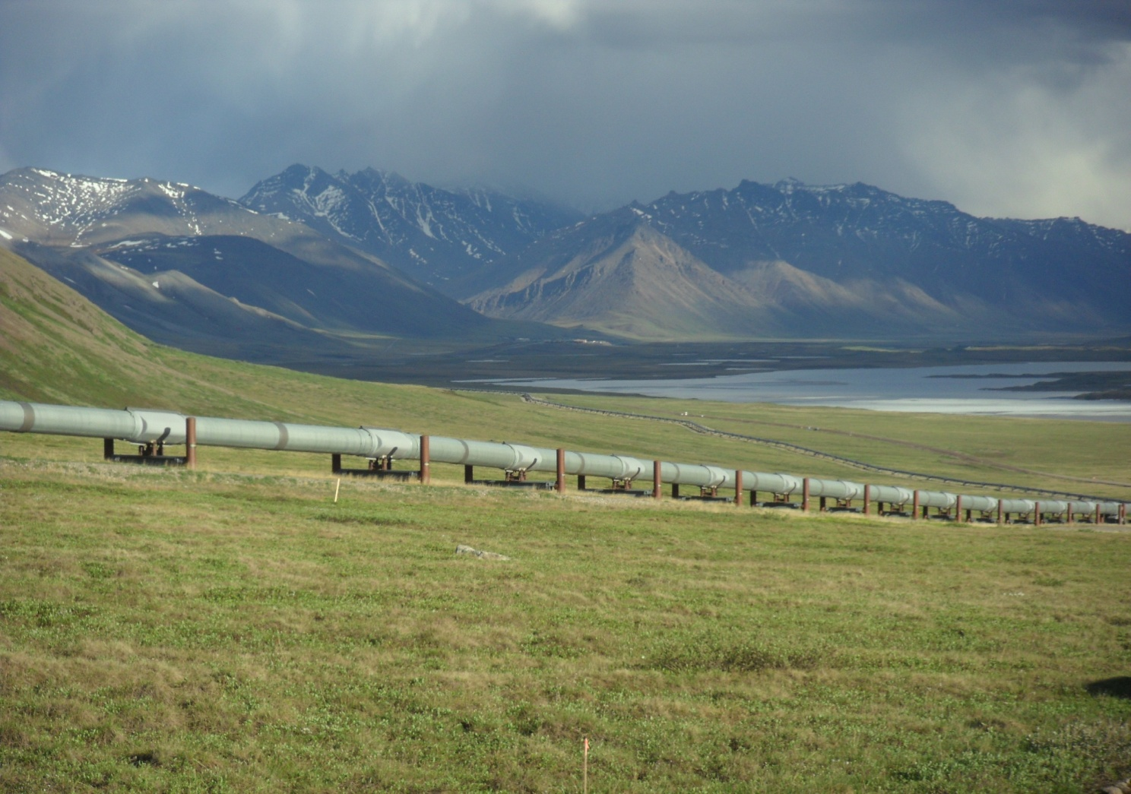
PolarTREC Journals
A Pipeline, A Haul Road, and a Research Station

Slide 13
I had a few students volunteer to follow my expedition journals over the summer

Slide 14
Journal writing?
Your students can read and summarize journal articles, and write their own…complete with pictures inserted.

Slide 15
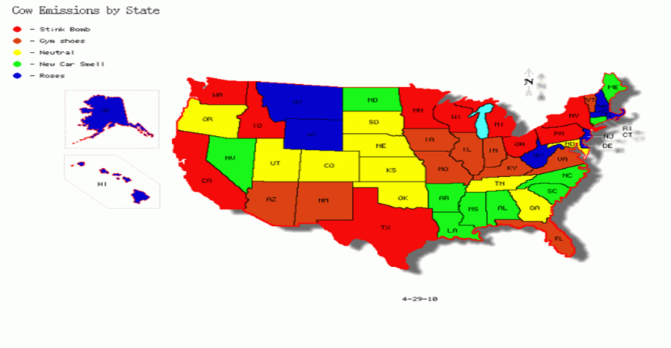
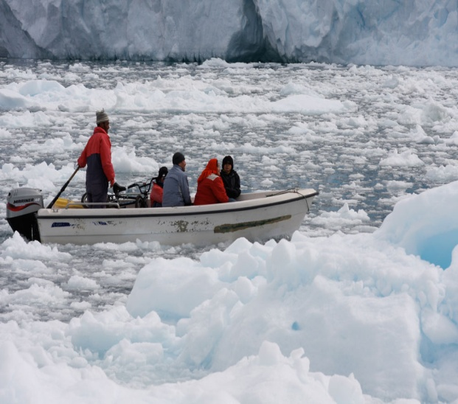
Why not have students write journal posts?
Cow emissions of methane
Natural Causes of Global Warming
Readers of the Science Magazine, We are here today to talk about the serious and imminent problem of global warming. The topic that I am presenting to you today is natural causes of global warming. People aren’t the only causes of global warming. It has been happening in cycles with ice ages since the formation of the Earth. Natural causes of global warming are: volcanic eruptions, increased solar activity (courtesy MEC student Sarah)
Climate change IS affecting the culture and lifestyle of the arctic people. Scientist have estimated that within a decade, the Inupiaq village of Sarichef will be swallowed by the rising sea. The reason for this horrible estimation is that back in October of 2001; a severe fall storm caused the shoreline to move inland over 125 feet. The people will now be forced to move to higher ground and will lose not only their land, but everything that their lives have been based on for the past 4,000 years that they have lived there. (courtesy MEC student Kylie)
How Climate Change is Affecting the People of the Arctic Nation’s Culture

Slide 16
Long term datasets
Graphing activity of ice duration on Lake Mendota
take a slip of paper when passed out, and graph the dataset “ice duration” correlated with “Year”
please use a range of 50 – 150 (days) on the y axis, and list your years on the x axis
You can rough it out on a piece of paper, but please make a poster sized edition of your graph on the large paper provided
As a group, come to a conclusion about what the data on your graph show.

Slide 17
Present your data
Your group should stand and hold up your poster for all to see, and clearly state the conclusions you have come to about the duration of ice on Lake Mendota for the time period you have graphed.

Slide 18
Let’s look at the data again
After all the presentations are made, take a few moments to lightly shade in the part of your graph that extends from the lowest point to the highest point.
Bring your poster to the front of the room, and tape it up on the wall in order from oldest year to latest year.

Slide 19
What does our data say now?
Do long term datasets help with our understanding of issues such as climate change? Duration of Ice on Lake Mendota
Other sources of long term datasets you can work with:
Climate and Hydrology database projects
History of Ice on Lake Mendota

Slide 20
UNDERSTANDING DATA… DOES IT MATTER?

Slide 21
New Law in North Carolina Bans Latest Scientific Predictions of Sea-Level Rise
Asbury Sallenger, an oceanographer at the USGS in St Petersburg, Florida, and his colleagues published their report today in Nature Climate Change¹. They analysed tide-gauge records from around North America from between 1950 and 2009, and found that the rates of sea-level rise along the northern half of the eastern seaboard — from Cape Hatteras, North Carolina, to Boston, Massachusetts — are increasing three to four times faster than rates of sea-level rise globally.
"Many people mistakenly think that the rate of sea-level rise is the same everywhere as glaciers and ice caps melt,” said Marcia McNutt, director of the USGS. However, regional variations in temperature, water salinity and air pressure can cause rates of increase to differ considerably, as can ocean currents and land movements.
http://www.nature.com/news/us-northeast-coast-is-hotspot-for-rising-sea-levels-1.10880
NC Considers Making Sea Level Rise Illegal

Slide 22
What can be learned from an activity like this?
Take another sticky note, title it:
Dataset
Jot down 2 or 3 things that can be learned from an activity like this
Post your sticky note on the poster paper marked dataset.

Slide 23
Other ways to incorporate authentic polar research into a classroom
Have students interact with PolarTREC teachers: Ask The Team
students learn good questioning skills
Lesson Plans and Activities
join a live webinar from the field!

Slide 24
You can use information from live expeditions to generate interest in your own classroom
How cool is this video of a solar oven s'mores at the pole! at the South Pole
Notes:
Need to build solar ovens? How cool is this video of a solar oven exp in Antarctica?

Slide 25
Field experience opportunities
PolarTREC: http://www.polartrec.com/
NOAA Teacher at Sea program: http://teacheratsea.noaa.gov/
LTER Research Experiences for Teachers: http://www.lternet.edu/education/ret
Research Vessel Joides Resolution

Slide 26
Opportunities to incorporate science
Citizen science:
Project BudBurst http://neoninc.org/budburst/index.php
Frogwatch USA http://www.aza.org/frogwatch/
Cornell University’s Nestwatch: http://watch.birds.cornell.edu/nestcams/home/index
Pisgah Astronomical Research Institute: http://www.pari.edu/programs/public/citizen-scientist-astronomy-with-the-pari-4-6-m-radio-telescope/
Education programs at the Appalachian Highlands Learning Center: http://www.nps.gov/grsm/forteachers/pk-education.htm#CP_JUMP_154258
The Globe program: http://www.globe.gov/
Cocorahs: http://www.cocorahs.org/

Slide 27
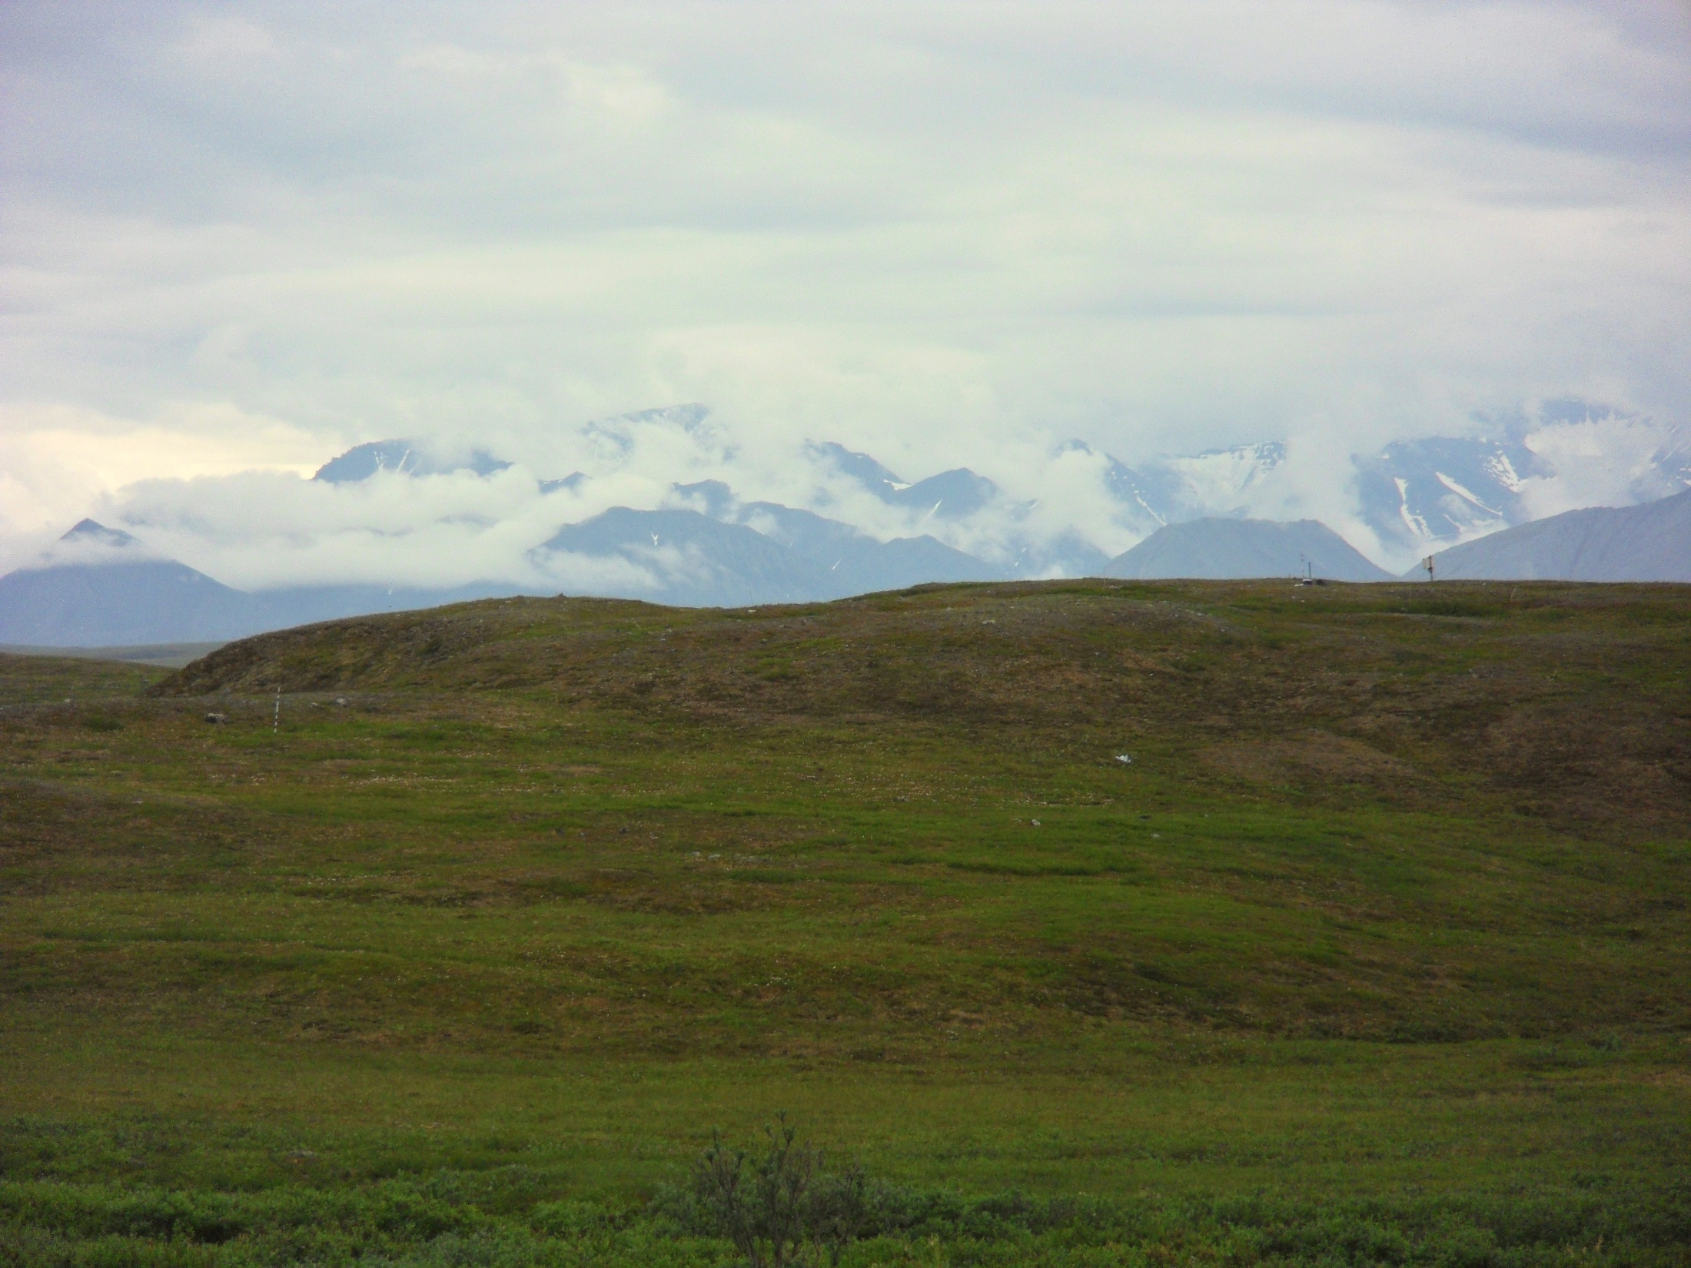
What was it like to go to the Arctic?

Slide 28
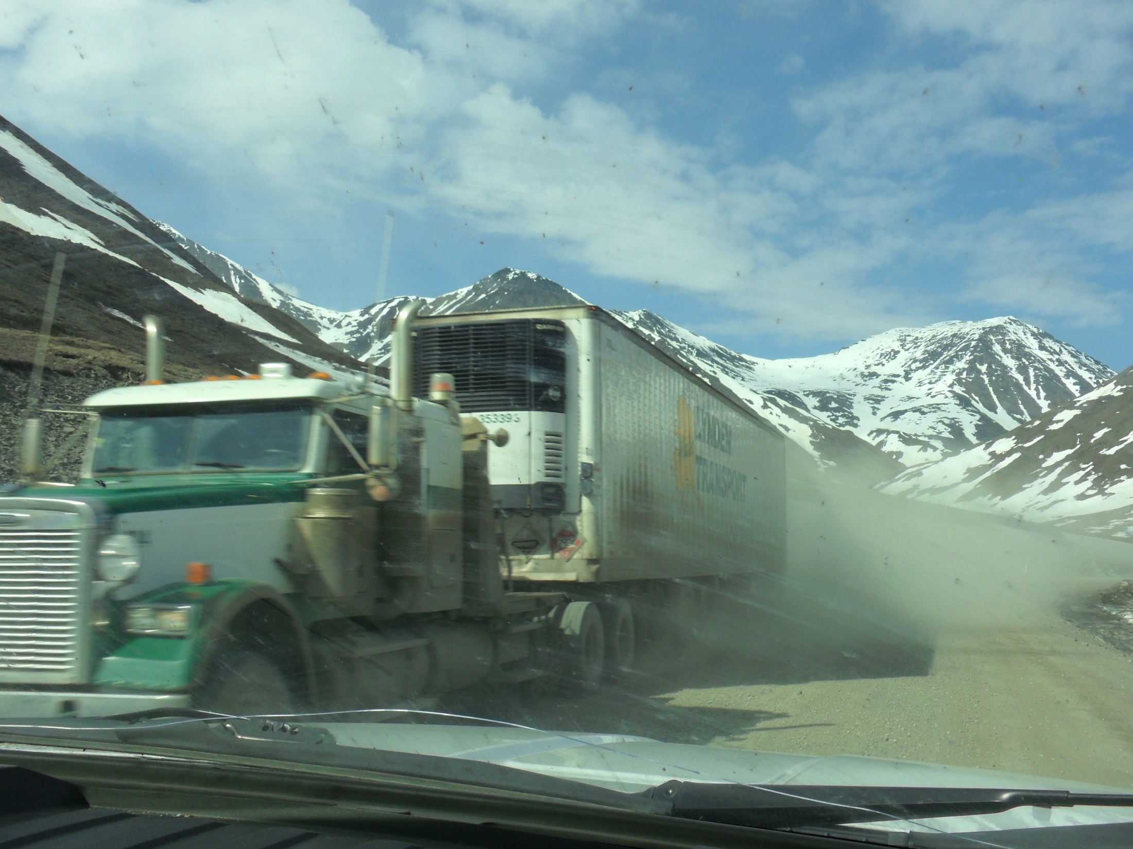
Notes:
We drove north out of Fairbanks on the Dalton Highway, aka the “Haul Road”; famous route of truckers supplying the oil fields of Prudhoe Bay. The drive would cover over three hundred miles, and takes about nine hours to reach the research field station where I worked.

Slide 29
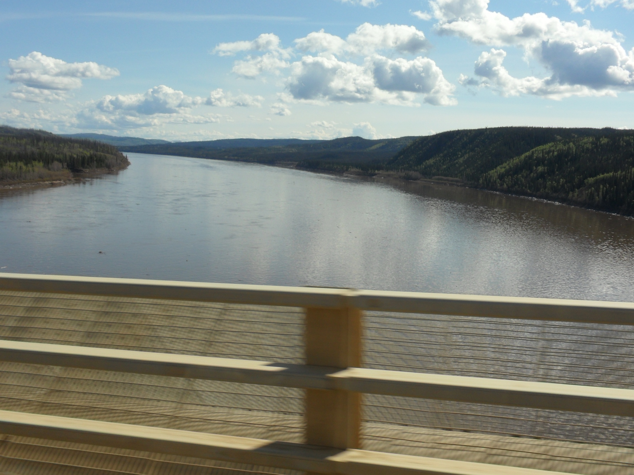
Notes:
Our trip north from Fairbanks took us across the Yukon River.

Slide 30
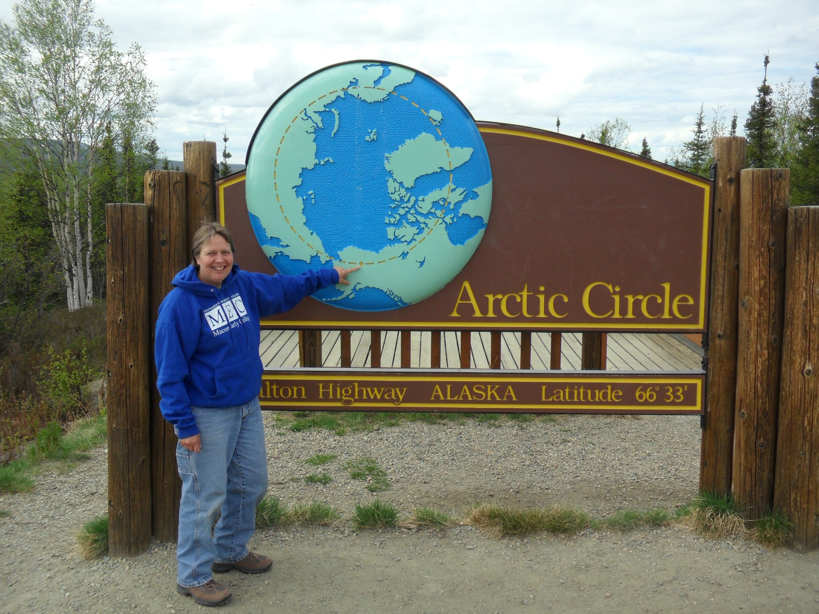
Notes:
At latitude 66….the Arctic Circle!

Slide 31
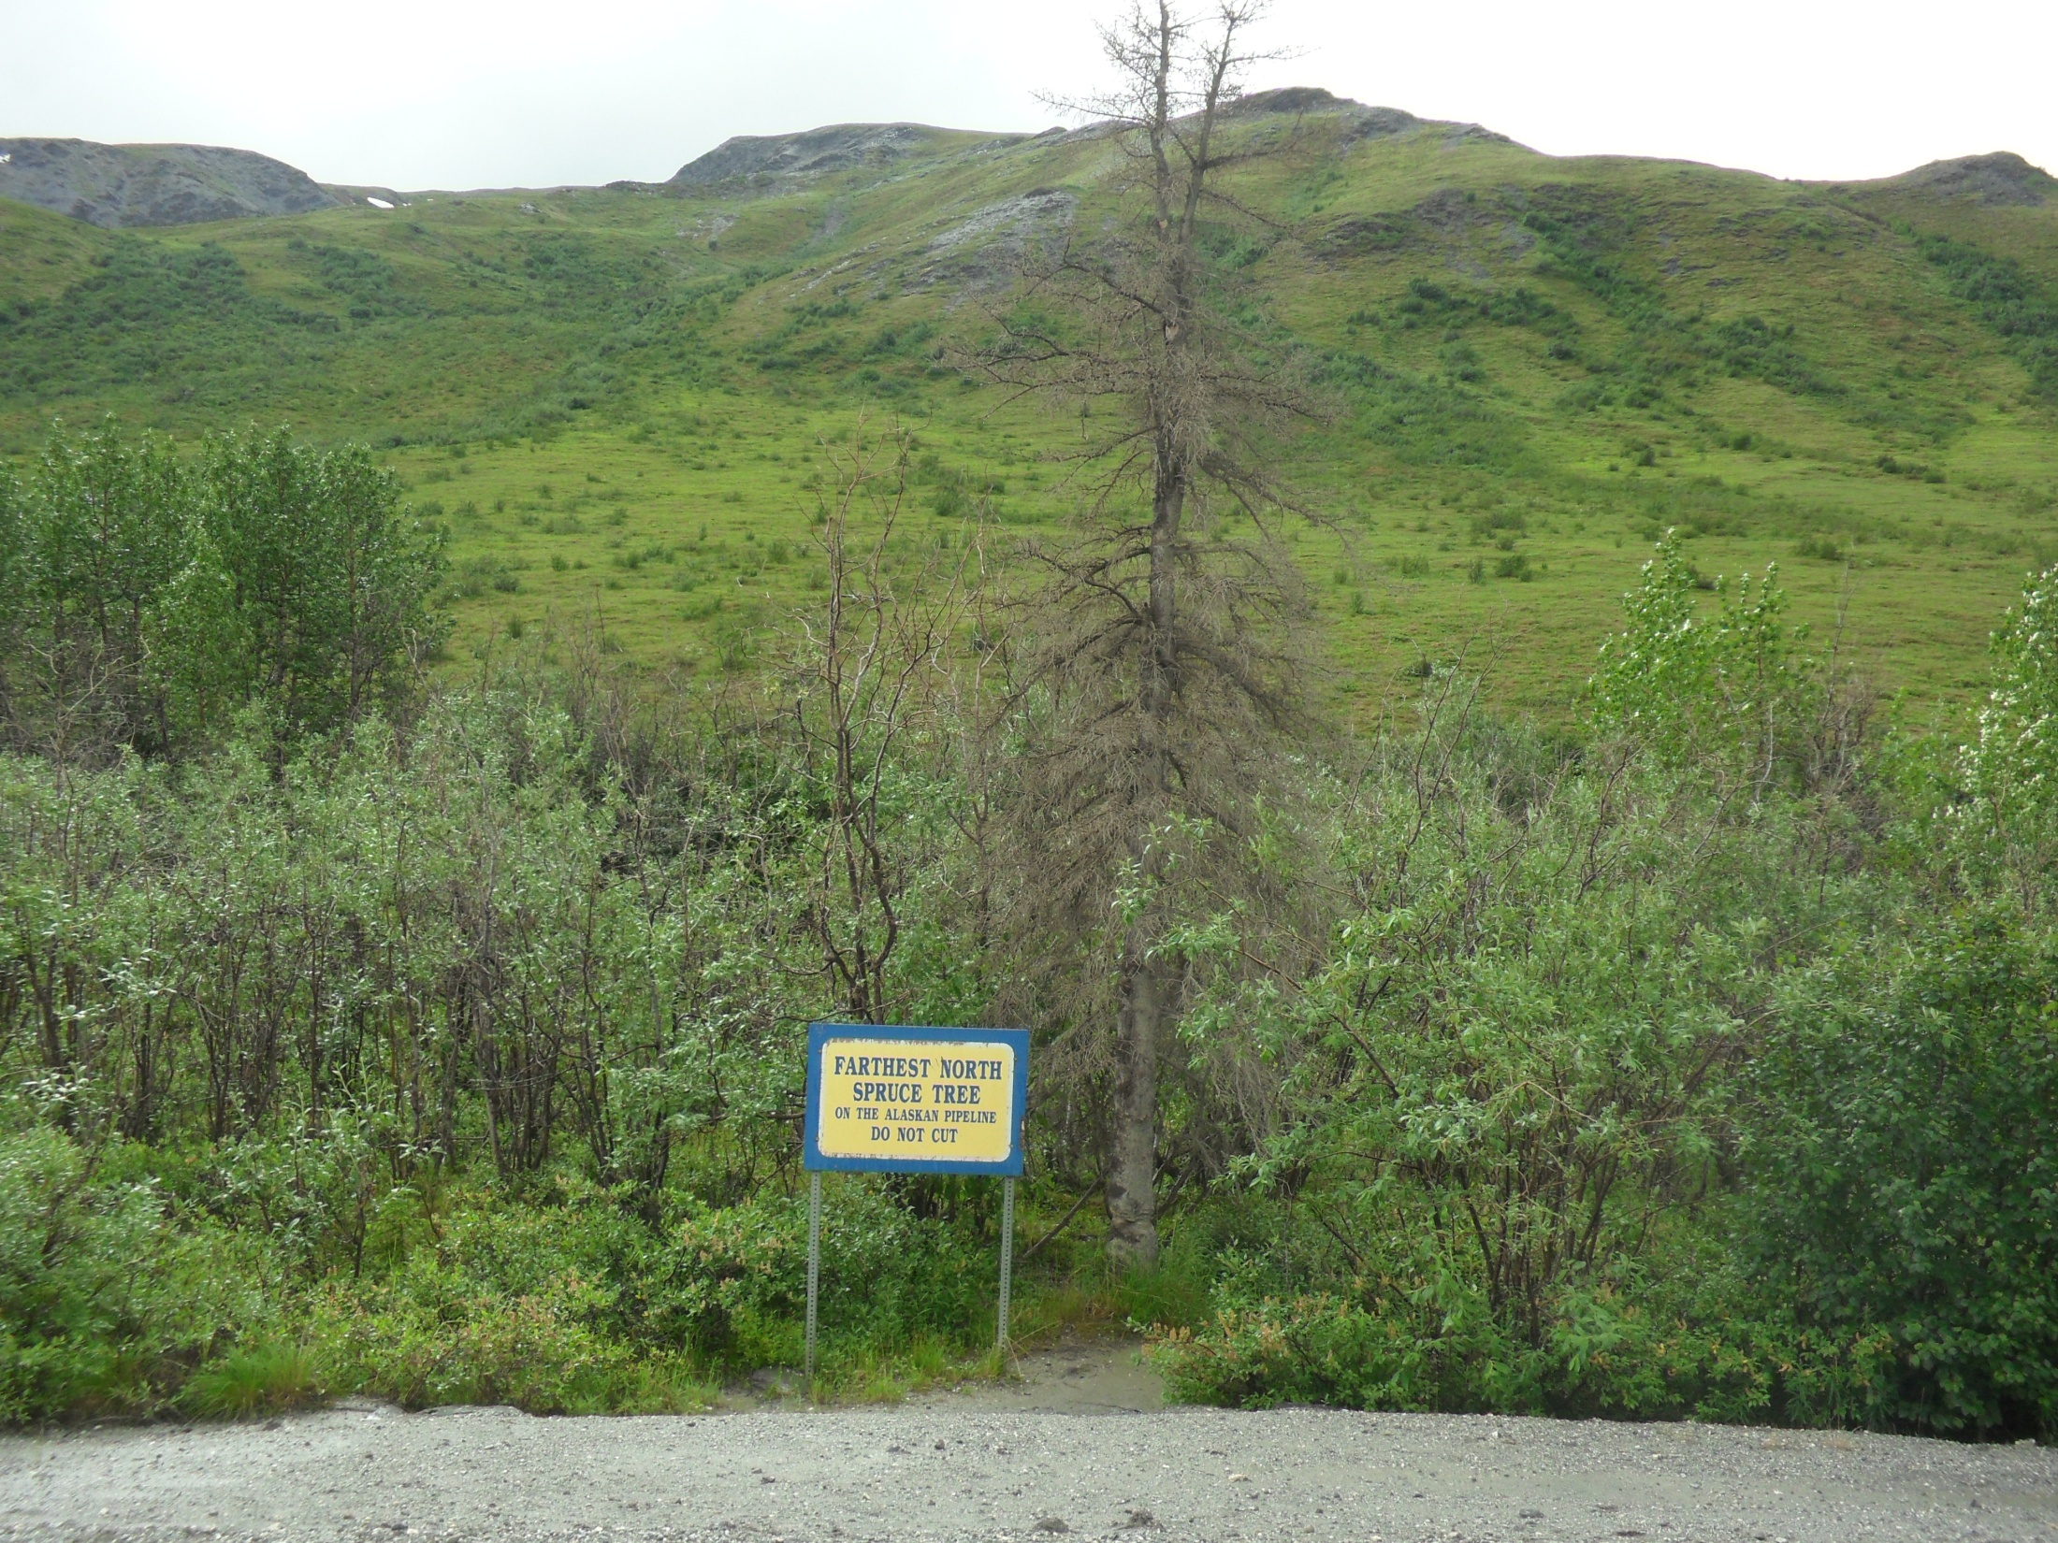

Slide 32
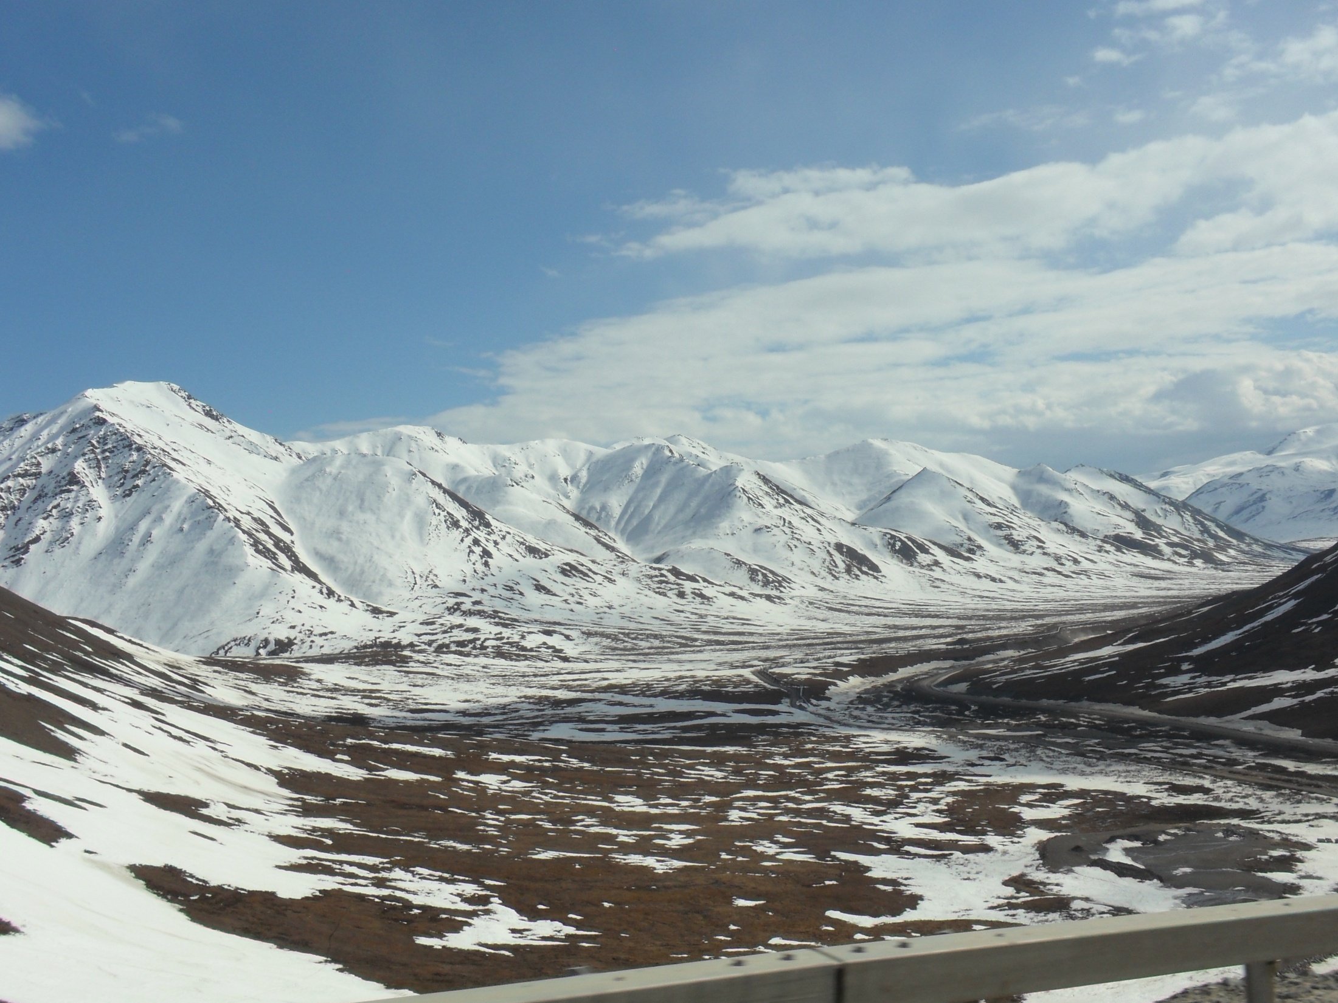
Notes:
And still further north, crossing the Brooks Range

Slide 33
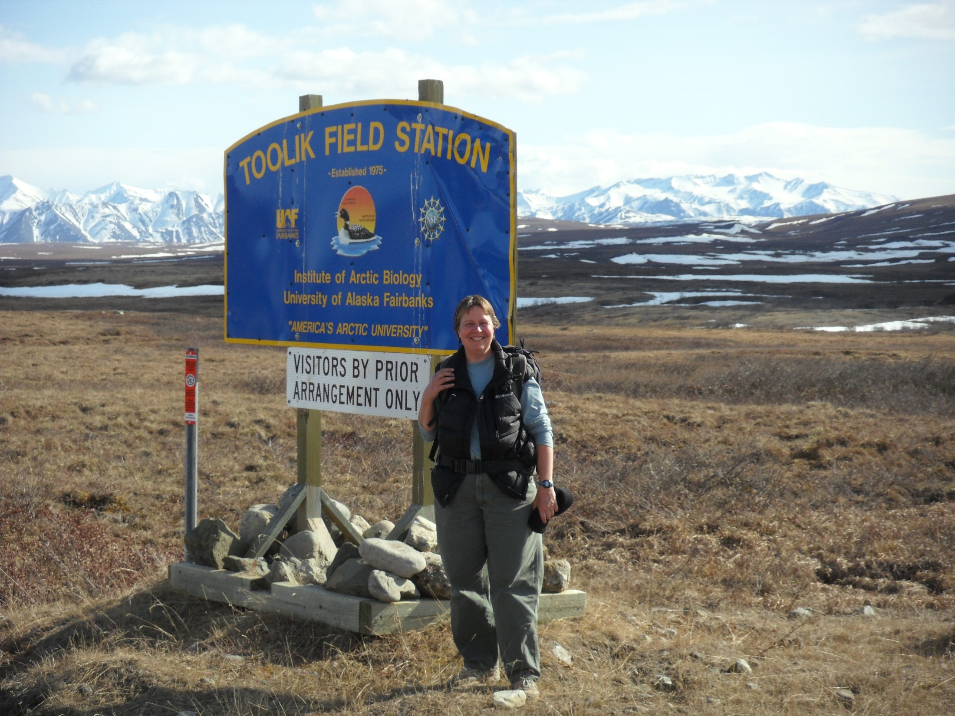
Notes:
To my destination for the next 6 weeks: Toolik Field Station!

Slide 34
Where are we?
357 miles (driving) from Fairbanks, AK
That’s 9 hours of driving the Dalton Highway! 158 miles north of the Arctic Circle 111 miles south of Prudhoe Bay 117 miles south of the Arctic Ocean
Toolik Field Station, About TFS, Fun Facts! http://mercury.bio.uaf.edu/toolik/about-tfs/index_about-tfs.html

Slide 35
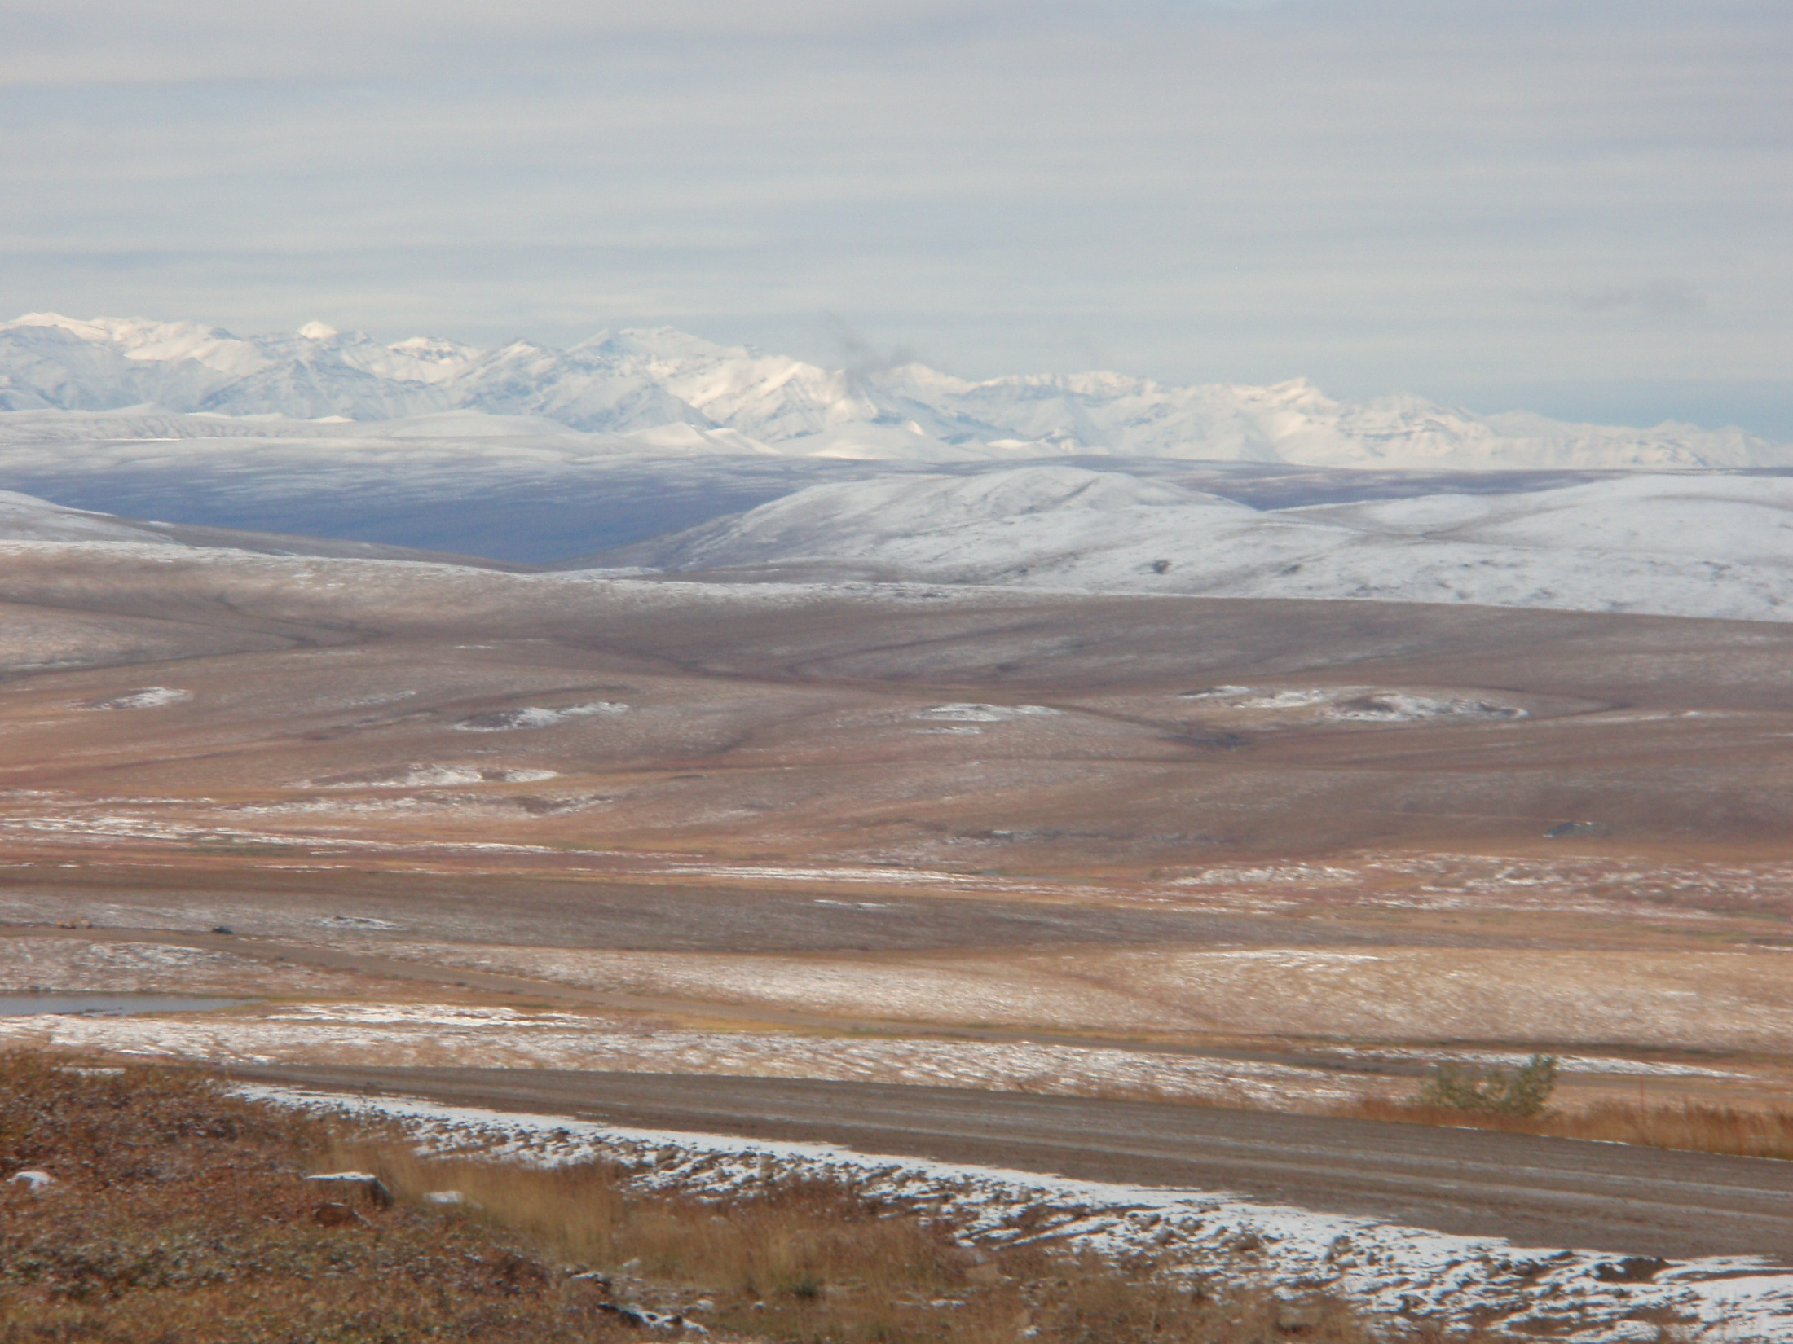
What is our research about?
Tundra soils are key regulators of many aspects of the Arctic System.
Arctic soils have large stores of carbon (C) and may act as a significant CO2 source with warming.
National Science Foundation, Grant 0902096
Notes:
Arctic soils have a large accumulation of carbon in partially decomposed and nutrient poor plant detritus due to decomposition being slower than plant growth. Remember, we are experiencing long days of sunlight, which makes the growing season long, and warming temperatures make it even longer.

Slide 36
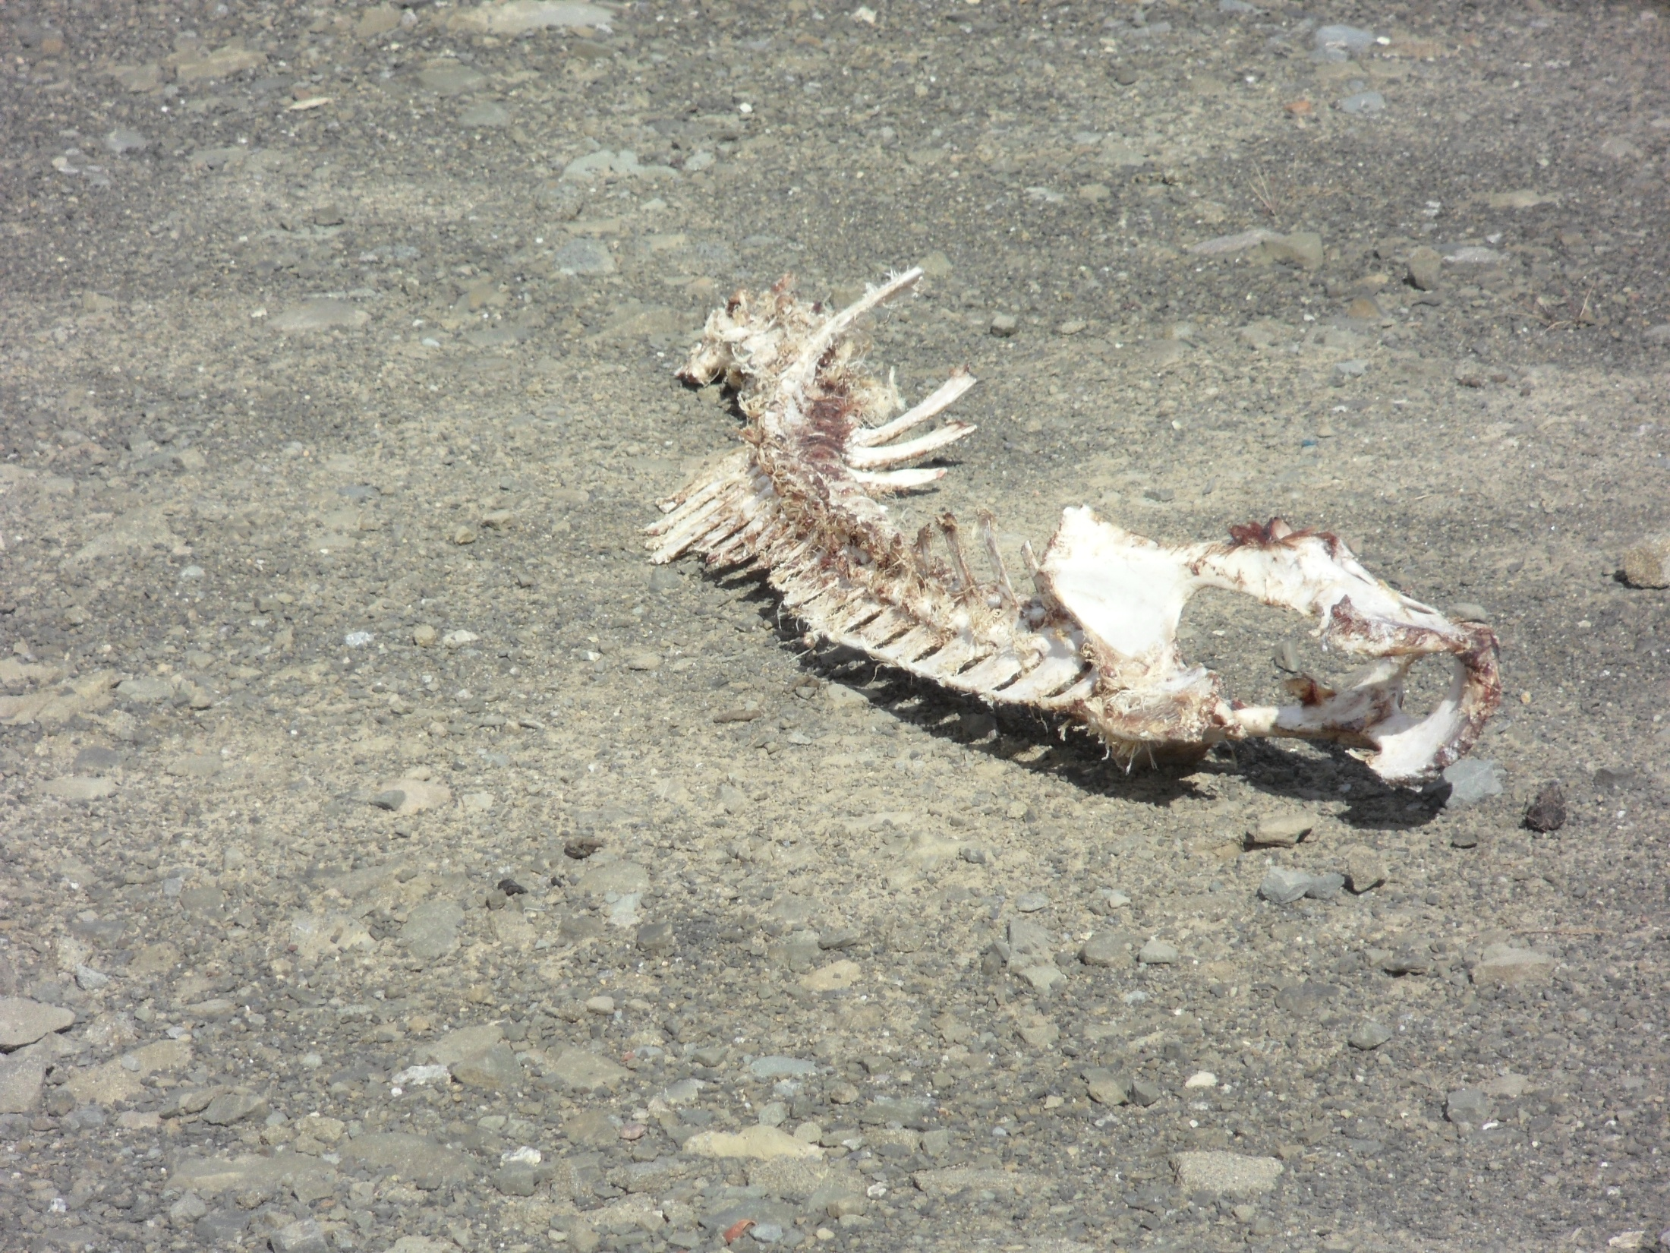

Slide 37
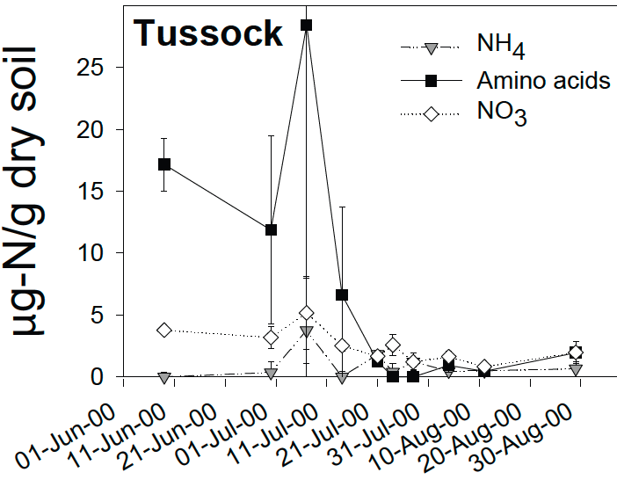
What do we need to know about tundra soil processes?
The key to understanding tundra soil processes is nitrogen (N), because both plant growth and decomposition are controlled by nitrogen availability
N availability is strongly seasonal with relatively high availability early in the growing season followed by a pronounced crash.
Weintraub MN & Schimel JP (2005) The seasonal dynamics of amino acids and other nutrients in Alaskan Arctic tundra soils. Biogeochemistry 73: 359-380
Notes:
Nitrogen in several forms (NH₄, amino acids, and NO₃,) is plentiful early in the season, but levels crash as the season progresses. This limits plant growth and also decomposition. In the diagram, you can really see the abrupt decline in Nitrogen levels. Peak green-up, indicating peak plant growth, occurs generally after mid-June and before July 1. Interestingly, the nitrogen crash appears to occur just after peak green-up.

Slide 38
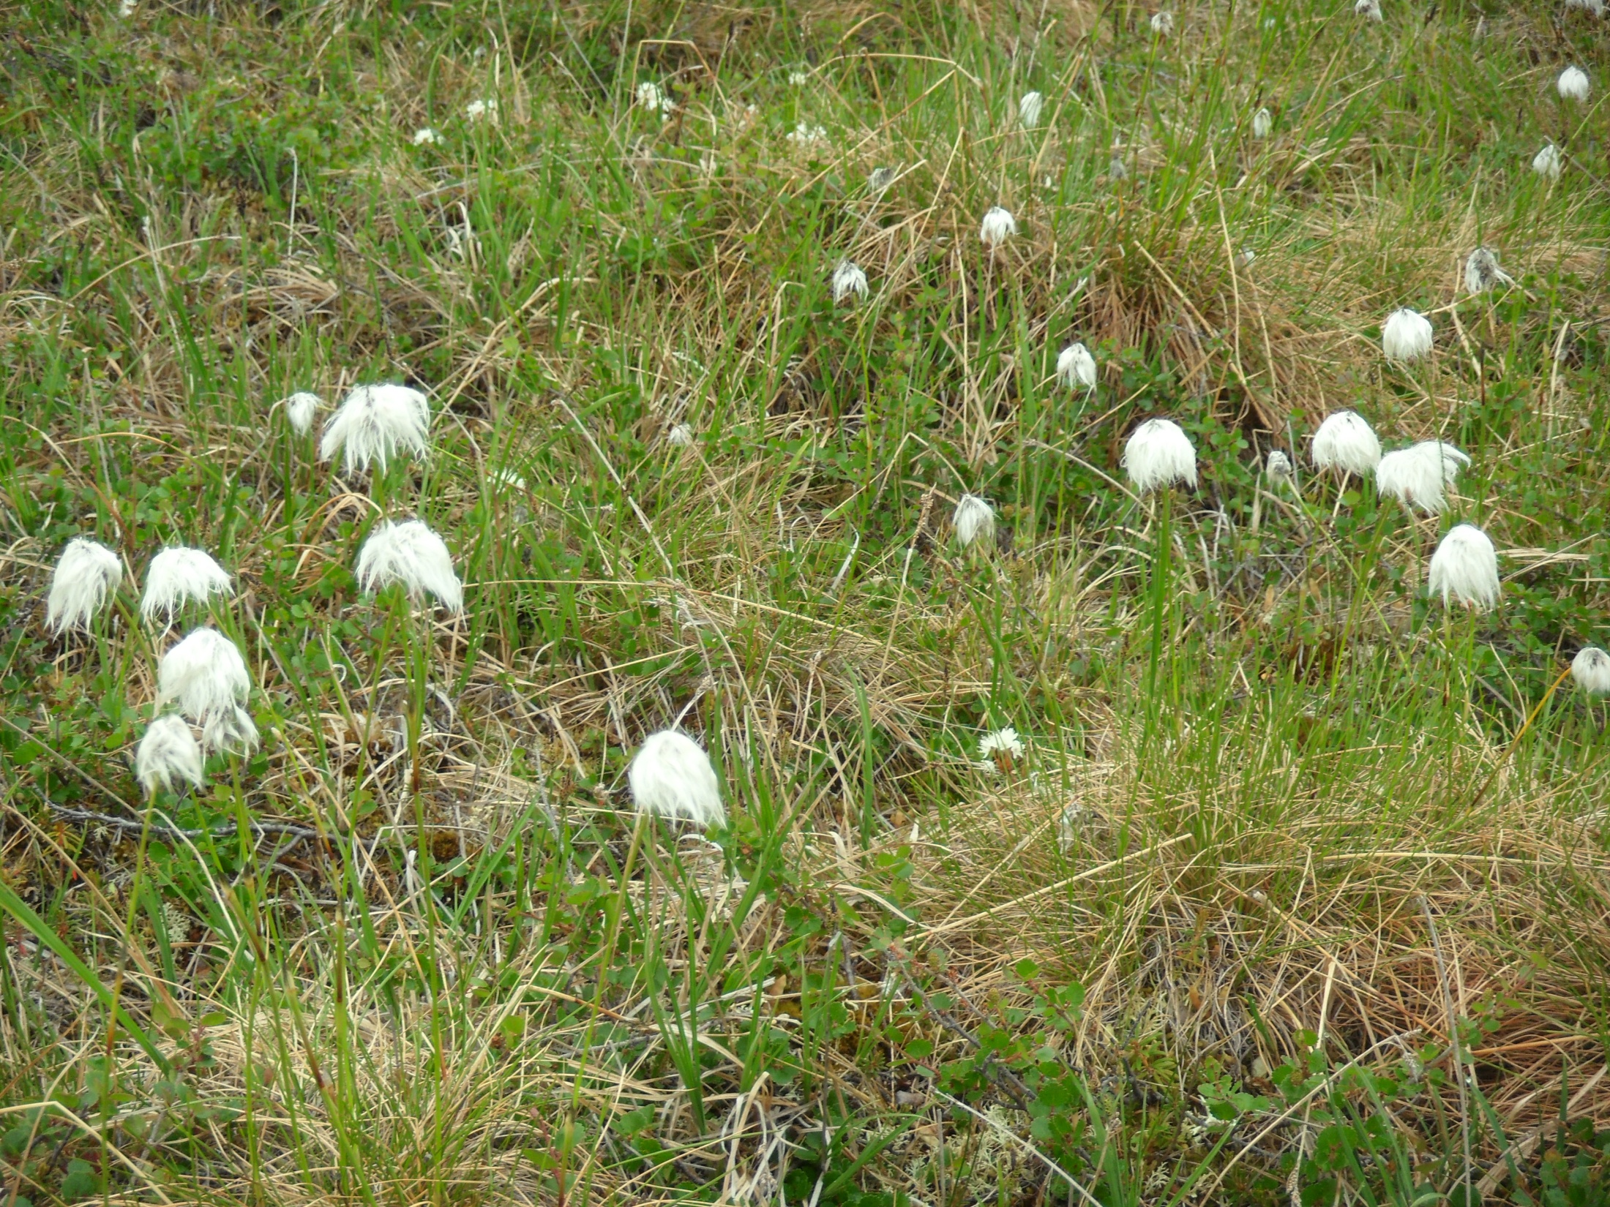
Tussock Cottongrass!

Slide 39
What are our Research Questions?
1) What causes the seasonal
nutrient crash?
2) Microbes are important decomposers, and thus processors of Nitrogen. Does microbial activity switch seasonally between Carbon and Nitrogen limitation?
3) How will a lengthening of the growing season alter overall ecosystem Carbon and Nitrogen dynamics, as a result of differential extension of the periods before and after the nutrient crash?
National Science Foundation, Grant 0902096
Notes:
Remember the big crash in nitrogen availability you saw a couple of slides ago? A great question is, what causes it? A second question is about the seasonality of carbon and nitrogen limitations, and if there are corresponding switches in our microbial decomposers. The next slide will illustrate for us the seasonal carbon and nitrogen balances.
The third question will also be illustrated by the next slide…but the question is about the effects of a lengthening growing season on carbon and nitrogen dynamics…we’ll also look at this differential extension thing on the next slide!

Slide 40
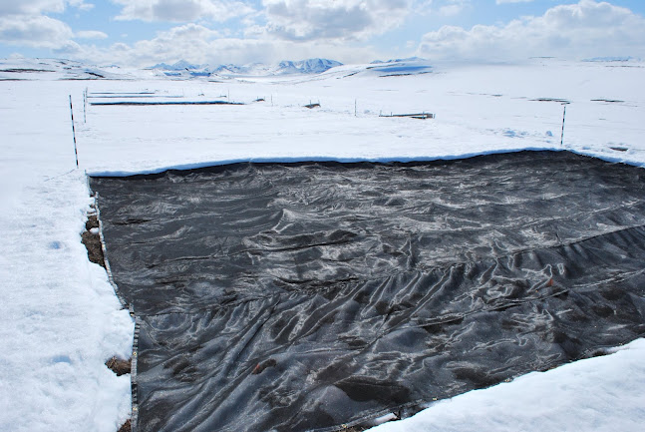
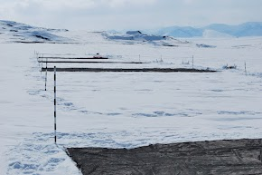
How are we getting answers to these questions?
Varying the length and timing of the growing season in the field by advancing snow melt
Snowmelt Project Folder, photos by Anthony Darrouzet-Nardi
https://plus.google.com/photos/112217004742857957314/albums/5737002629718470865
Notes:
Shadecloth fabric is deployed over plots before snowmelt to accelerate snowmelt

Slide 41
and warming the ecosystem!
Pictured here is a six sided plastic structure called an Open Top Chamber (OTC). These are used to warm a section of tundra in order to study the effects of warming climate
Snowmelt Project Folder, photos by Anthony Darrouzet-Nardi by Anthony
https://plus.google.com/photos/112217004742857957314/albums/5737002629718470865
Notes:
An open top chamber with mantis poised over a section of tundra. The mantis holds sensors that record environmental conditions within the chamber, as well as record data about plant phenology. The mantis can literally watch the grass grow!

Slide 42
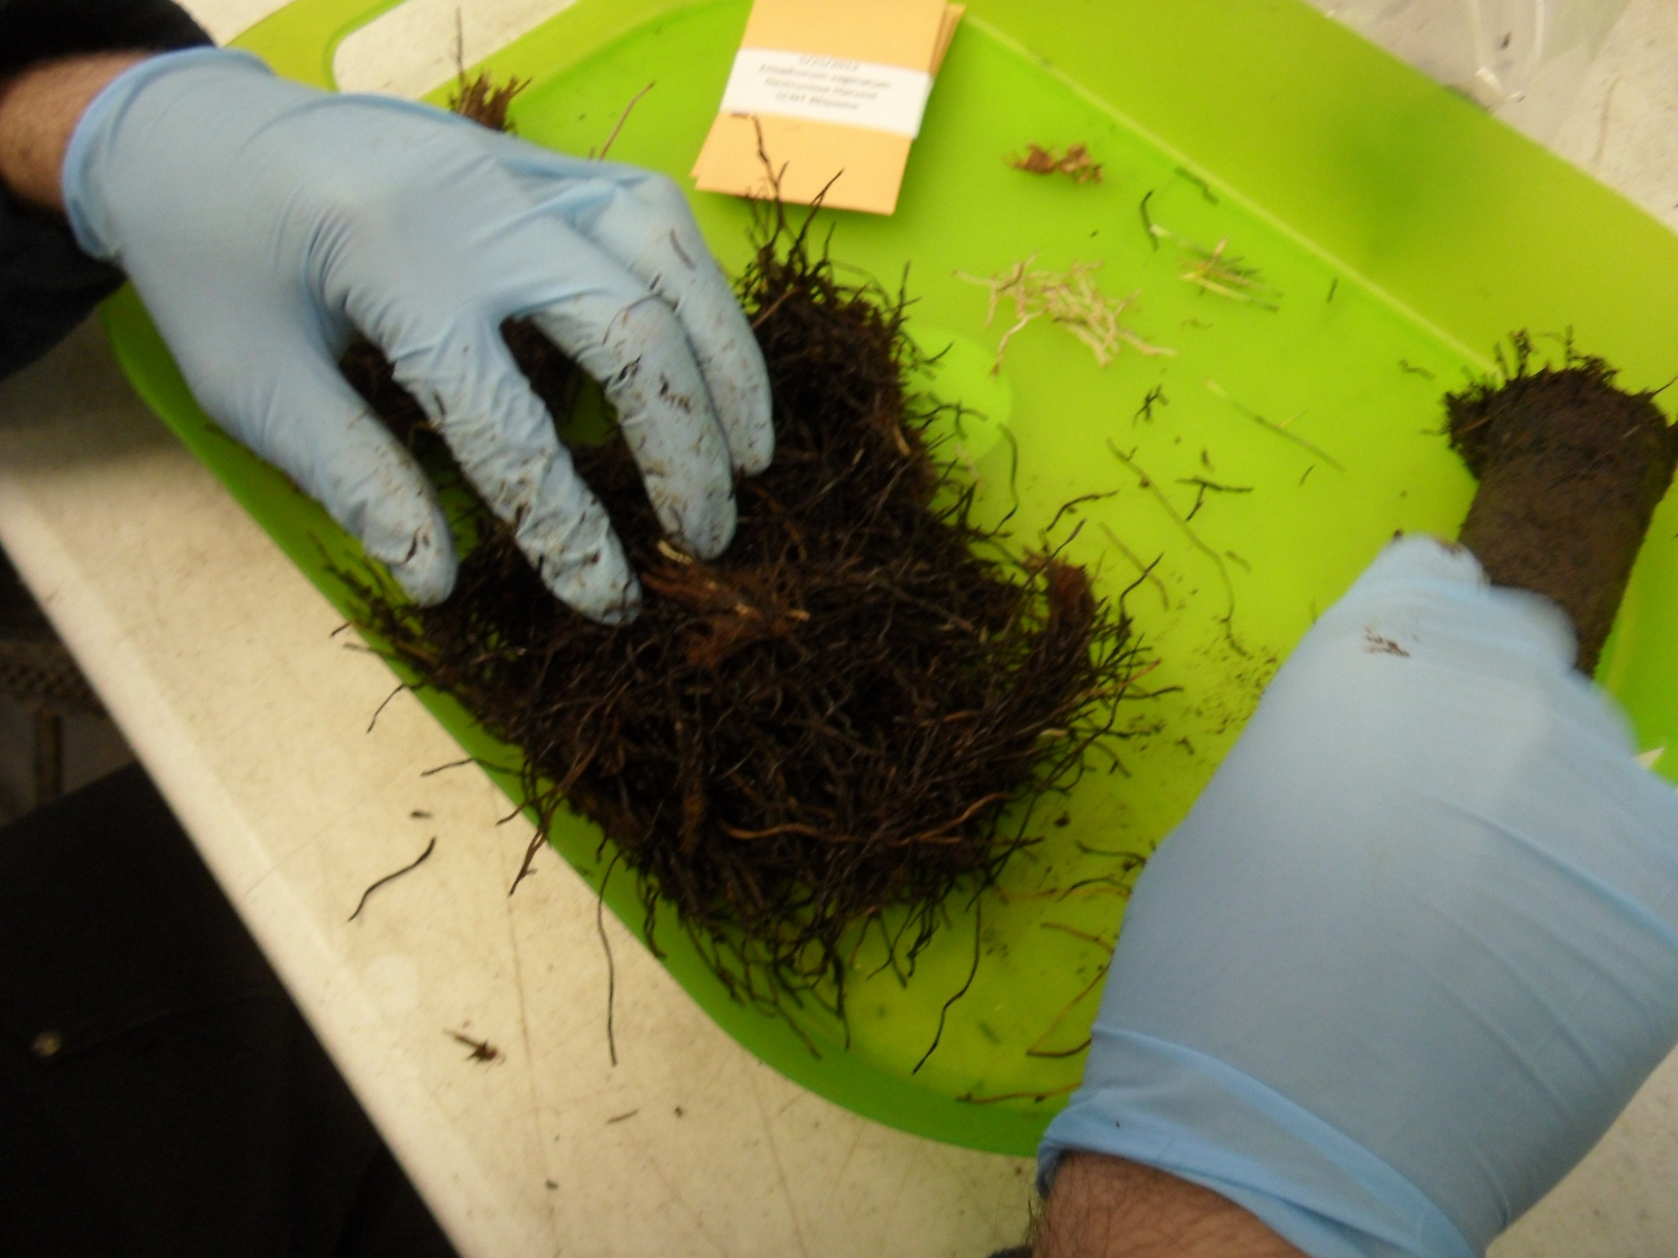
Soil? !
Notes:
Work in the lab processing soil samples

Slide 43
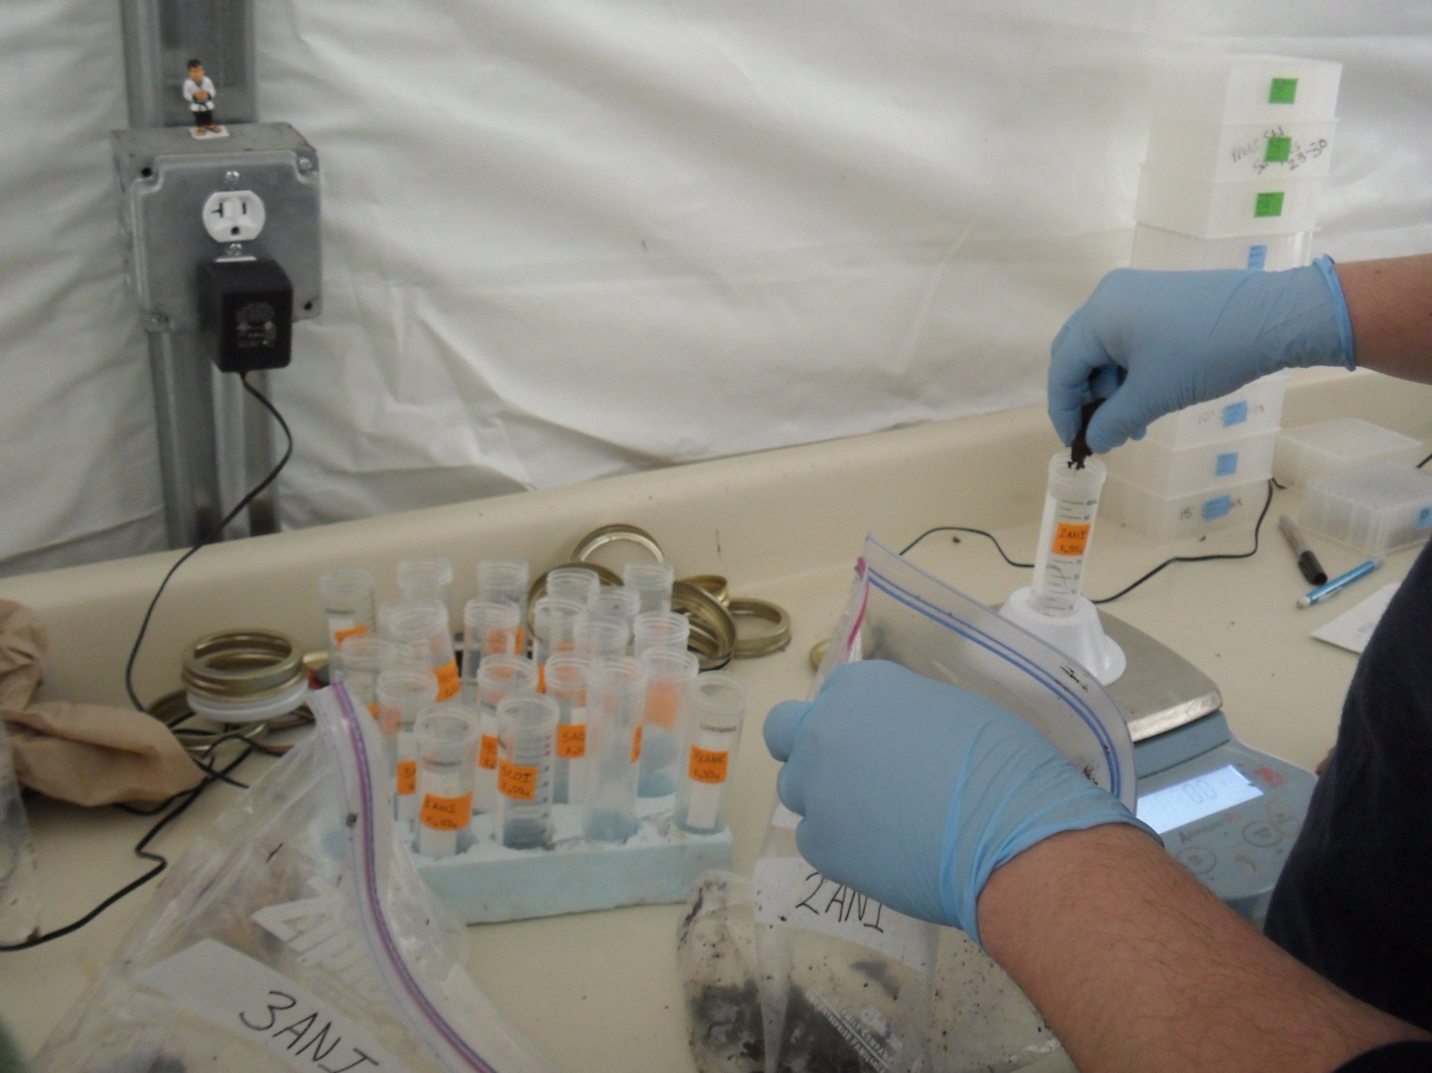
Notes:
Doing lab work

Slide 44
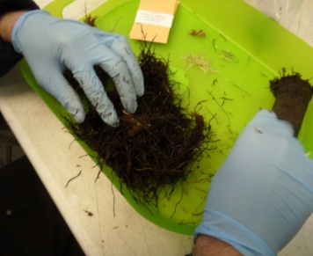
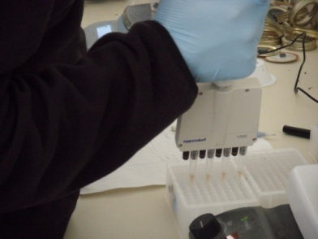
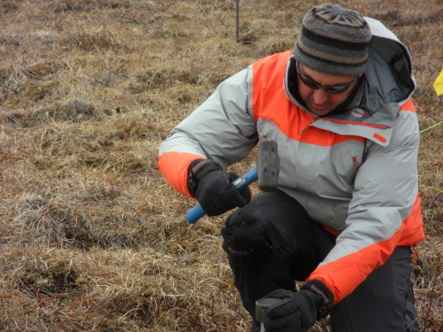
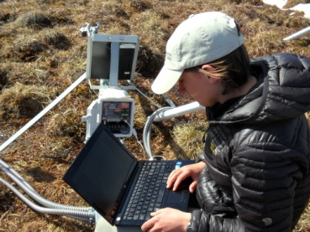
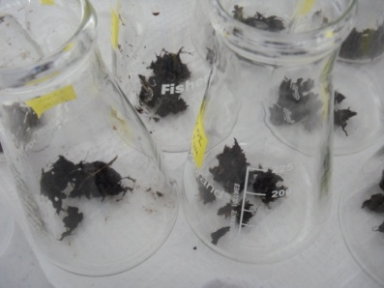
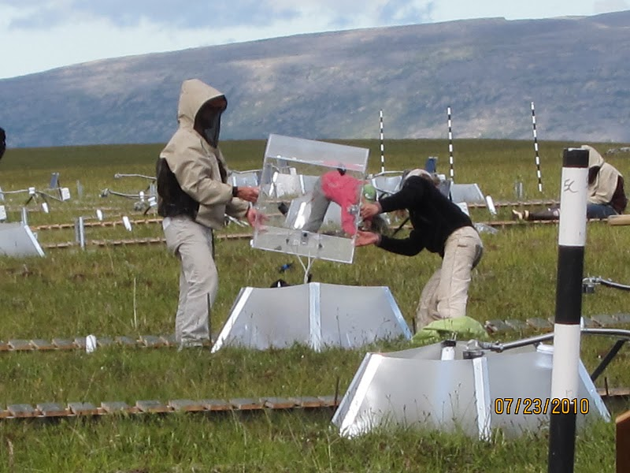
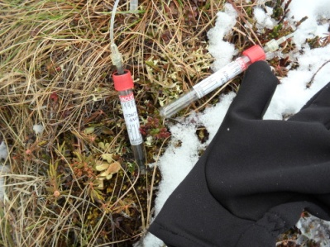
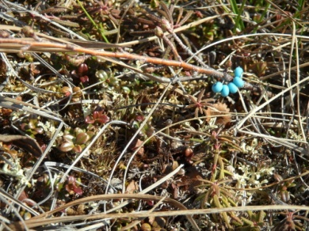
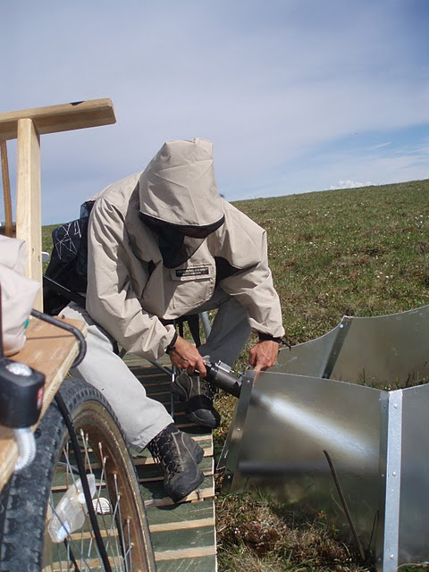
Soil samples
Enzyme assays
Microbial biomass
Microlysimeter samples
Phenology data
Rhizotrons
Respiration chambers
Environmental conditions
Notes:
Top left clockwise: Coring a soil sample, separating the soil from the living matter, preparing to test for soil enzymes that digest the soil organic matter, samples of soil ready to chloroform to figure out how much microbial activity is in the soil, microlysimeters to sample soil solution for nutrients (such as n), beads marking a plant to track its growth progress, lowering a camera into a rhizotron to look at roots, setting a chamber over a plot to measure respiration rates, and programming a datalogger on a mantis array that will keep track of environmental conditions and also has a device that quantifies plant green-up.

Slide 45
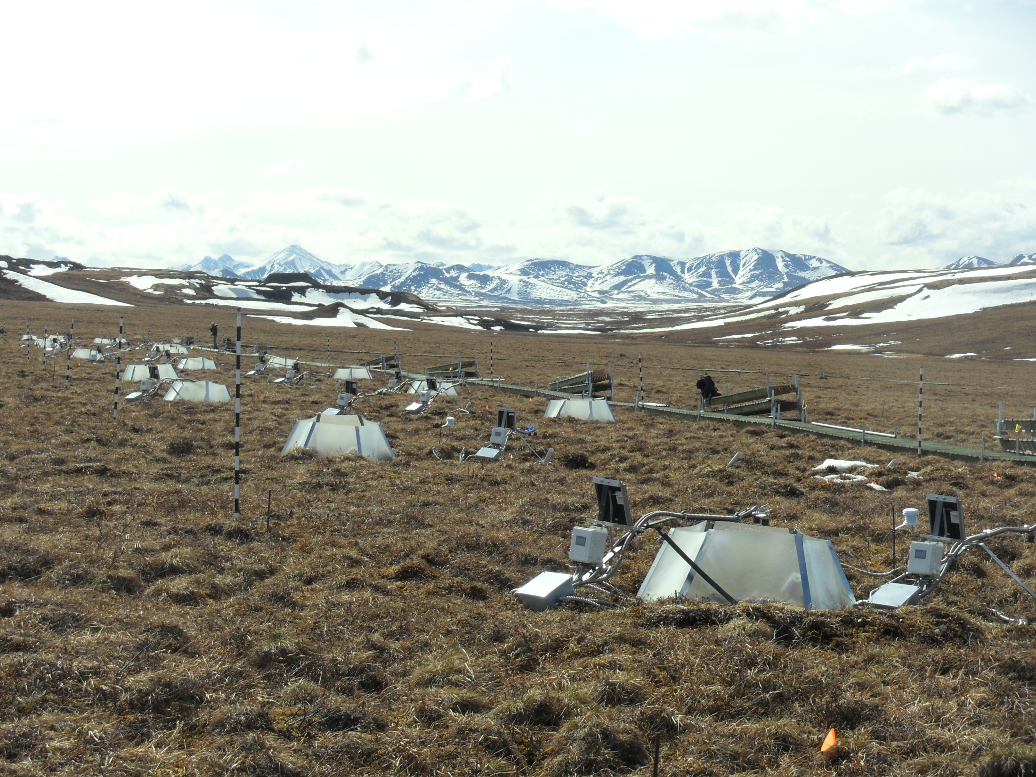

Slide 46
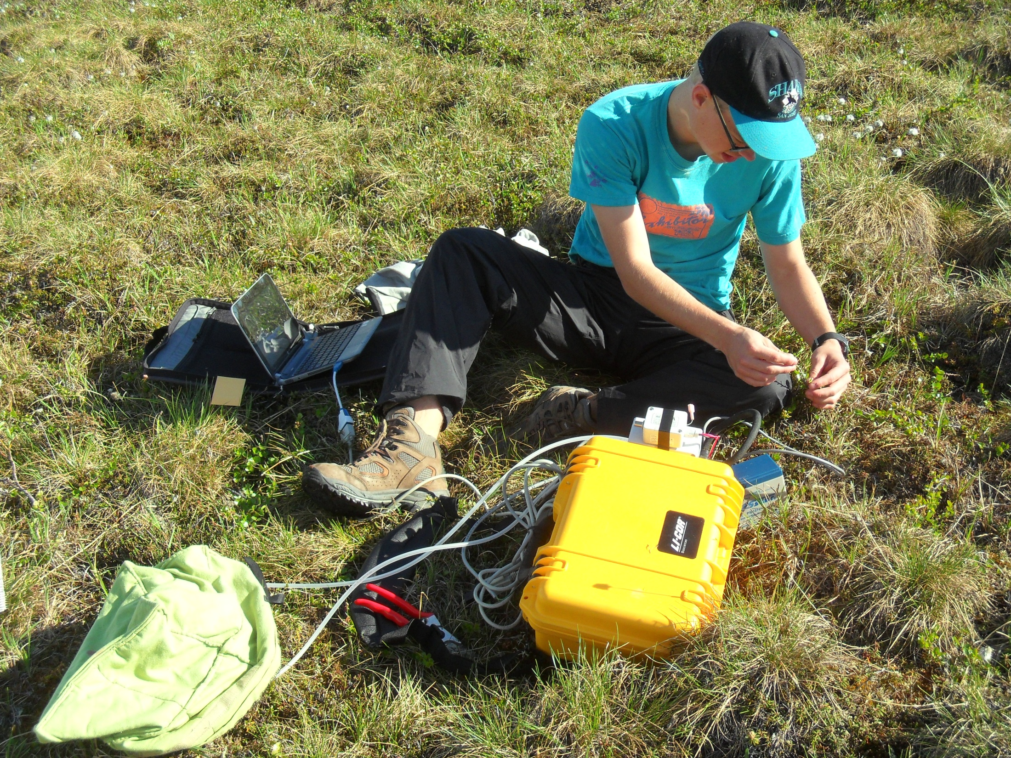
Notes:
Help with field collections and measurements…such as individual plant respiration measurements

Slide 47
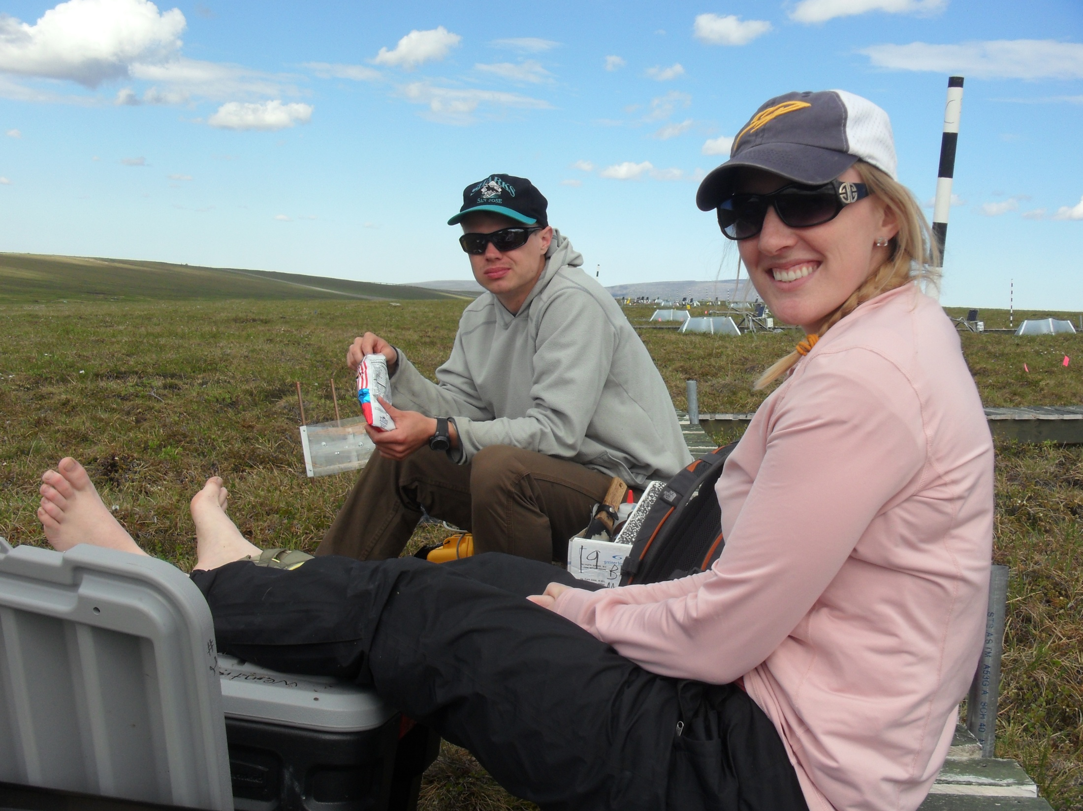

Slide 48
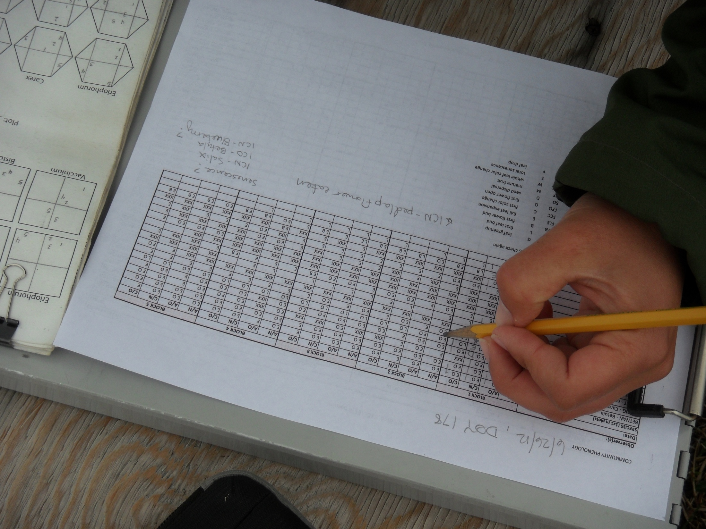

Slide 49
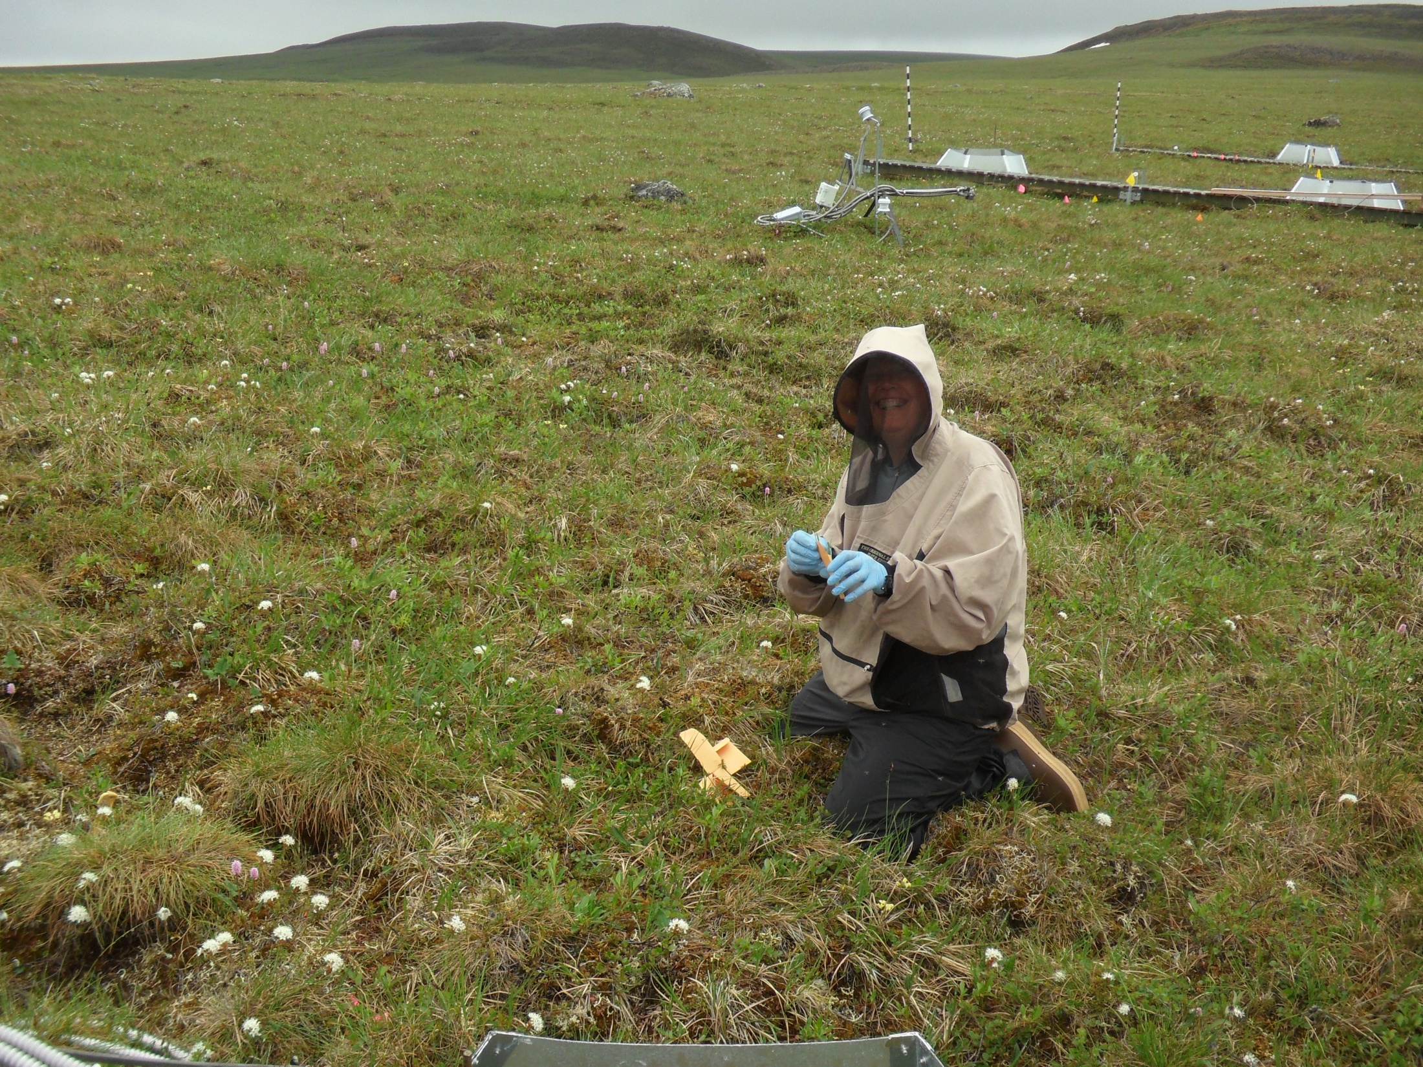

Slide 50
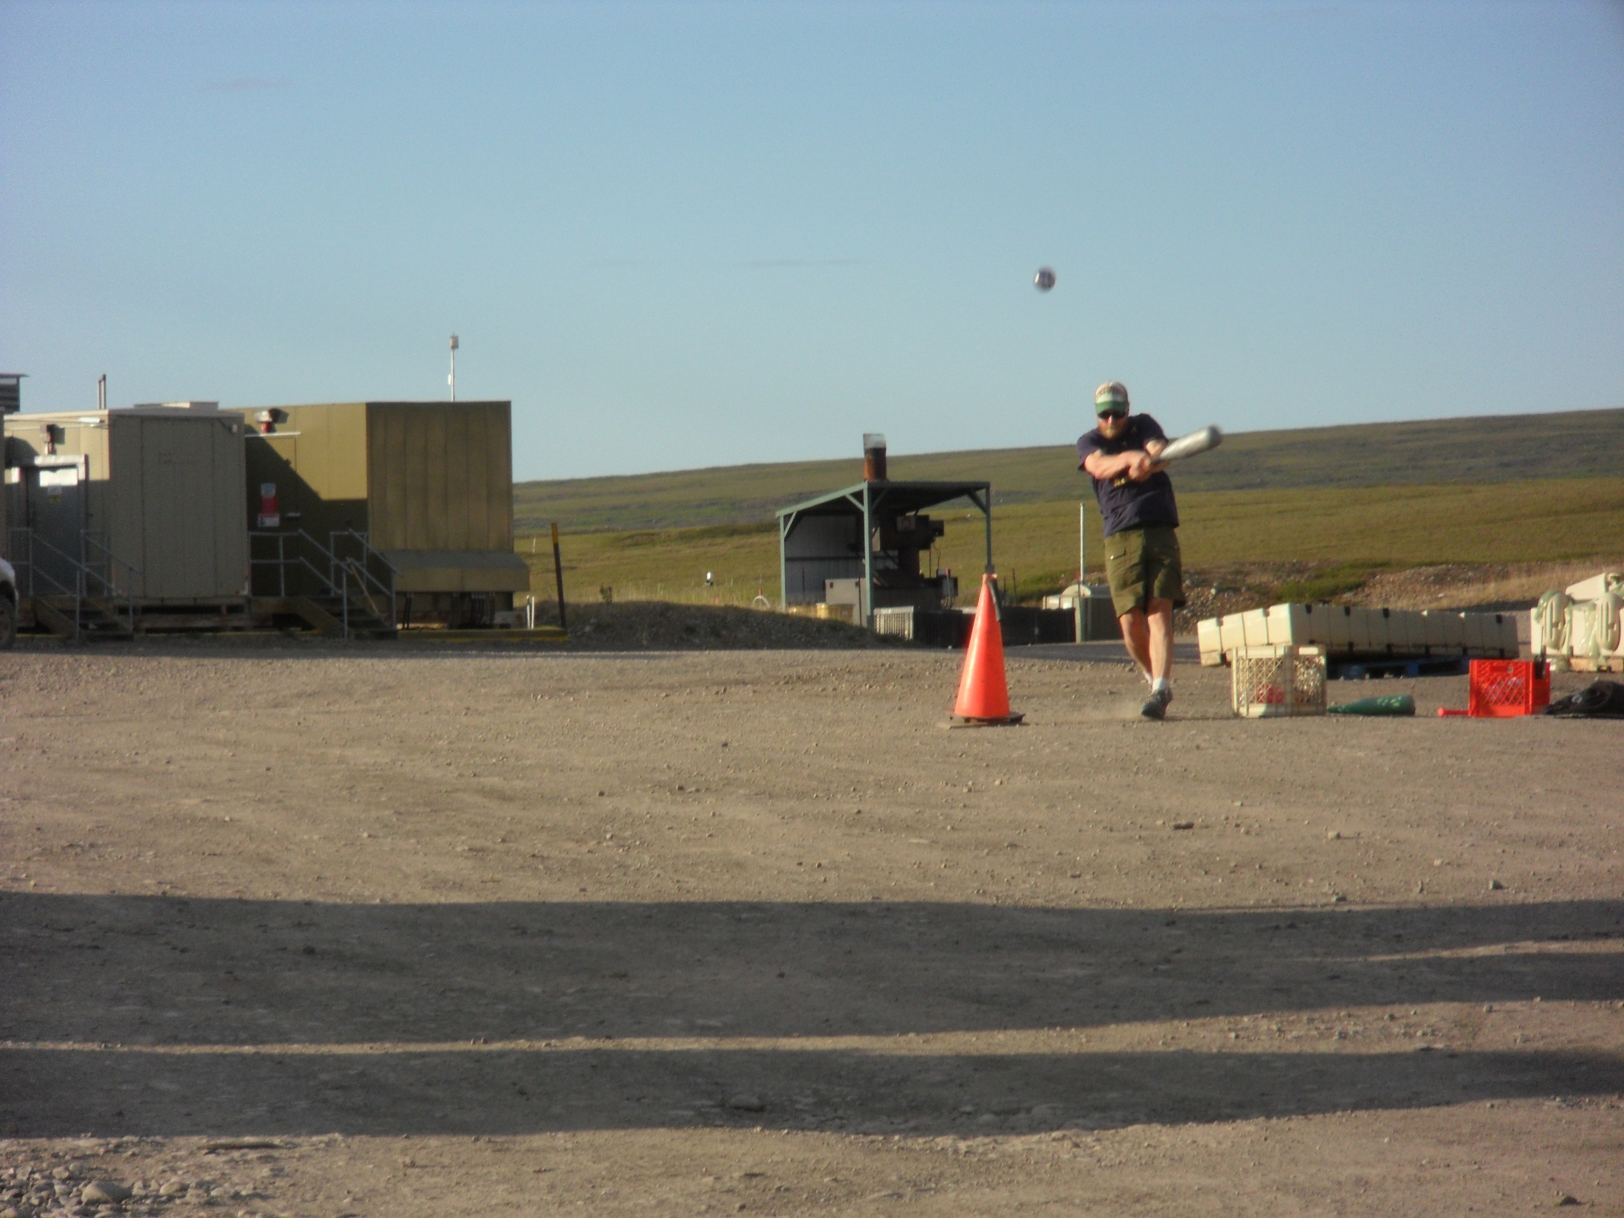

Slide 51
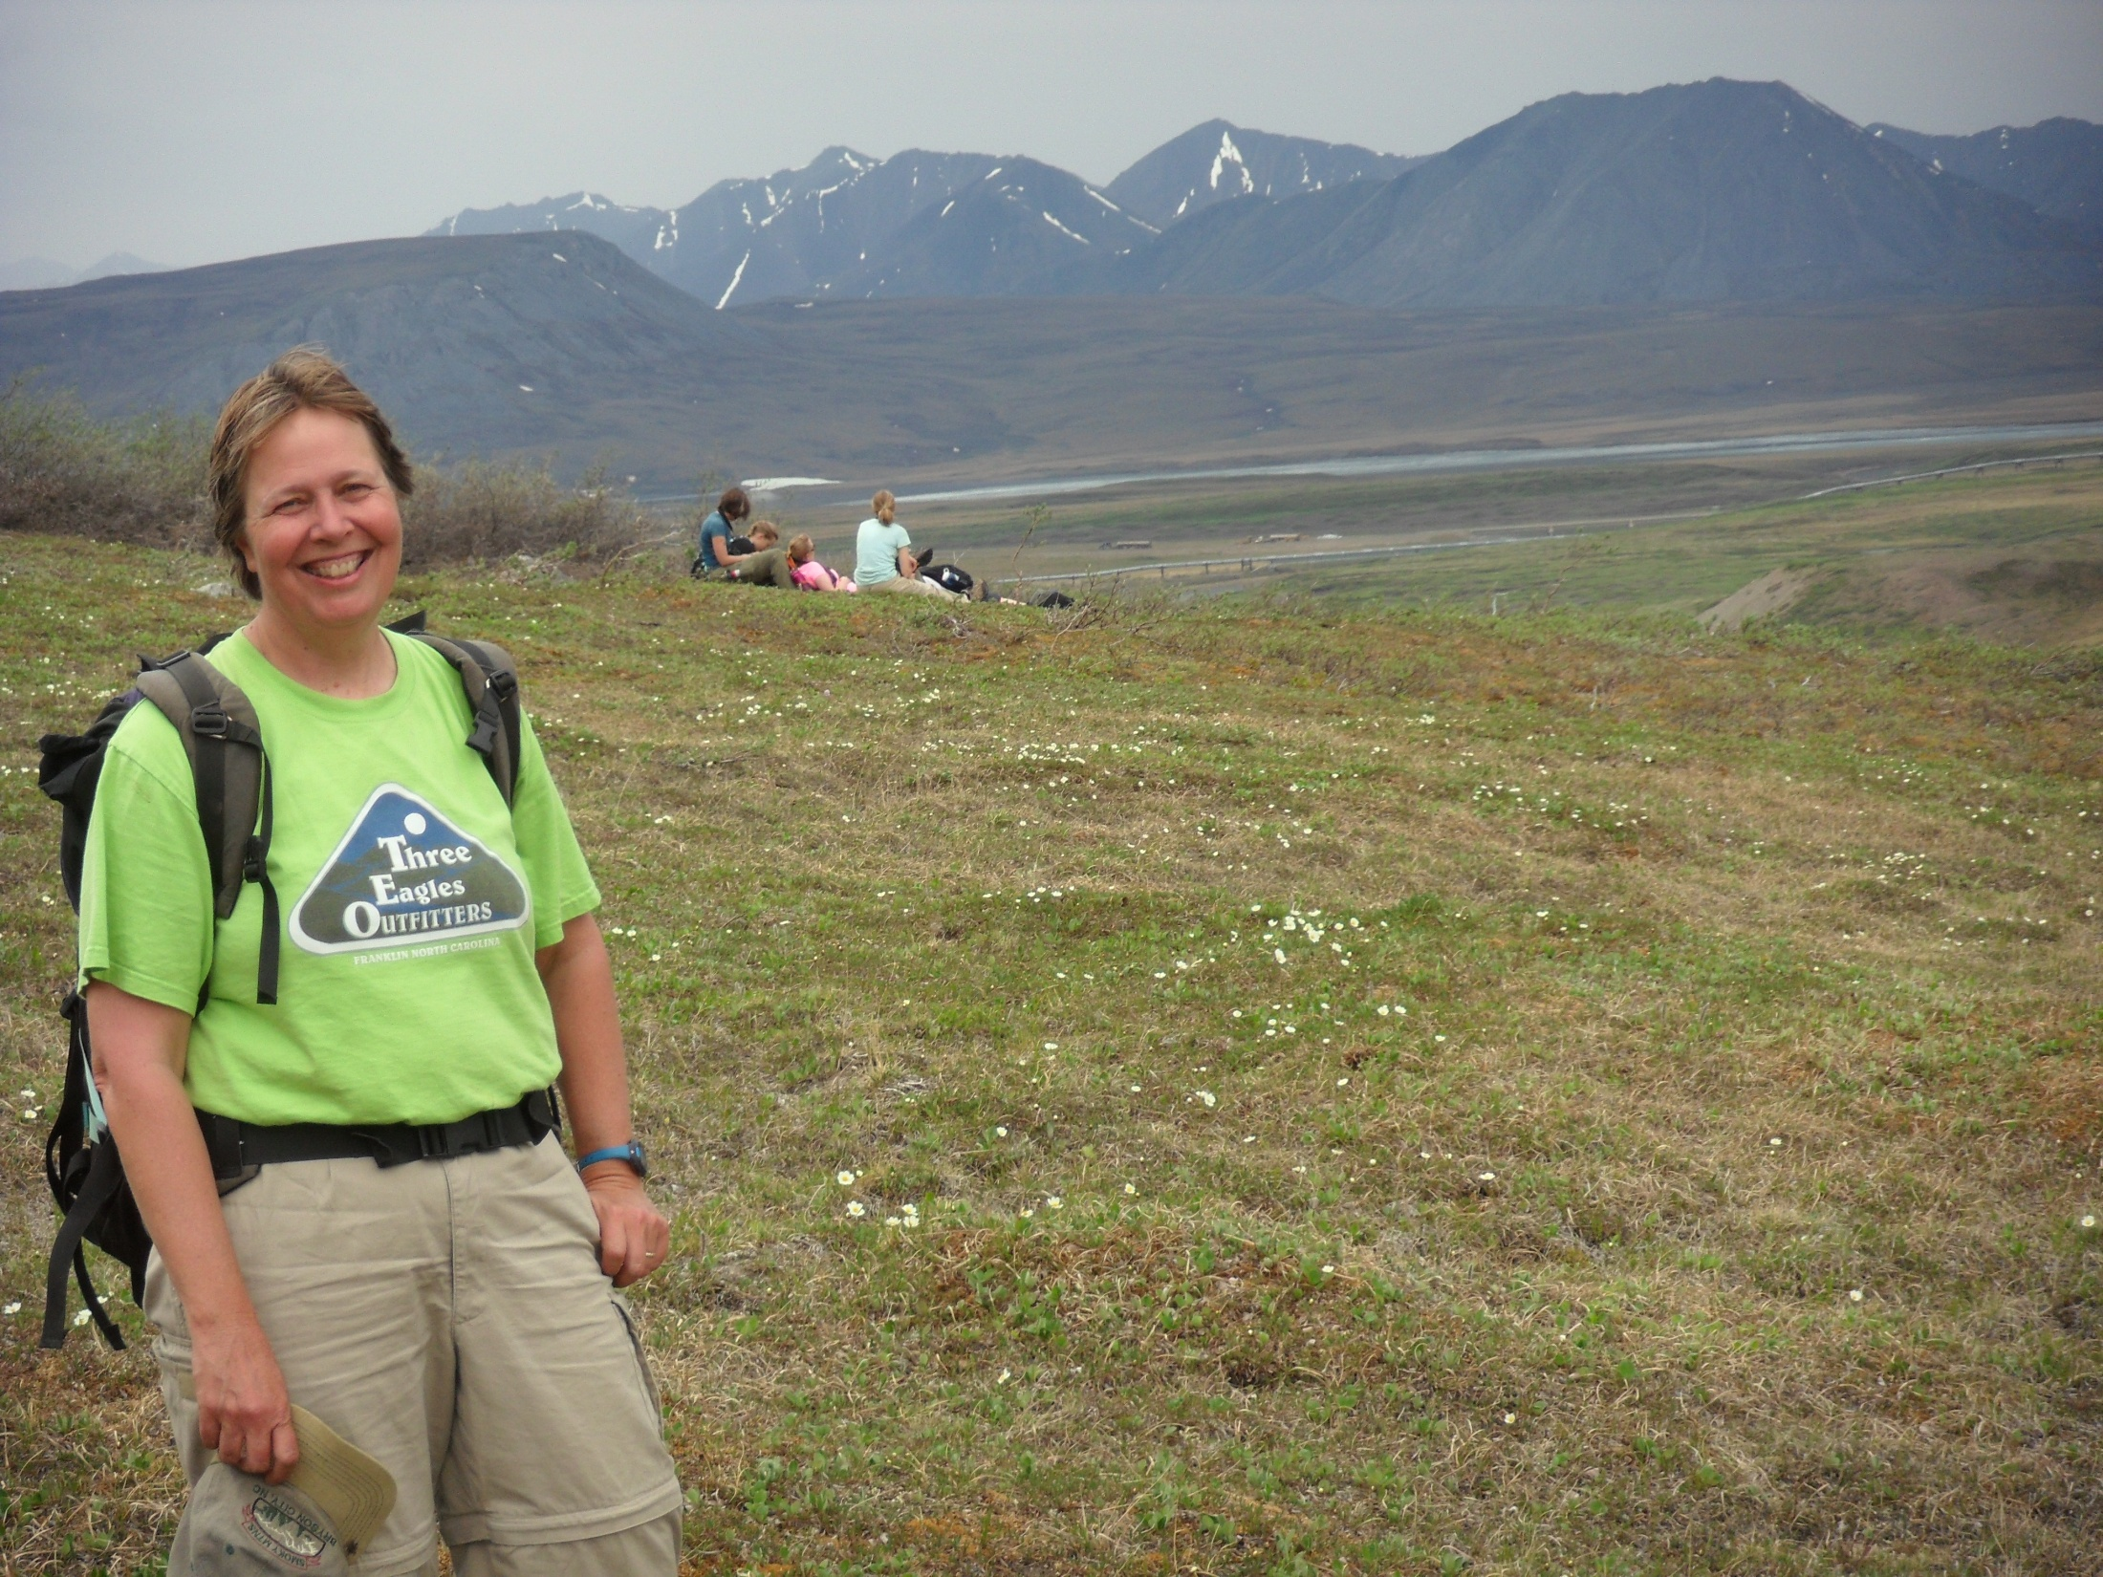
Notes:
Take time off to go hiking

Slide 52
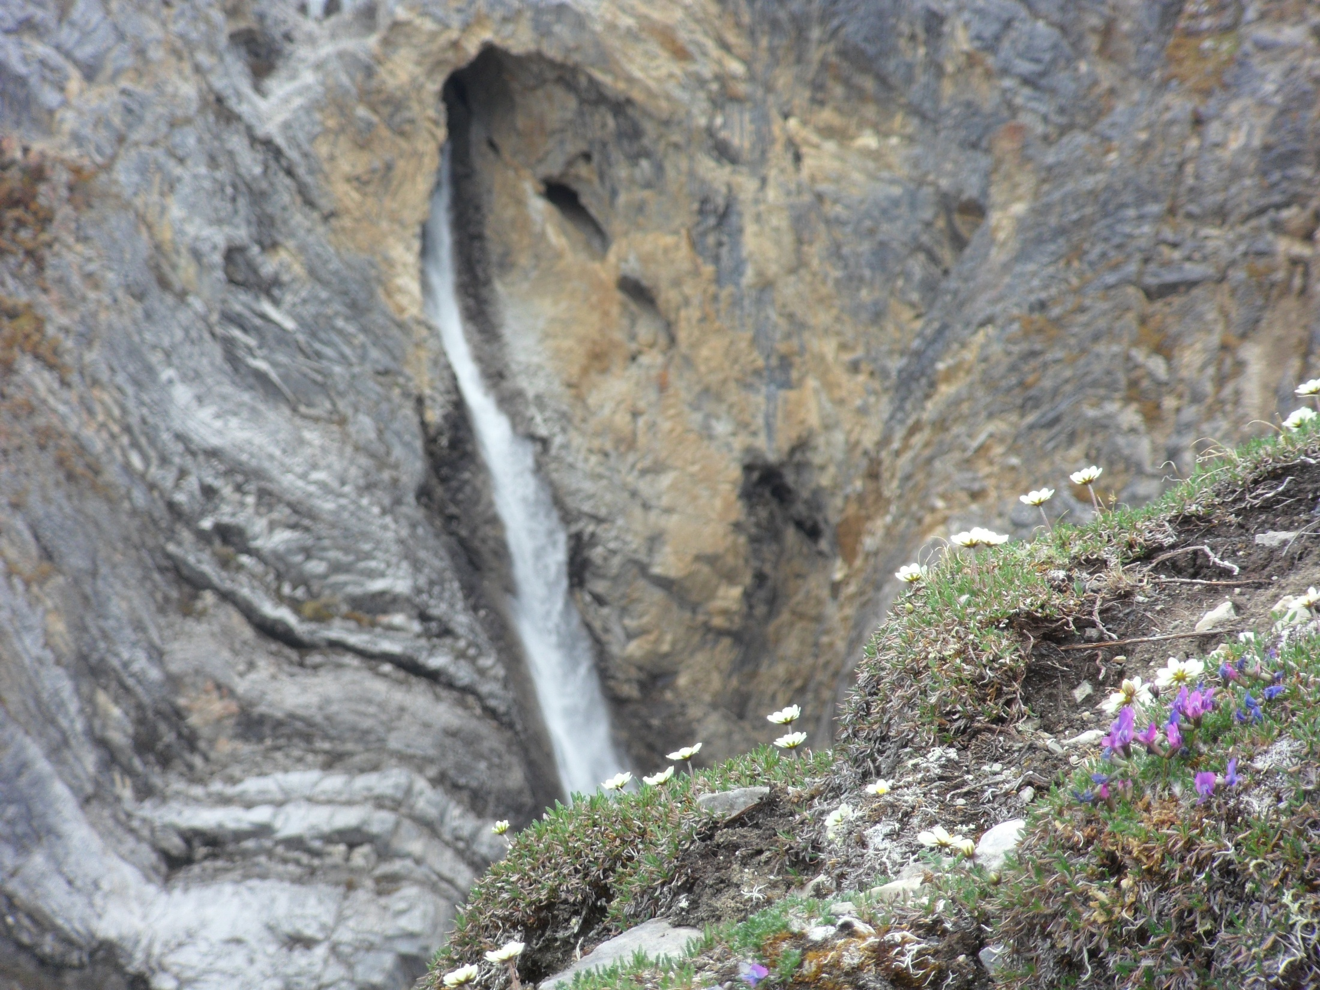

Slide 53
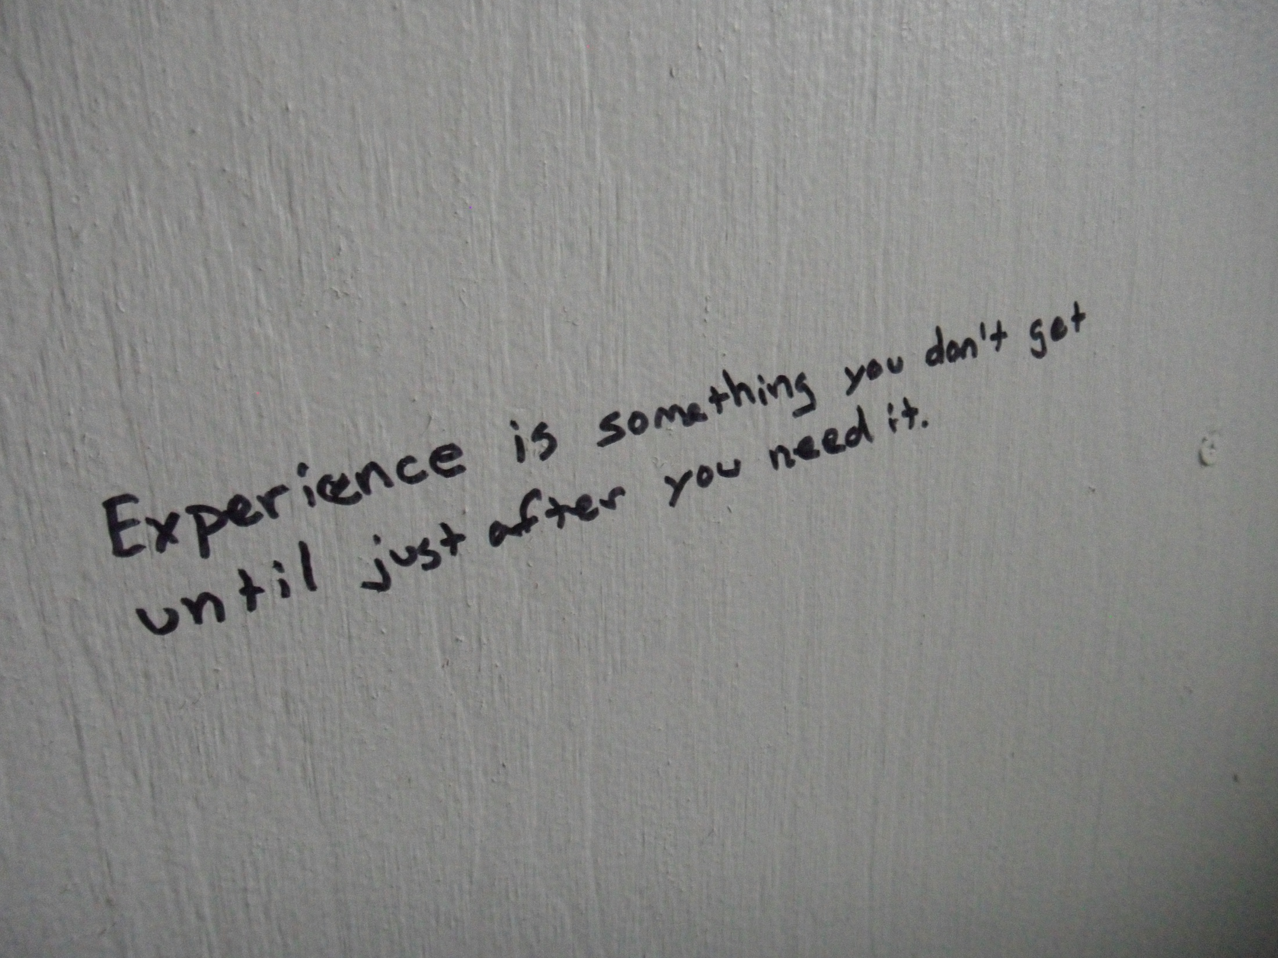

Slide 54
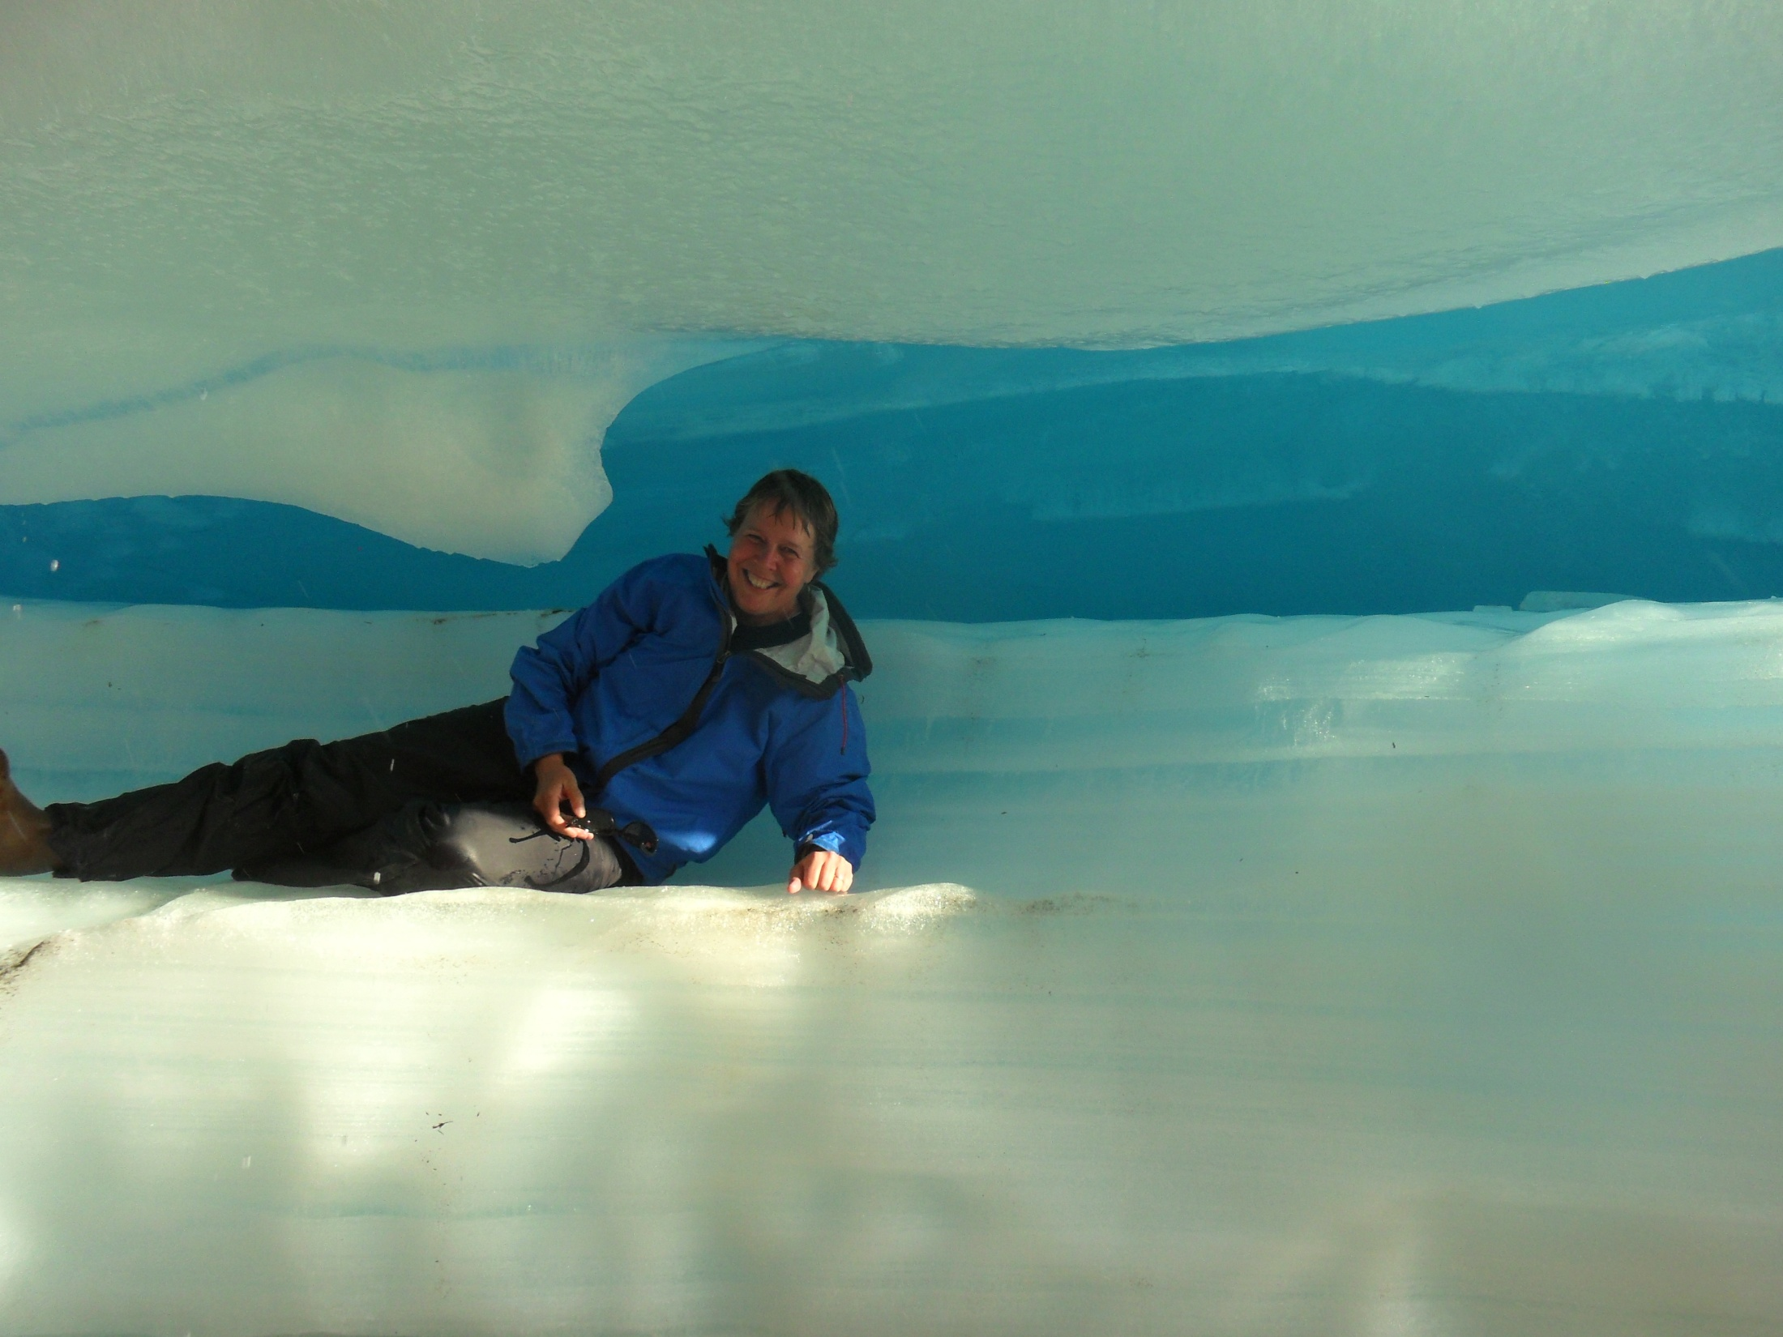
Notes:
Check out the formations in the aufice

Slide 55
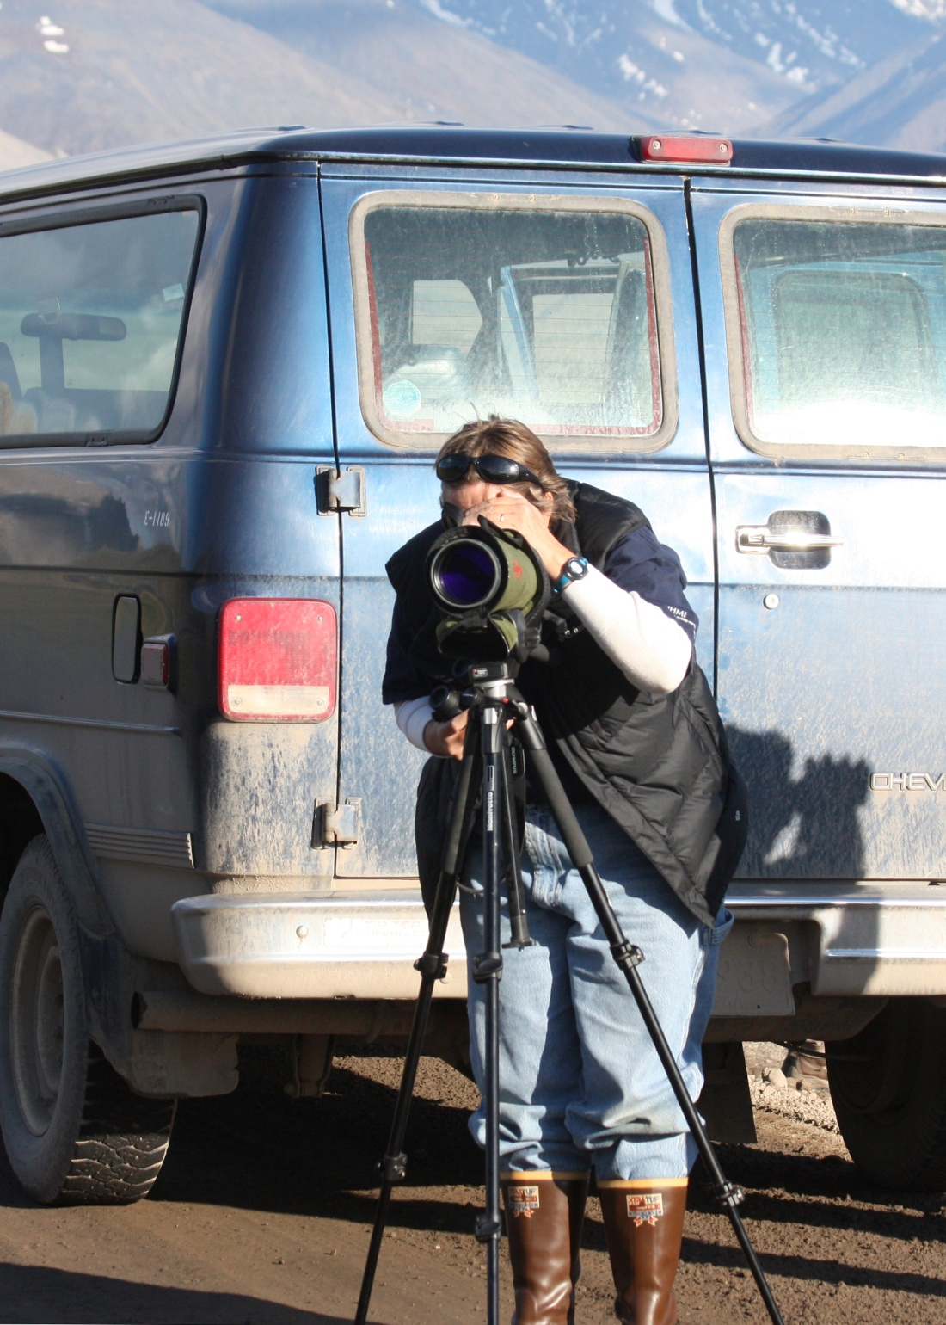
Notes:
Partake in some opportunities to check out amazing birds of Alaska!

Slide 56
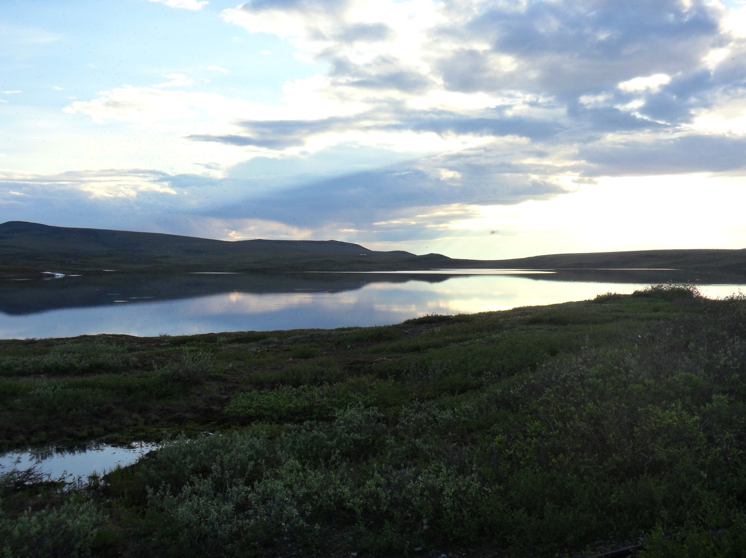

Slide 57
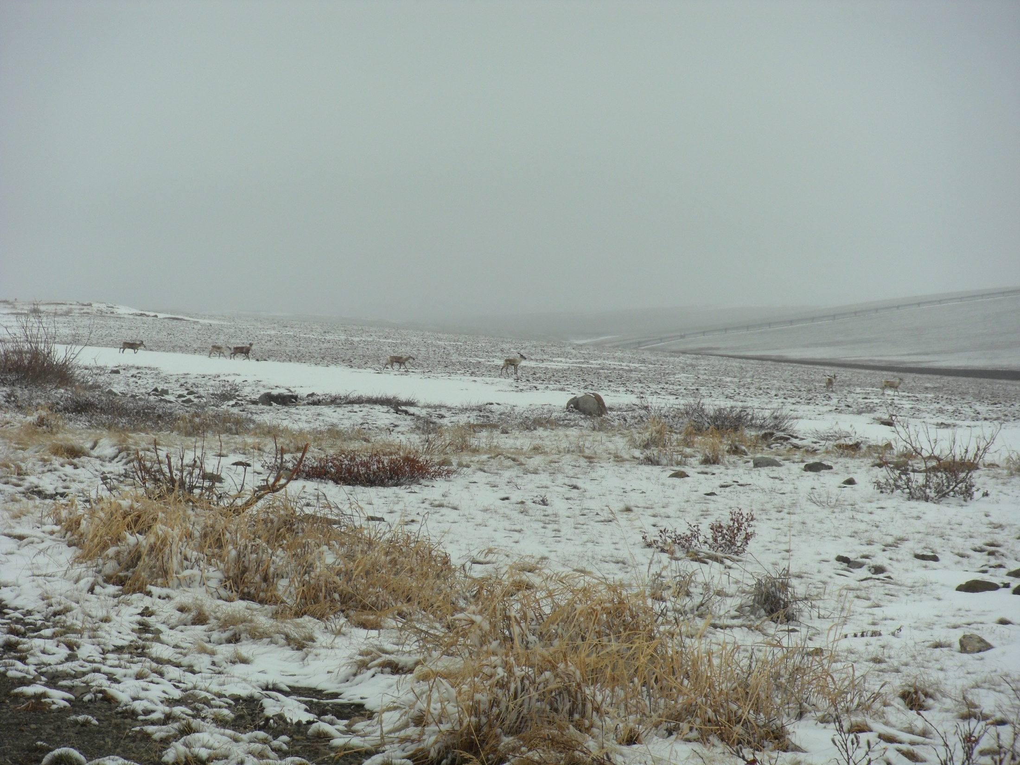
Notes:
Enjoy the wild life at our field site!

Slide 58
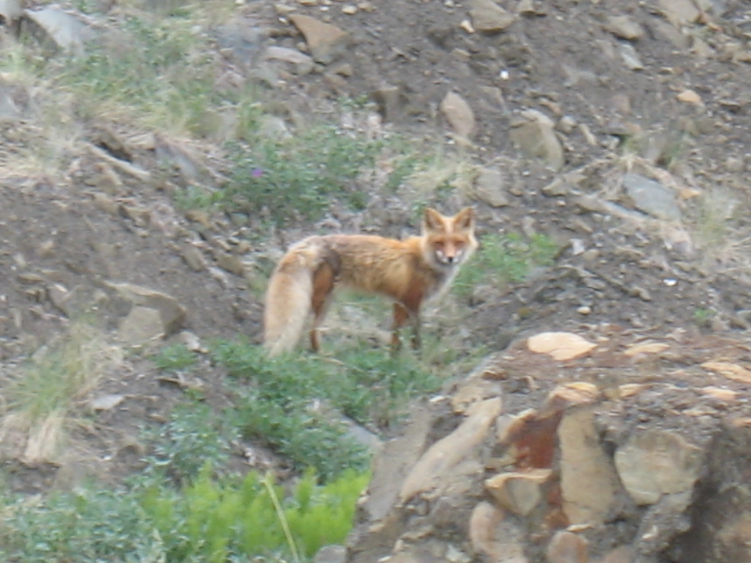
Notes:
Lots of fox around, this one was a red fox that lived near our Imnaviat Creek plots

Slide 59
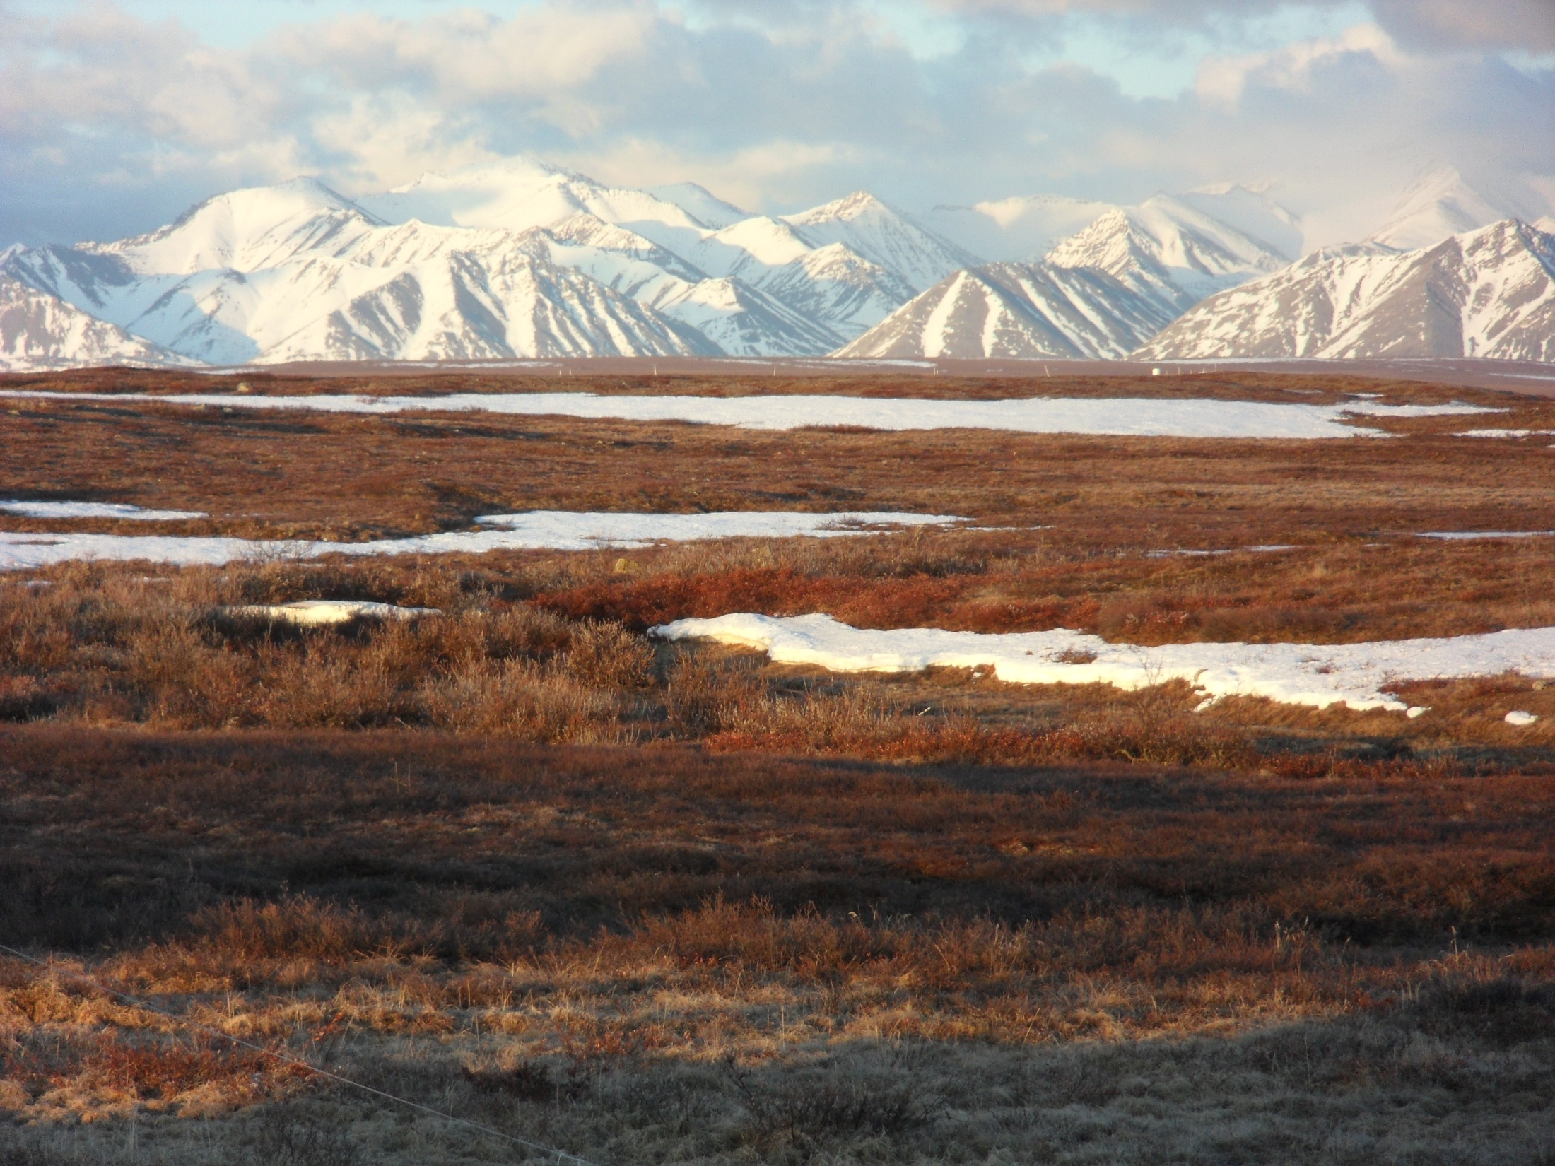
Notes:
Enjoy the midnight sun, looking off the deck of the dining hall

Slide 60
Notes:
The many rainbows

Slide 61
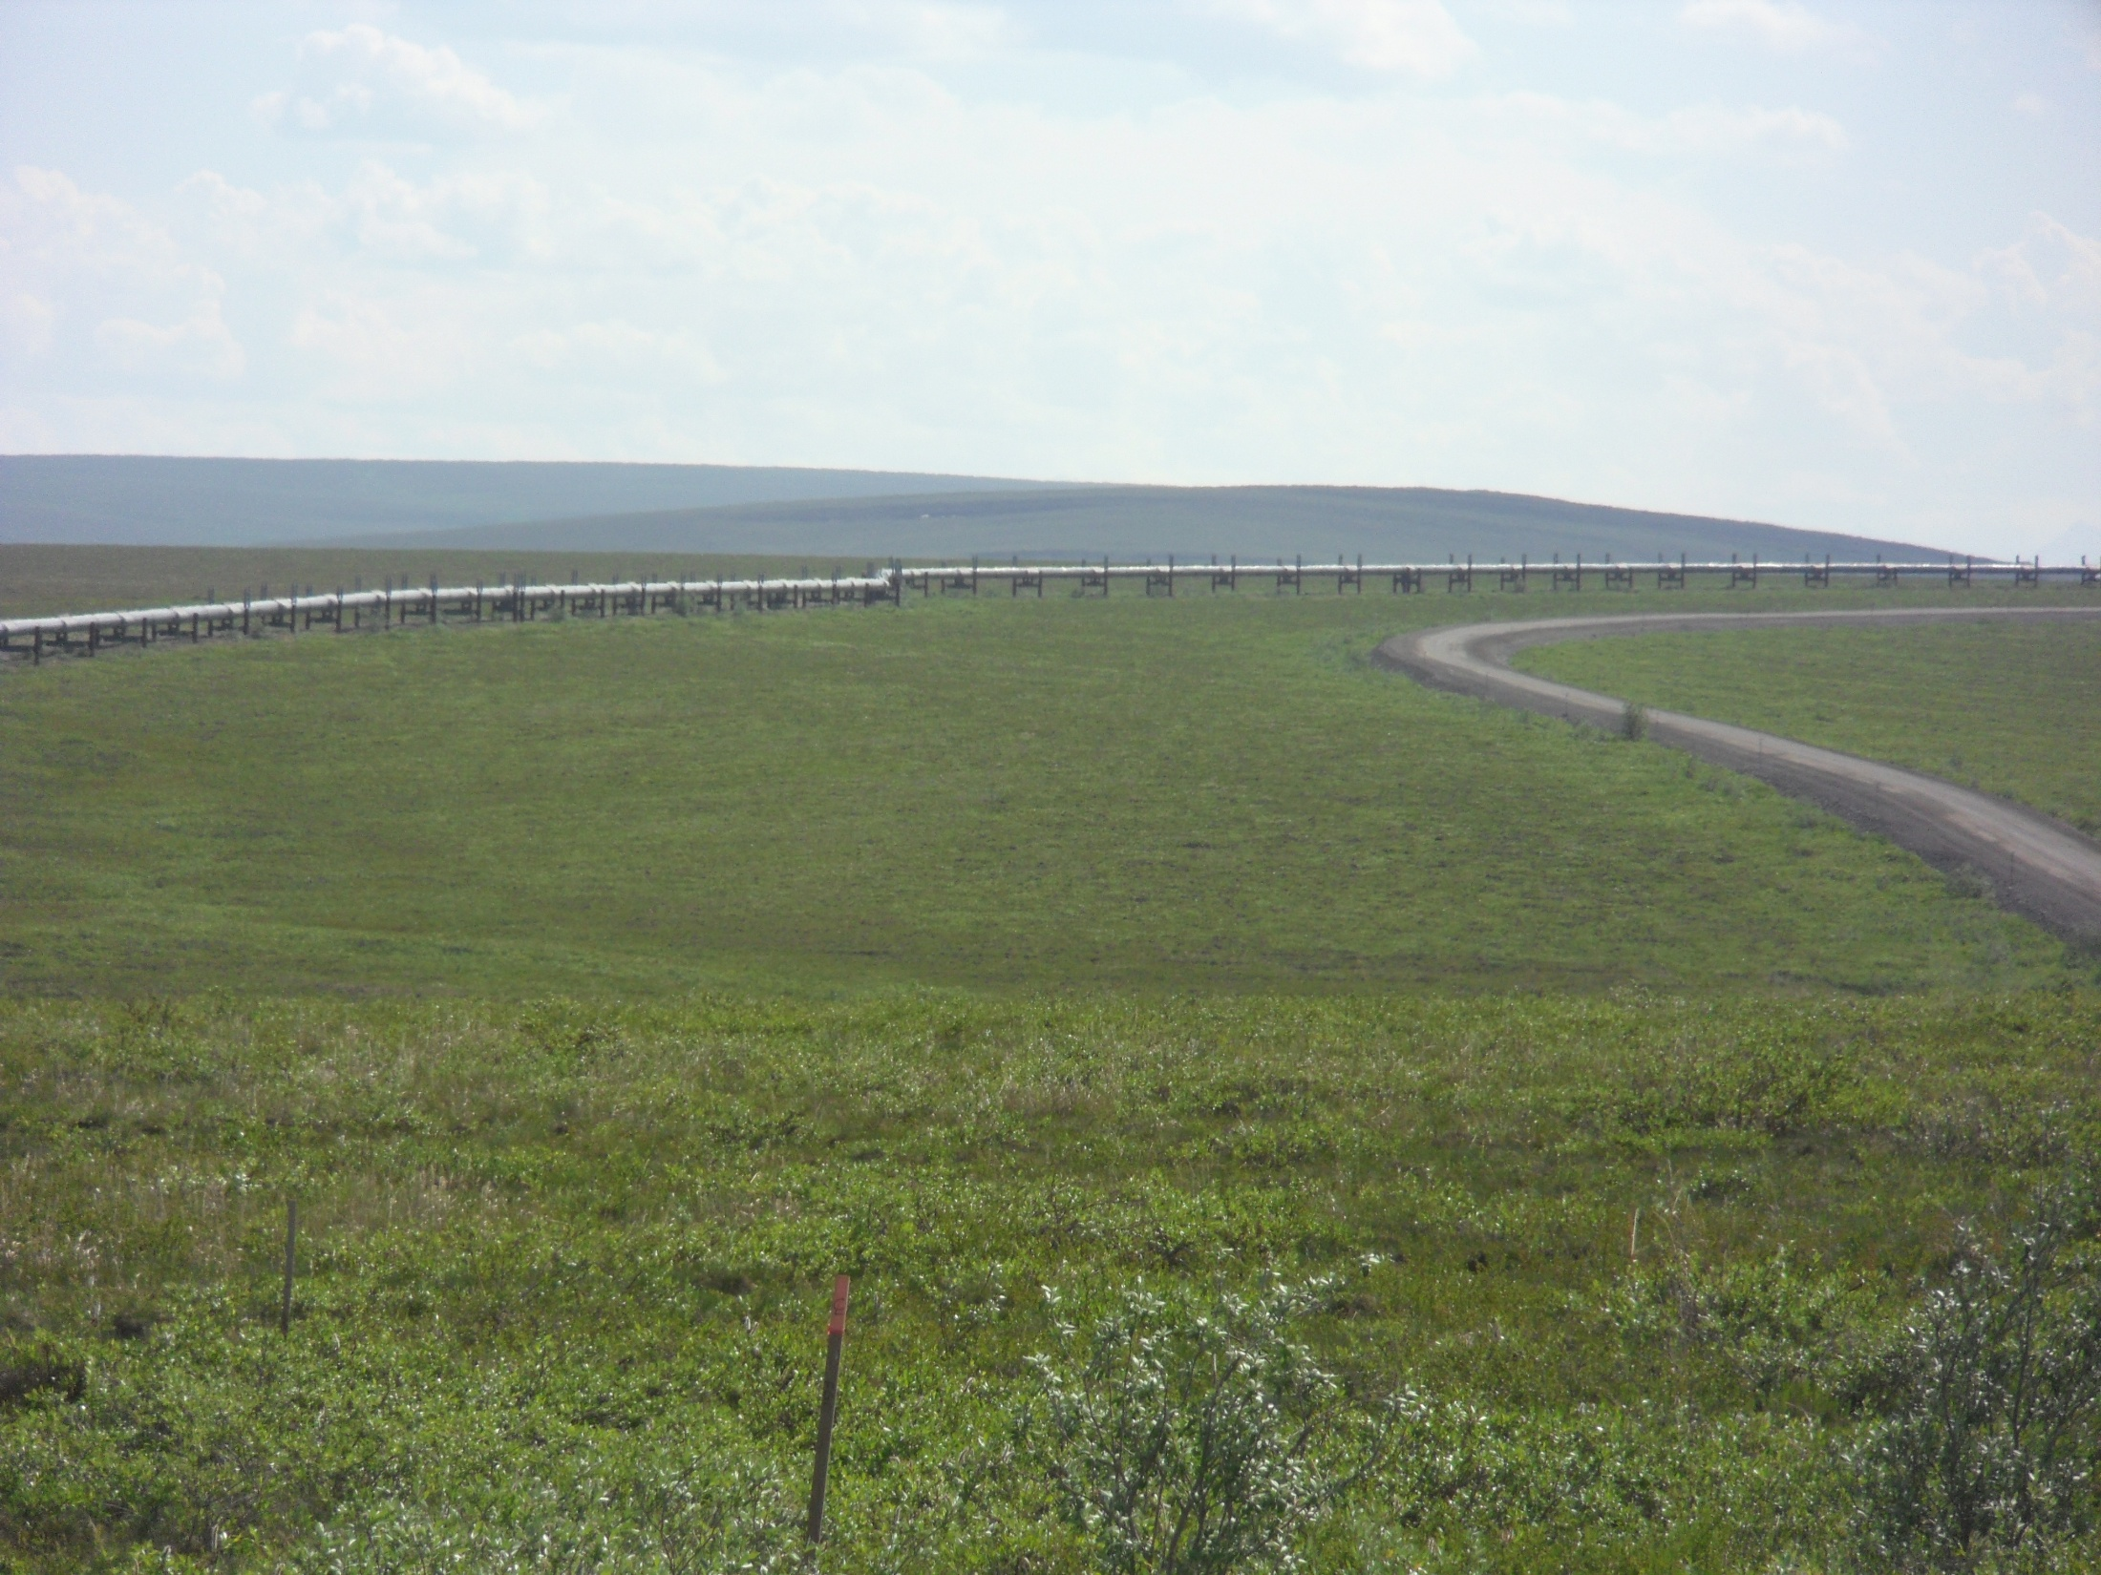
Notes:
Enjoy the vastness of the tundra…and ever present pipeline

