Slide 1
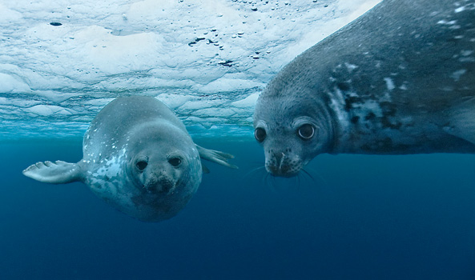
When environmental conditions promote evolution
An introduction to morpho-physiological and behavioral differences between two phocids

Slide 2
Introduction – The Phocidae family
The Phocidae (true seals), are one of the three families of the Pinnipeds order.
Pinnipids are a group of marine mammal who can live both on land and at sea. The word pinniped means ‘fin’ or ‘feather’ footed – referring to their flippers.

Slide 3
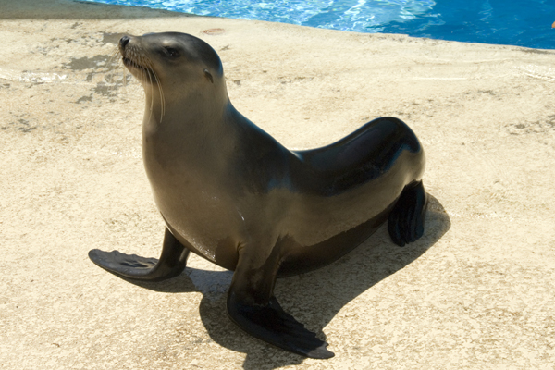
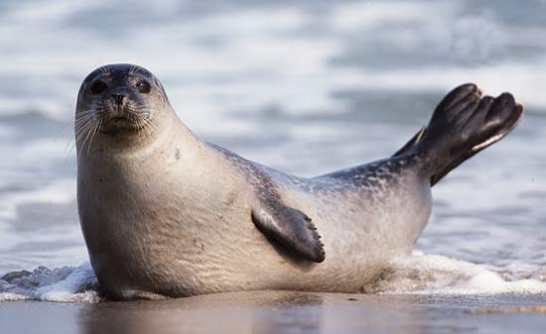
Why they are called true seals?
Let’s compare. Which of these is the true seal?
What differences can you see?
Photo Credits: Lion Seal –Karamash at en.wikipedia; common Seal –Ingo Arndt/Nature Picture Library

Slide 4
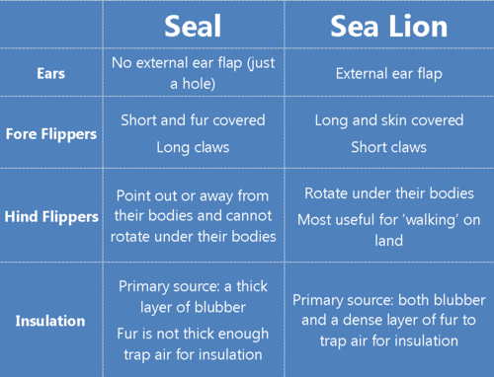
The table below show the differences between common seals and sea lions
Table Credits: Alex Eilers Weddell Seals in the Ross Sea jounal, PolarTREC

Slide 5
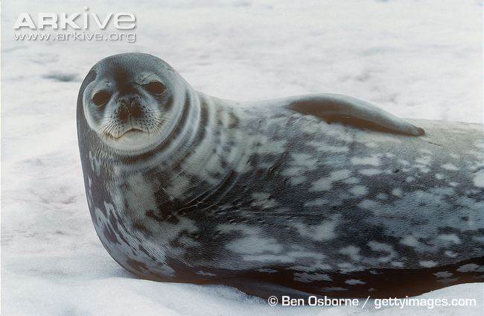
Let's learn more about phocids and deepen a little more.
The Weddell Seal
Kigdom | Animalia
Phylum | Chordata
Class | Mammalia
Order | Carnivora
Suborder | Pinnipedia
Family | Phocidae
Tribe | Lobodontini
Genus | Leptonychotes
Species | L.weddellii
Named after Captain James Weddell had
wrote about his encounters with the seals in the 1820s

Slide 6
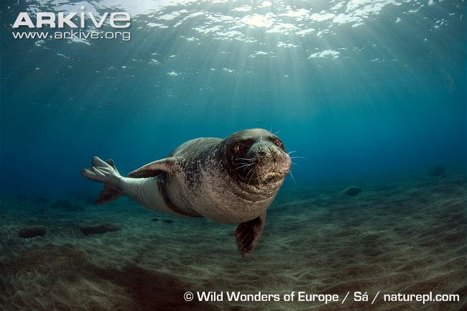
The mediterranean monk seal
Kigdom | Animalia
Phylum | Chordata
Class | Mammalia
Order | Carnivora
Suborder | Pinnipedia
Family | Phocidae
Genus | Monachus
Species | M. monachus
Monk seals were named by Johann Hermann in the eighteenth century after he watched a captured individual arching itself up against the edge of its container.

Slide 7
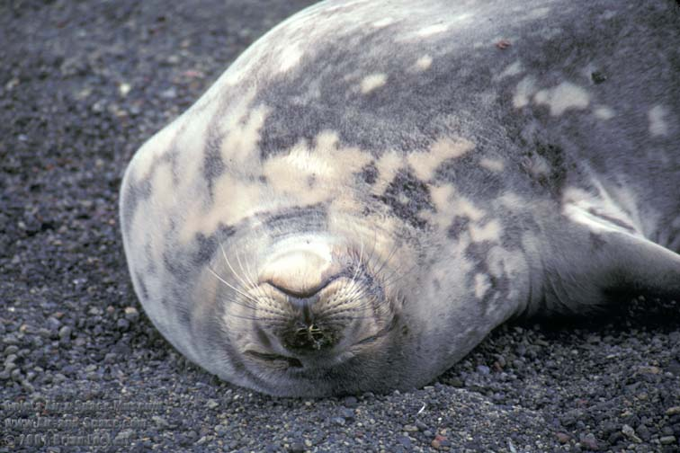
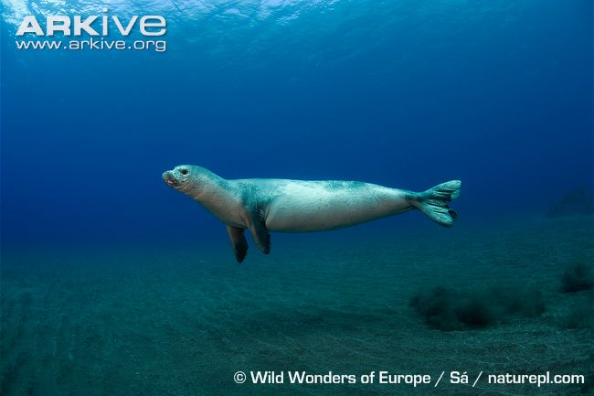
Do you know where these seals live?
True seals are marine mammals that have two different habitats: one on land – or ice – and one in water.
Brian Locket, Air-and-space.com
Weddell seal at Whalers Bay, Deception Island
Monk seal in water

Slide 8

Where we can find an weddell seal and a monk seal? Do you have any ideia?
They are from same family. Should they live at same place?
In fact these two species, although from the same family inhabit regions quite distant and different.
Let’s take a closer look!

Slide 9
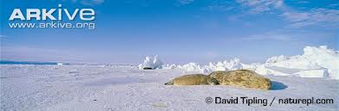
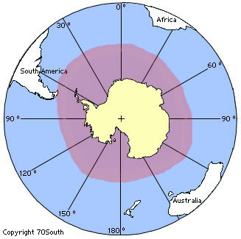
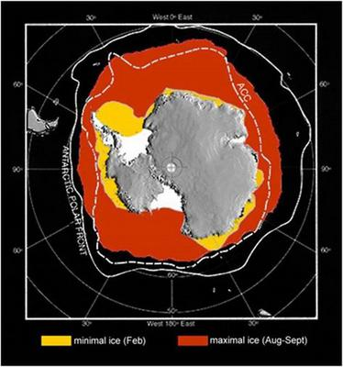
Weddell Seal
Distribution
They live in the Southern Ocean surrounding Antarctica and hold the record for living further south than any other mammal.
General habitat of the Weddell seal - as well as seasonal ice coverImage credit: Jennifer Burns.

Slide 10
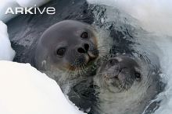
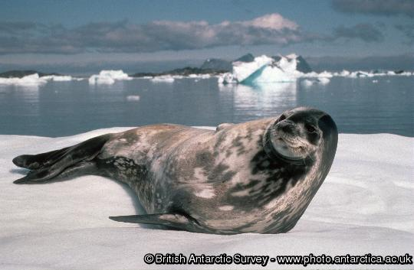
Weddell Seal
Distribution
Weddell seals live in Antarctic regions on fast ice areas and in the sea. They don't migrate and local movements are caused by changes in ice conditions.
Underwater swimming occurs under natural ice cracks or under ice areas thin enough so that the seals can chew breathing holes using canine teeth. Ice areas where these seals dwell are usually flat icy plains

Slide 11
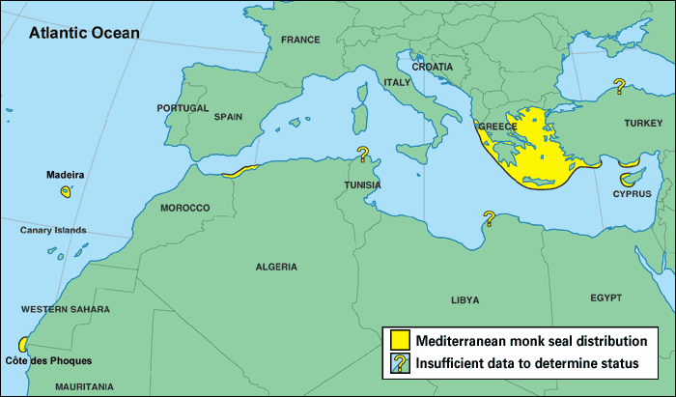
Mediterranean Monk Seal Distribution
There are two populations, one in the northeastern Mediterranean and the other in the northeast Atlantic, off the coast of northwest Africa .

Slide 12
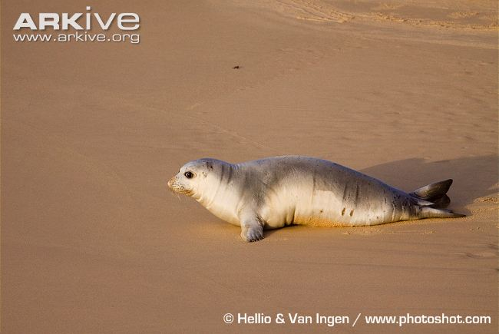
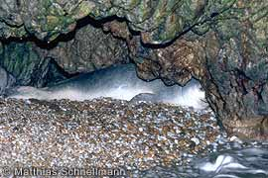
Mediterranean Monk Seal Distribution
Mediterranean monk seals mostly seek refuge in inaccessible caves, often along remote, cliff-bound coasts. Such caves may have underwater entrances, not visible from the water line.
Mediterranean monk seals habit in

Slide 13
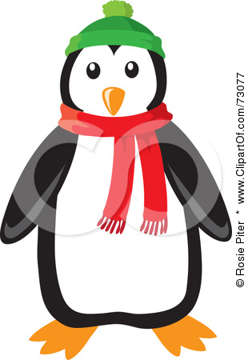
Incredible !!
These species live in very different environments, with opposite climates.
Will these climatic differences interfere in their behavior?
How will your body woks in temperatures so different?
How Weddell seals survive such cold climates?
Tip: the human species inhabits in climates ranging from tropical to polar (Arctic indigenous peoples). What are the strategies that we have for survival in these climatic extremes?
Can a Scarf and an hat be the solution for weddell seals or a sun glasses and flip-flops for Monk Seals?

Slide 14
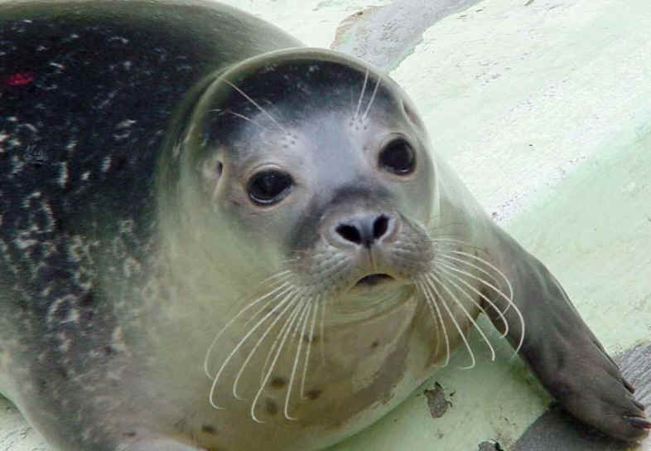
Let’s compare the morpo-physiology
Photo credits: huntercourse.com
and behaviour

Slide 15
Vital statistics
Leptonychotes weddelli | Status: Least Concern
Adult male | Length: | up to 2.5-2.9m (nose to tail).
 | Weight: | 400-600kg
 | Colour: | Coat is usually quite dark, mottled with large darker and lighter patches, more of the lighter patches on the front
Adult female | Length: | Slightly longer than male (up to 3.3m).
 | Weight: | 400-600kg
 | Colour: | Predominantly greyish, with several variations.
Pup | Length: | 1.2-1.5m (nose to tail).
 | Weight: | 22-30kg
 | Colour: | soft grey, grey brown or golden coat which it moults completely after six weeks
Monachus monachus | Status: Critically endangered.
Adult male | Length | 2.4 meters (nose to tail).
 | Weight | 250-300 kg (estimate only).
 | Colour | Predominantly black with a white belly patch, but several variations exist.
Adult female | Length | Slightly smaller than male (2.4 m).
 | Weight | 250-300 kg (estimate only).
 | Colour | Brown to dark grey, with numerous scars on the back
Pup | Length | 94 cm (nose to tail).
 | Weight | 15-20 kg.
 | Colour | Soft woolly hair, black to chocolate, with distinctive white belly patch.
(all figures are averages)

Slide 16
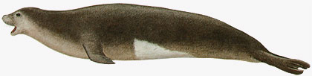
Body
The true seals bodies are streamlined ("fusiform"). They lack any external ear (we did know it!). Forelimbs are relatively short, less than 25% of the length of the body and smaller than the hind flippers. They have well developed claws. The large hind flippers extend straight backward and cannot be brought under the body. On land, earless seals are awkward, moving by a combination of sliding and flexing their spines from side to side. Even so, some species are capable of moving faster than a human. Phocids have a short, stubby tail.
Mediterranean monk seal body format

Slide 17
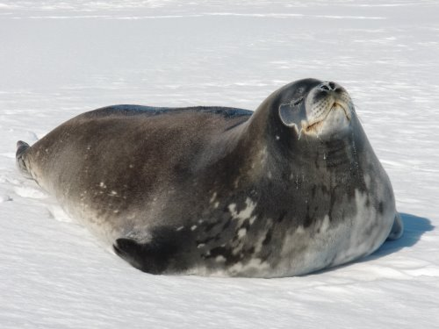

Body
Weddell seals earn the first prize on body size. This is stunning.
Photo Credits: Alex Eilers Weddell Seals in the Ross Sea jounal, PolarTREC

Slide 18
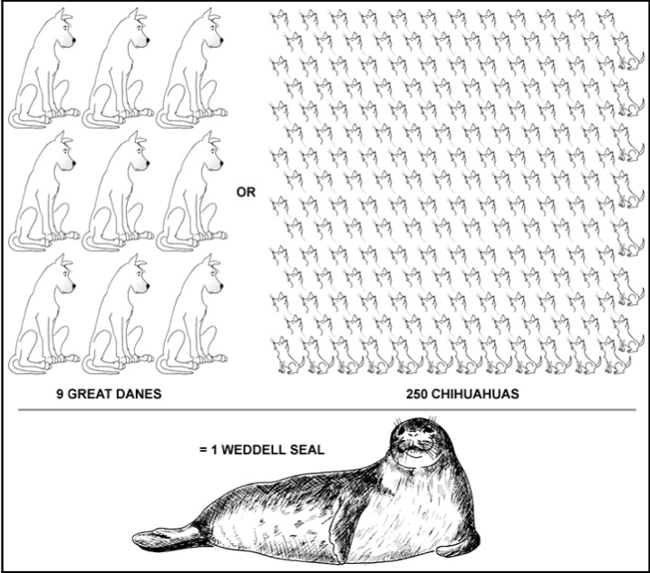
Body
Each seal is equivalent in weight to nine Great Dane dogs or 250 Chihuahuas!
That is a lot of seal.
Draft credits: Terry Williams, In the chille of the night

Slide 19
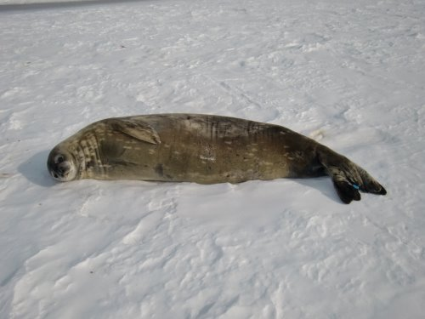
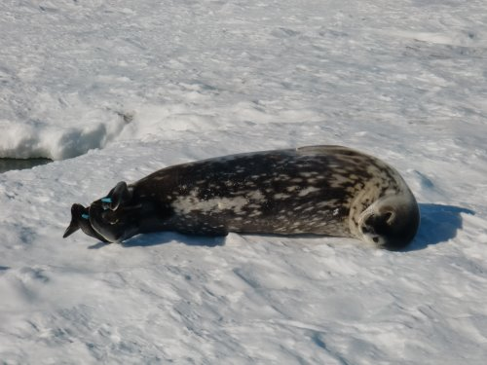
Fur
Weddell seal
The fur is short – only about 1 inch long, straight and more dense than the hair on our heads. It covers his entire body and acts as a protective layer for the skin. The fur of adult Weddell seals consists entirely of short, shiny, guard hairs. they don’t rely on their fur for insulation – they have blubber for that!
Unmolted seal
Weddell seals molt annually (shed their fur, once a year, in summer). The old, brownish fur is shed and the new, shiny fur grows.
Photos Credits: Alex Eilers Weddell Seals in the Ross Sea jounal, PolarTREC
molted seal with new coat of fur

Slide 20
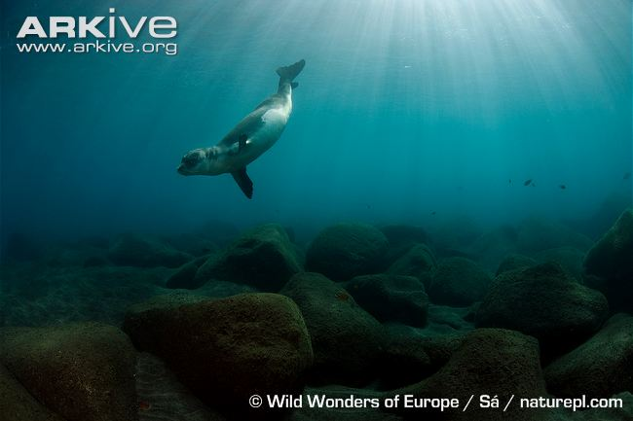
Fur
Mediterranean monk seal
Have the shortest hair of any pinniped, the fur is black (males) or brown to dark grey (females), with a paler belly, which is close to white in males.
Mediterranean monk seal male
They molt at about four to six weeks and their black woolly coat is replaced by a silvery gray coat that can darken over time . Molting occurs also over a very protracted period, extending throughout the year.
molted seal with new coat of fur

Slide 21
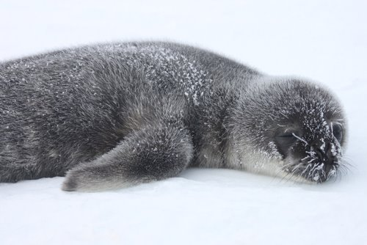
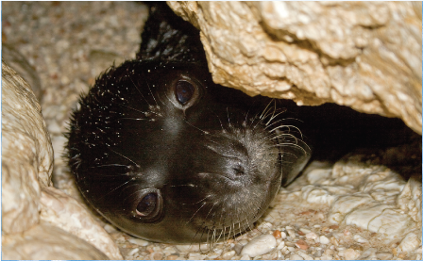
Fur
Pupies fur
Pup is born with a really soft, fuzzy, fluffy brown or grey coat. That coat is called the lanugo- primary source of insulation. iIt insulates the pup by trapping air around the fuzzy fur – it sort of acts as a down blanket to keep the seal warm.
Alexandros Karamanlidis, MOm
Weddel seal pup . Lanugo can be brown or grey
Mediterranean monk seal pup born in a black or chocolate-brown lanugo coat with a creamy-white patch on their belly

Slide 22
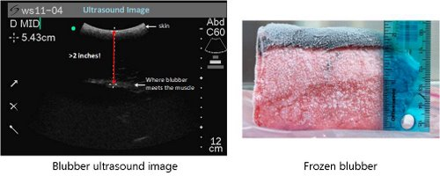
Blubber
Under their skin, seals have a thick layer of body fat called blubber.
What is the purpose of this layer?
Insulation
Energy
Buoyancy
Streamlining
Pupping
Molting
Swimming
Hunting
Tick layer of blubber from Weddell seals
Photo Credits: Michelle Shero Weddell Seals body composition, Alexs Jounal

Slide 23
Blubber
How about Mediterranean monk seal?
The Bluber layer will be as thick as those of weddell seal?
Let us remember their habitat and think about bubller.

Slide 24
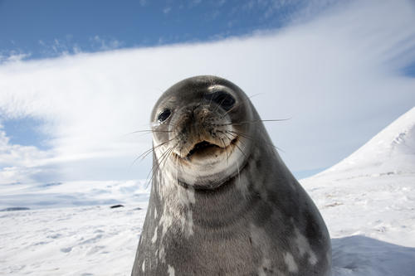
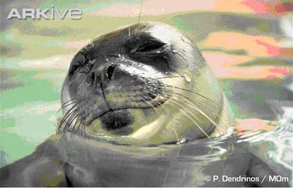
Whiskers
Are a very important sensory organ that can detect the slightest movements in the water help detect fish movements through the water and thus aid in hunting
Photo Credit: Daniel Costa,
Weddell ,Alexs Eiler journal, PolarTREC
Weddel seal Whiskers
Mediterranean monk seal Whiskers
Weddell seals can use the whiskers as an additional sense to guide them through the icy Antarctic waters in the dark depths of the ocean, or during the long dark winter months.

Slide 25
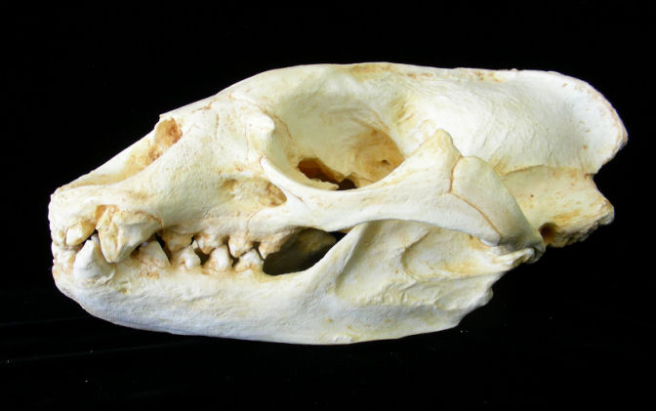
Theet
Mediterranean monk seal
4 incisors, 2 canines and ten molars in each (upper and lower) jaw.
Incisors are characterised by their large size and a small ridge located at the rear of the tooth.
Photo Credit:Educatyional Biofacts,

Slide 26
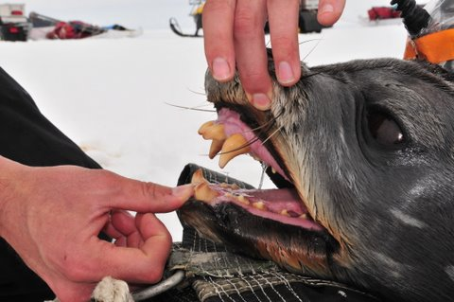
Theet
Weddell seals
4 canine teeth, 4 incisors.
This seals typically swallow their food whole, they don’t use post-canines for grinding food – their teeth are used to help get the food down
Most carnivores use their incisors to help hold prey but Weddells are able to survive under the ice shelf because their canines and incisors are specially adapted (they stick out) which allows them to ream, or break through the ice to make and keep their breathing holes open.
Photo Credit: Jennifer Burns
Check out this video to see how they do that! Weddell seal shaving ice with teeth to maintain breathing hole Video
Credit: BBC Natural History Unit, Arkive

Slide 27
Diving
Seals have to breathe regularly like other mammals to release carbon dioxide and to inhale oxygen. In order to stay under water longer, seals have adjusted to particular laws of nature .
they store more oxygen
a litre of Monk seals two and a half times more
oxygen than the blood of a human
a litre of Weddell seal blood holds five
times more oxygen than a litre of human blood.
Data
Having regard to these facts what we can provide for your dives?

Slide 28
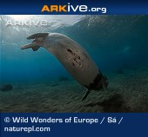
Diving
Mediterranean monk seal
Two distinct types of dives:
‘Spot feeding dives' where the seal dives continuously, perhaps for several hours, in the same spot.
‘Transit feeding dives' where the seals cover some distance along the shoreline.
average dive depths -50 m
duration - 6-12 minutes.
The longest dive recorded has been 18 minutes and the greatest depth 75m
Check out this video Mediterranean monk seal swimming underwater
Credit: arkive.org

Slide 29
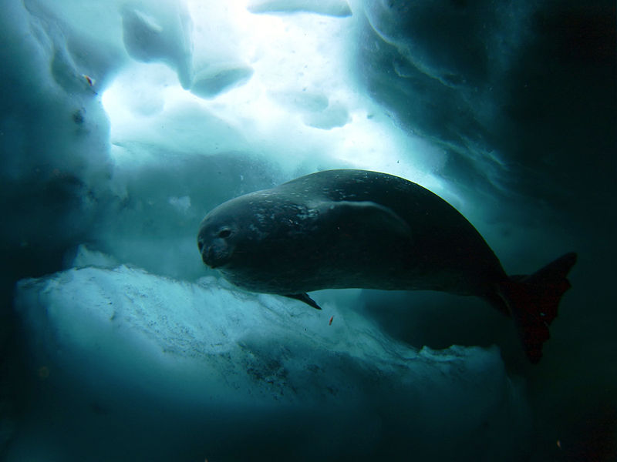
Diving
Weddell seals
Deep dives involve foraging sessions, as well as searching for cracks in the ice sheets that can lead to new breathing holes.
Can collapse its lungs, while at the same time lowering its metabolic rate; this allows it to remain underwater for extended periods.
Dive depths- may reach some 750 m
Duration- may reach 80 minutes.
Check out this video that shows weddel-seal-movements
credit: Kim Goetz, PolarTrec resources
Photo credits: Steve Rupp, National Science Foundation

Slide 30
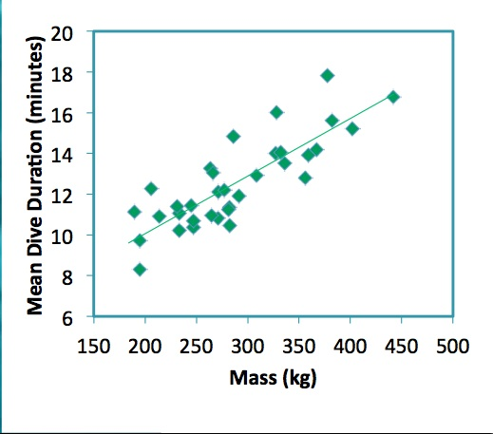
Let’s look some data:
What is the relationship between the duration of dives and body mass?
What can we conclude?
Weddell seals dive duration versus mass
graphic credit: Jennifer Burns.

Slide 31
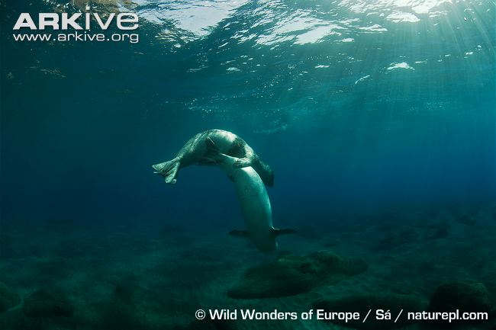
Mating
Mediterranean monk seal
Principal mating season is from October to November.
Delayed implantation occurs, and the time between fertilization and birth is about one year.
Mediterranean Monk seals mating
Several adult males display underwater territorial behaviour, with the apparent aim of gaining and maintaining access to females

Slide 32
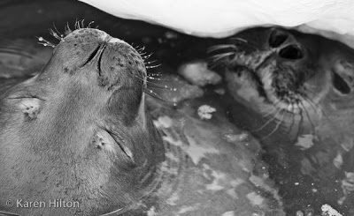
Mating
Weddell seals
From mid-September to late December active spermatogenesis occurs. In late November to mid-December females are impregnated and about mid-January implantation occurs, with ensuing gestation lasting nine to ten months.
Copulation has only been observed to occur underwater
Weddell seals mating

Slide 33
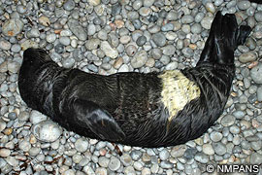
Pupping
Mediterranean monk seal
Females give birth and nurse their pups isolated haul-out sites and sea caves
Females give birth to pups year-round, but pupping generally peaks September-November
Mothers and pups develop a strong, important bond. Pups are generally weaned after 4 months, but sometimes stay with their mothers for up to 4 years
Mediterranean Monk seal pup.

Slide 34
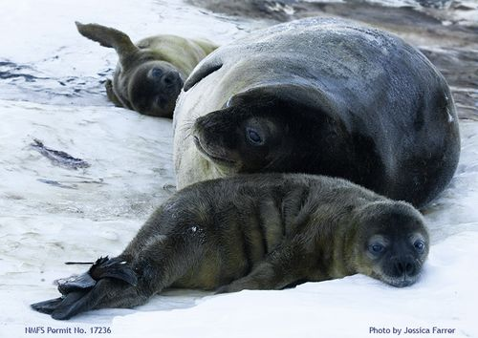
Pupping
Weddell seals
Breed stems during the austral spring, with the peak pupping falling between September and November
The seals breed in colonies, often in fast ice or shore fast ice-away from predators.
is one of the only breeds of seals that can give birth to twin pups.
Mother with twin pups.
Weddell mothers nurse their pups almost continuously for the first 6 weeks of their lives, which is long enough for them to develop their own blubber. The milk from a Weddell seal contains around 60% fat. That’s a lot of fat!!!
Let’s go to got ice cream activity from TheWilliams Lab at UCSC

Slide 35


Status
Mediterranean monk seal
Weddell seals
The IUCN Red List of Threatened Species considers Mediterranean Monk seals to be “critically endangered.
Top Threats
habitat deterioration and loss
deliberate killing
accidental entanglement
decreased food availability
stochastic events

Slide 36
Conclusions
Weddell seals are well adapted to harsh enviromenmts as well Mediterranean seals are adapted to enviromenmts.
Adaptations are crucial on species survival
Environmental conditions promote adaptation and so on evolution. This is a great example to aplie Charles Darwin Teory
Summer time is an importante time for both species
Comparing data it’s importante to undesrtand behaviours
Human beahaviour has a great impact on the species conservation.

Slide 37
Dive in – Questions for further exploration
What is the relationship between fat and buoyancy?
Hemoglobine and mioglobline presents in seals blood and seals muscles are importante functions on stores more oxigen. What is the importance of these proteins in this process?
Seals have well developed underwater vision. How their eyes are able to see? Could be seals eye to diferent from human eye?
Why Weddell seals diving so deep an so far? There are an obvious reason?
The Man is responsible for the near extinction of the Mediterranean Monk Seal. What strategies would you propose to rehabilitate this species?
Will there be any problem that might jeopardise the survival of weddell seals?

Slide 38
References
www.polartrec.com
http://www.arkive.org/
http://www.pinnipeds.org
Johnson, W.M. 2005. In echoes of the past, the sound of the present. The Monachus Guardian 8(1): May 2005.
Lavigne D.M. and W.M. Johnson. 2001. Hanging by a thread. The Monachus Guardian 4 (2): November 2001.
http://www.youtube.com/watch?v=iuhBrY8MzdE Mediterranean Monk Seal Parturition
Gabriela Muñoz, Alexandros A. 2011. Vocalizations by Wild and Rehabilitating Mediterranean Monk Seals (Monachus monachus) in Greece. Aquatica Mammals
Dr. Jennifer Burns, University of Alaska Anchorage
Alex Eilers , PolarTREC Teacher, Pink Palace Museum, Tennessee
http://www.zeehondencreche.nl/wb/pages/about-seals
http://www.polarconservation.org
http://marinesciencetoday.com
http://eol.org
http://www.antarctica.ac.uk

