Slide 1
Diving Adaptions in Marine Mammals
Tammy Orilio
CISE Fall 2012

Slide 2
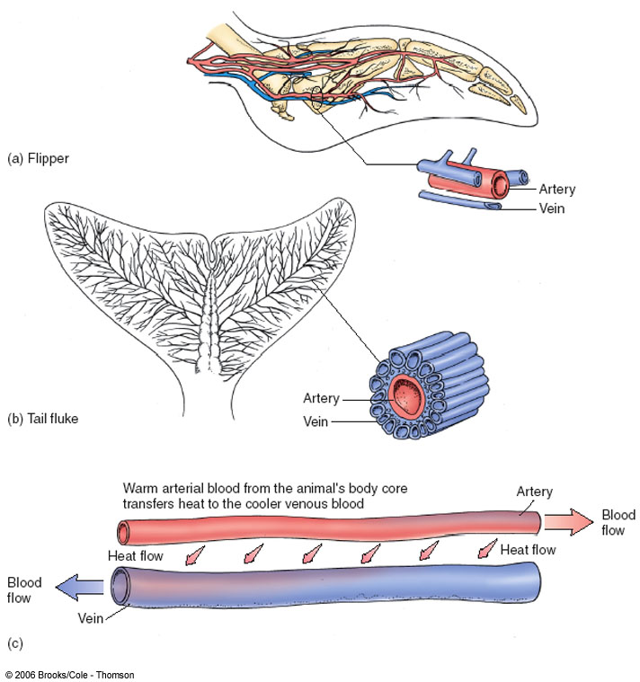
Keeping Warm…besides blubber
Countercurrent Heat Exchange
Helps to minimize heat loss to environ so the heart doesn’t have to pump as rapidly to maintain core temp & metabolic rate

Slide 3
Mammalian Diving Reflex
Occurs in all mammals
Triggered by cold water (<70°F / 21°C) touching the face
Allows body to tolerate low(er) oxygen levels

Slide 4
3 things happen in the MDR
Bradycardia:
heart rate slows
Why decrease the heart rate?
Peripheral Vasoconstriction:
blood flow to non-essential parts reduced
What does vasoconstriction accomplish?

Slide 5
Mammalian Diving Reflex
Blood Shift:
(during deep dives) blood plasma & water diffuse across circulatory walls into chest cavity
Why fill up the chest cavity with liquid during a deep dive?
FreeDiving & Fishing

Slide 6
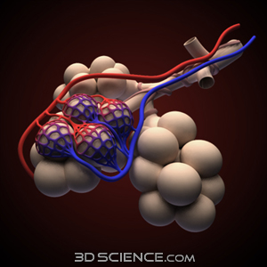
Adaptations for Diving (besides the MDR)
Very efficient at exchanging air in lungs w/ blood
Many alveoli- air sacs
Collapsible lungs & rib cage squeeze most air into blood

Slide 7
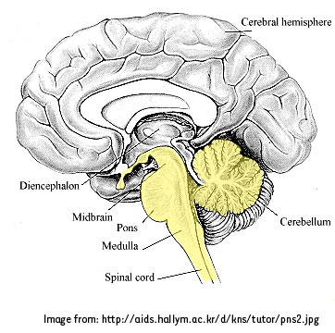
Adaptations for Diving
Medulla oblongata- part of brain that deals with autonomic functions
Less sensitive to CO₂ levels in blood, so they can stay submerged longer without feeling the “need” to inhale

Slide 8
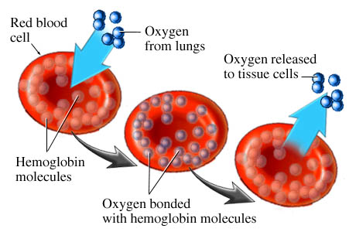
Adaptations for Diving
Marine mammals have 2x as much blood per pound of body weight than humans, so they can carry more oxygen in bloodstream
More myoglobin & hemoglobin

Slide 9
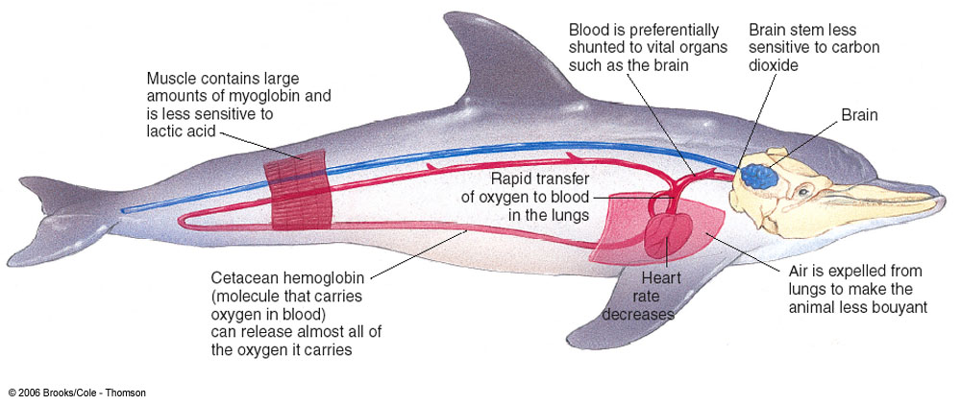

Slide 10
Possible Activities
The Blubber Glove
Short activity that can be done with just a few volunteers or the entire class. Uses rubber gloves or plastic bags and shortening to demonstrate the insulating properties of blubber. Always intriguing to compare results at the end and see if the boys or girls were able to keep their hand submerged longer!
Notes:
Blubber glove website: http://www.gma.org/surfing/antarctica/blubber.html
Blood flow and thermoregulation: http://www.teachersdomain.org/resource/lsps07.sci.life.reg.heatexchange/
Lung Capacity: http://biologycorner.com/worksheets/lungcapacity.html
Follow-up Website: http://www.bio.davidson.edu/people/midorcas/animalphysiology/websites/2005/Lewis/index.htm

Slide 11
Blood flow and thermoregulation animation from Teachers Domain
Simple little animation illustrating heat loss to the environment, and vasoconstriction. Page also has some discussion questions.

Slide 12
Measuring Lung Capacity activity from biologycorner.com
Easy activity to have students measure and compare their tidal volume and vital capacity.
Good follow-up website with info about deep diving, oxygen storage, decompression illness.

Slide 13
Video clip about vasoconstriction- from the Blue Planet series, “Coasts” episode. It’s a short section (32:50-33:20) but it shows how a walruses skin color differs when in vs. out of the water, and vasoconstriction is explained.
I couldn’t find a clip of that particular part online, but you can buy the episode on Amazon.com
Notes:
3250-3320

